Slide 1
Thesis Update #12
June 13, 2019
James Erik Groving Meade

Slide 2
Demo!
Inference-only
2. Training with small dataset and frequent stat updates shown
3. Training speed with total disregard for results, only used to show performance with regard to how fast training occurs

Slide 3
Updates
Implemented a softmax layer to compute a proper loss
Gradient checking in python script verifies that the gradients were indeed correct
Precision issues
Created memory map through DDR SDRAM between ARM and FPGA
Wrote C programs to perform various functions on the FPGA
Created custom BOOT.bin image with the bitstream and U-Boot that invokes a PetaLinux image. Put the MNIST dataset and a few C programs on the SD card.

Slide 4
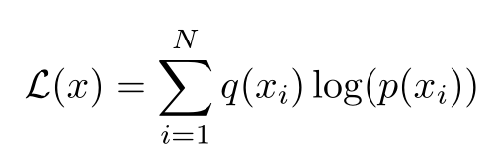
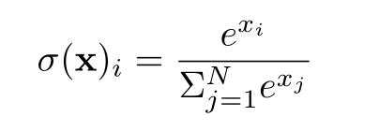
Softmax Layer
Why?
Needed to calculate using an actual loss function for gradients, otherwise unable to learn properly
Softmax is one of the best loss functions for training neural networks
Mathematically:

Slide 5
Softmax Layer Structure
Pipelined for the 10 output neurons, takes about 50 cycles for the 10
Convert to float
Perform e^{x}
Convert back to fixed
Sum all e^{x}
Divider core
Derivative is quite simple for softmax. It is just the output of the softmax for non-label neurons, and output minus 1 for the label neuron

Slide 6
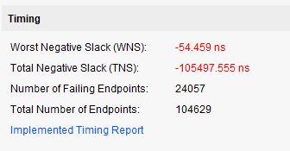
Also… don’t set the divider IP core to 1 cycle

Slide 7
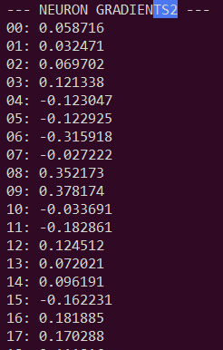
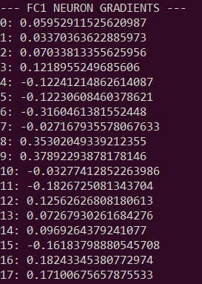
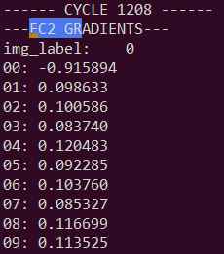
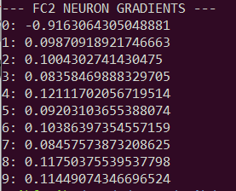
Verification of Softmax
… I found out that SystemVerilog/Verilog can display floating point, so it’s quite quick to visually verify now. Output from the softmax layer, and previous neuron gradients vs. Python script
Python
FPGA
Python

Slide 8
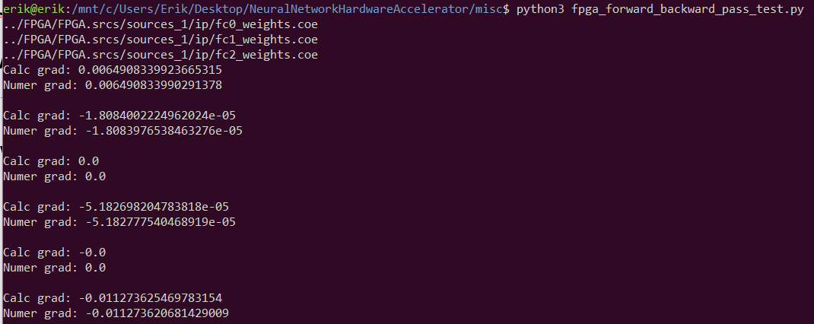
So, softmax seems to be verified. Training still off, why? Could the Python script be wrong?
Wrote gradient check testing in the python script to verify that the script was indeed correct. So the calculated gradients are correct.

Slide 9
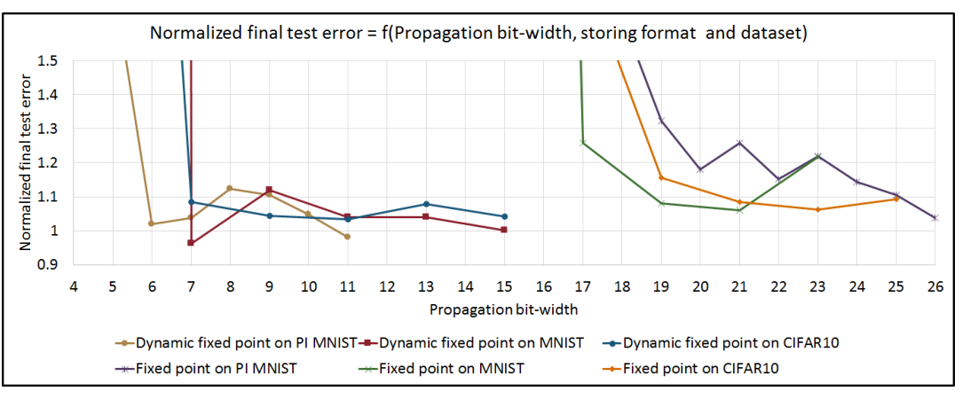
What’s going on, if the gradients calculated are correct, why isn’t it training to perfection!
This reminded me of a paper I read back in February
The below graph was a part of it

Slide 10
My theory
Observe the gradients from the simulation
Gradients in general want to push up the correct neuron by a lot, and at the same time lower the other gradients a bit
The gradients are Q3.13, activations are Q8.8
When updated, these are multiplied by 0.001, or shifted to the right by 10. Only 3 fractional bits remaining, so gradients effectively truncated at 0.125 steps.
Result is that many of the gradients that “push” final layer neuron output down get effectively truncated to zero, and as a result, the pushing up is much stronger than the pushing down
Recall the the train_small example, learning happens, as the accuracy does occur, but if neuron output is only pushed up, then eventually they will all saturate

Slide 11
Solution: More Precision Needed if Training is to be Supported
Will try 24-bit and 32-bit solutions to see if the precision is good enough for training.
Most important part is that the negative gradients multiplied by around 0.001 will not disappear
Probably prioritize writing the design and testing section of report for now though, since this is more of a result section asepct.

Slide 12
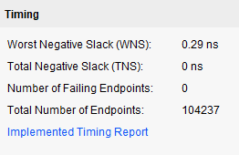
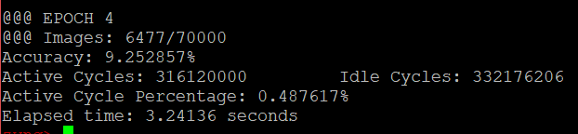
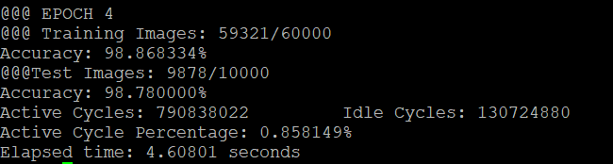
FPGA Clock Frequency
50 MHz timing met
FPGA being at 50 MHz, should I try to get it back to 100 MHz?
No, DDR transmission is the bottle neck, as observed by the active cycle percentage
Also, active cycle percentage is ~2x for training compared to inference.
This is because training is ~2x more cycles, so roughly ~2x more time to load the next image
Inference
Training

Slide 13
Timing/Results
Faster than CPU by a lot, on both inference and training
GPU
Faster for batch size of 1, but I discovered the PyTorch framework GPU training uses a coarser-level of parallelism. It doesn’t parallelize the computation of a single input, but instead parallelizes the input samples in a batch. I.E input 1 to a core, input 2 to another core, and so on
Therefore it’s unfair to compare against GPU batch size of 1, since it doesn’t parallelize at that level
Example timing for batch size of 5 and 200 shown below (though this means it performs (batch size - 1 fewer updates than my batch size = 1 model)

Slide 14


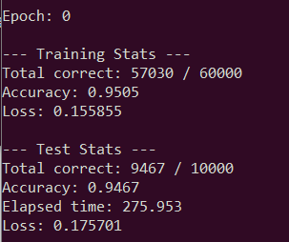
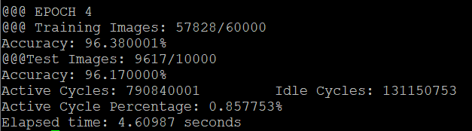
Timing/Results
For training on 60,000 training images, then inference on 10,000 test images
PyTorch: Batch size of 5, GPU
PyTorch: Batch size of 200, GPU
PyTorch: Batch size of 1, CPU
My Software Model, CPU
FPGA Accelerator

Slide 15
Timing in a neat table
Model | Time for 1 Training Epoch
Software Model, Batch Size = 1 | 275.95 seconds
PyTorch CPU, Batch Size = 1 | 122.65 seconds
PyTorch GPU, Batch Size = 5 | 74.93 seconds
PyTorch GPU, Batch Size = 200 | 7.14 seconds
Hardware Model, Batch Size = 1 | 4.61 seconds

Slide 16
Memory Map between PS and FPGA
Created a memory map so that data can be sent over DDR
CPU side: handle to /dev/mem with a pointer at the offset specified by the Zynq PS system in Vivado
FPGA side: AXI slave interfacing with the AXI Master from Zynq PS

Slide 17
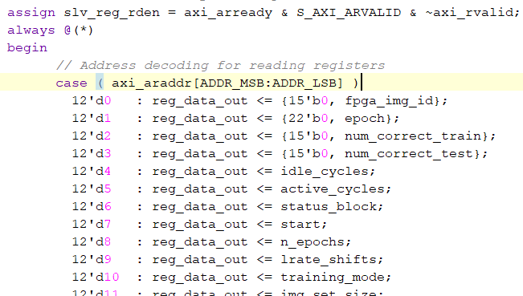
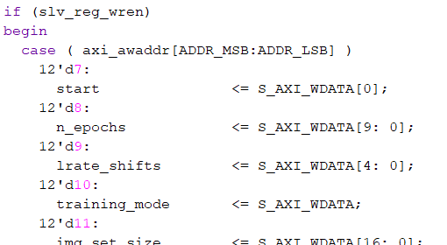
FPGA Side
Based on a modified Vivado provided Axi core
FPGA to PS
PS to FPGA

Slide 18
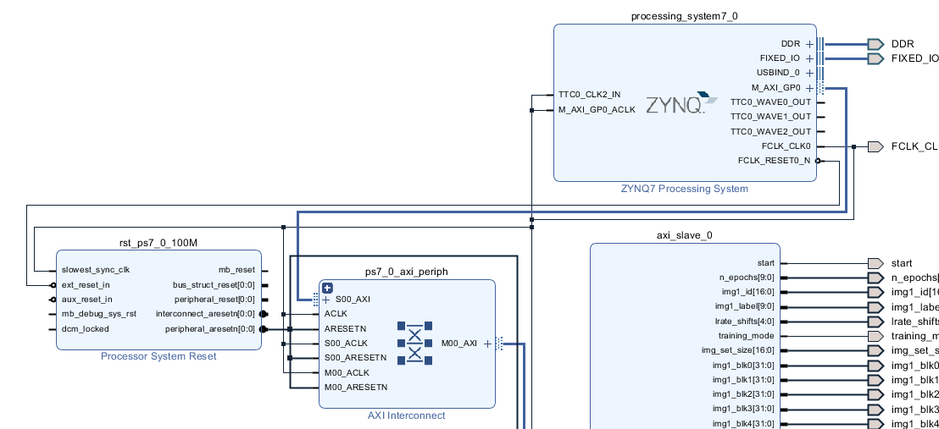
FPGA Side

Slide 19

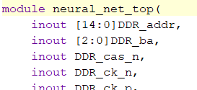
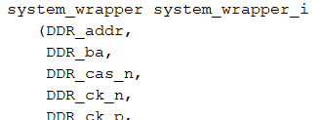
FPGA Side
Defining the Virtual Address Space
Generated the block diagram from previous slide. Then created and instantiated the wrapper in my neural_net_top.sv file and forward inputs/outputs
In neural_net_top.sv

Slide 20
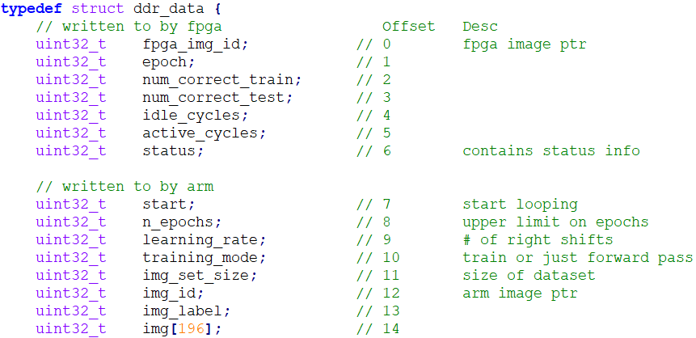
ARM Core

Slide 21
Training Programs
Easier to show than put on slide

Slide 22
Customized Boot Images
Exported hardware to Xilinx SDK, allows me to create a boot image with first-stage boot loader, bitstream, and U-Boot
Then put on a root file system and PetaLinux image
Root file system could be modified in a linux distribution, modified init.d/rcS to assign the Zedboard an IP of 192.168.1.10 for SCP/SSH and to mount the SD card

Slide 23
Power measurements?
Will I be able to do this now that I have something benchmarkable running?

Slide 24
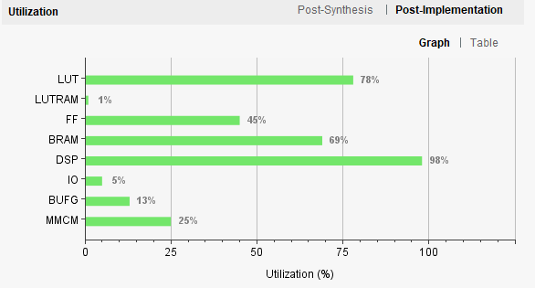
Report Writing
Have about 15 pages written so far, now that I’ve finished most of what I want to do, can put most time into that. Would ideally like to increase precision on FPGA, but 2 concerns, 1 being time and 1 being that the resource usage might be too high if I increase precision:

Slide 25
Exam Date
Seems we have confirmed for July 8! Very happy to hear, will wait for confirmation of the time slot.

