Slide 1
Thesis Update #10
May 27, 2019
James Erik Groving Meade

Slide 2
Hardware Model Update Overview
Have correctly implemented and verified a design to compute both steps of backpropagation
I have only chosen to modify the last layer, however, all functional aspects of the backward pass are implemented and verified
Fixed precision issues in the forward/backward pass
Backpropagation takes twice the amount of MACs as forward pass, but the distribution is the same, so fortunately, the current DSP allocation to layers is still near optimal

Slide 3
The Overall Architecture of the System
Buffer
Buffer
Layer 1
Layer 2
Layer 3
Input Image
Prediction

Slide 4
Architecture of a Layer
Layer
Weight BRAM
Forward Pass Scheduler
Backward Pass Scheduler
(Previous Layer Neurons)
Backward Pass Scheduler
(Current Layer Weights)
Activations In
Gradients In
{Forward, BP_MODE}
Gradients Out
Activations Out
Computational Kernel Pool

Slide 5
Backward pass has two schedulers
This is because there are two gradients that need to be calculated for each layer, the weight gradients for the neurons in the current layer, and the gradients for the neurons in the previous layer.
The mode is designated by the BP_MODE logic that is either WEIGHT_MODE or NEURON_MODE

Slide 6
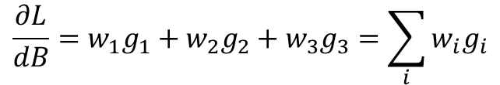
Neuron Mode: Calculate dL/dN for previous layer
g₁
If we know how much each neuron in the next layer affects the loss with a gradient (g), and we know how much the activation will be multiplied by(w), we know how much the error will be affected.
For example, if w₁ = 0.5, and g₁ = 0.3, then if the output of neuron B increased by 1, the input to neuron g₁ would increase by 0.5, which would impact the loss by 0.15
A
w₁B_{out}
g₂
w₂B_{out}
B
w₃B_{out}
g₃
$$\frac{∂L}{dB}=w_{1}g_{1}+w_{2}g_{2}+w_{3}g_{3}=\sum_{i}{w_{i}g_{i}}$$

Slide 7


Weight Mode: Calculate dL/dw for current layer
g_{c}
If we know how much each neuron in the next layer affects the loss with a gradient (g) and we know the activation of the neuron for a weight (A_{out}, B_{out}), then we can calculate the gradient for the weight.
If A_{out} = 2, and g_{c} = 0.1, then if we increased w₁: (w₁ + 0.15)A_{out} would increase by 0.3. Since g_{c} is 0.1, the Loss would increase by 0.03 at the current derivative rate.
C
w₁
A
w₂
g₂
B
g₃
$$\frac{∂L}{dw_{1}}={g_{1}A}_{out}$$
$$\frac{∂L}{dw_{2}}={g_{1}B}_{out}$$

Slide 8
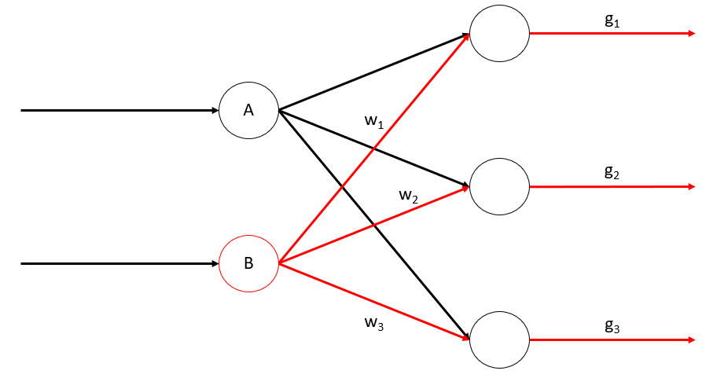
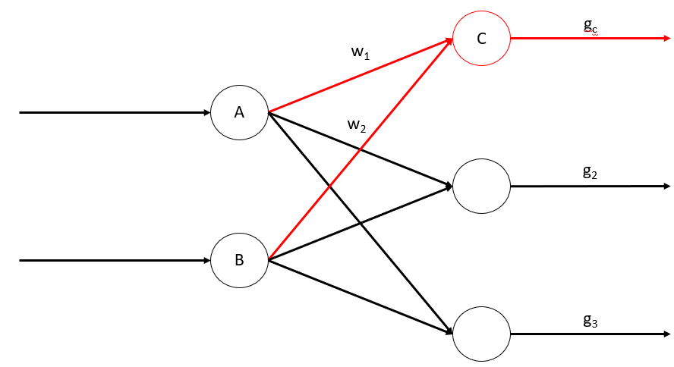
Performing backpropagation
When we know the gradients of the neurons for a layer:
First calculate the gradients for the previous layer so the previous layer can start working
Then, calculate the gradients for the weights in the current layer
We then repeat this process throughout each layer

Slide 9
Architecture and Cycles
There are 3 layers, FC0, FC1, and FC2, my SW Model trains to roughly 97.5% on MNIST with this architecture
FC0 has 98 neurons with a fan in of one 28*28 image: 784.
FC1 has 64 neurons
FC0 has 10 neurons
Forward pass: FAN_IN * N_Neurons MACs
NEURON_MODE: FAN_IN * N_Neurons MACs
WEIGHT_MODE: FAN_IN * N_Neurons MACs
Therefore, backward pass requires roughly double the amount of MACs as the forward pass (no NEURON_MODE for the first layer)

Slide 10
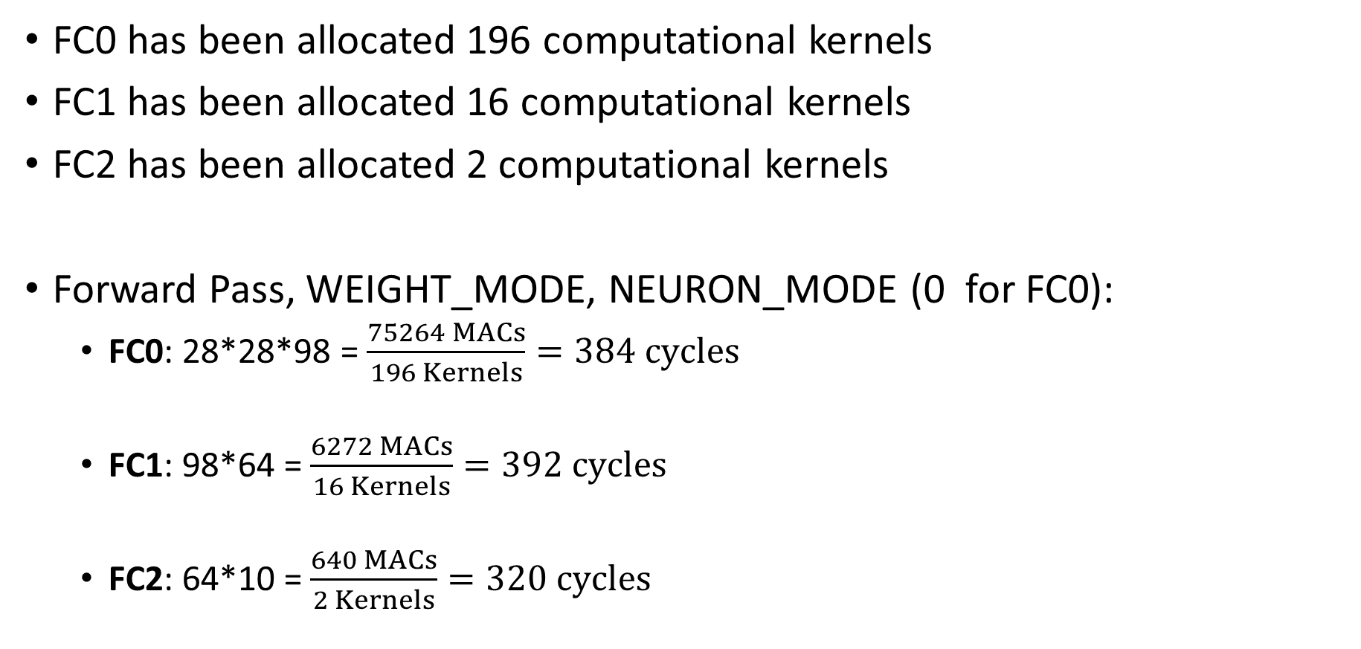
Architecture and Cycles
FC0 has been allocated 196 computational kernels
FC1 has been allocated 16 computational kernels
FC2 has been allocated 2 computational kernels
Forward Pass, WEIGHT_MODE, NEURON_MODE (0 for FC0):
FC0: 28*28*98 = $\frac{75264 MACs}{196 Kernels}=384 cycles$
FC1: 98*64 = $\frac{6272 MACs}{16 Kernels}=392 cycles$
FC2: 64*10 = $\frac{640 MACs}{2 Kernels}=320 cycles$

Slide 11
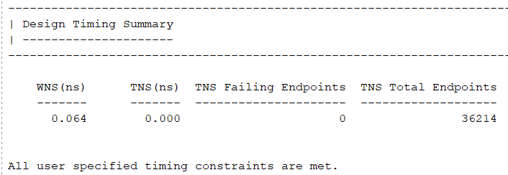
Verification
Python script loads weights from the .coe files and computes then forward pass and then the backward pass of the fc2 layer
Verify simulation results against the python script computations
Also verified that output was correct using LEDs on FPGA
No endpoints with negative slack, all timing constraints met

Slide 12
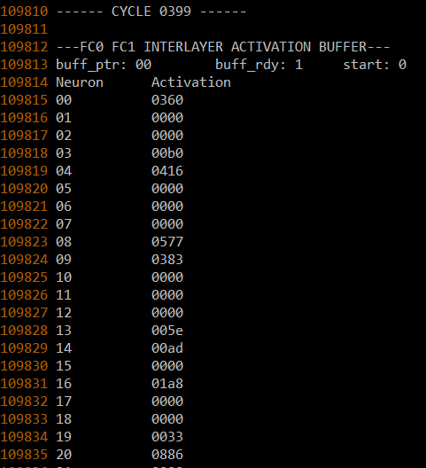
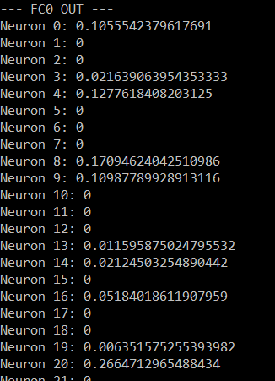
Verification: FC0 Forward Pass (384 Cycles)
Simulation Output and Python Verification output (Neurons 21-97 not shown)
0.10546
0.02148
0.12769
0.17078
0.10974
0.01147
0.05176
0.00623
0.26636

Slide 13
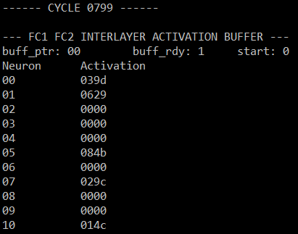
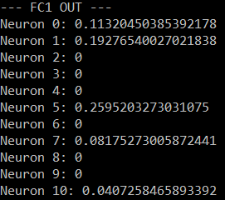
Verification: FC1 Forward Pass (392 Cycles)
Simulation Output and Python Verification output (Neurons 11-64 not shown)
0.11291
0.19250
0.25916
0.10546
0.04053

Slide 14
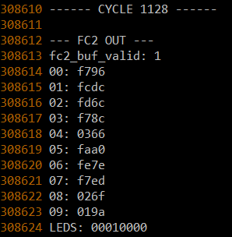
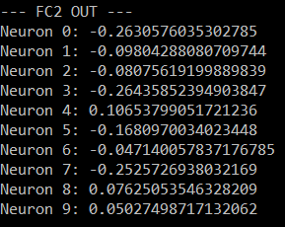
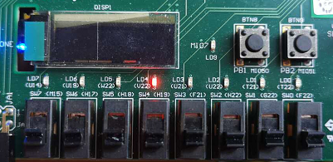
Verification: FC2 Forward Pass (320 Cycles)
Simulation Output and Python Verification output
-0.26294
-0.09814
-0.08057
-0.26416
0.10620
-0.16797
-0.04712
-0.25232
0.07605
0.05005
LED 4 is correctly lit up

Slide 15
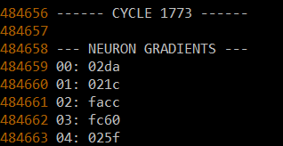
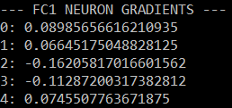
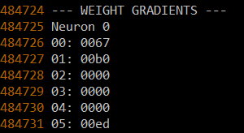
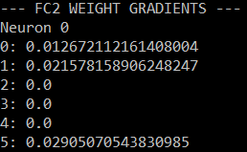
Verification: FC2 Backward (320 + 320 Cycles)
Simulation Output and Python Verification output
Neuron gradients 5 – 63 not shown
Weight gradients 6 – 639 not shown
FC2 backward pass finished in Cycle 1773.
FC0 Forward – 384 Cycles
FC1 Forward – 392 Cycles
FC2 Forward – 320 Cycles
FC2 Backward – 320 + 320 Cycles
Total = 384 + 392 + 320 + 320 + 320
Total = 1736 Cycles
Other cycles are from reset and pipelining latency
0.08911
0.06592
-0.16260
-0.11328
0.07410
0.01257
0.02148
0
0
0
0.02893

Slide 16
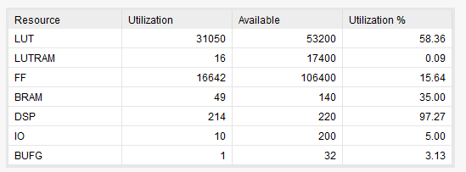
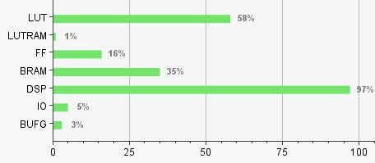
Resource Usage
Recall we have 196, 16, and 2 computational kernels to perform MACs in layers FC0, FC1, and FC2
Each kernel uses a DSP, this is 196+16+2 DSPs = 214 DSPs, which is what we can observe as reported by the Vivado synthesis tool
Maximization of DSP usage has been accomplished. There is also enough BRAM to double the storage of each to store gradients for weights in BRAM

Slide 17
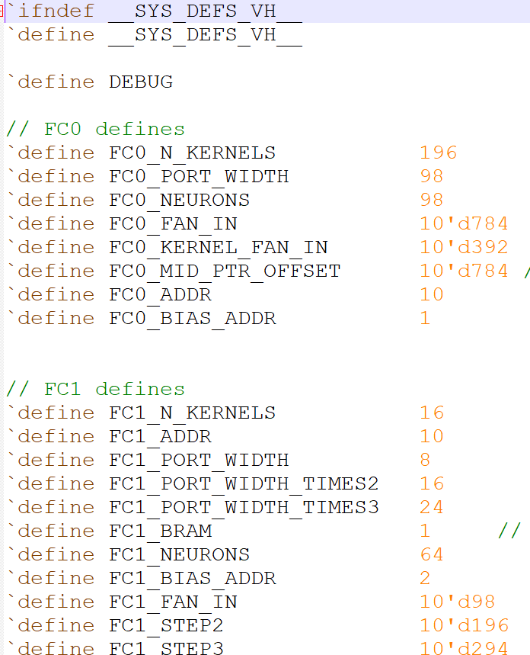
Generalizability
Layers are all the same exact structure, and differ by including different macros from a Verilog header file
All layers and kernels use the exact same scheduler and computational kernel
Two differences: memory controller and fc2 backward pass.
The memory controller and BRAMs had to be made by hand for each layer, since the amount of weights are different by layer.
Only FC2 layer has backward pass implemented, main purpose was to verify the architecture as functional, could be extended to previous layers, but amount of gradients is large, so would need to make BRAM modules to store gradients as opposed to 640 * 16-bit registers for FC2

Slide 18
Going forward
Will start writing report
The forward pass is pipelined, should I have a benchmark in hardware where I perform X amount of forward passes and time how long it takes? Should be relatively good performance since 214 DSPs will be more or less active constantly
Will replace the coefficient files in the BRAM holding the weights with weights trained from my software model, will replace the input buffer with actual MNIST images that can be changed via the switches
Perhaps will have a demo where the image can be drawn and loaded over to the FPGA via UART from my laptop to show a bit more interactivity in a demo

Slide 19
Report Writing (Questions)
Should source code go in the appendix in addition to the Github repository link?

Slide 20
Exam Date
Thesis hand-in is on Friday, June 28, I fly to the US on Wednesday, July 10.
We have tentatively scheduled the exam for July 8, 2019.

