Slide 1
Thesis Update #12
June 13, 2019
James Erik Groving Meade

Slide 2
Demo!
Inference-only
2. Training with small dataset and frequent stat updates shown
3. Training speed with total disregard for results, only used to show performance with regard to how fast training occurs

Slide 3
Updates
Implemented a softmax layer to compute a proper loss
Gradient checking in python script verifies that the gradients were indeed correct
Precision issues
Created memory map through DDR SDRAM between ARM and FPGA
Wrote C programs to perform various functions on the FPGA
Created custom BOOT.bin image with the bitstream and U-Boot that invokes a PetaLinux image. Put the MNIST dataset and a few C programs on the SD card.

Slide 4
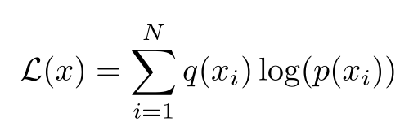
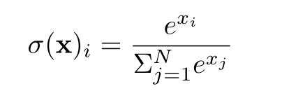
Softmax Layer
Why?
Needed to calculate using an actual loss function for gradients, otherwise unable to learn properly
Softmax is one of the best loss functions for training neural networks
Mathematically:

Slide 5
Softmax Layer Structure
Pipelined for the 10 output neurons, takes about 50 cycles for the 10
Convert to float
Perform e^{x}
Convert back to fixed
Sum all e^{x}
Divider core
Derivative is quite simple for softmax. It is just the output of the softmax for non-label neurons, and output minus 1 for the label neuron

Slide 6
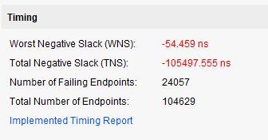
Also… don’t set the divider IP core to 1 cycle

Slide 7
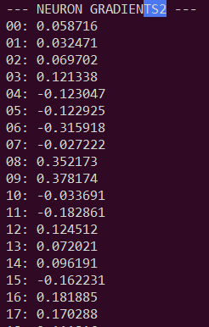
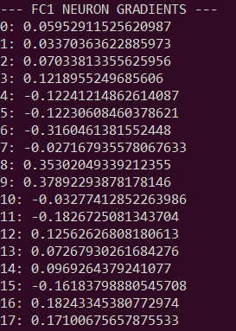
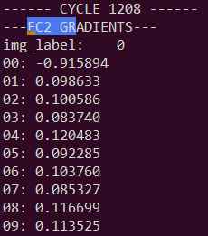
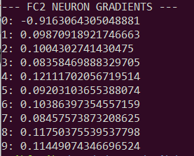
Verification of Softmax
… I found out that SystemVerilog/Verilog can display floating point, so it’s quite quick to visually verify now. Output from the softmax layer, and previous neuron gradients vs. Python script
Python
FPGA
Python

Slide 8
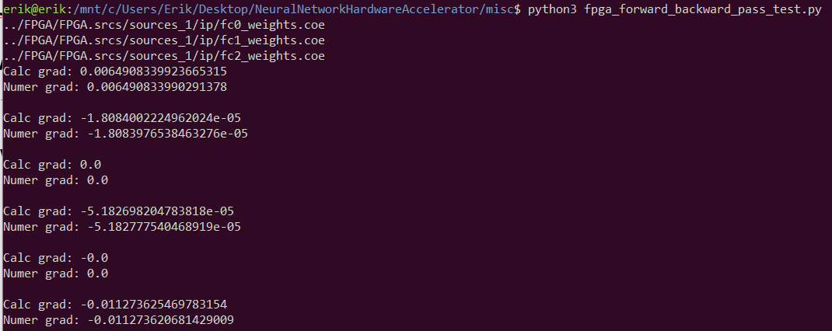
So, softmax seems to be verified. Training still off, why? Could the Python script be wrong?
Wrote gradient check testing in the python script to verify that the script was indeed correct. So the calculated gradients are correct.

Slide 9
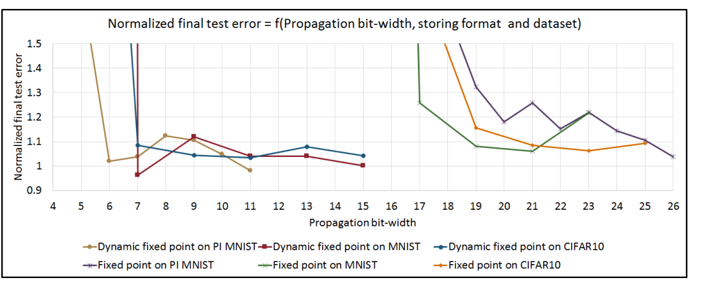
What’s going on, if the gradients calculated are correct, why isn’t it training to perfection!
This reminded me of a paper I read back in February
The below graph was a part of it

Slide 10
My theory
Observe the gradients from the simulation
Gradients in general want to push up the correct neuron by a lot, and at the same time lower the other gradients a bit
The gradients are Q3.13, activations are Q8.8
When updated, these are multiplied by 0.001, or shifted to the right by 10. Only 3 fractional bits remaining, so gradients effectively truncated at 0.125 steps.
Result is that many of the gradients that “push” final layer neuron output down get effectively truncated to zero, and as a result, the pushing up is much stronger than the pushing down
Recall the the train_small example, learning happens, as the accuracy does occur, but if neuron output is only pushed up, then eventually they will all saturate

Slide 11
Solution: More Precision Needed
Will try 24-bit and 32-bit solutions to see if training can be successfully implemented in such a scheme

Slide 12
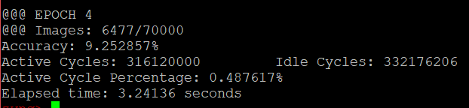
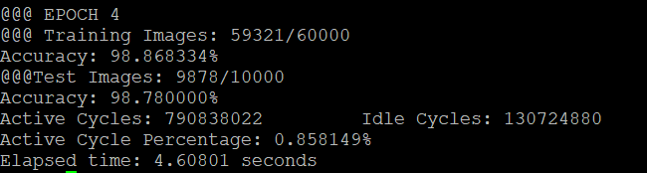
FPGA Clock Frequency
FPGA being at 50 MHz, should I try to get it back to 100 MHz?
No, DDR transmission is the bottle neck, as observed by the active cycle percentage
Also, active cycle percentage is ~2x for training compared to inference.
This is because training is ~2x more cycles, so roughly ~2x more time to load the next image
Inference
Training

Slide 13
Timing/Results
Faster than CPU by a lot
GPU
Faster for batch size of 1, but I discovered the GPU doesn’t parallelize by single input, it parallelizes by batch. So Batch size of 10 is roughly 10x faster than 1. Not entirely linear, but batch size of 200 is

Slide 14
Results
Will I be able to

Slide 15
Exam Date
Thesis hand-in is on Friday, June 28, I fly to the US on Wednesday, July 10.
We have tentatively scheduled the exam for July 8, 2019.

