Slide 1
Thesis Update #6
April 8, 2019
James Erik Groving Meade

Slide 2
Agenda
New CNN model
Proposed HW architecture model
Software model

Slide 3
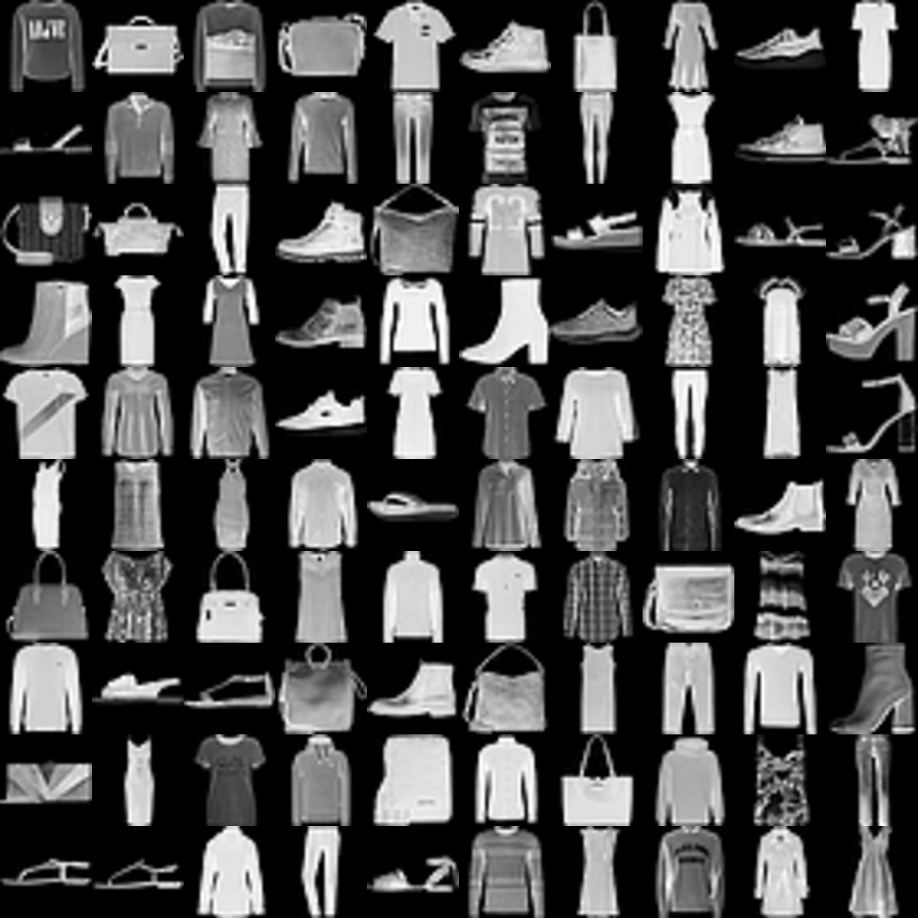
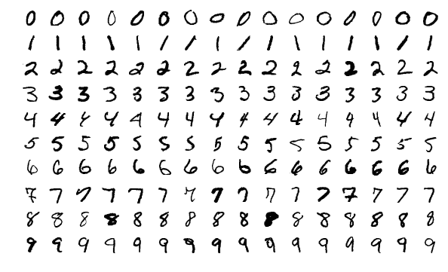
New Problem
Considering how low the accuracy was on CIFAR10, I would like to switch to a dataset that does not need as much preprocessing of the input data, as that’s not my focus
MNIST and MNIST Fashion (by Zalando), both are same format, 28x28 greyscale
MNIST Fashion being slightly tougher

Slide 4
CNN Model
Similar format but different sizes, all activations are ReLU except last
Trained to 99.01% on MNIST. 90,914 parameters.
Conv1 (Input: 1x28x28. Output: 3x28x28)
Pooling (Input: 3x28x28. Output: 3x14x14)
Conv2 (Input: 3x14x14. Output: 6x14x14)
Pooling (Input: 6x14x14. Output: 6x7x7)
Conv3 (Input: 6x7x7. Output: 8x7x7)
FC1 (Input: 8x7x7. Output: 32)
FC2 (Input: 32 Output: 10) {Softmax, use big LUT}

Slide 5
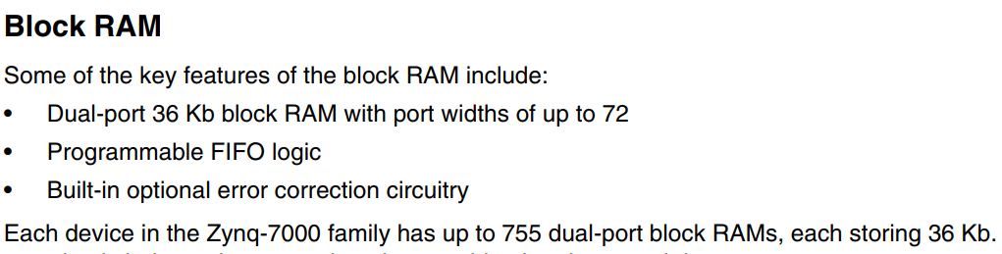
Overall Structure Hardware Model
CNN’s have a memory pattern stream that can be utilized to schedule computation
Each layer will have a scheduler that streams data into kernels that perform computation
BRAM on the Zynq ZC7X020 is true dual-port and word size is configurable up to 72 bits (while remaining dual-port), 140 total
DSP’s are 25x18, run up to 741 MHz, will be used for the MACs.

Slide 6
Concurrency
Concurrency is achieved through multiple kernels running simultaneously in all layers, will be shown in future slides
Convolutional and fully-connected layers will be pipelined

Slide 7
General Structure, every layer will have a scheduler, BRAM, and kernels
Convolutional Layer
Pooling Layer
Fully-Connected Layers
Scheduler
Scheduler
Scheduler
BRAM
Conv. Kernels
BRAM
Pooling Kernel
BRAM
FC Kernel
Conv. Kernels
Pooling Kernel
FC Kernel
Conv. Kernels
Pooling Kernel
FC Kernel

Slide 8
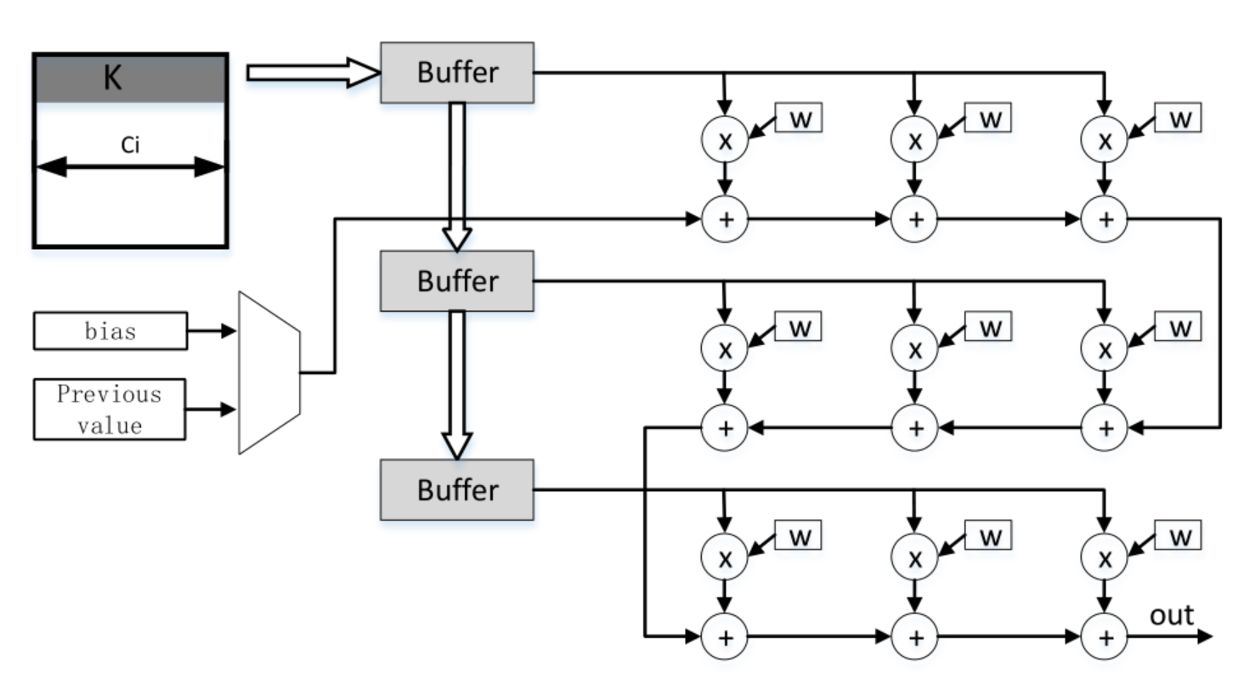
Architecture – Convolutional Kernel
Very similar to the F-CNN model shown in the right, but I do not have the fortune of having the weights in flip-flops, so I will need to read them from BRAM as well
Bias if starting convolution in first input map, previous value if otherwise
To pipeline this kernel, 9 new weights and activations must be read every second, thus in the current naïve proof of concept, this will require 9 BRAMs for the weights, and 9 (shared w/ next layer) BRAMs for the activations

Slide 9
Architecture – Max Pooling Kernel
BRAM
(activations from previous layer)
BRAM
(activations for next layer)
>
>
>
Requires 4 activation reads and 1 activation write. Can use a 32 bit read port on the activations from previous layer and a 16 bit write port for the next layer.
Only need 1 pooling kernel per 4 kernels in previous layer

Slide 10
Architecture – Fully Connected Kernel
Similar to convolutional kernel
Can be just viewed as a convolution over the entire image
Input dimension to first fully connected is 1x392(8x7x7) for each neuron, can just two pipelined 4x4 MAC kernels and compute across the 392 activations for each neuron. Each kernel loads 16 activations at a time and then 16 weights per cycle
Only 320 MACs for final FC layer, can just have it entirely in fabric

Slide 11
General BRAM Layout and Configuration
Weights (and their momenta/gradients) will be stored in separate BRAM from activations
Weights will be in BRAM blocks instantiated in the layer
Activations will be in BRAM blocks in between the layers
For simplicity of initial concept, read and write port will be set to 16 bits, so 1 weight or 1 activation can be read/written to at a time.
Once concept works, can increase port width to have higher BRAM bandwidth and therefore more kernels running in parallel
Layer
Layer
Layer
BRAM
BRAM
BRAM
BRAM
BRAM
BRAM
BRAM
Input
Read
Write
Activations
Read
Write
Activations
Read
Weights
Weights
Weights

Slide 12
Data Reuse?
Fully connected layers have a very simple data reuse on the activations, each neurons has the same activation input as the others
Convolutional – Planning to get data reuse from activations, however, in proof of concept will just be completely naïve
Once POC is working, scheduler can be modified to reuse
There’s a simple sliding window method that would only require 3 activations be read (in a 3x3 filter) for every 9 weights, incurriing a 40% data reuse (6 reuses from 15 reads)
Even more reuse is possible if entire rows are read at a time, also possible since BRAM supports large port

Slide 13
Proposed Layout Specific to this CNN
We want the throughput of data to be roughly equal across the layers to minimize stalling for previous layer to finish computation, or for next layer to finish computation before writing new data
Let’s look at the amount of MACs per layer and throughput requirements

Slide 14
Proposed Layout Specific to this CNN

Slide 15
What About the Backward Pass?
Well… actually the backward pass can use the exact same kernels to compute the gradients for the weights!
However, as expected, the data-stream pattern will be completely different
This means that the layers need two different schedulers
Start with forward pass scheduler and implementation, then create a scheduler for the backward pass and updating weights

Slide 16
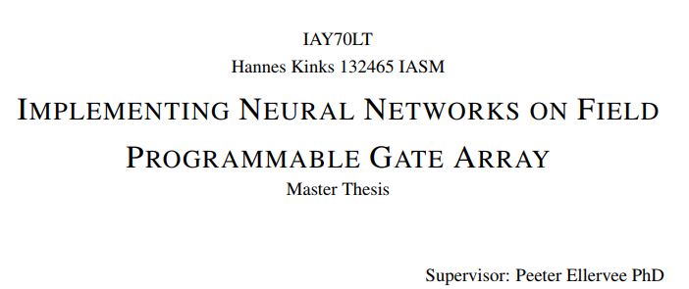
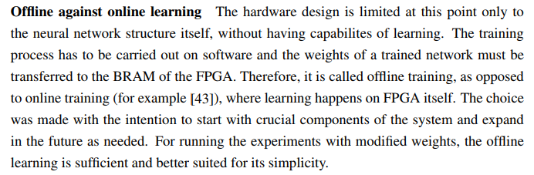
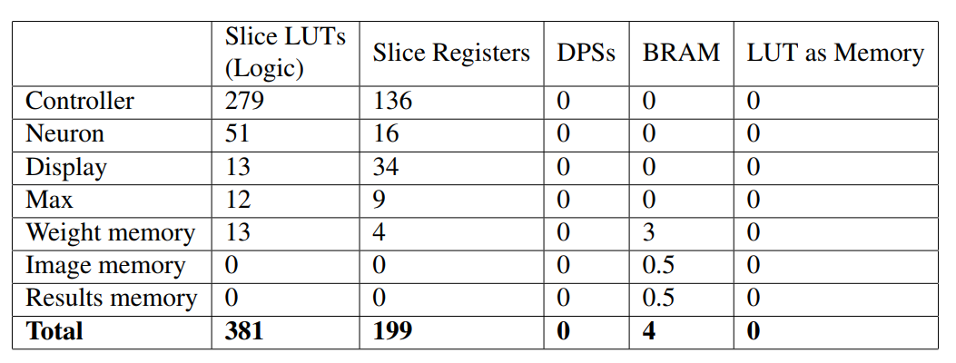
Hopefully, will have time to finish the backward pass, but it might be a bit too much for time restrictions
Someone who tried similar…
In this person’s thesis, everything was put in RAM, even the images
Did not use any of the DSPs
HW impl. was only 1 neuron
In comparison… my current scope is a lot bigger, hopefully is okay.

Slide 17
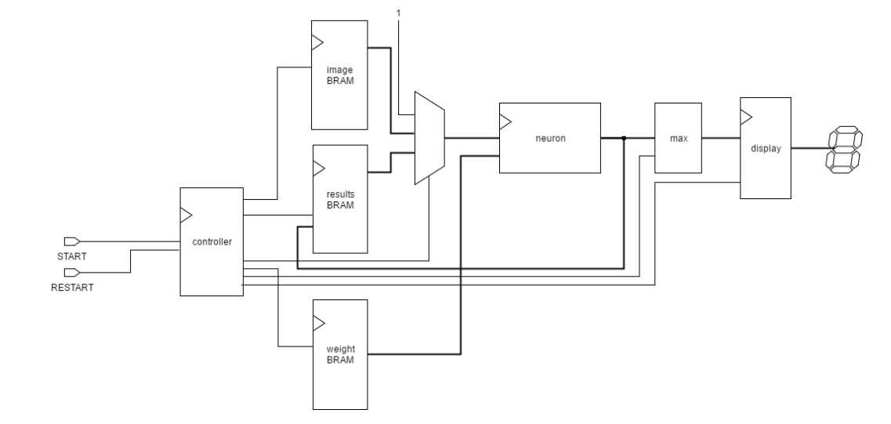

Slide 18
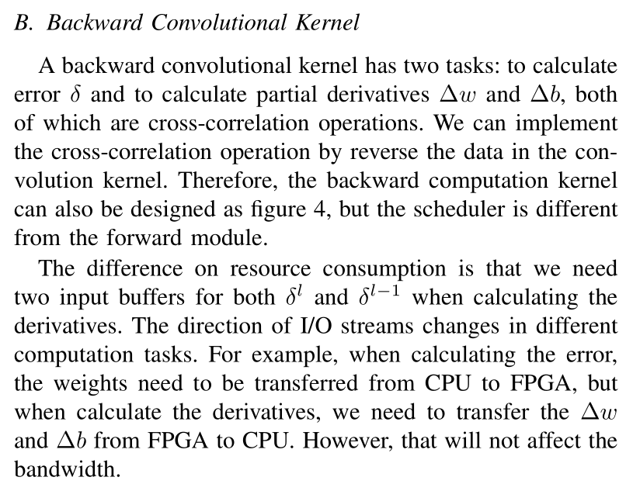
Forward and Backward Pass Schedulers
The forward pass is very easy to create a scheduler for as the memory accesses just iterate over the inputs
The backward pass will require more finesse but seeing as I have implemented the backward pass in software, and it is also just for loops, there is also a way to schedule this
Backward pass requires reading from activations, but not writing, dual-port, so two layers can simultaneously read the activation BRAM between them
From F-CNN Paper

Slide 19
Software Model

