Slide 1
Thesis Update #1
February 11, 2019
James Erik Groving Meade

Slide 2
Inference vs. Training (Forward pass or both forward and backward)
Many models implement only the classification on these lower power/computational power accelerators
This means using a pre-trained networks parameters and simply computing the forward pass of the network
The training component is a bit trickier because there are a lot of intermediate computations and results to be stored and forwarded

Slide 3
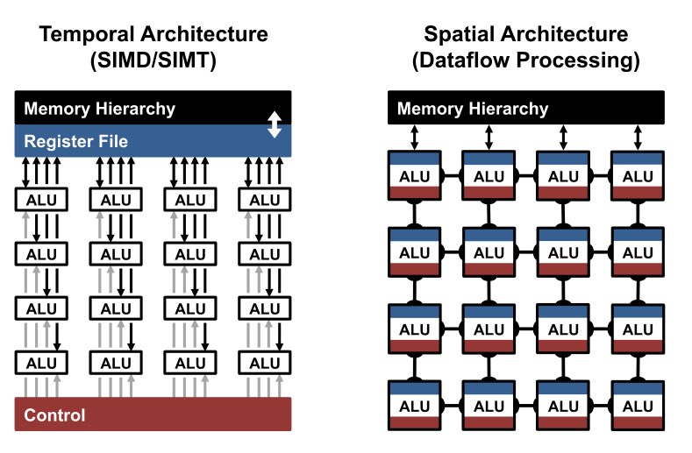
FPGA’s strength: spatial models
FPGA-based models are excellent for implementing a spatial architecture
On the other hand, CPUs and GPUs using temporal models (SIMD) and efficient matrix multiplication via optimized easily via software libraries

Slide 4
Representing a Deep Neural Network (DNN) in the Accelerator Space
To characterize workload, two main parameters are used, since they take the most time:
Multiply & Accumulates (MACs)
Number of weights
Some of the famous DNN’s inference statistics:
LeNet-5: 431k weights 2.3 million MACs per image
AlexNet: 61 million weights 724 million MACs per image
ResNet: 25.5 million weights 3.9 billion MACs per image

Slide 5
Goals of the Accelerator
Minimize energy usage and maximize speedup
Memory access is a huge bottleneck for FPGA based DNNs
We want to reduce the energy cost by minimizing the distance the memory has to travel, we can do this by employing a hierarchical dataflow
Maximize data reuse (especially relevant for the convolutional layers). Fetching data from a neighboring processing unit is much cheaper than going to DRAM
Using optimal data reuse in AlexNet can reduce the amount of DRAM reads for inference by roughly ~500x
Balance between DRAM to fetch vs. BRAM and computational resources on the chip

Slide 6
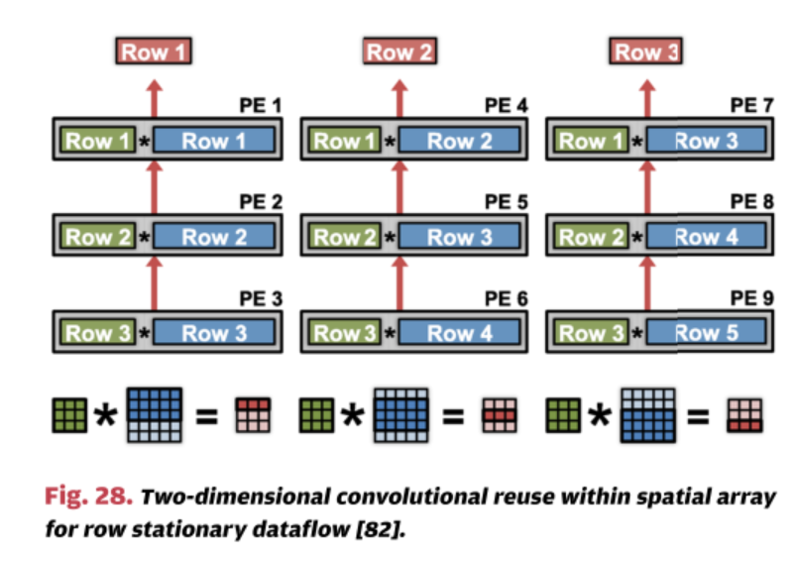
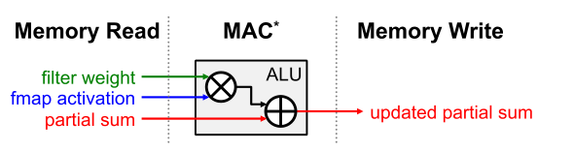
Minimizing memory reads and maximizing data reuse
The EyeRiss DNN chip from MIT uses a row stationary method to optimize data reuse and minimize amount of BRAM needed per processing element

Slide 7
Generic vs. Module-Generated Architecture
Some implementations (i.e: EyeRiss, Tabla, Deep-learning processor from Bang 2017) implement a generic processing element (PE) model where the PE performs simple MACs assigned by a central task scheduler
Some other models like F-CNN define modules for specific layers and then have the code generated for the model and placed on the FPGA
Some models define the PE’s to be more than MAC focused, but as collections of modules similar to F-CNN, however, are generic. This is seen in an implementation such as the nn-X chip

Slide 8
Precision Required
nn-X paper cited a source which claimed Q8.8 is roughly equally accurate to 32 bit floating point
EyeRiss implemented dynamic fixed precision, with a 8-bit dynamic fixed precision weight and 12-bit dynamic activation with only 0.3% accuracy loss
Relevant to minimize amount of memory accesses needed to fetch weight and partial computations
Obviously, in the MACs, partial results will have higher resolution but the end result will be stored in
Side note: recent popular topic is binarized neural networks, where the weights are either 1 or -1, two implementation, BinaryConnect and Binarized Neural Network achieve 19.2% and 29.8% accuracy loss on AlexNet, respectively

Slide 9
Relevant Metrics
Accuracy
Training time
Energy efficiency
Utilization of resources on FPGA and precision
Number of weights in network
Number of MACs in network

Slide 10
What models have been done:
The following slides will briefly discuss the architecture of some recently proposed and implemented accelerators:
EyeRiss Massachusetts Institute of Technology
Tabla Georgia Tech
F-CNN Tsinghua University
nn-X Purdue University
Unnamed University of Michigan

Slide 11
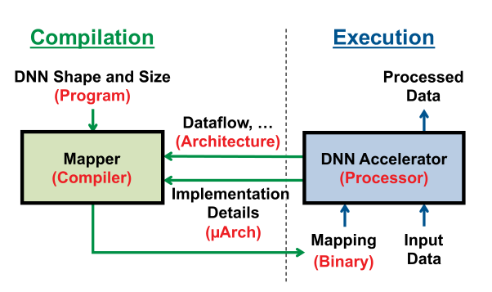
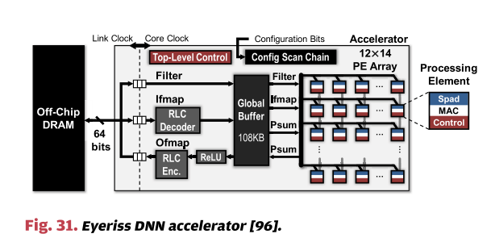
Eyeriss: A Spatial Architecture for Energy-Efficient Dataflow for Convolutional Neural Networks
Uses a 12x14 PE array, each PE has MAC and control signals. Design is fixed but can handle any input.
Inference only chip
Processing element architecture

Slide 12
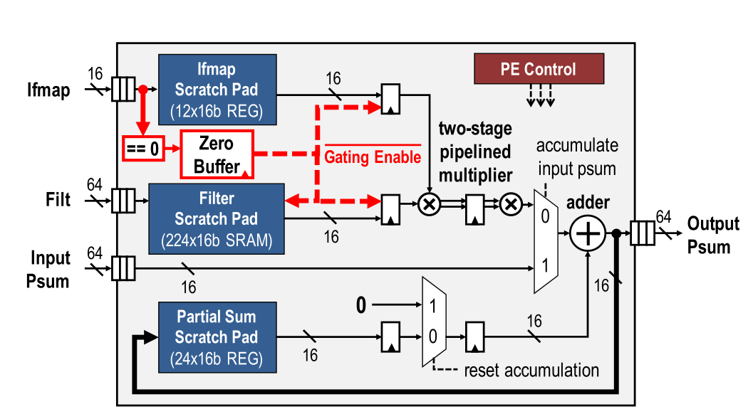
Eyeriss: Processing Elements

Slide 13
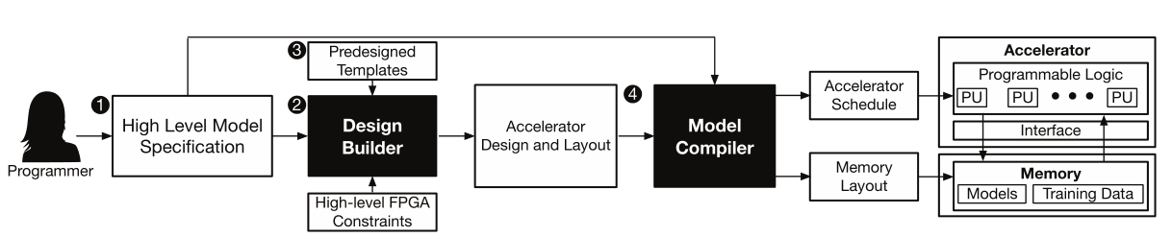
TABLA : A Unified Template-based Framework for Accelerating Statistical Machine Learning
TABLA is not a chip or FPGA prototype but a framework to allow for easy usage and implementation of machine learning systems
Has support for both inference and learning for any FPGA
Code regenerated on network change but overall architecture is similar to Eyeriss
“These templates, designed by expert hardware designers, are in synthesizable Verilog format. The design builder generates the accelerator and its interfacing logic using these accelerator templates. Specifically, the final output of the design builder is a set of synthesizable Verilog code. Internally, it uses a predesigned Verilog template, along with the programmer-specified gradient function and a high level specification of target FPGA platform.”

Slide 14
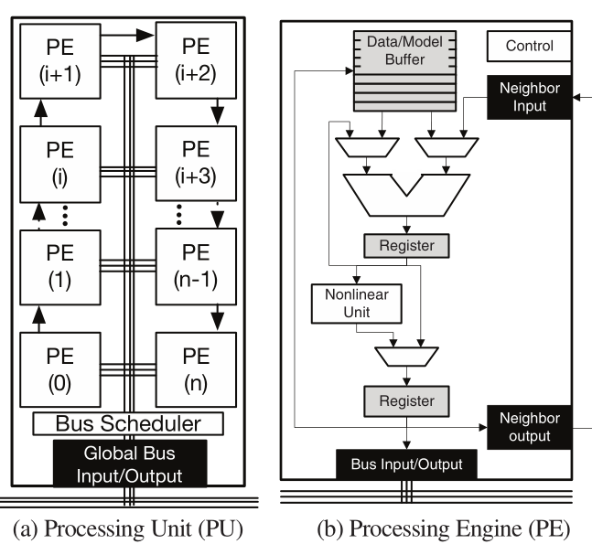
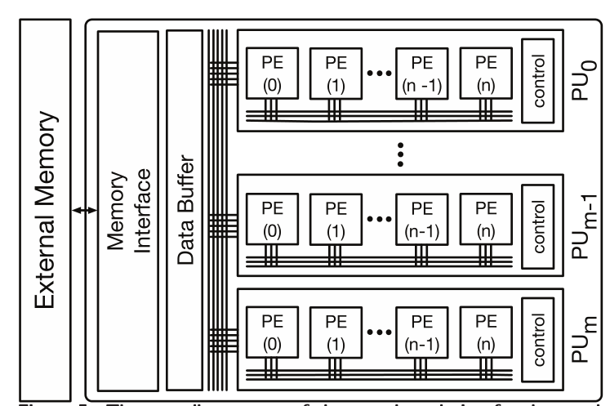
Tabla: Basis of the Generated Architecture

Slide 15
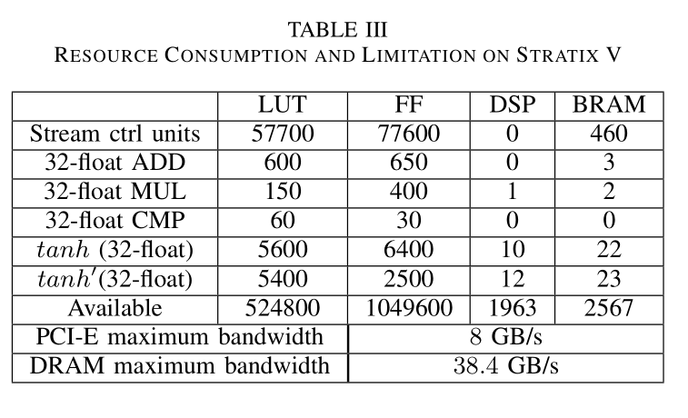
F-CNN
Full-functional FPGA based model, uses modular layers design, has three types of modules: convolutional, pooling, and fully connected. Firmware for FPGA must be regenerated on a network architecture change
Uses Altera Maxelor and floating point precision
4x faster than their CPU model, 7.5x more energy efficient than their GPU model
Weights and baises stored in CPU, training data in DRAM
Did not appear to use much data reuse, potential for expansion

Slide 16
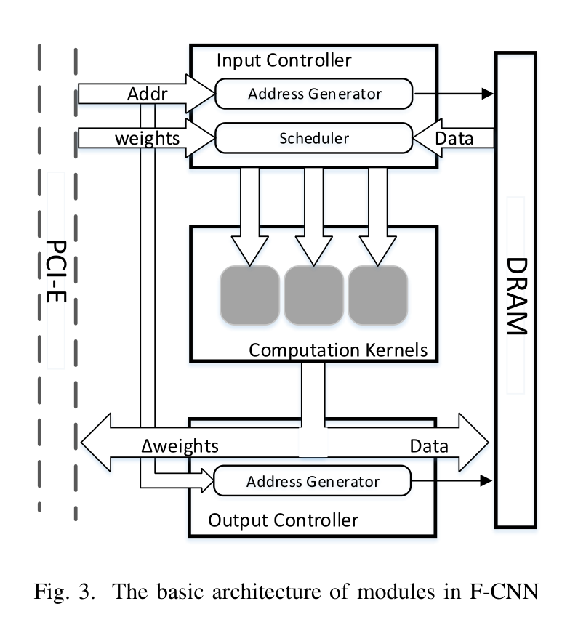
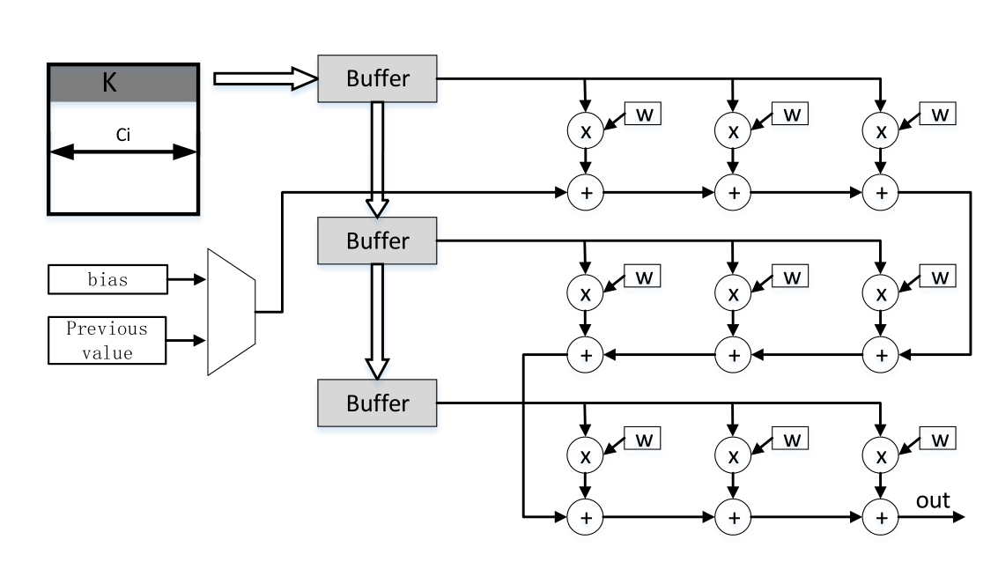
F-CNN: Modular based architecture

Slide 17
nn-X: A 240G-ops/s Mobile Coprocessor for Deep Neural Networks
Performs inference only, designed to handle and accelerate the heavy computational workload of a DNN on mobile devices
Implemented on Xilinx Zynq SoC
Has something similar to processing elements but are called ”Collections”
Each collection contains several functional modules: convolutional, pooling and a dynamically programmable function region
32-bit floating point precision
All control logic and collections are handled by the configuration bus from the host processor

Slide 18
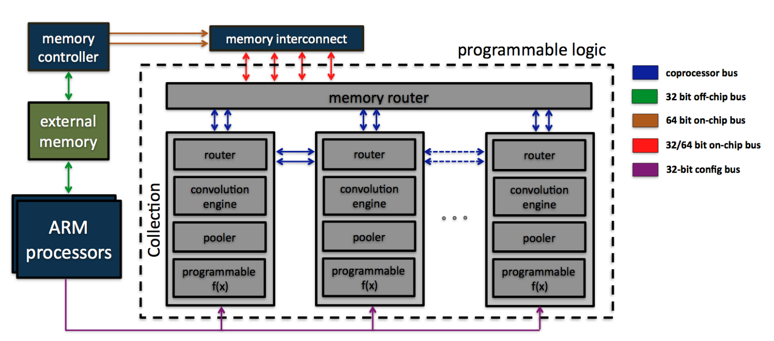
nn-X Overall Architecture

Slide 19
A 288μW Programmable Deep-Learning Processor with 270KB On-Chip Weight Storage Using Non-Uniform Memory Hierarchy for Mobile Intelligence
Low power deep learning accelerator (low-power achieved by storing all weights on-chip)
Four processing elements on chip with 270 kB memory (this sets a cap to the depth of the DNN)
NUMA memory hierarchy and reconfigurable fixed point representation (but not live dynamic)
NUMA results in 40% energy saving compared to a standard UMA
The non-linear activation functions are implemented with a lookup table

Slide 20
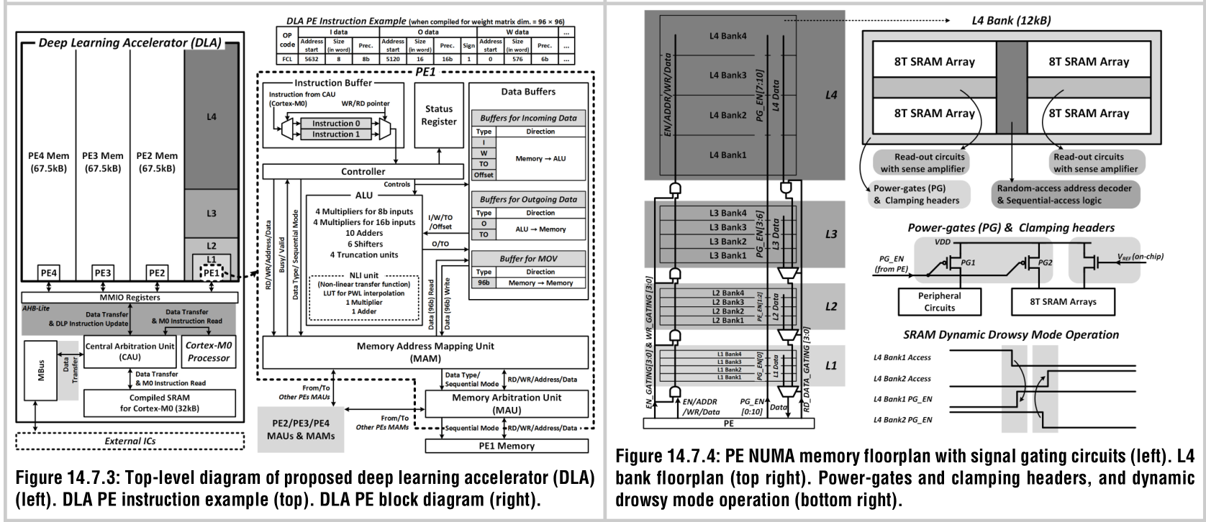
Architecture of the chip

Slide 21
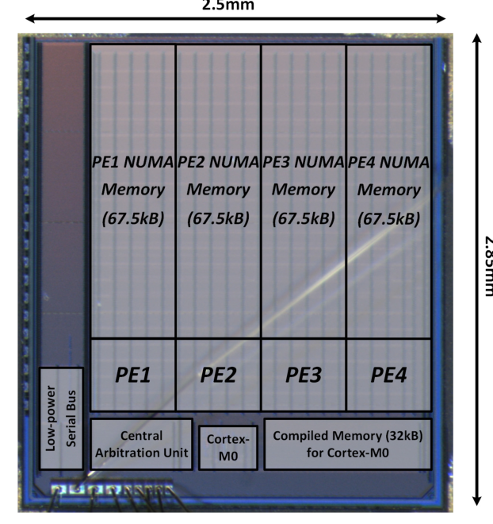
Architecture Superimposed on the Die

Slide 22
Going forward
Application: Inference, or both inference and training?
I would like to try both inference and training
Precision: Floating point, dynamic fixed point, static fixed point?
Static fixed point for now
Architecture: MAC PE’s, Modular PE’s, Modular-generated?
Up for discussion. Perhaps a modular PE or modular generated would be easier.
Network to train: LeNet? CIFAR? ImageNet?
LeNet is quite easy to achieve high accuracy, might not give a good reflection of the effect of reduced precision from FP. ImageNet is a massive scale set. CIFAR is a medium size dataset and the images are relatively non-massive. Therefore, I suggest CIFAR as the dataset to train a network on
Comparison: How to build CPU- and GPU-based models?
TensorFlow
Activation: What non-linear activation function should be used?
ReLU to save our LU’s and reduce cycles required for computation
Need: DRAM to store training data. SoC, ideally with a nice chunk of memory to store weights and partial results to minimize DRAM accesses

