Slide 1
Thesis Update #9
May 22, 2019
James Erik Groving Meade

Slide 2
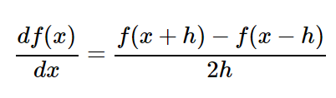
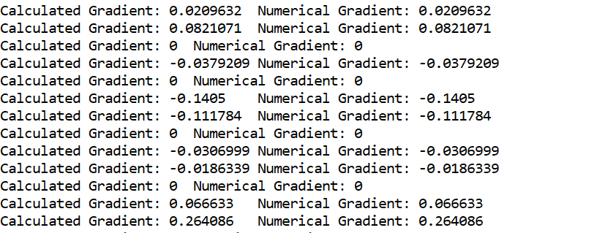
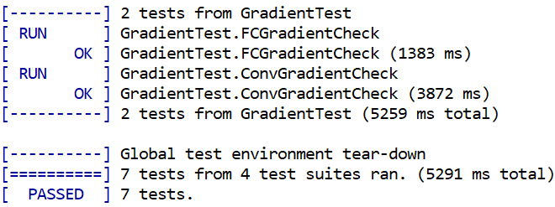
Software Model Update
Through gradient check testing, was able to debug the software model
Select random weight, small h = 1e-5, and perform the calculation shown above.
Can then compare gradient from backward pass with estimated gradient
Uses random input and output labels, checks 100 different weights with random layer, neuron, and weight index

Slide 3
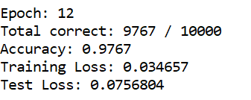
Software Model Update
Works with all types of layers
Trains to the same accuracy as open source frameworks
Accuracy by epoch 12 with my software model using the revised network architecture on MNIST:

Slide 4
Hardware Model Update
Revised the HDL to successfully compute the forward pass of the proposed network
Increased internal precision of MACs for better precision
Next step: scheduler for backward pass. Can use a gradient checking method to verify the correct gradients were calculated for testing
Think I will have to stick with a batch size of 1 for now

Slide 5
Report Writing
Have started writing the report, using “Luke’s Thesis”
Proposed structure (non-inclusive of summary, title page, preface, and acknowledgements):
Chapter 1: Introduction
Project plan – how did the original project plan differ from what was actually done (original and revised in appendix, no need for introduction)
Problem statement – What am I trying to accomplish and why
Briefly describe “table of contents”
Prototype for ASIC, premature
Chapter 2: Software Models
Model made from PyTorch Framework** make sure the results are worth discussing
My own software neural network frameworks, and the testing of it
Notes:
Background – don’t be like a textbook, be very surface, can add references, chapter 2
Context – Introduction to deep neural networks and the parallelization possible for training, second chapter
Related work second chapter
Brief introduction of PyTorch

Slide 6
Report Writing
Chapter 3 – Hardware model
The actual architecture, displaying the parameterization and flexibility of making changes
Resource usage
Generating coefficient files with scripts for weights, only ‘rigid’ part of the architecture
Chapter 4 – Hardware model testing
Generating coefficient files for the BRAM and random input testing
Calculating floating-point precision output from coefficient files using Python comparing to simulation output files using Vivado tcl commands
Chapter 5 – Results
Cycle analysis for forward and backward pass of hardware model from simulation
Training time and accuracy benchmarks from software models
**if enough time** Training time and accuracy benchmarks from hardware model

Slide 7
Report Writing
Chapter 6 – Analysis
Comparison of hardware and software models, explanations of why
Chapter 6.5 – Missing pieces w/ design and without implementation
Batch size
MMIO interfacing with CPU to train network and then eventually support forward pass
Chapter 7 – Discussion
Reflecting on project, results
Future work to improve the model (batch size (what is needed to get this done), asic, more layer types supported, generated hdl)
Chapter 8 – Conclusion
What was accomplished, overall results that were obtained
Bibliography
Appendices

Slide 8
Report Writing (Questions)
Should all comments regarding the process be handled in the revised project plan section?
Should I mention the iterations in model design for hardware? Or just describe the final hardware architecture? I changed my design quite a lot
What should I have in the “summary” section, just like an abstract?

Slide 9
Exam Date
Would like to schedule a date for the defense now that we are a little over a month out
Ideally as soon as possible for me, so that way I can get my proof of graduation
Thesis hand-in is on Friday, June 28, I fly to the US on Wednesday, July 10.

