Slide 1
Thesis Update #4
March 26, 2019
James Erik Groving Meade

Slide 2
Brief Recap of Current State of Affairs
Initial network architecture proposed (9 layer conv net)
Using highly optimized framework model for CPU and GPU is done, benchmarks on the initial proposed network architecture have been logged
Began work on a software model to make sure the algorithmic implementation of the training via stochastic gradient descent is properly done
Began thinking about various ideas for how the hardware model should work

Slide 3


Using the PyTorch Framework Results:
The network reaches its best accuracy after around 10 epochs
CPU training:
Training time for 10 epochs is 23389 seconds
Alternatively, 6 hours 29 minutes and 49 seconds
GPU Training:
Training time for 10 epochs is 1743 seconds
Alternatively, 29 minutes and 3 seconds
Speedup of 13.42 for GPU
The difference between CPU and GPU for training time is massive
Due to “embarrassingly parallel” nature of deep convolutional neural networks

Slide 4
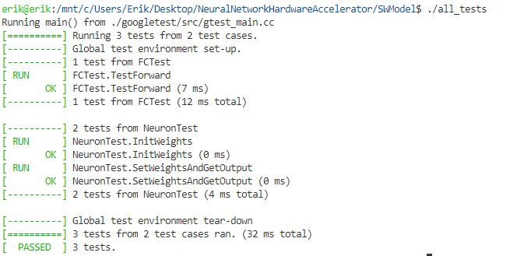
Software Model
Decided to make a robust model flexible to support any network architecture
Google Test for unit testing

Slide 5
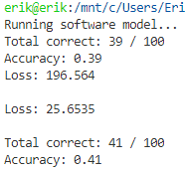
Software Model
Currently backward pass is being debugged, will need few days to debug, still on schedule
Good at minimizing loss but currently my loss function is not proper for image classification and perhaps a few bugs to be ironed out
Right shows before and after 10 epochs of training on small randomized dataset of 100 elements

Slide 6
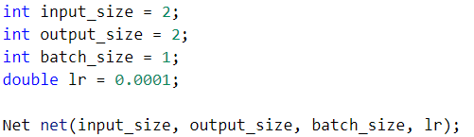
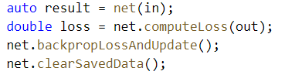


Software Model: Easy and intuitive to understand
Make a Net object
Train on a labeled dataset
Make layers to add
Add layers to the Net object

Slide 7
Hardware Ideas and Keeping Things Feasible
Imposing a few restrictions on the supported size of networks
To perform the backward pass, the activations of the neurons (outputs) must be saved for every single image in a batch
The amount of memory required for activations will grow linearly according to the batch size
Current thoughts:
Weights stay on the FPGA (like in the F-CNN paper), they do not shift in and out of memory for now
Have an activation buffer on chip. For each image processed, all activations from the forward pass will be stored in there. If the buffer tail pointer reaches the head, then we write the entire buffer to memory and repeat

Slide 8
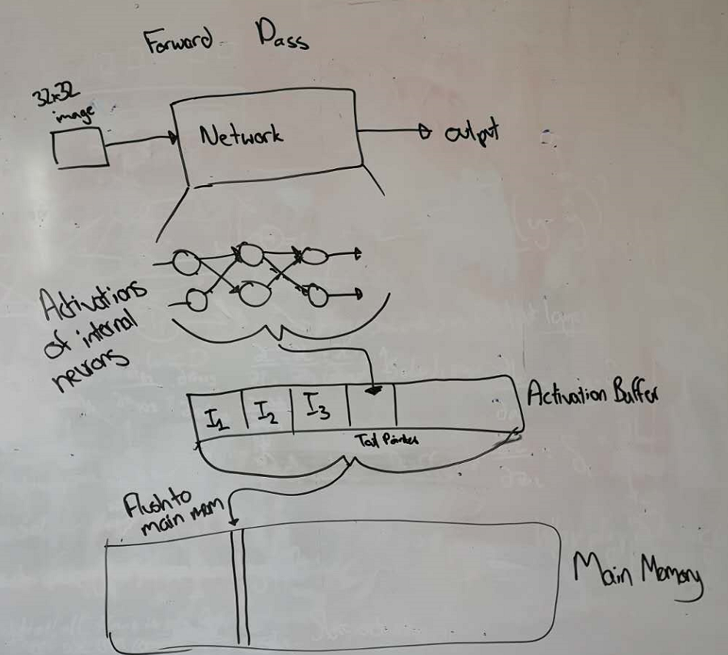
Illustration of forward pass with proposed activation buffer

Slide 9
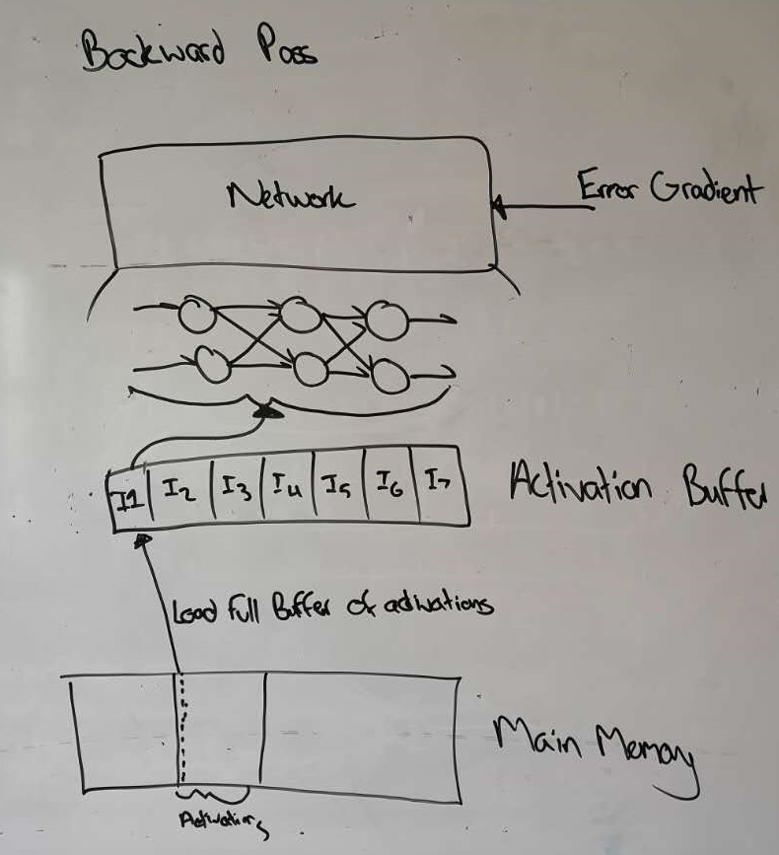
Illustration of backward pass with proposed activation buffer

