Slide 1
Thesis Update #7
April 23, 2019
James Erik Groving Meade

Slide 2
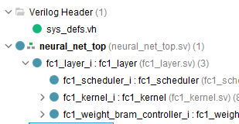
Hardware Model
Writing hardware model in SystemVerilog
Currently working on forward scheduler for Fully Connected layer
BRAM can be preloaded with values from a coefficients file, no need to use LFSR to initialize weights
Pre-loaded BRAM with activations can be used to test the hardware

Slide 3
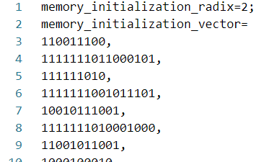
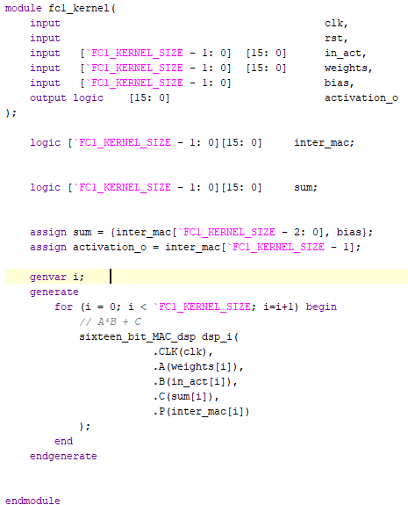
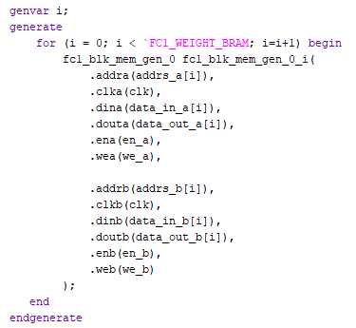
Weight Initialization and Kernel Setup
Created a Python script to perform He Initialization and convert to Q3.13 fixed point
Kernel models and BRAM are set up

Slide 4
Current FC1 Layer Architecture
Two 8-stage MAC pipelines
32 neurons, each with 8*7*7 = 784 weights
8 weight dual-port BRAM to feed the pipelines
Since we have 8 BRAM, each BRAM stores the weights for 4 neurons
Scheduler iterates down the BRAM with 2 pointers
Ptr1
Neuron 1
BRAM
Neuron 2
Ptr2
Neuron 3
Neuron 4
Pointers simply iterate downward during the forward pass, reading weights and supplying to the kernel

Slide 5
Implementing Training
To stay true to the proposed project, not prioritizing forward pass for convolutional, pooling, and fully connected layers
Instead, will do forward pass for fully connected, then work on backward pass for fully connected
Fully connected training should be able to completed
Then can do forward for pooling and convolution if time allows

Slide 6
List-of-Things-Todo, by priority and category
Hardware
Fully Connected forward pass on FPGA
Fully Connected backward pass on FPGA
Set up PetaLinux and have pictures loaded via DRAM to FPGA
Support for larger batch size (requires moving activations to DRAM)
Software
Gradient checking/testing for software model
Pooling layer forward and backward pass
Report
Writing report
Convolutional layer forward and backward pass

