Slide 1
Thesis Update #13
June 17, 2019
James Erik Groving Meade

Slide 2
Increased Precision
Increased precision from 16 bits to 18 bits, cannot go further because DSP slices are 25x18 input
No longer same radix for activations and gradients/weights
Activations are Q6.12
Gradients and weights are Q1.17

Slide 3
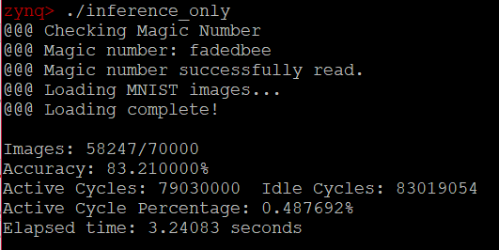
Training
Training is now stabler, but haven’t able to get more than 85% on the entire MNIST dataset, due to precision
On small datasets, can perfectly learn the dataset
Created boot image where weight updates for fc0 are disabled
Created boot image where weight updates for fc0 and fc1 are disabled
Will use in analysis, since gradients decrease with each layer

Slide 4
Training
Tradeoff:
High learning rate with low batch size is generally unstable, but it means I can keep more bits of data from the gradient
Low learning rate with low batch size is ideal, but I have to shift so many bits of data out that I lose my precision
Have had to find a balance of learning rate vs. precision to maximize the results of training

Slide 5
Report, Results Section
Benchmarks
Maximum accuracy attained for the network
Timing for training epochs
Timing for inference
Active cycles vs. idle cycles
Cycle analysis (for timing)
Resource usage
Implemented design

Slide 6
Report
Rough draft for chapter 2 (background) and chapter 3 (software model) complete
Chapter 4 (hardware model) is in progress
Question:
Should I provide descriptions of the project structure?
I have written a brief description of each file in my software model chapter.

Slide 7
Key Conclusion:
Can use specialized hardware result in finer-grained parallelism than what deep learning frameworks offer (GPU sends images to processing units that process the image serially, my accelerator parallelizes a single image)
As a result, for datasets that train better with small batch sizes, using specialized hardware could potentially offer massive orders of magnitude higher speedup
Recent papers have shown a smaller batch sizes can result in better trained networks
However, should this be implemented, training should not be done with 18-bit fixed point, either 8, 16, 32-bit floating point or 32 bit fixed point at the least.

Slide 8
Exam Date
The defense will be on July 8th, exact details still yet to come

