Slide 1


OpenLayers
Open Source Web Map Development with OpenLayers

Slide 2
What is this About?
This talk is about OpenLayers, an API that allows you to easily create powerful web maps
Geared towards beginners / intermediate users
I’ll try to cover all the major parts of the OpenLayers library, but this will serve mainly as an introduction
Feel free to ask for clarification or questions at any time
Slides and code can be found at my site
  vasir.net

Slide 3
What is OpenLayers?
Open source, client side Javascript library for making interactive web maps
  Cross browser (even IE6 support)
  No special server side software required, unless you want to use your own map server
Originally developed by Metacarta as a response, in part, to Google Maps
Current version is 2.10

Slide 4
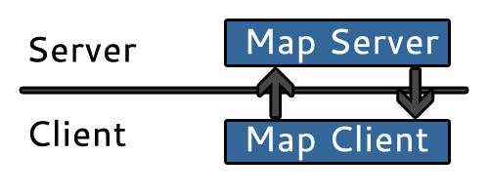
How Does it Work?
Anatomy of a web map
  Client sends requests, server returns map tiles

Slide 5
Where Does OpenLayers Fit In?
OpenLayers is the client side part of the client-server model
The map server can be nearly anything
  WMS, WFS, Google Maps, Bing, ESRI, Yahoo, TileServer, OpenStreets Map, etc.
OpenLayers sends requests to the map server to get the right map tiles when you navigate around the map

Slide 6
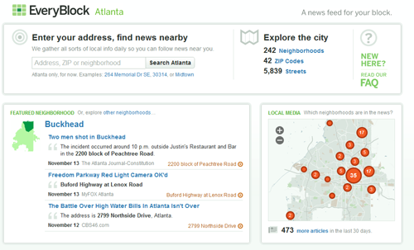
Who Uses OpenLayers?
EveryBlock
  Tracks neighborhood events
WhiteHouse
  http://www.whitehouse.gov/change
Me
  At FREAC (Florida Resources and Environmental Analysis Center) with iMapInvasives
  to track invasive species

Slide 7
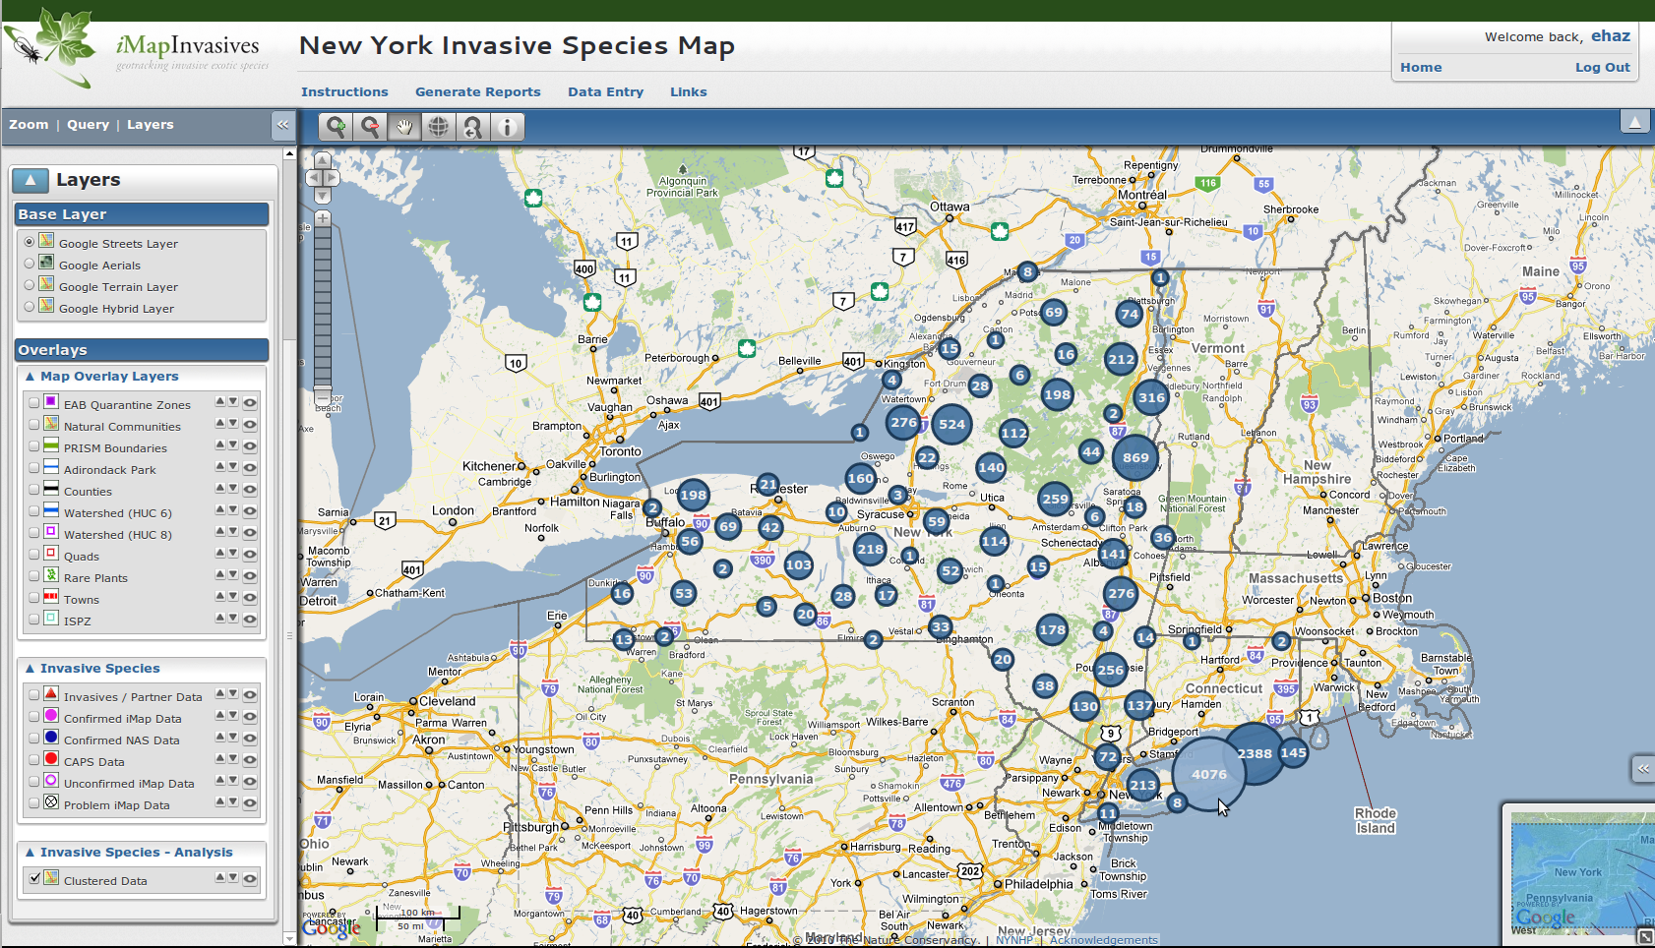
FREAC – Tracking Invasive Species
Using a vector layer and clustering to group invasive species observations

Slide 8
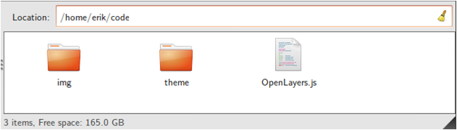
Getting OpenLayers
Download at http://openlayers.org
After downloading, copy over the img and theme folders, along with OpenLayers.js to your map page’s directory
  Example

Slide 9
Making a Map with OpenLayers
Basic process for making a map
  1. Create a map object and a div the map will go in
  2. Create a layer object and add it to the map object you created
  3. Create control objects and add them to the map object
  4. Zoom the map to some location
    In this example, we’ll zoom to the map’s max extent

Slide 10
Our First Map
Let's make a map using a WMS service provided by MetaCarta
<!DOCTYPE html>
<html lang='en'>
<head>
<meta charset='utf-8' />
<script type='text/javascript' src='OpenLayers.js'></script>
<script type='text/javascript'>
var map;
function init() {
map = new OpenLayers.Map('map_element', {});
var wms_layer = new OpenLayers.Layer.WMS(
'OpenLayers WMS',
'http://labs.metacarta.com/wms/vmap0',
{layers: 'basic'},
{}
);
map.addLayer(wms_layer);
map.zoomToMaxExtent();
}
</script>
</head>
<body onload='init();'>
<div id='map_element' style='width: 500px; height: 500px;'></div>
</body>
</html>

Slide 11
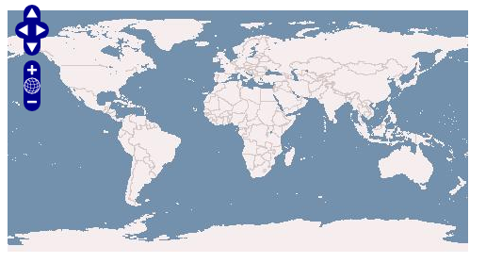
The Map
We should see

Slide 12
Dissecting the Code
We first need to include the OpenLayers library
  <script type='text/javascript' src='OpenLayers.js'></script>
The code works basically like this
  Create an HTML <div> to hold the map
  Create a global variable called map so we can access it outside the init() function
  Create an init() function that will create the map
  Call the init() function

Slide 13
Dissecting the Code – Step 1
Step 1 said to create a map object and div
  HTML Div:
    <div id='map_element' style='width: 500px; height: 500px;'></div>
  Javascript:
    map = new OpenLayers.Map('map_element', {});

Slide 14
Dissecting the Code – Step 2
Step 2 was to create a layer object and add it to the map
The first parameter is the layer's name, which will show up in things like the layer switcher control
The second parameter, the first { }'s, specify the parameters to send to the WMS server
The third parameter, the second { }'s is an optional options object with OpenLayer's layer specific setting (like opacity)
var wms_layer = new OpenLayers.Layer.WMS(
'OpenLayers WMS',
'http://vmap0.tiles.osgeo.org/wms/vmap0',
{layers: 'basic'},
{}
);
map.addLayer(wms_layer);

Slide 15
Dissecting the Code – Step 3
Step 3 said to create control objects
We didn't create any, so default controls will be used
  ArgParser
    Will parse arguments (if they exist) and zoom the map to passed in positions (used with permalinks)
  Attribution
    Allows us to add attributions (text) to the map for each layer
  Navigation
    Allows mouse dragging
  PanZoom
    The pan zoom bar on the left side

Slide 16
Dissecting the Code – Step 4
Step 4 was to zoom to some extent
Here, we do it the standard way
  First, we check to see if the map's center has already been set (via the argparser control if coordinates were passed in)
  If it's not set, we zoom to the map's max extent
if(!map.getCenter()){
map.zoomToMaxExtent();
}

Slide 17
How it Works
OpenLayers uses Object Oriented Programming (OOP)
  OpenLayers is divided into many classes
    Example: the Layer class, the Map class, etc.
To use the library, we basically create objects from the classes OpenLayers provides

Slide 18
OOP
So, to really do things, we need to create objects which we'll interact with
For example, in OpenLayers:
  Every map needs a map object created from the OpenLayers.Map class
To create objects in Javascript we do
  use the new keyword
  specify the class we want to create the object from
  specify any parameters to pass into the class

Slide 19
Creating an Object
We’ve done this with
  map = new OpenLayers.Map('map_element', {});
Here we’re creating an object called map from the OpenLayers.Map class
  Notice how we use the new keyword, then specify the class name OpenLayers.Map
We also pass into two parameters
  The ID of the div we want the map to go in
  An optional options object which specifies any additional settings we want the object to have

Slide 20
The Options Object
The options object is called an anonymous object or object hash.
This means, essentially, it is an object that is not created from a class
In Javascript, an anonymous object is compromised of key:value pairs separated by commas. For example
  var dummy_object_hash = { ‘answer’ : 42, 'question': undefined };
Why?
  Openlayers uses anonymous objects frequently to specify settings when create objects

Slide 21
The Map Class
OpenLayers' Map class is what drives our maps
Control and Layer objects belong to a map object
  Creating control objects or layer objects alone will not get us very far. These objects must be hooked up to a map if we want them to do anything.
So, we need a map object to actually make a map

Slide 22
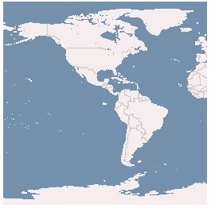
Create a Map Object
Let’s practice creating a map object from the Map class
We’ll use some custom settings using an anonymous object
Let's limit the map's extent to -180, -90, 0, 0
map = new OpenLayers.Map('map_element', {
maxExtent: new OpenLayers.Bounds(-180,-90,0,0)
});

Slide 23
More on the Options Object
In the previous example, maxExtent was our key and a OpenLayers.Bounds object was our value
The list of possible keys and values to use for options objects for all classes can be found in the OpenLayers docs
http://dev.openlayers.org/docs/files/OpenLayers/Map-js.html

Slide 24
Overriding Map Controls
By default, all maps get four control objects
  Let's override that by setting the controls property in the options object
How do we know what to set the value as? The docs tell us
  {Array(OpenLayers.Control)} List of controls associated with the map.
So, we'll need to pass in an array of control object
  If we pass in an empty array, the map gets no controls. Useful, for instance, if we want to show a static map for printing
map = new OpenLayers.Map('map_element', {
maxExtent: new OpenLayers.Bounds(-180,-90,0,0),
controls: []
});

Slide 25
The Layer Class
OpenLayers, as the name implies, allows multiple layers in a map
We can use WMS layers, OpenStreet Map, Google Maps, Bing, Yahoo, static images, the list goes on
All layers have an optional options anonymous object ( {key:value} pairs ) which specify OpenLayers specific things, like opacity
Let's make a little mashup with Google and WMS

Slide 26
Google + WMS Map
First we need to link to the Google Maps API
  We'll use v3 of the Google Maps API. To link to it:
Next, we'll set the map's projection to 'EPSG:900913' and set the map's maxExtent
  Projection created by 900913 (Google)
<script src='http://maps.google.com/maps/api/js?sensor=false'></script>
map = new OpenLayers.Map('map_element', {
projection: new OpenLayers.Projection('EPSG:900913'),
//set the bounds. This roughly translates to -180, -90, 180, 90
maxExtent: new OpenLayers.Bounds(-20037508, -20037508, 20037508, 20037508)
});

Slide 27
Projections
OpenLayers default projection is EPSG:4326
It also supports EPSG:900913, which is the projection used by third party APIs
  Google, Bing, Yahoo, ESRI, etc
We can do transformations between projections
Out of the box, only transformations between 4326 and 900913 work, but we can use Proj4js to support nearly any projection
  http://proj4js.org/
  http://spatialreference.org/
    Contains definitions for a ton of projections, can drop in to openlayers after including the Proj4js library

Slide 28
Google + WMS Map Con't.
Now, we create our Goolge layer
And then our WMS layer
  The WMS layer will attempt to use the map's projection, EPSG:900913, so be sure your WMS server supports it
var google_layer = new OpenLayers.Layer.Google(
'My Google Layer',
{}
);
var wms_layer = new OpenLayers.Layer.WMS(
'OpenLayers WMS',
'http://vmap0.tiles.osgeo.org/wms/vmap0',
{layers: 'basic'},
{opacity:.7, isBaseLayer: false}
);

Slide 29
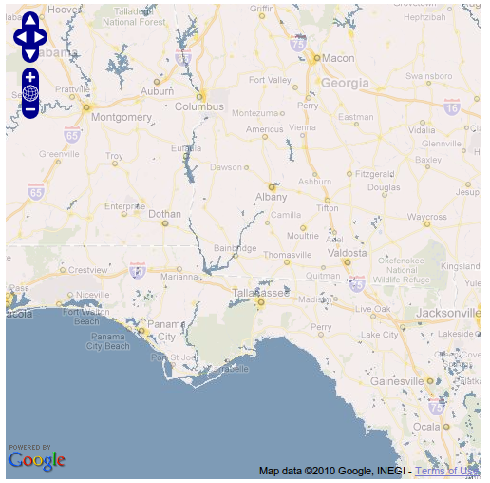
Result
Finally, we can call map.addLayers and pass in an array of layers to add to the map
  Last time, we passed in a single layer with map.addLayer
map.addLayers([google_layer, wms_layer]);

Slide 30
Control Class
The Control class lets us make our maps interactive
  No controls, no map interaction
One of the most basic controls, as we've seen, is the Navigation control
  Allows panning / zooming, added by default
Tons of additional controls
Very easy to create your own

Slide 31
Control Class Con't.
Let's add some controls to our map now
The basic format is
  var my_control = new OpenLayers.Control.CONTROL_NAME( {} );
  map.addControl(my_control);
The { } is an optional options object that controls control specific settings
  Possible keys and values change per control

Slide 32
Add Some Controls
Let's add some controls
There are a few different ways to add them
  e.g., addControl or addControls
//Create a control object then add it to the map
var layer_switcher = new OpenLayers.Control.LayerSwitcher({});
map.addControl(layer_switcher);
//Add some controls on the fly
map.addControls([
new OpenLayers.Control.ScaleLine({}),
new OpenLayers.Control.MousePosition({})
]);

Slide 33
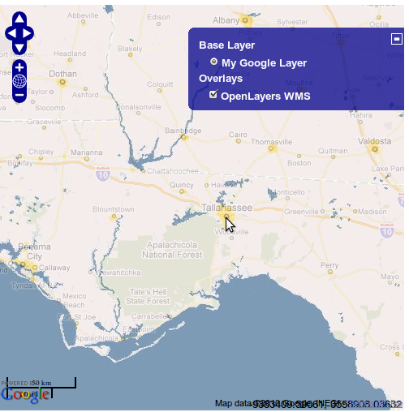
Result
We'll see something like this
  It's hard to see the scaleLine and mousePosition controls though

Slide 34
Styling Controls
We can style any control with CSS
  We can either modify the theme's CSS file
  Or include an external CSS file
  Or write the CSS inline
To keep things simple, we'll just do it inline
We'll need to include the !important keyword to make sure our CSS overrides the default theme's style
Styled via classnames, typically in the form of olControlCONTROLNAME

Slide 35
Some style
We'll add this inside the <head> tag
<style>
.olControlMousePosition {
background: rgba(220,220,220, .8) !important;
color: #336699 !important;
font-size:1.2em !important;
padding:0 0 1em 0 !important;
}
.olControlScaleLine {
bottom:75px !important;
font-family: 'Arial', sans-serif !important;
font-weight: bold !important;
position:absolute !important;
right: 0 !important;
}
</style>

Slide 36
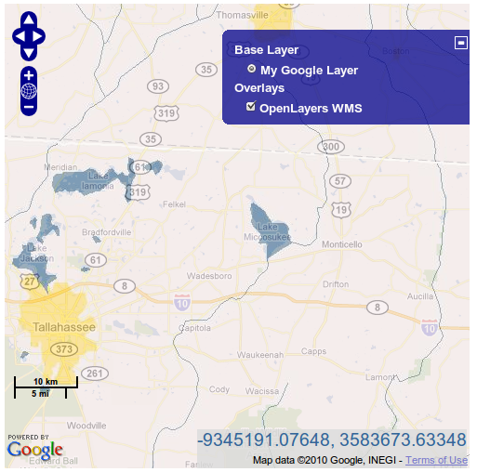
Result
And we'll see something kind of ugly

Slide 37
Using Vectors
We can use the Vector Layer class to create a vector layer
  Rendered with either SVG, Canvas, or VML
    You can choose which one, SVG by default
Vector layers contain Features, which are basically the objects in the vector layer
  Points, polygons, lines, etc.
Let's add a Vector layer and a EditingToolbar control which lets us place features (vector objects) on the map

Slide 38
Vector Layer
Create a vector layer and editingToolbar control
  Must pass in vector layer object to the control
//Add a vector layer
var vector_layer = new OpenLayers.Layer.Vector(
'Vector Layer',
{});
//add it to the map
map.addLayer(vector_layer);
//add an editing toolbar to the map
map.addControl(new OpenLayers.Control.EditingToolbar(vector_layer));

Slide 39
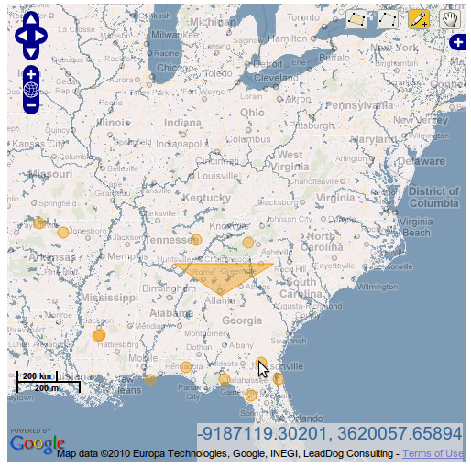
Result
Add some features

Slide 40
Adding Features + Style
We can load in features from KML, GML, GeoJSON, and other formats
We can also dynamically create them
  Make sure you use coordinates in the right projection
Let's create some features with random points
  We'll call transform on the point coordinates to turn them from EPSG:4326 (lon / lat) to EPSG:900913

Slide 41
Add Them
The code
//Create some points
for(var i=19; i>=0; i--){
//call the addFeatures method of the vector layer object
vector_layer.addFeatures([
//An openlayers feature.vector object
new OpenLayers.Feature.Vector(
new OpenLayers.Geometry.Point(
(Math.floor(Math.random() * 180) - 90),
(Math.floor(Math.random() * 180) - 90)
).transform(new OpenLayers.Projection('EPSG:4326'),
new OpenLayers.Projection('EPSG:900913'))
//transform takes in two projection objects
// the first is the source projection, second is the target
)]);
}

Slide 42
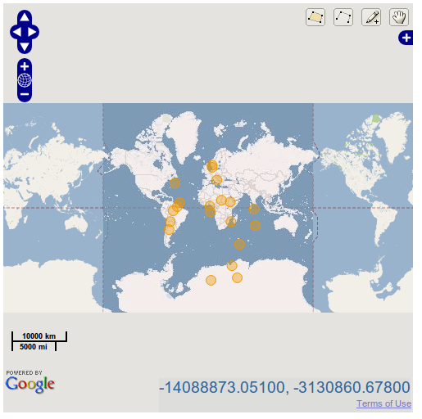
And We Get

Slide 43
Styling Vectors
To style a vector layer, we'll use a StyleMap object which maps Style objects to 'renderer intents'
  A render intent is basically a 'state' of the map
    Possible values are 'default', 'select', 'temporary', 'delete'
Process is to:
  1. Create a style object
  2. Create a style map object, use key: value to apply intent: style object
  3. Add style map object to vector layer

Slide 44
Style Map code
Style object contains a symbolizer
  A symbolizer is basically just an anonymous object, { key:value } pairs
  Similar to CSS
var vector_style = new OpenLayers.Style({
cursor: 'pointer',
fillColor: '#aaee77', fillOpacity: .8,
pointRadius: 8
strokeColor: '#669933', strokeDashstyle: 'solid',
strokeWidth: 4
});
var vector_style_map = new OpenLayers.StyleMap({
'default': vector_style
});
//Add the style map to the vector layer
vector_layer.styleMap = vector_style_map;

Slide 45
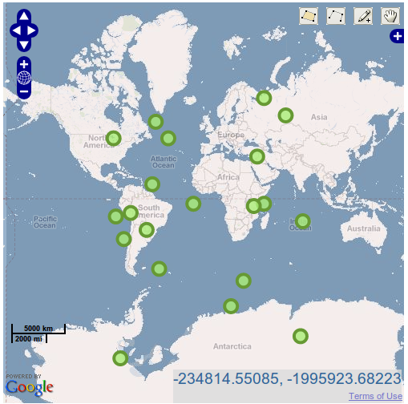
And We Get

Slide 46
Attribute Replacement
We can also use attribute replacement
  Looks at a feature's properties and applies values to the style object
Uses the syntax '${attribute_name}'
  The attribute_name is a property inside the feature's attribute object

Slide 47
Attribute Replacement
First we'll add a property to the OpenLayers.Feature.Vector objects we generate
Next, we just use the replacement syntax in our vector_style object
new OpenLayers.Geometry.Point(
(Math.floor(Math.random() * 180) - 90),
(Math.floor(Math.random() * 180) - 90)
).transform(new OpenLayers.Projection('EPSG:4326'),
new OpenLayers.Projection('EPSG:900913')),
{
//Properties each feature will get
point_size: (Math.floor(Math.random() * 30))
}
pointRadius: '${point_size}',

Slide 48
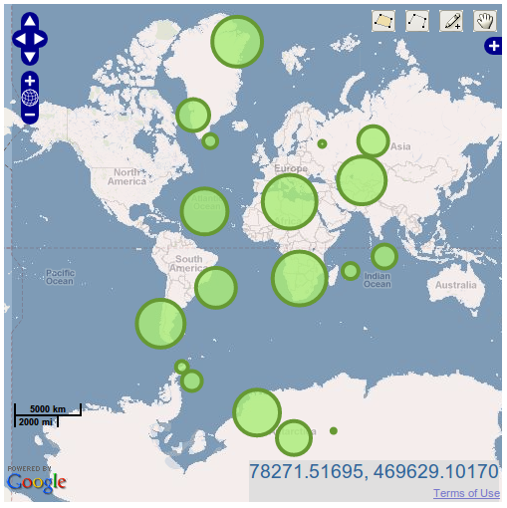
And We Get

Slide 49
What Else
We can load in data from WFS servers, static KML / GeoJSON files
We can also use Rules and Filters to get even more fine grain control over how our features are styled
We can use Strategies to affect the way features behave (e.g. clustering, like in the screen shot at the beginning)

Slide 50
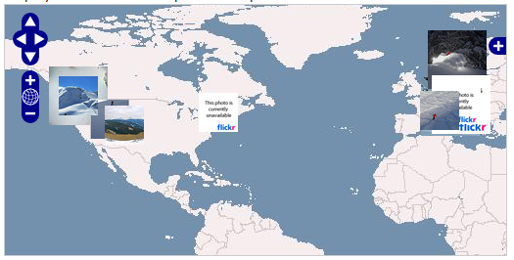
What Else Con't.
Tons more we can do – load in images from Flickr, for instance

Slide 51
What Else (Almost Done)
OpenLayers is extremely powerful, but pretty easy to use
Tons of great resources to help get you started
  Tons of examples with code
    http://dev.openlayers.org/releases/OpenLayers-2.10/examples/
  OpenLayers Docs
    http://dev.openlayers.org/docs/files/OpenLayers-js.html
  Mailing List
    Can access through a web interface at nabble
      http://osgeo-org.1803224.n2.nabble.com/OpenLayers-f1822462.html

Slide 52
Questions?
Questions?
Me – Erik Hazzard
  vasir.net
    Tutorials, blog posts on OpenLayers
  OpenLayers 3.0: A Beginner's Guide and Manual
    Expected publish date Q1 2011

