Slide 1
Computer Graphics
Final Project
Erick Ibarra A00959090
Marc Abonce A01200356
Benjamin Van Renterghem A01677076

Slide 2
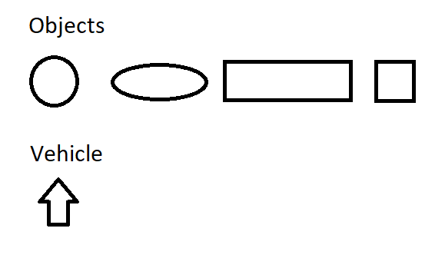
Items
The players/users will be able to control the vehicle they are racing with. With the arrow keys they can move forward, left and right.
Small 1 or 2 unit blocks will appear on roads, this will have to be shot by the mouse. If they are not shot, you can crash with them and lose time.

Slide 3
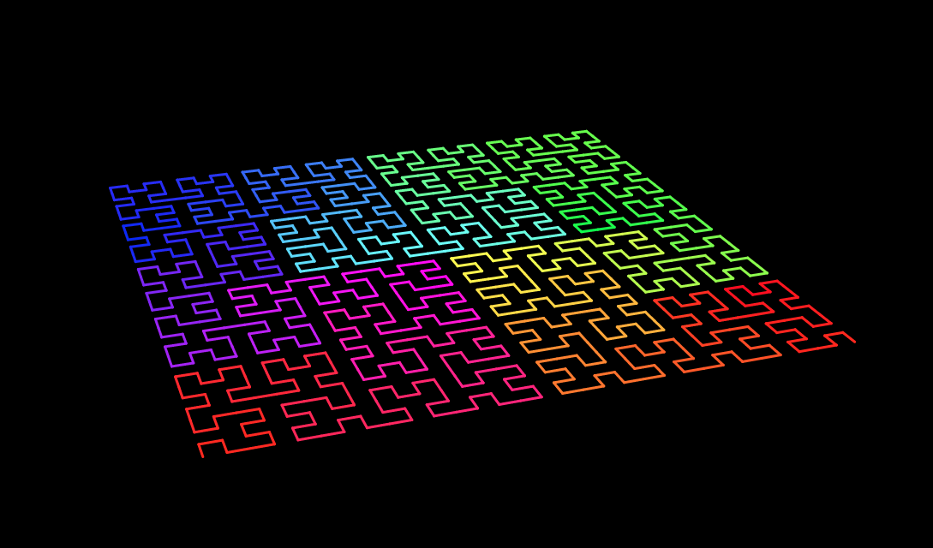
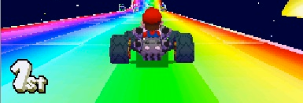
Scenery and Colors
Black background with rainbow roads.
Automatically generated roads.
Color palette inspired by Tron and Mario Kart.

Slide 4
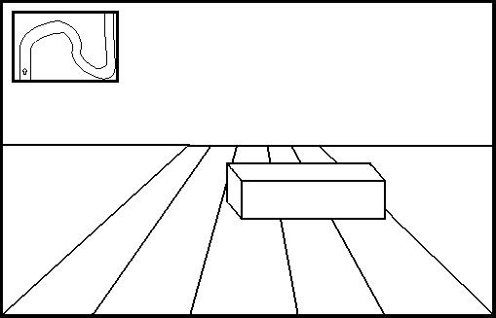
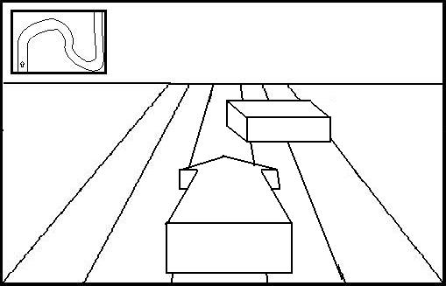
Interface
Game interface with both first and third person point of view cameras.
Road map on top corner.

Slide 5
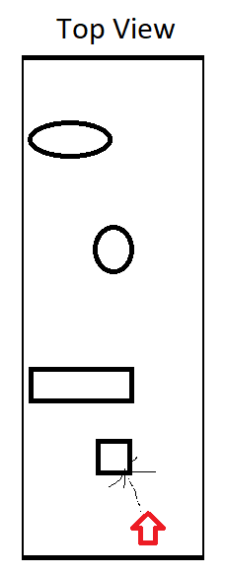
User Interaction
Users can:
Move their car with the arrow keys.
Shoot object by clicking with the mouse. Bullets will be limited to 3 and will require 5 seconds to reload.

