Slide 1
DEVOPS

Slide 2
BACKGROUND
The last stage of full-stack software development is devops.
This division discusses testing, building, and deploying to the internet.
A tradtional deployment process for a small app is just a matter of running a few command lines and send the application on the internet. However, for larger applications, this process is often automated using CI/CD pipelines using Jenkins.

Slide 3
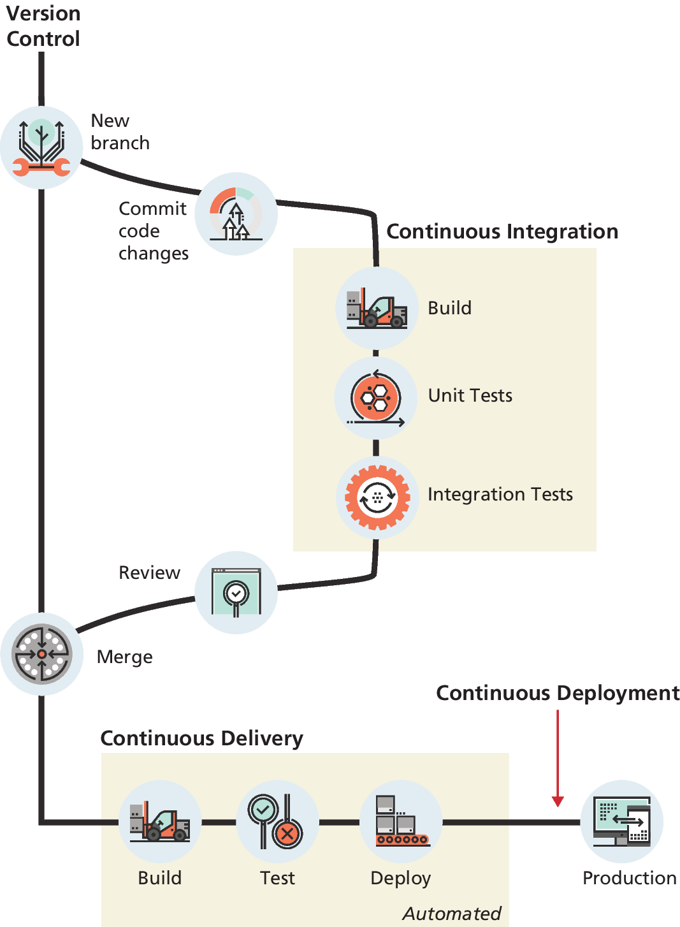
CI/CD
Continuous Integration (CI): aspires to shorten development cycles by making each developer integrate their changes against a central code repository as often as possible.
The term Continuous Delivery (CD): refers to this practice of automating the release process.
The logical continuation of Continuous Delivery is Continuous Deployment, in which changes in the source code that passes the tests within a continuous integration cycle is automatically deployed to production without the intervention or approval of the developer.

Slide 4
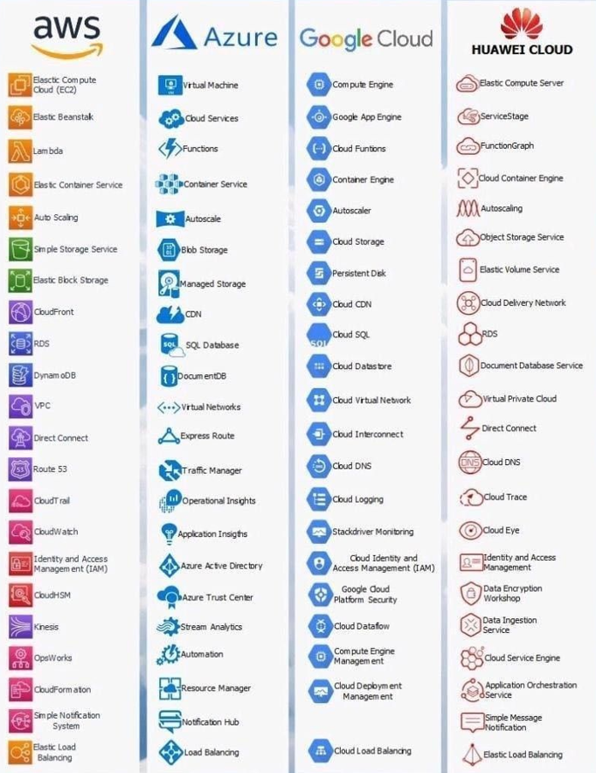
DEPLOYING
When deploying, it’s important to pick the right technology for the job.
Some hosting solutions are better for security, scaling, or performance.
The most popular plans include AWS and Azure.

