Slide 1
FORMS

Slide 2
OVERVIEW

Slide 3
OVERVIEW
Review importance of forms and their structures.
Review common form controls such as textboxes and dropdowns.
Review JavaScript libraries such as bootstrap, moment, and processing.

Slide 4
BACKGROUND
Forms are flagship products of full-stack development.
They provide a way for users to input information that can interact with a web server.
Users can enter text, choose items from lists, and click buttons.

Slide 5
FORM STRUCTURE
Forms are constructed in HTML similar to the way tables are created.
A form is usually defined with a <form> element. Only one <form> element should be included in a page.
A form can be processed server side using PHP, ASP.NET, ASP, or Java.

Slide 6
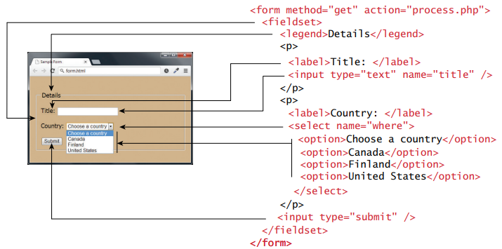
FORM STRUCTURE

Slide 7
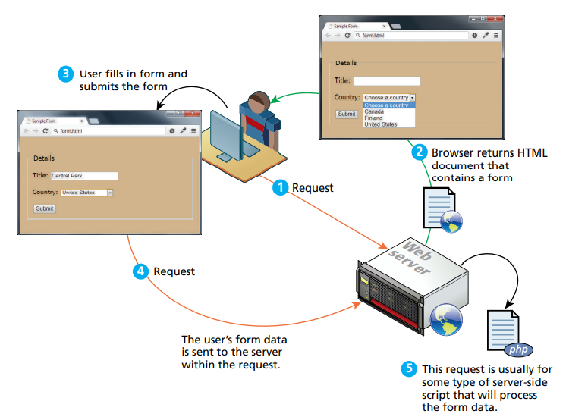
FORM PROCESSING

Slide 8
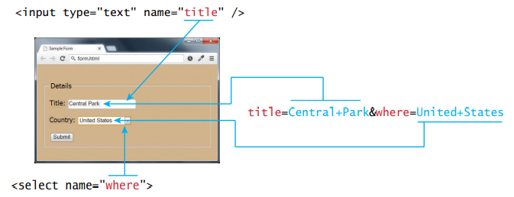
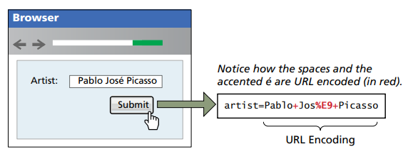
QUERY STRING

Slide 9
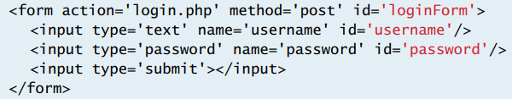
BASIC FORM

Slide 10
INPUT CONTROLS

Slide 11
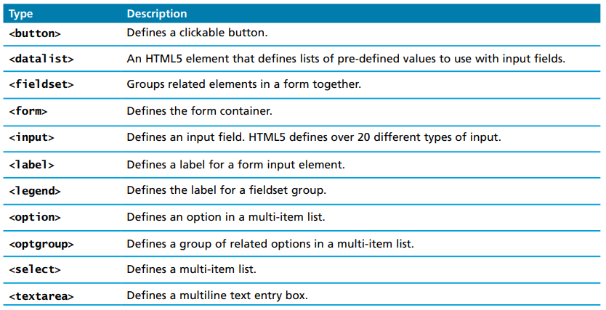
INPUT CONTROLS

Slide 12
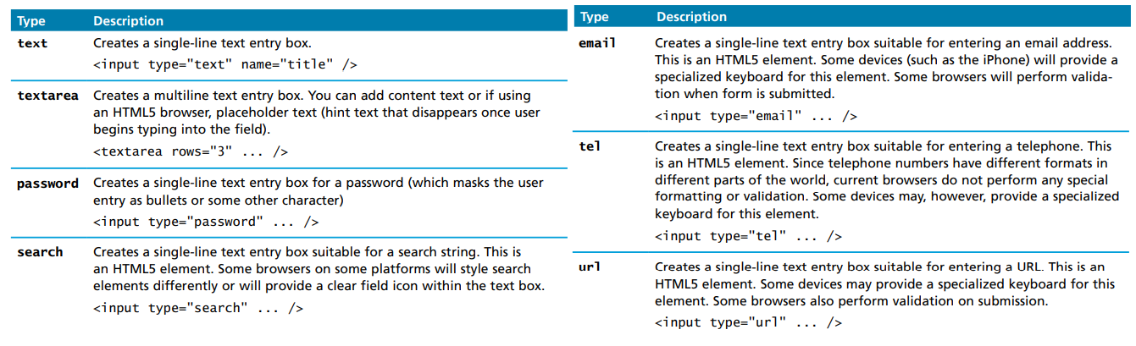
TEXT INPUT CONTROLS

Slide 13
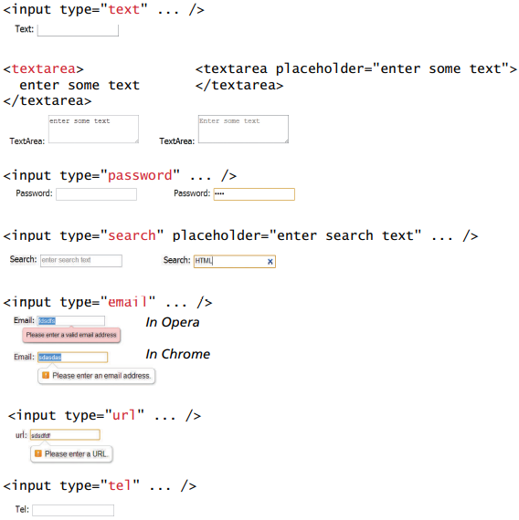
TEXT INPUT CONTROLS

Slide 14
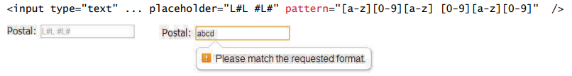
TEXT INPUT CONTROLS

Slide 15
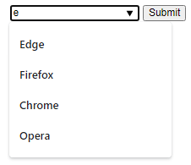
DATALIST CONTROL
The datalist control is an HTML autocomplete control.
The user has to type a series of keyword for the item to show up.
This control can save a lot of time for long lists of items on terms that the user doesn’t fully remember.

Slide 16
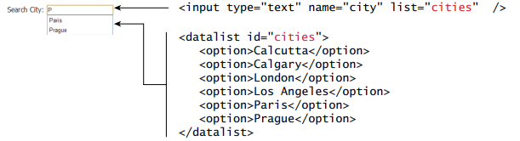
CHOICE CONTROL
Choice controls are often used to let the user select an option from a group of existing choices.
These include radio buttons, checkboxes, or dropdowns.
The value attribute of the option element is what is sent back to the server.

Slide 17
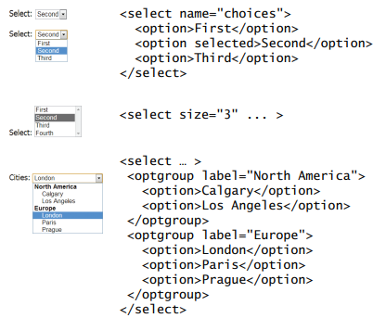
CHOICE CONTROL

Slide 18
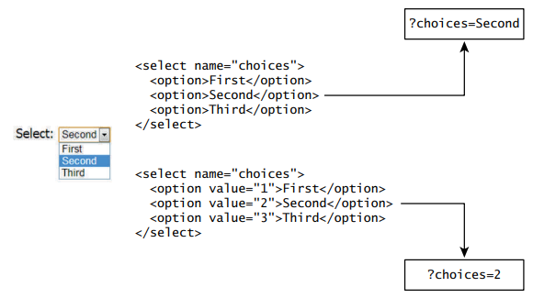
CHOICE CONTROL

Slide 19

CHOICE CONTROL

Slide 20
RADIOS
Radio buttons are useful when the user wants to select a single item(mutually exclusive) from a list as opposed to checkboxes.
Radio buttons take more space than dropdowns but they only require 1 click, as opposed to 2 clicks.

Slide 21
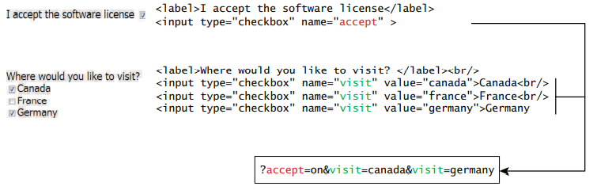
CHECKBOXES
Checkboxes are used for binary(yes/no) responses from users.
Checkboxes can be grouped but are not necessarily mutually exclusive.

Slide 22
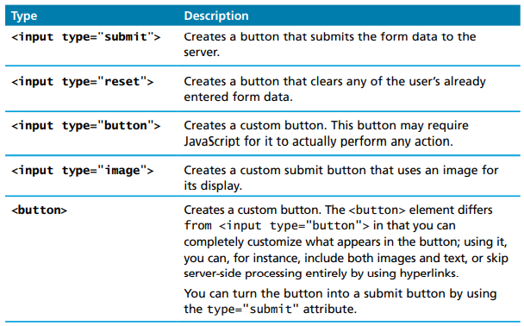
BUTTONS

Slide 23
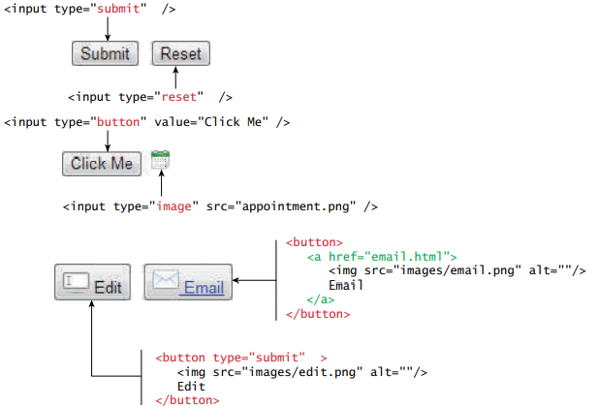
BUTTONS

Slide 24
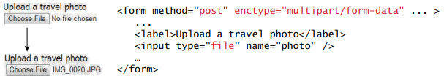
BUTTONS

Slide 25
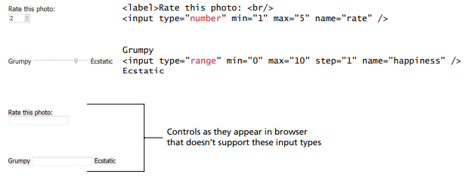
INPUT TYPES

Slide 26
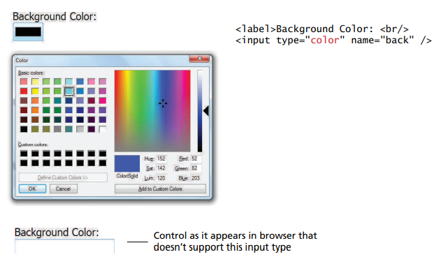
INPUT TYPES

Slide 27
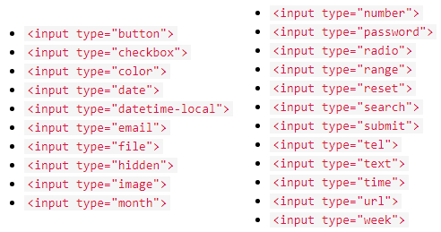
INPUT TYPES

Slide 28
INPUT ATTRIBUTES
The ‘value’ attribute is used to define the value of an input.
The ‘readonly’ attribute removes the ability to edit an input.
The ‘disabled’ attribute sets an input field to be unusable and un-clickable.
The ‘size’ attribute specifies the visible width, in characters, of an input field.
The ‘multiple’ attribute allows the user to enter more than one value.
The ‘pattern’ attribute is used to add regex to an input.
The ‘placeholder’ attribute is used to enter pre-text on an input.
The ‘required’ attribute is used to assure that a value is entered on an input.

Slide 29
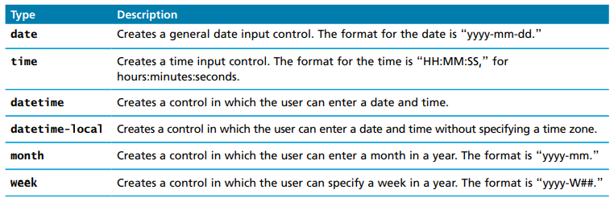
DATE TIME PICKERS
Asking user to pick dates and times is very common in web development.
Dates are known to be very tricky in software development, because not only do they come in many different formats(MM/DD/YY or YYYY/MM/DD) but also that they can be affected by daylight savings time, time zones, and server locations.

Slide 30
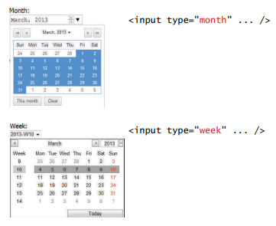
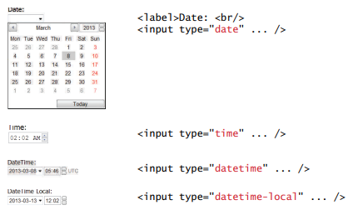
DATE TIME PICKERS

Slide 31
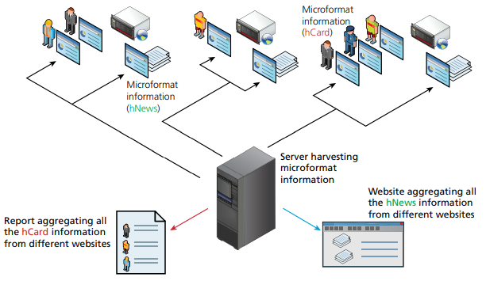
MICROFORMATS
Microformats are standard formats used for common page attributes like contact information.
They are useful for maintaining consistency when running web scraping scripts.

Slide 32
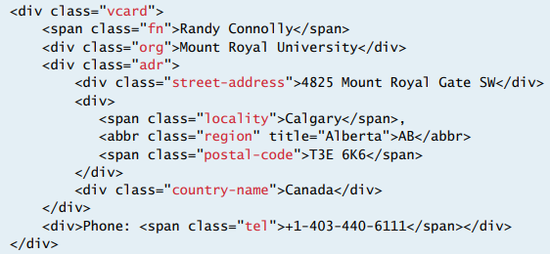
MICROFORMATS

Slide 33
VALIDATION

Slide 34
VALIDATION OVERVIEW
Validation is the process of making sure that user inputs are valid before submitting.
Writing code to pre-validate forms side will reduce the number of incorrect submission on the backend.
Although most validation occurs on the server side (since client-side JavaScript can be circumvented), JavaScript pre-validation is best practice.
Common validation includes required, email, phone, and number entries.
It is common to validate using regex.
Most people are not familiar with regex, and will often copy something from the internet not understanding how it works.
Invalid results can be notified with an alert that triggers on submit or an inline validator. Most libraries include textboxes with built-in validators.

Slide 35
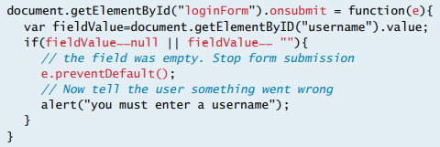

EMPTY FIELD VALIDATION
The most common validation is making sure a user entered something into a field. There’s no reason to save an empty entry in a database.
Checkboxes may require different validation compared to textboxes.

Slide 36

NUMBER VALIDATION
It’s also common to validate for numbers, because downstream operations may expect numbers only from the database, and may fault otherwise.
Common ways to check for numbers in JavaScript is using parseInt(), isNAN(), and isFinite()

Slide 37
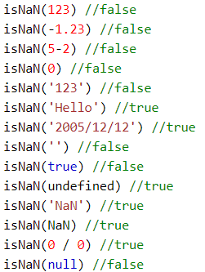
ISNAN()

Slide 38
DESIGN CONSIDERATIONS

Slide 39
ACCESSIBILITY
Accessibility deals with the process of viewing the contents of pages to all users.
For instance, color blind people may only see certain colors or users with muscle issues may have trouble accessing a mouse.
To address this, the W3C created the Web Accessibly Initiative(WAI) in 1997.
It provides text, content, and display alternatives to help make everything easy to access by many.

Slide 40
TABBING
In every app, pressing TAB causes the browser to focus on the next sequential control input, going from left to right and top to bottom.
Some inputs want to be skipped during this tabbing process, and this is achieved by adding a tabindex=“-1” as an attribute of the html element to skip.
One key difference between readonly and disabled textboxes is that disabled textboxes can’t be focused.

Slide 41
CLICK COUNT
When choosing a control input, it’s important to reduce click count as much as possible.
For example, a dropdown requires 2 clicks, one to open the list, and another to select. A radio button only requires one click to select. However, a radio button takes more space than a dropdown.
On some occasions, consistency has more precedence than click count. If the entire form has dropdowns, it’s best to keep them all dropdowns, even if one of the lists only has 2 items.

Slide 42

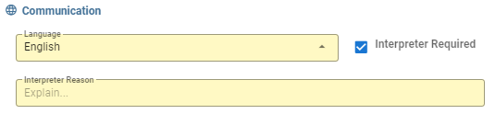
HIDING UNUSED TEXTBOXES
It’s good practice to hide UI elements that are irrelevant to the user.
For instance, if a checkbox is only relevant for user of type A, that checkbox should be hidden for that user, instead of making it read only, or keeping it there.
Textbox pops when this checkbox is checked

Slide 43
SIMPLICITY
A good form is simple and intuitive.
It’s easy to get carried away on a complicated form and keep adding UI components as required by the use case specifications. However, the real art in designing a good form is consolidating inputs into very few elements.
A good example of this is the difference between Robinhood and TD Ameritrade. On Robinhood, a single textbox is used to figure out the stock specified i.e. the user can type code, description, or company name and Robinhood will figure out the desired result whereas TD Ameritrade uses 5 hard-coded textboxes with several lookup tables that are very confusing to use.

Slide 44
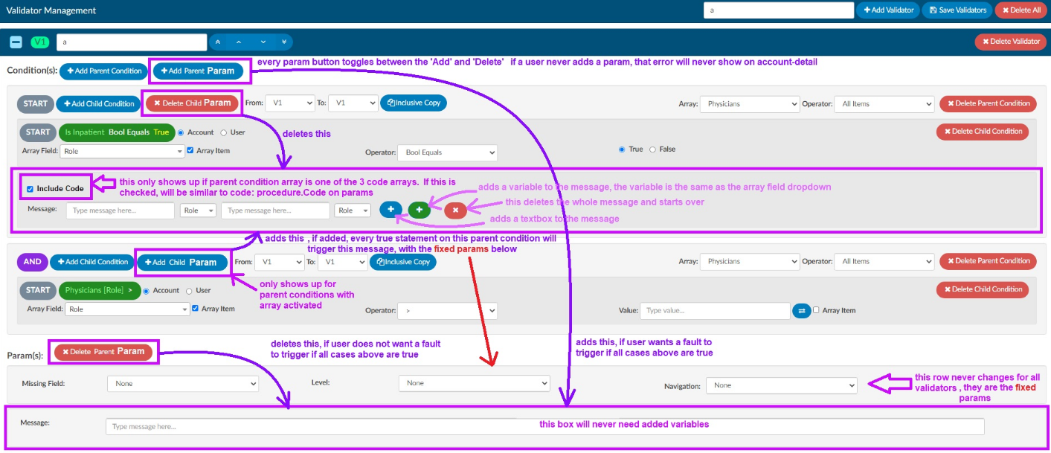
SIMPLICITY

Slide 45
UNDO
On some forms that require heavy editing, an undo button is often required.
When designing an undo button, it’s best not to reverse engineer every user event, because that could be difficult to maintain.
One way to achieve this is by creating an array that records every user event. On every event, this array runs through each instruction from start to finish. On undo, the last event is popped out of the array, and the instructions continue to run from start to finish, up to the last event.

Slide 46
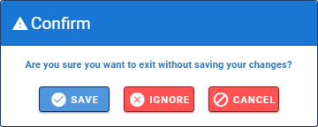
DIRTY CHECKING
Every form should include some form of dirty checking.
Dirty checking is the process of alerting the user of any changes that were unsaved.
The best way to achieve this is by making a deep copy of the original structure and comparing it to the modified structure any time the user navigates away from the page. If the 2 structures are different, then a confirmation alert will prompt.
This method is much more maintainable than setting a dirty flag for every button clicked or every textbox changed.

Slide 47
AUDITING
Every form should include some form of auditing.
Auditing is the process of recording user changes in the database.
This can include user events or data structure changes that were made on certain fields.

Slide 48
CONCURRENCY
There comes a time where more than 1 user is loading a form that is accessing the same database.
This can cause problems, because data becomes stale, after it’s loaded by the 1st user, after the 2nd user made changes to the database.
One of the common ways to address this is by using a chat room service whenever more than 1 user is accessing a form. This chat room service allows both users to communicate with each other, so that changes are made in unision.

Slide 49
SUBMISSION
The last step of using a form is submission.
It is common to bind the submit button with the ENTER key-press event.
In the submission function, it’s common to follow this sequence of events before saving the data to the database:
Validate for data entry errors and notify accordingly
Condition data for correct fields
Save the data to the database
Audit the modifications
Update the original copy to reset the dirty flag
Notify user success

Slide 50
