Slide 1
ARCHITECTURE

Slide 2
BACKGROUND
Applications can be written in many different shapes and forms.
There is no one size fits all in software.
Some of the most common architectures include monolith and microservice architectures.

Slide 3
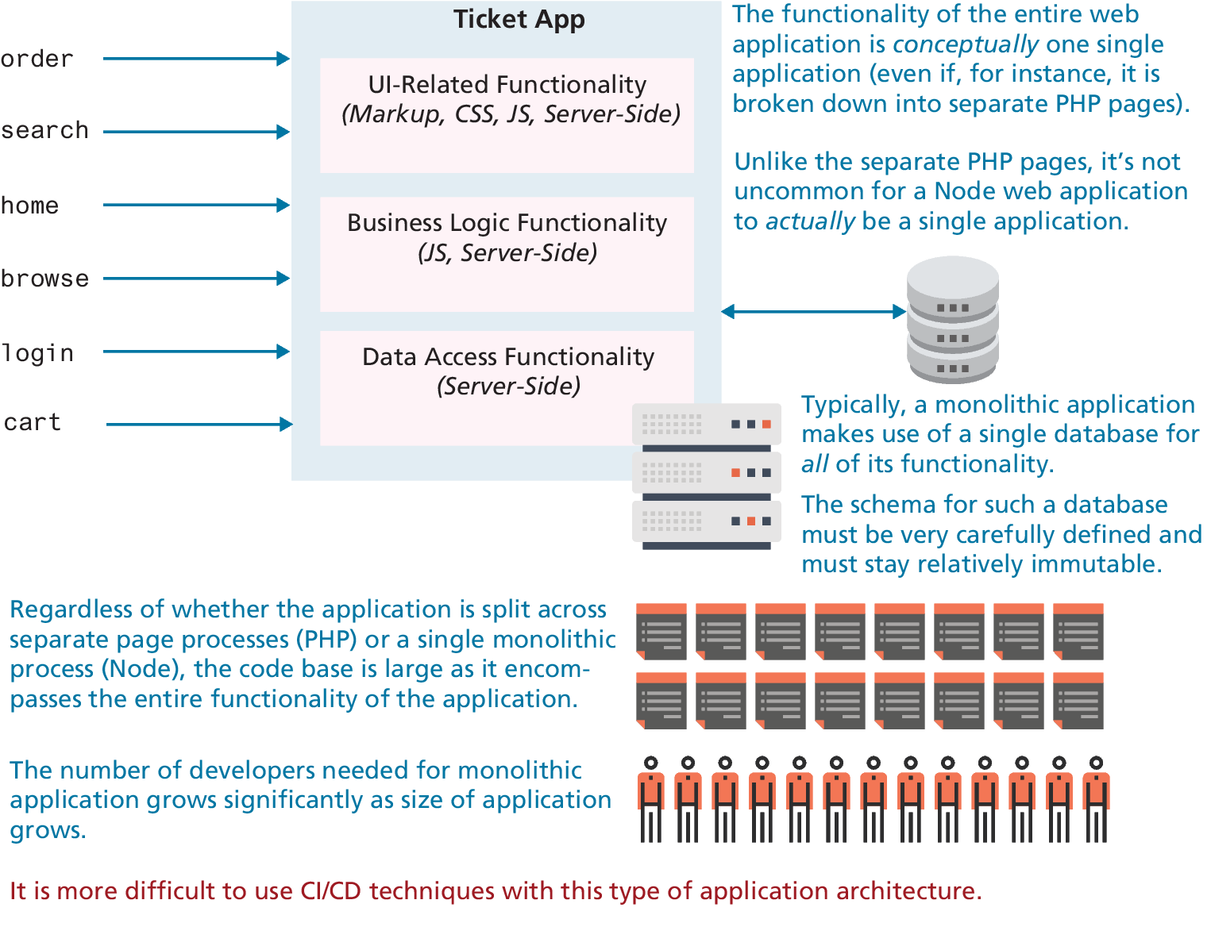
MONOLITH ARCHITECTURE
In a monolithic architecture the code base—encompassing, HTML, CSS, JavaScript, and whatever server-side language files are being used.
Such an architecture, with dozens if not hundreds of dependencies, is difficult to understand, test, maintain, and expand.

Slide 4
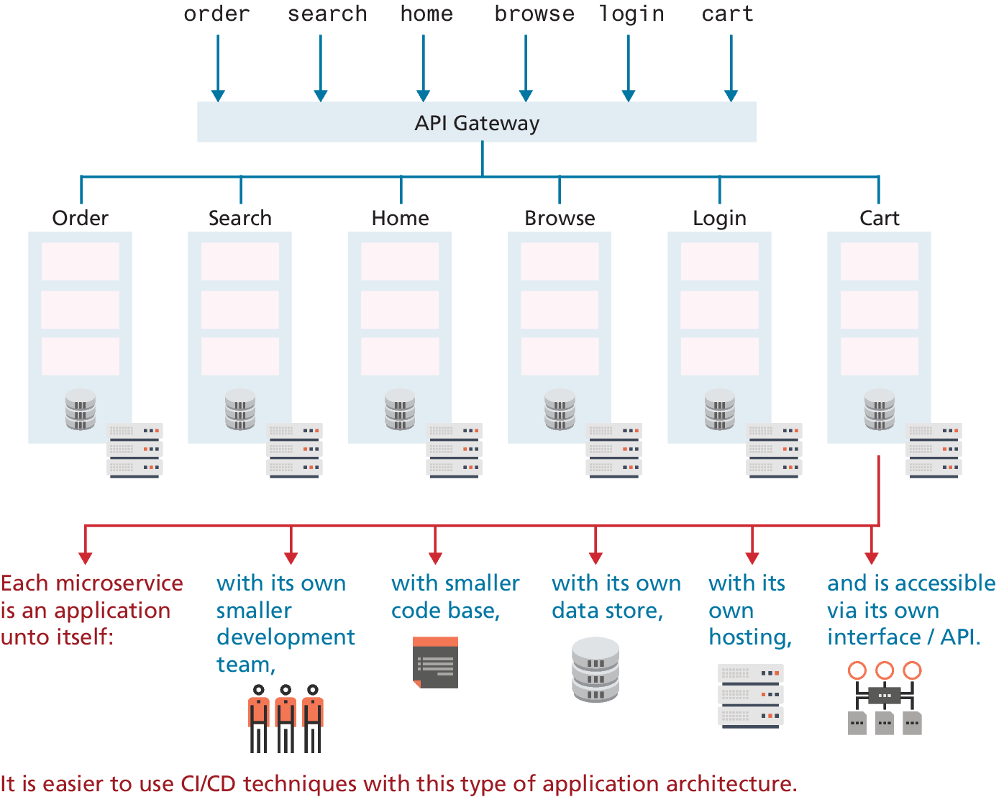
MICROSERVICE ARCHITECTURE
Microservice architecture—disaggregates the single monolith into a system comprising many small, well-defined modules, scripts or programs.
The advantages of a microservice architecture is that it encourages distributed, non-centralized code bases and teams.

