Slide 1
AUTHENTICATION

Slide 2
BACKGROUND
Authentication is the process of assuring that a user has the right to view a certain page or feature of an app.
Authentication can take the form of users providing usernames/passwords, fingerprint detection, or facial recognition.
The field of security has a big hand on proper authentication.

Slide 3
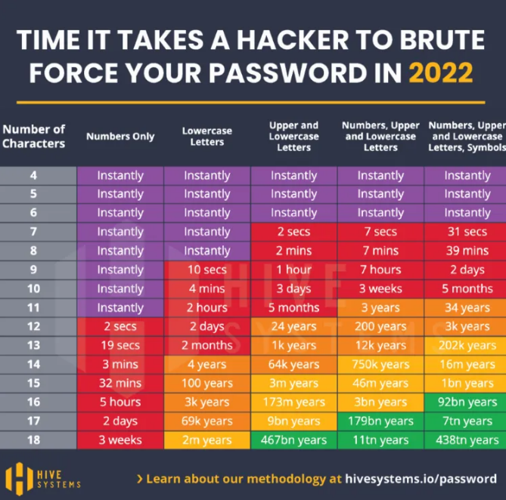
SECURITY
PASSWORD SELECTION
Passwords should not be a password you used on other apps. The reason for this is because some apps are not as secure as others, and when they are compromised, they will use that password on your other apps and gain access, especially when most apps do not use 2-factor authentication.
Passwords should also be long with a variety of characters because it takes longer to crack those passwords.

Slide 4
DESIGN CONSIDERATIONS
Authentication usually occurs on backend scripting because it is more secure than on client-side scripting.
It is better to authenticate with libraries such as express-user-management or express-openid-connect. These libraries will store the user profiles on their own servers, so that data becomes separate from your application database. These libraries also provide standard features like logging in using your Google or Facebook account, loging out, or features for resetting your password if you forgot it.
It’s important that authentication is maintained throughout every page of the app, otherwise if someone has the URL of an admin page, they can simply paste it on a browse and gain access.

Slide 5
DESIGN CONSIDERATIONS
Add 20 min inactivity timeouts.
Add a lock after 5 log attempts with a 3 - 5min delay.

Slide 6
PASSWORDS
Passwords should never be processed on the client side, only server side.
Passwords should never be stored as is, they should be hashed. Hashes manipulates strings into bit-type chars that are difficult to decrypt.
It is better to store hashes instead of passwords.

