Slide 1
BOOTSTRAP

Slide 2


Slide 3
BACKGROUND
Bootstrap a library used mainly for frontend UI element development.
It is used to standardize textboxes and dropdowns.
It includes forms, buttons, typography, tables, navigation, tables, and modals.
It is often used for responsive design.
Boostrap was developed by developers at Twitter and was the first project on gitHub back in 2011.
When importing Boostrap, some of the standard HTML tags like <h1> or <small> may look different, because Boostrap will overwrite those standard tags.

Slide 4
IMPORTING
The preferred way to import is to use the npm install command.
Another way is to insert the CSS and JavaScript links(shown below) on the index.html file:
<link rel='stylesheet' href='https://maxcdn.bootstrapcdn.com/bootstrap/3.3.2/css/bootstrap.min.css'>
<script type="text/javascript" src='https://maxcdn.bootstrapcdn.com/bootstrap/3.3.2/js/bootstrap.min.js'></script>

Slide 5
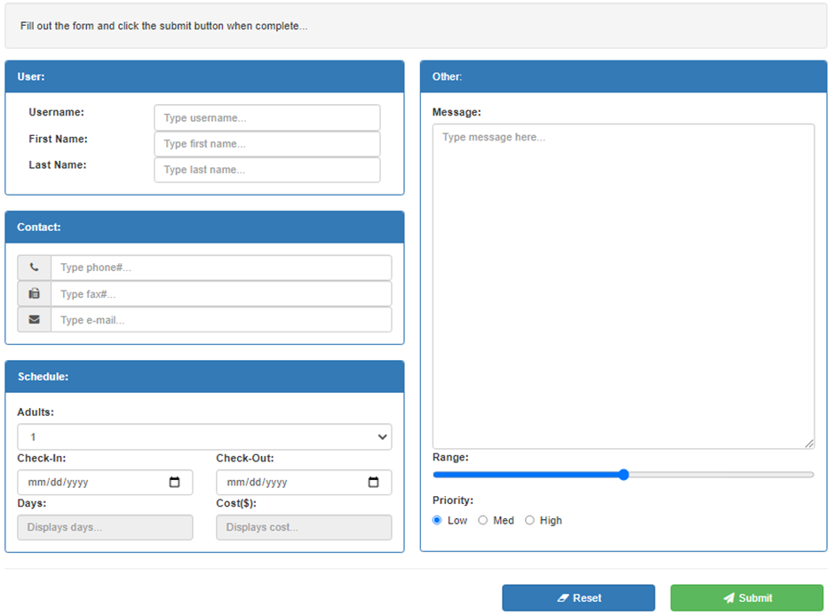
EXAMPLE

Slide 6
GRID SYSTEMS
Grid systems are used to properly organize the elements of a page, including labels, textboxes, or checkboxes.
Layouts are mainly used to organize the bulk containers like panels and headers, whereas the grid system is used to organize the inner components.

Slide 7

GRID CLASSES

Slide 8
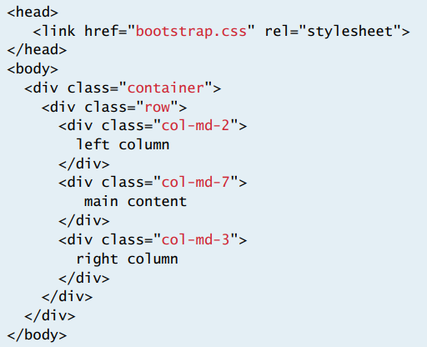
THE RULE OF 12
Most grid systems adapt a 12-col grid system.
It is critical that the width of each row does not add up to more than 12-cols, otherwise the page will overflow.
Each row and col uses the <div> element with classes defined by the framework.

Slide 9
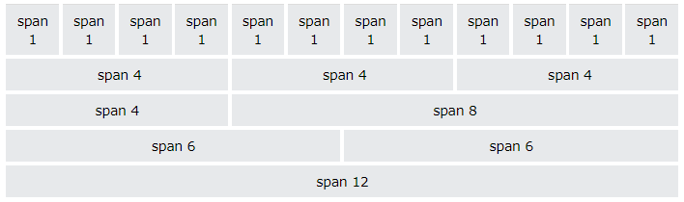
THE RULE OF 12

Slide 10
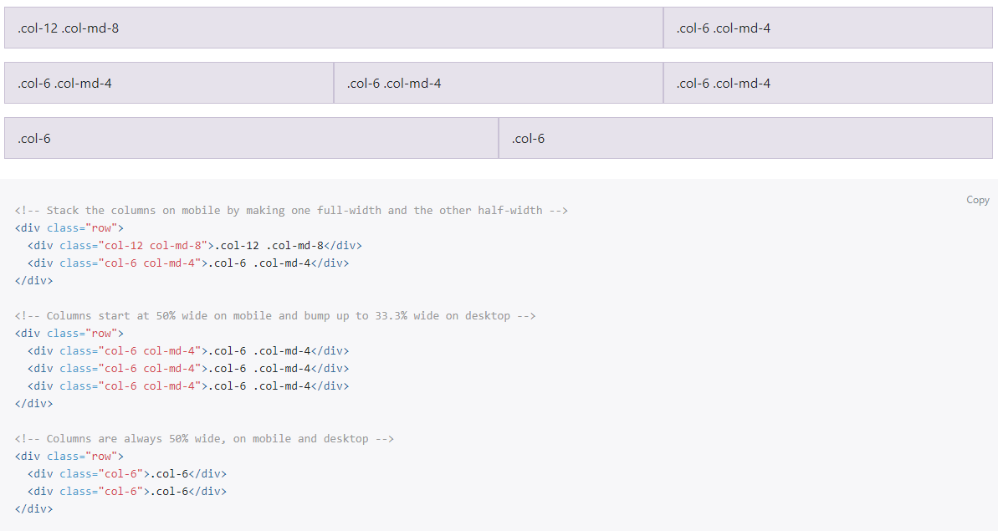
DON’T GO OVER 12

Slide 11
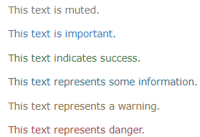
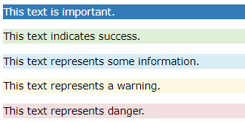
TYPOGRAPHY
Bootstrap has a series of classes that can be applied for standard text colors and highlight colors.
It’s good to use these built-in Bootstrap classes to maintain consistency so that all text and highlights are using the same colors.

Slide 12
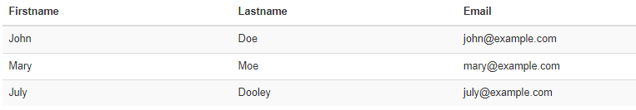
TABLES
Bootstrap can also be used for tables.
By applying the ‘table’, ‘table-bordered’, ‘table-striped’, and ‘table-hover’ class, a table can look much more professional from the default HTML table.

Slide 13

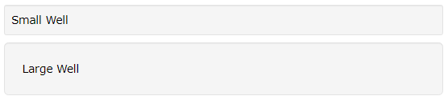
WELLS
The .well class adds a rounded gray section around an element with padding.
These are good for keeping information organized on a web page.

Slide 14
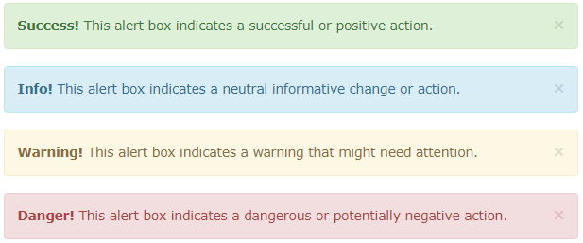
ALERTS
Bootstrap has its own version of alerts but they are not commonly used.
Alerts are defined with the alert-success, alert-info, alert-warning, or alert-danger classes.
It’s best to use Toastr for alerts.

Slide 15

BUTTONS
Bootstrap also has a series of button styles, similar to Vuetify and JQuery UI.
The btn class must be used to apply the button style, and another class can be applied to apply style, such as btn-default, btn-primary, btn-success, btn-info, btn-warning, btn-danger, or btn-link.
Size classes can also be applied with btn-lg, btn-sm, btn-xs.

Slide 16


BUTTON GROUPS
It’s good to group buttons together if they’re related.
This can save a lot of space in a form and keep a page intuitive.

Slide 17


BADGES
Badges are used to reinforce an indicator.
They are often used to indicate counts.

Slide 18
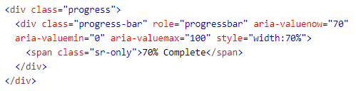
PROGRESS BARS
A progress bar is used to show the progress of a long task.
It is applied using the progress and progress-bar classes.

Slide 19

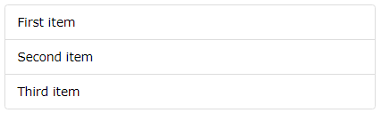
LIST GROUP
Bootstrap has a much better way of displaying lists than the standard <ul> or <ol> HTML tags.
The list can be applied using the list-group and list-group-item classes.

Slide 20

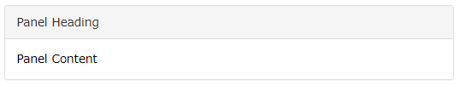
PANELS
Panels are similar to wells, but they are better for sections that need a header.
To apply a panel, a panel-heading, and panel-body should be applied.

Slide 21
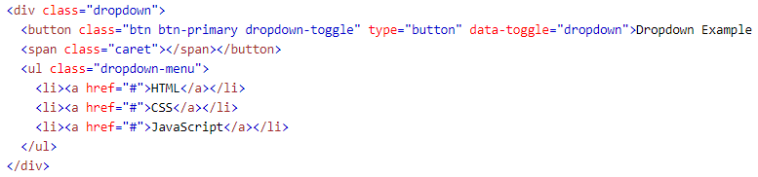
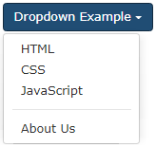
DROPDOWNS
Bootstrap also has a standardize class for dropdowns.
It is applied using the dropdown and dropdown-toggle classes.

Slide 22
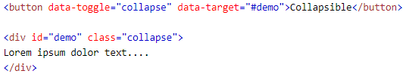
COLLAPSE
Forms that have a lot of content should have a way to be collapsed, otherwise it may intimidate the user.
To make an element collapsible, the collapse class can be used with collapse assigned to a data-toggle attribute.

Slide 23
FORMS
It’s good to use Bootstrap form classes when designing forms because they use a set of standard inline and block spaces that are often seen in industrial applications.
Some of the most common Bootstrap form classes are form-group, form-control, and form-inline.
It’s important to include these divs inside an HTML <form> tag to take advantage of form HTML, such as the type=‘submit’ attribute that allows pressing the ENTER button to click the submit button.

Slide 24
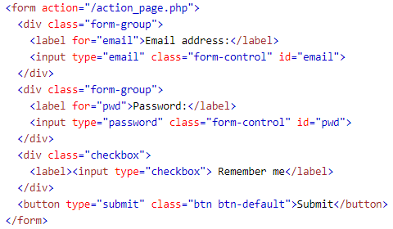
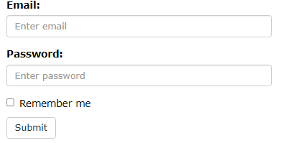
FORMS

Slide 25
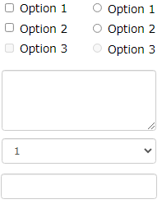
INPUTS
The form-control class supports all sorts of HTML controls such as textboxes, textareas, checkboxes, radios, and selects.
A label should be applied to each control input by using the Bootstrap <label> tag to wrap the label text.

Slide 26
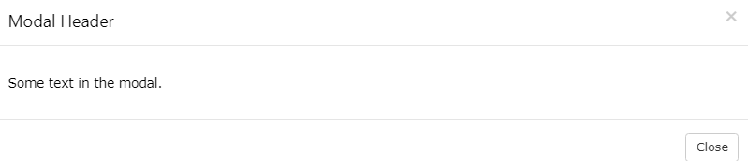
MODALS
Modals are good for displaying additional information that would otherwise crowd the form.
Modals should not contain more than a few controls or a few paragraphs of information. If more information is required, a separate page should be created.

Slide 27
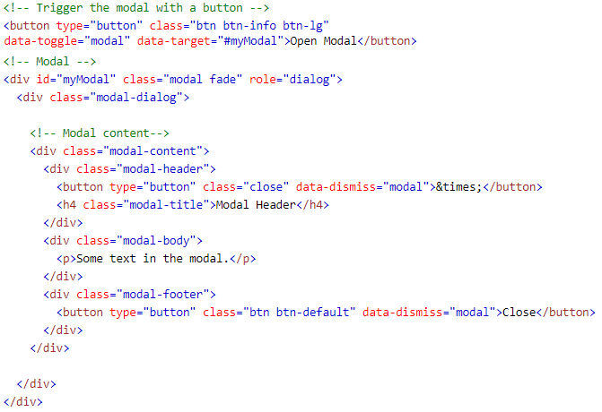
MODALS

Slide 28

POPOVER
Popovers are similar to tooltips, but they are mainly used as indicators that popout to provide direction on where to click within an app.

Slide 29
AFFIX
The affix class is used to fix containers that shouldn’t move when scrolling through a page.
This can often be achieved using the sticky style, but sticky doesn’t always work with internet explorer, whereas affix does.

Slide 30

TOOLTIP
Bootstrap also offers classes for tooltips that look more presentable than the standard HTML title tooltip.

