Slide 1
C#

Slide 2
BACKGROUND
C# is a commonly used language for backend development.
It is associated with an Microsoft stack such as .NET and .NET Core.

Slide 3
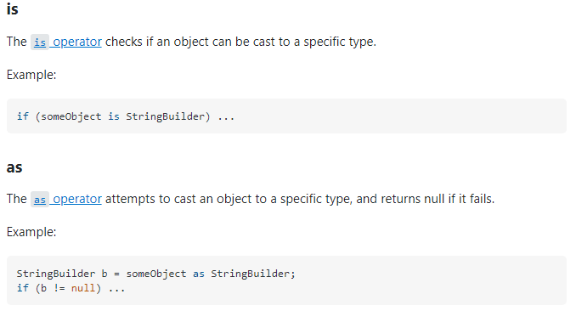
IS VS AS

Slide 4
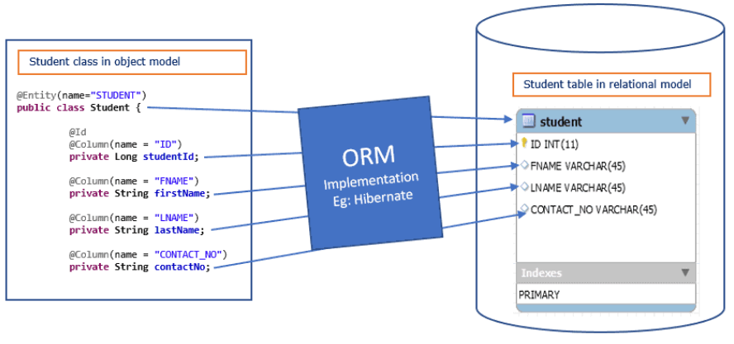
ORM
Object relational mapping is a technique for converting data between C# objects and relational database.
It converts data between 2 incompatible type systems.
LINQ and SQL are example ORM software packages.

Slide 5
LINQ
SQL is a Structured Query Language used to save and retrieve data from a database.
In the same way, LINQ is a structured query syntax built in C# and VB.NET to retrieve data from different types of data sources such as collections, ADO.Net DataSet, XML Docs, web service and MS SQL Server and other databases.

Slide 6
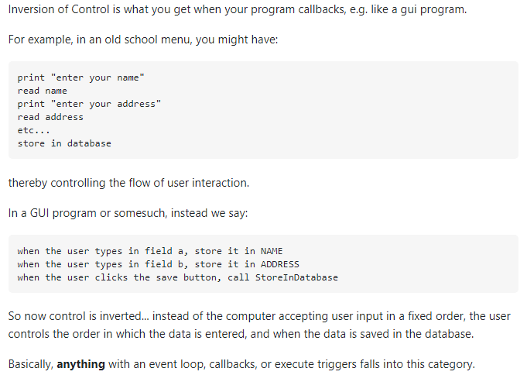
INVERSION OF CONTROL/IOC

Slide 7

ARRAY FUNCTIONALS
Filter = Where()
Map = Select()
Reduce = Aggregate()
Some = Any()
Every = All()
ForEach = ForEach()

