Slide 1
DEBUGGING

Slide 2
BACKGROUND
Debugging is the process of troubleshooting applications so they are bug-free and proper results are displayed on the browser.
Common ways of debugging include process of elimination, adding breakpoints, skimming through code, and reviewing data structures.

Slide 3

BUGS VS WARNINGS
In the console of every browser, there’s a chance that warnings and bugs might prompt as shown below.
Warnings are acceptable, but bugs are not.

Slide 4
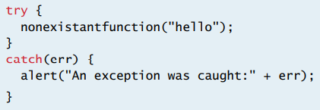
TRY CATCH EXCEPTION HANDLING
If code is likely to error out, it’s good practice to wrap the code in a try-catch block.
A try-catch block will not display the red error message shown in the previous slide, but instead a clean message to the user that an error occurred. This is much better practice at displaying errors to a user.

Slide 5
TRY CATCH EXCEPTION HANDLING
Try-catch blocks should not be used on every block of code in JavaScript, because they are heavy and can slow down the performance of an app.
The error message that it catches can be displayed specifically by reading the err object it provides, typically the message is err.Message.
On rare occasions, web developers also include a ‘finally’ clause after the catch clause, which tells the program to run the code inside ‘finally’ even if an exception occurred.

Slide 6
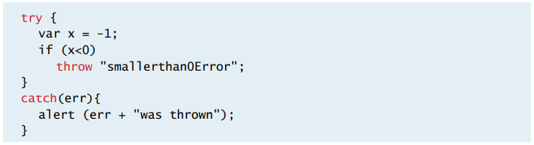
THROWING EXCEPTIONS
Exceptions can also be thrown deliberately using the ‘throw’ syntax.
This will halt the sequence of a program similar to using the return syntax of a function.

Slide 7
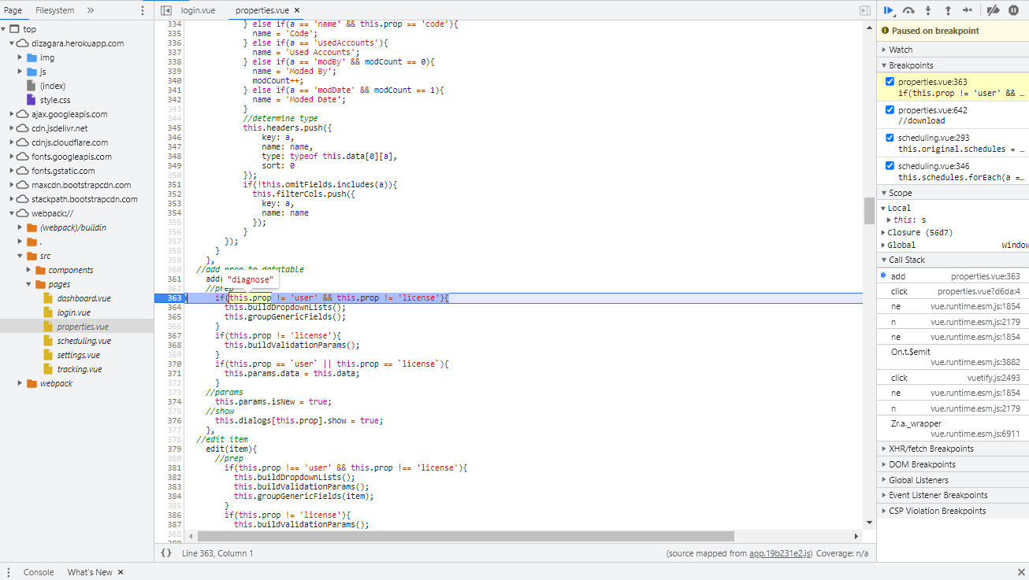
DEBUGGING WITH DEV TOOLS
Browser dev tools provide an excellent way to debug client side code.
Breakpoints can be added, lines can step in and out using F10 and F11, and variables can be diagnosed at every stage of the program.

Slide 8
DEBUGGING WITH CONSOLE.LOG()
Console.log() is one of the best ways to display values on the browser console.
It is used heavily for testing and debugging purposes.
For complicated JSON variables, it is sometimes common to use the stringify() function so that the JSON can be viewed easily on a JSON viewer.
It is very lightweight and does not await the app as does the alert() function.
Every browser console allows JavaScript to be entered and tested directly as well.

Slide 9
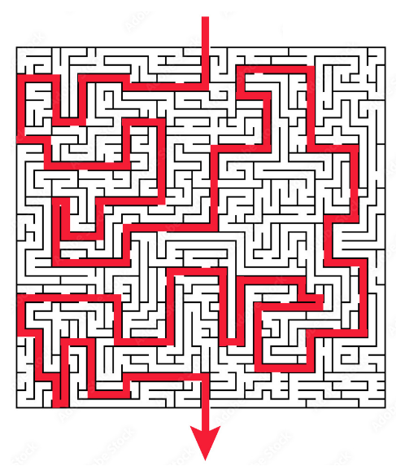
CHOOSE YOUR PATH WISELY

Slide 10
