Slide 1
FIDDLES

Slide 2
BACKGROUND
Fiddles are useful for showing how a code will perform without having to install any modules or packages.
Fiddles can also be very useful for interviews if your computer is not setup properly to handle certain tech stacks and packages.
They are very different than IDEs, because they are hosted on the internet and do not require installations.

Slide 3
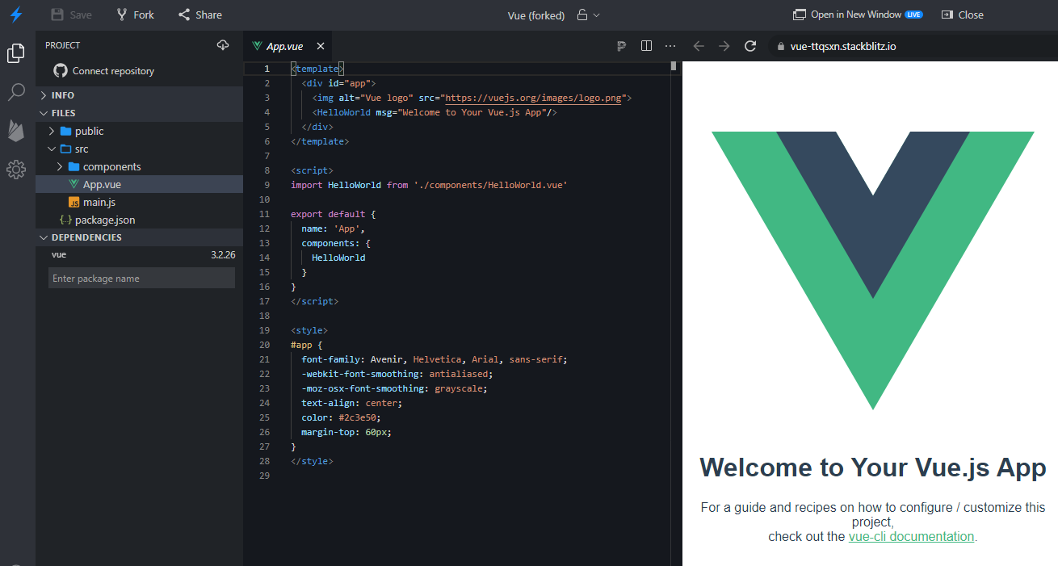
STACKBLITZ.COM
Good for SPAs like React or Vue.

Slide 4
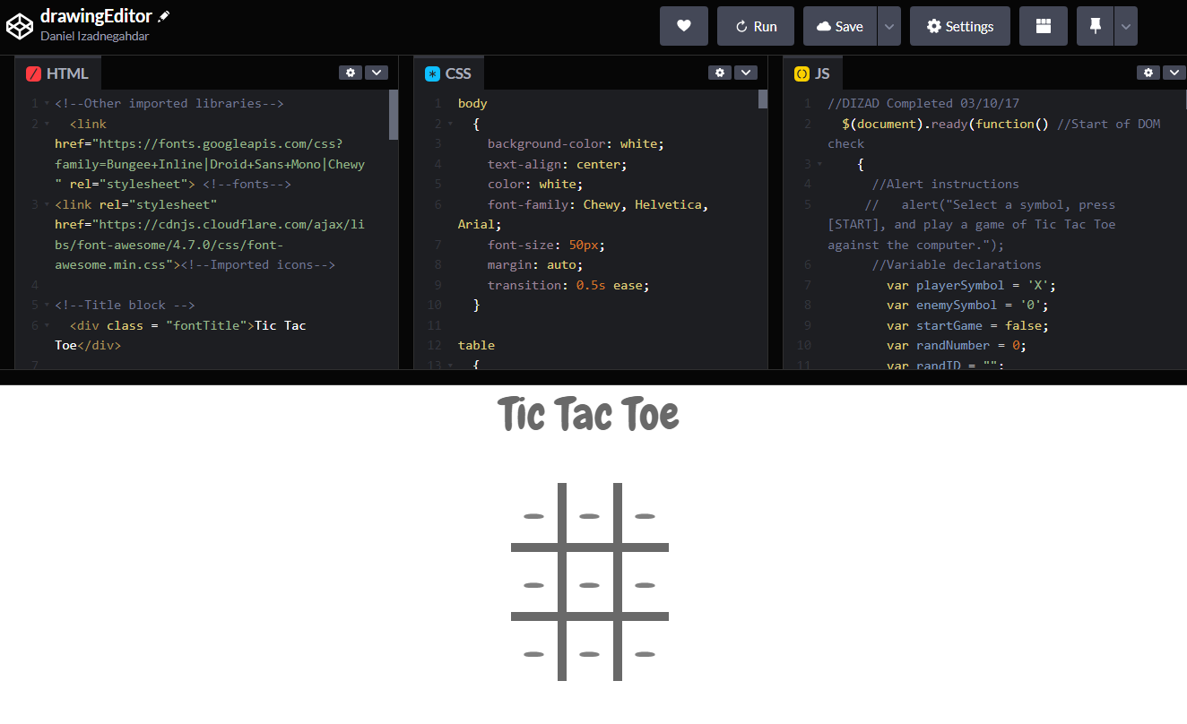
CODEPEN.IO
Good for JavaScript, CSS, and HTML.

Slide 5
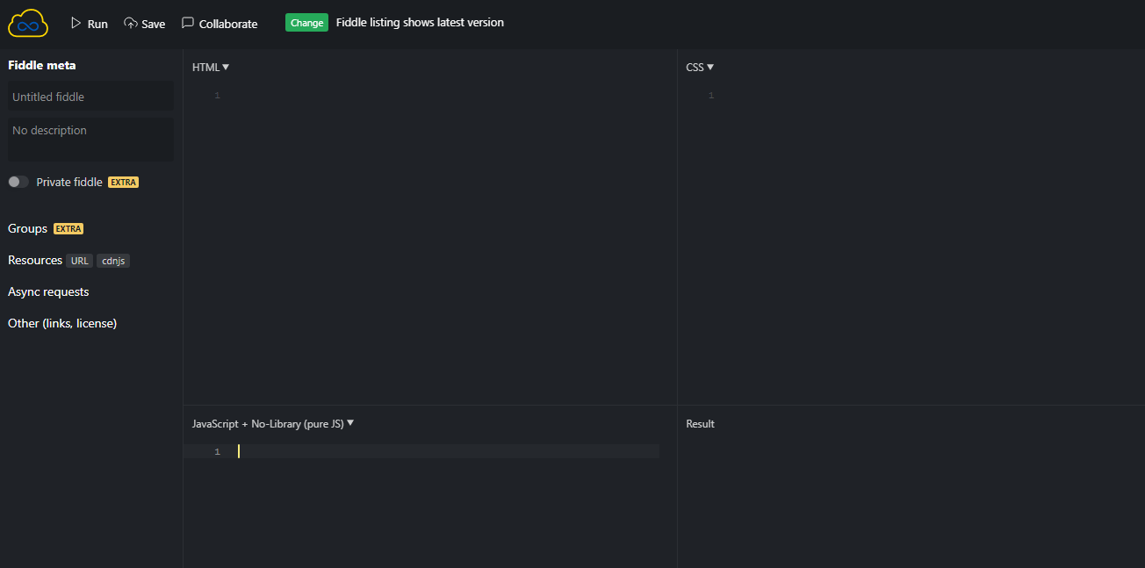
WWW.JSFIDDLE.COM
Good for JavaScript.

Slide 6
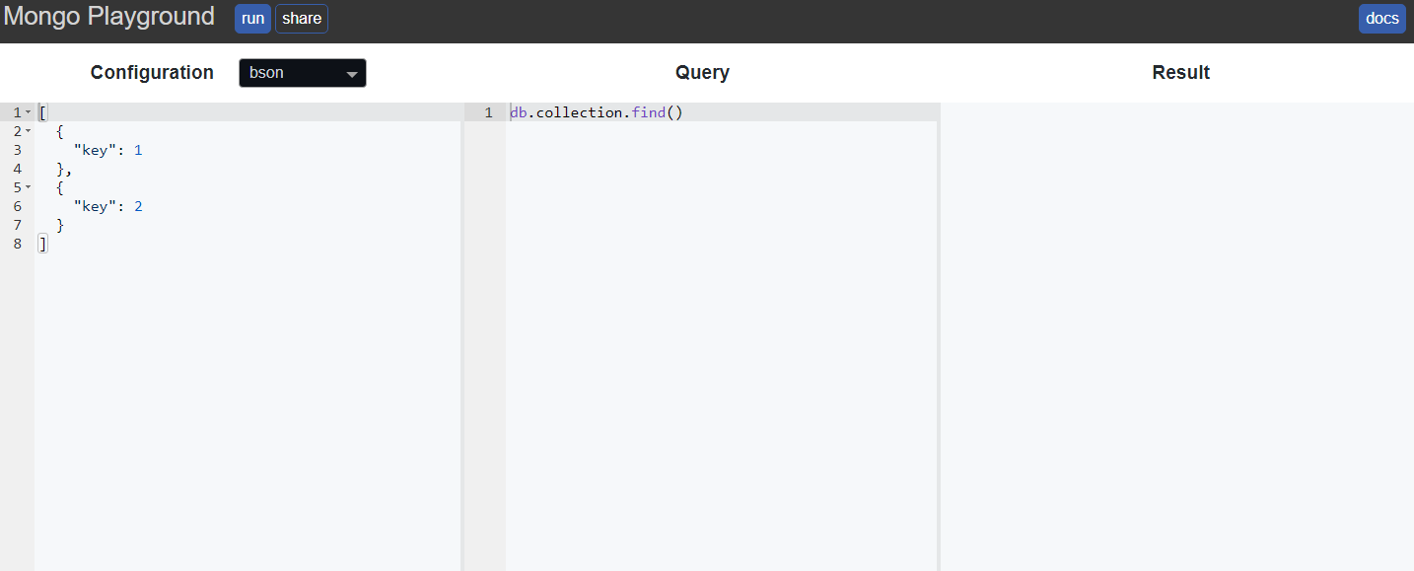
HTTPS://MONGOPLAYGROUND.NET/
Good for mongoDb queries and aggregates.

Slide 7
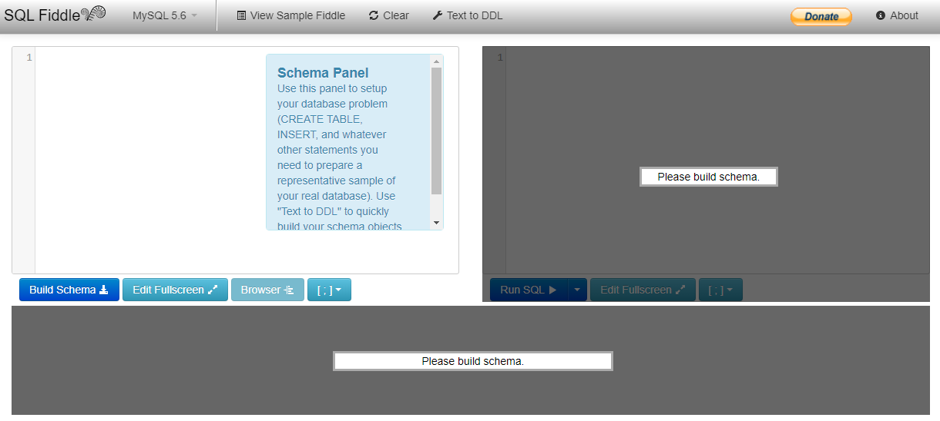
HTTP://SQLFIDDLE.COM/
Good for SQL queries and aggregates.
Make sure to paste the schema queries on the left panel.

