Slide 1
IDES

Slide 2
BACKGROUND
Integrated development environments(IDEs) are used to make it easier to code programs.
IDEs can usually handle multiple languages but are not bound by languages, languages and IDEs are 2 very separate entities.
Without an IDE, most languages almost look exactly the same on the surface, a series of chars that can be opened with a regular text editor.
IDEs are used to make it easier to see the code, by color coding, by applying intellisense to verify syntax/options, and navigate easily through code.
There is no right or wrong choice for picking an IDE for a language, this will often come at the preference of the software engineer.
Lite weight IDEs may sometimes be referred to editors.

Slide 3

PICKING AN IDE
A good IDE has the following properties:
Lite weight/loads quickly
Automatic Syntax detection
Intellisense
Navigation
Debugging
Recommended IDEs:
C# – Visual Studio(most popular)
Java – Netbeans
JavaScript– Visual Studio Code
HTML – Notepad++
C/C++ – CLion

Slide 4
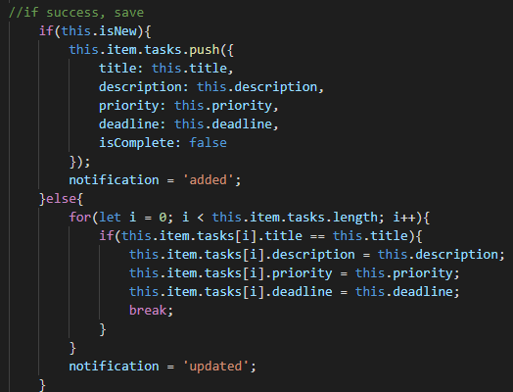
COLOR CODING
A good IDE is good at color coding between comments, variables, and values.
This color coding will change based on the language selected by the IDE.
The color schemes can often be changed in the settings. This can be useful for color blind people.

Slide 5
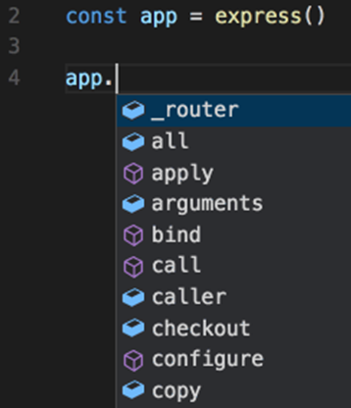
INTELLISENSE
Intellisense is a way to auto-complete partially complete syntax.
It can be used to display the constructor of an object, the field options it has available, or display the expected arguments of a function.
Intellisense is very good at speeding up software development because it prevents a lot of syntax errors from being made.

Slide 6
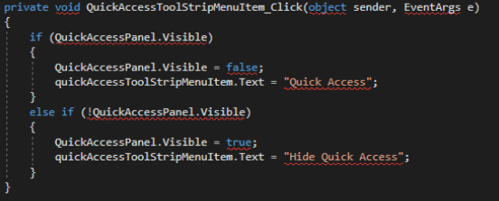
SPELL CHECKING
A good IDE can check for basic syntax errors in real time.
They display a red squiggly underline on function names that are never defined, notifying where invalid argument counts are specified, or identifying variable names that are never declared.

Slide 7
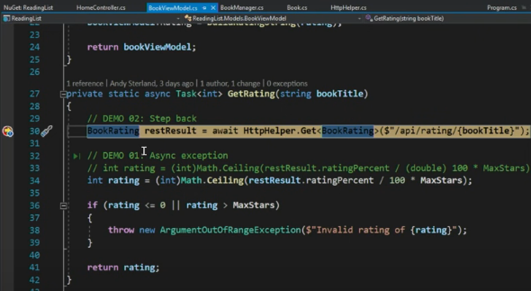
DEBUGGING
IDEs are also used for debugging. While client side code is debugged using a browser, server side code is debugged using an IDE.
Breakpoints can be applied, variable values can be watched, and code can be navigated one step at a time of its execution.

Slide 8
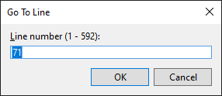
NAVIGATION
Visual Studio and Studio Code both contain navigation buttons on the upper left. They are used to navigate to the previous or next selection that was made during development. As trivial as they sound, they can save a tremendous amount of time in development.
Most IDEs also adopt the CTRL+G shortcut, which opens up a window to navigate directly to a specific line number.

Slide 9

REPLACING
Replacing syntax is very common in software development. A common application is changing variable names throughout an app.
CTRL+H is universal amongst IDEs, to prompt the replacement window.
It’s important to check the match case and match whole word buttons when doing a replacement, otherwise variable names with different cases will be replaced, and cause a lot of rework.
Replacing can be very detrimental if not used with caution. Some replacements can not be undone, and could break the app and cost weeks of work to recover.
Always be very cautious when using ‘Replace All’ throughout the entire app, and double check your textboxes very carefully.

Slide 10
AUTO-FORMATING
Auto-formatting is the process of automatically setting indents and curly braces whenever syntax is pasted and applied.
This can either be a pro or a con, depending on how the settings are set.
The length of each indentation and type of curly braces can all be modified with great detail.

Slide 11
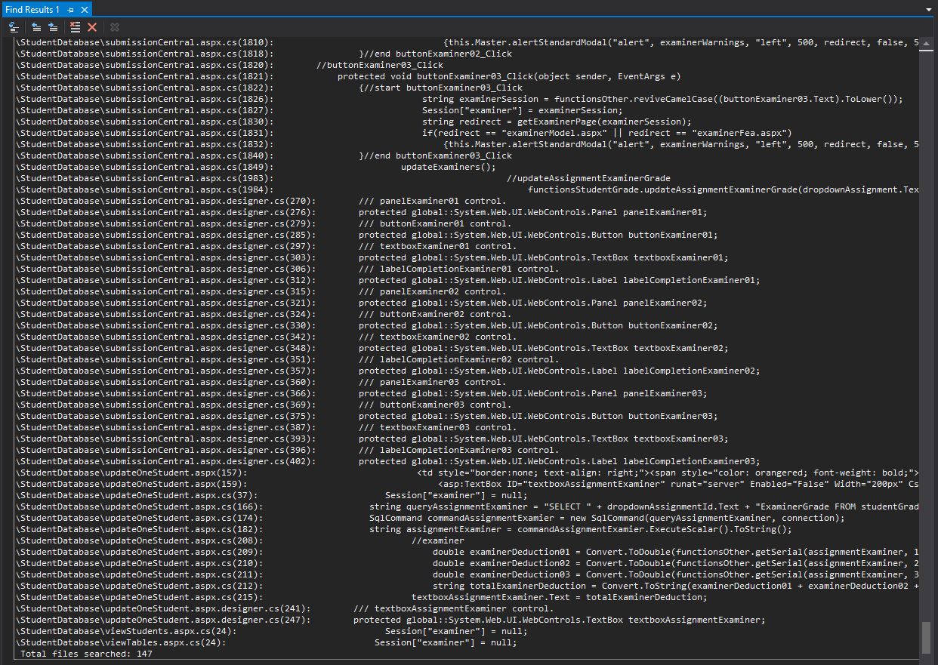
FIND ALL
The ‘Find All’ function is very common in software development.
It’s a way to lookup syntax of an existing feature so it be copied and modified for a similar feature request.
When searching for a term, it’s important to use as much of a unique identifier as possible, for instance a label with unique terms, this way less results will display and be easier to trace.
It’s also a good idea to do a secondary search on the results window, by searching for .html files for instance.
Regex can also be used on find queries.

Slide 12
TEAM EXPLORER
The team explorer is excellent for version control.
It also allows engineers to pull from master, create branches, make changes, commit changes, and push to master.
For every commit, changes can be checked by using the ‘compare with unmodified’ button.

Slide 13
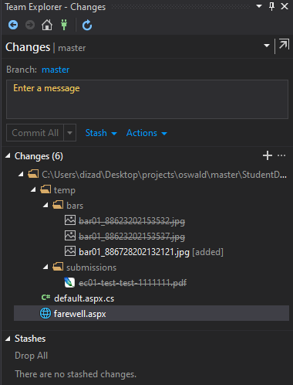
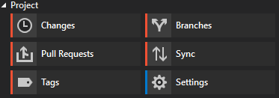
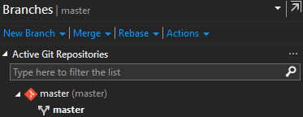
TEAM EXPLORER

