Slide 1
JQUERY

Slide 2


Slide 3
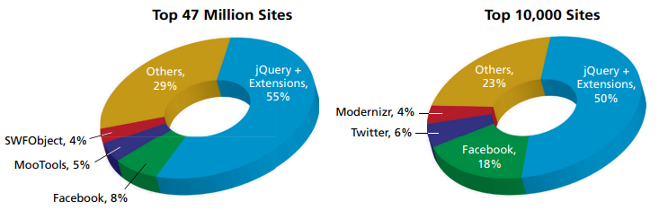
BACKGROUND
JQuery is JavaScript library used for making JavaScript easier to use.
It is commonly used for DOM manipulation and AJAX.
By DOM manipulation we mean changing the html/css using JavaScript programmatically.
It is lightweight library with the moto ‘write less, do more’.
It is the most popular internet library out there, used by 73% of the top 10 million websites on the internet.
It was created by John Resig in August 26, 2006.
The documentation can be found here https://api.jquery.com/.

Slide 4
IMPORTING
JQuery can be imported like any other library, by either pasting the link inside the <head> tag or installing it using the npm install command.
A reliable third party host is Google and Microsoft using the content delivery network (CDN). Although mainstream CDNs are very reliable, it’s good to include fail-safe backup JQuery locations as shown below.
Another way is to insert the JavaScript link(shown below) on the index.html file:
<script type=“text/javascript” src="https://ajax.googleapis.com/ajax/libs/jquery/3.5.1/jquery.min.js">
</script>

Slide 5

DOCUMENT.READY()
JQuery starts with $(document).ready(), a function that executes only after the DOM has been fully loaded.
If this function is not called, JQuery selectors may not work properly, because the DOM may not have fully loaded the tags to select.

Slide 6
$ BLING
JQuery starts with the ‘$’ symbol often called bling.
It is the equivalent to the getElementById() vanilla JavaScript function and is the starting point to select an element from the DOM.
Once an element has been selected, a JQuery function can be applied using dot notation.

Slide 7
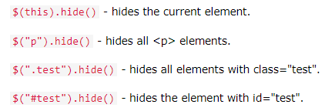
SELECTORS
Inside the params of the $() are the selectors.
Selectors can either select tags, ids, or classes but the proper syntax is required to select either as shown below.

Slide 8
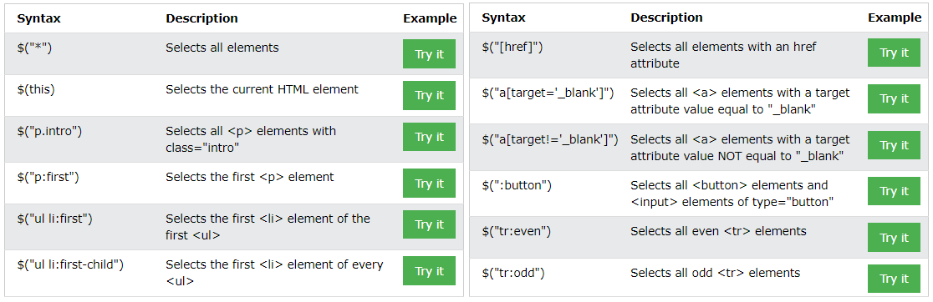
SELECTORS

Slide 9
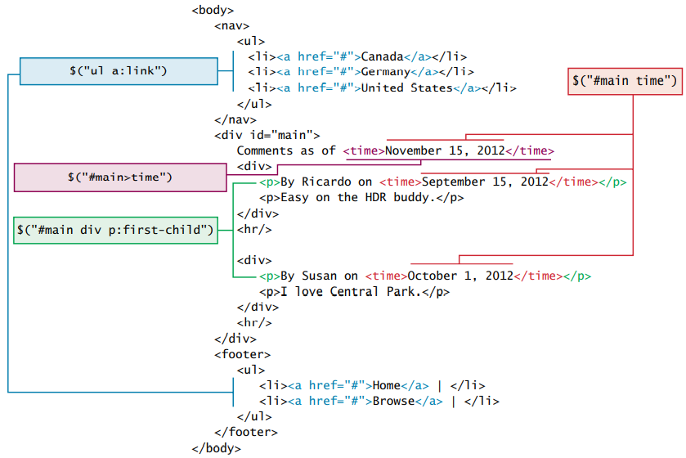
SELECTOR EXAMPLES

Slide 10
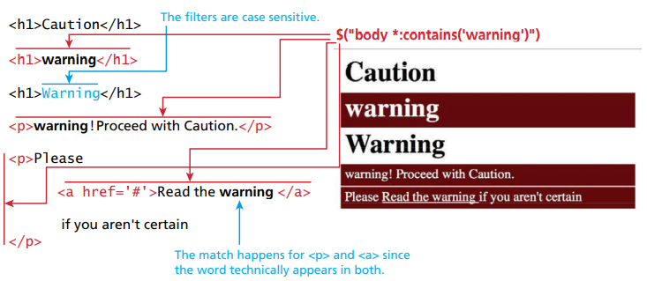
SELECTOR EXAMPLES

Slide 11
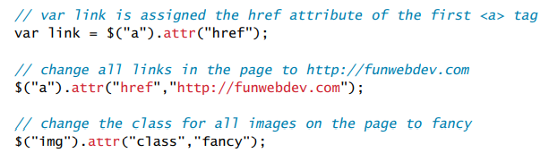
SELECTOR EXAMPLES

Slide 12
SPECIAL SELECTORS
Selectors can either be by attribute, pseudo-element, or contextual.

Slide 13
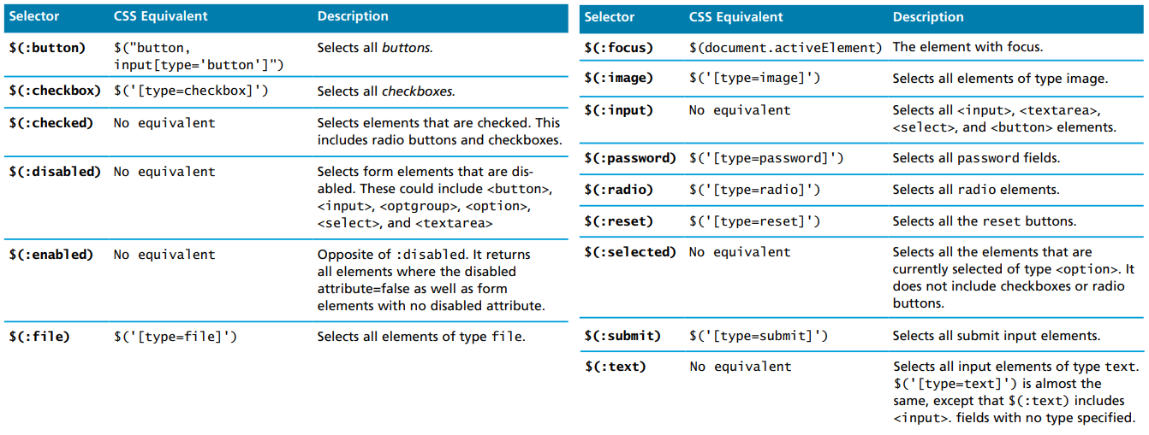
SPECIAL SELECTORS

Slide 14
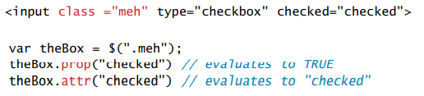
PROP VS ATTR

Slide 15

EVENTS
Events can also be applied to elements, similar to the JavaScript addEventListener() function.
These events include mouse clicks, keyboard presses, and scrolls.

Slide 16
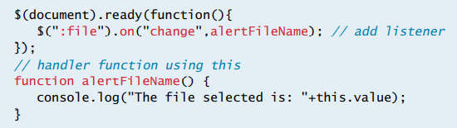
EVENTS
One way to add listeners is using the .on() and .off() methods.

Slide 17
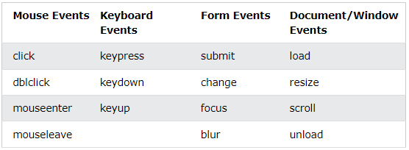
EVENTS

Slide 18

HIDE / SHOW
Elements can be displayed or hidden using the hide() and show() functions.
It’s easier to use this syntax than to use vanilla em.style.display syntax.

Slide 19
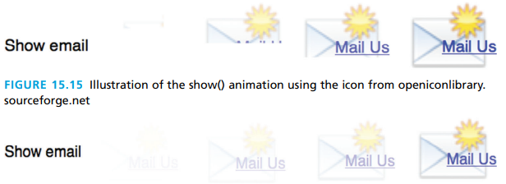
JQUERY ANIMATIONS
JQuery can be used to generate animations for sliding up, down, or fading.
All these functions can be toggled with the JQuery toggle() function.
The .animate(properties, options) function is useful for generic animations like rotations.

Slide 20

FADING
JQuery also allows elements to gradually fade in and out.
This is done using the fadeIn() and fadeOut() functions.
Parameters can also be added inside the ().

Slide 21
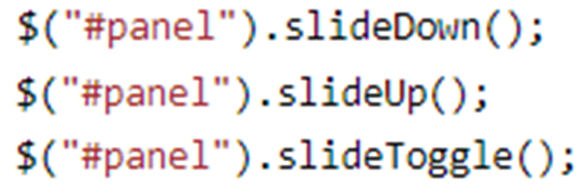
SLIDING
Sliding is used to animate slide transitions between elements.
They are done with the slideDown() and slideUp() functions.

Slide 22

ANIMATE
To create custom animations, the animate function can be used.
Containers can be moved, expanded, slice, de-colored with great control.
To stop an animation, the .stop() function can be used.

Slide 23
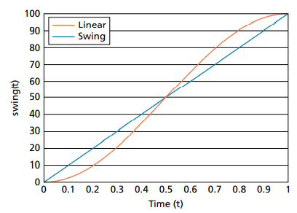
EASE

Slide 24

GET
JQuery has the ability to ‘get’ or return elements from the DOM.
To return text inside tags within a selector, use the text() function.
To return all html markup within a selector, use the html() function.
To return the value of a form field, use the val() function.

Slide 25

SET
JQuery has the ability to ‘set’ or define values of the DOM.
To define values, simply add values inside the () of the text(), html(), and val() functions.

Slide 26
ADDING
JQuery allows adding elements before or after certain elements.
To add html at the end of a selection, use append().
To add html at the start of a selection, use prepend().
After() and before() are also used but they do not place on the first selection, not the last or first index of the selection.

Slide 27
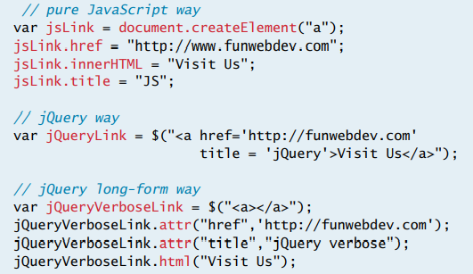
CREATING HTML ELEMENTS

Slide 28
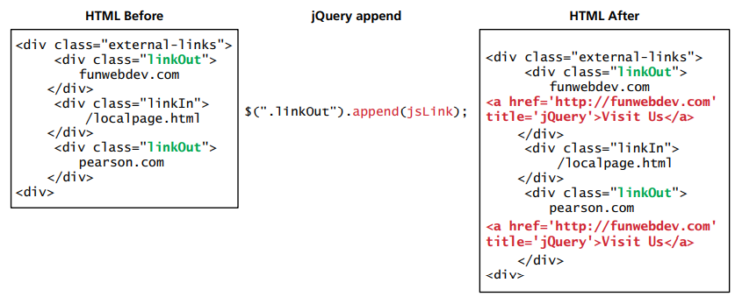
APPEND ELEMENT

Slide 29
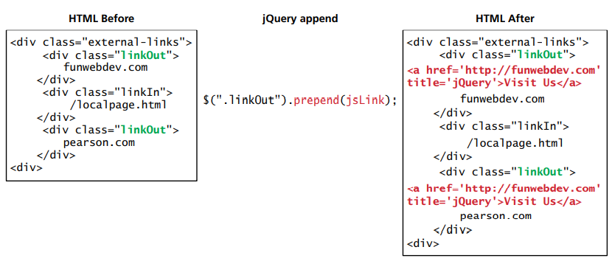
PREPEND ELEMENT

Slide 30

REMOVING
Elements can be removed from the DOM using the JQuery function remove().
To remove the child elements of a parent selector, the empty() function can be used.

Slide 31
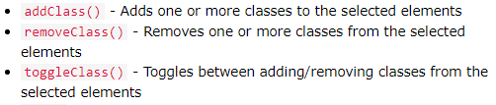
CLASSES
Classes can be added or removed using JQuery.
A common application of this is on textboxes that have validation errors.
If an error occurs, the .addClass() can be used to apply a style that makes the textbox look red.
When the textbox is validated, the .removeClass() can be applied to make it look normal again.

Slide 32
STYLES
Custom CSS styles can be applied easily in JQuery, using the css() function.
The 1st argument inside the () is the property, and the 2nd argument is the value.
The .css method can be used or the .addClass(), .removeClass(), and .toggleClass().

Slide 33

CONTENT MANIPULATION
JQuery can change the content of an HTML tag by using the .html() method.
The .val() method can be used to fetch the value of a tag.

Slide 34
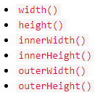
DIMENSIONS
JQuery can get or set dimensions of any container.
To get a dimension, the functionName() is called, and to set the dimension, a param is passed inside the functionName().

Slide 35
TRAVERSAL
JQuery allows easy DOM traversal between parents, children, and siblings.
Ancestors can be selected using parent(), parents(), or parentsUntil().
Descendants can be selected using children(), or find().
Siblings can be selected using siblings(), next(), nextAll(), nextUntil(), prev(), prevAll(), and prevUntil().
Filters can be set using first(), last(), eq(), filter(), and not().

Slide 36
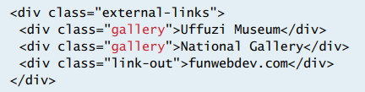
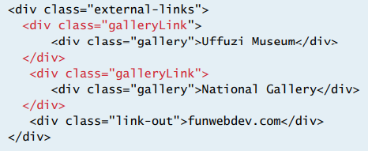
WRAPPING
Wrapping is used to wrap HTML around selected HTML elements.
Other wrapping functions include unwrap() and wrapAll().

Slide 37

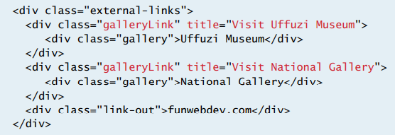
WRAPPING WITH CALLBACK
A function can be added to the wrap to give it added functionality.

Slide 38

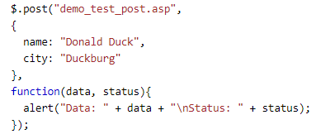
AJAX
AJAX is the process of exchanging data with the server and updating the web page accordingly.
HTTP requests with get and post can be done using $.get() and $.post().

Slide 39
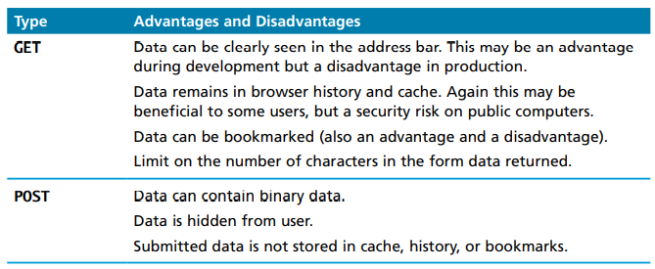
GET VS POST

