Slide 1
MOMENT

Slide 2


Slide 3
BACKGROUND
Moment is a JavaScript library used for managing time.
Time has always been a touchy issue in software. Not only does it come in different formats (DD-MM-YYYY or YY-MM-DD) but has added factors on it such as daylights savings time, time zone, am/pm…etc.
The documentation can be found here https://momentjs.com/.
Specifically, moment can be used for the following:
Create date stamps of the current time.
Add/Subtract time from existing dates.
See if one date is before or after another.
See if the date is the same as another.
Parse date/time for min, day, week, month…etc.

Slide 4
IMPORTING
The preferred way to import is to use the npm install command.
Another way is to insert the JavaScript link(shown below) on the index.html file:
<script type="text/javascript" src='https://cdnjs.cloudflare.com/ajax/libs/moment.js/2.22.2/moment.min.js'></script>

Slide 5
DATE OBJECTS

Slide 6
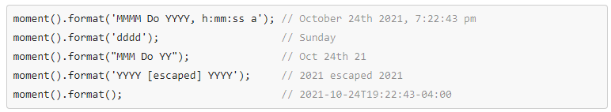
FORMAT DATES

Slide 7



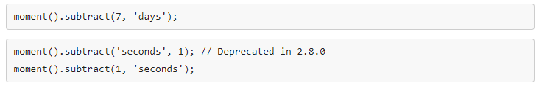
ADD / SUBTRACT TIME

Slide 8

DATE COMPARISON

Slide 9
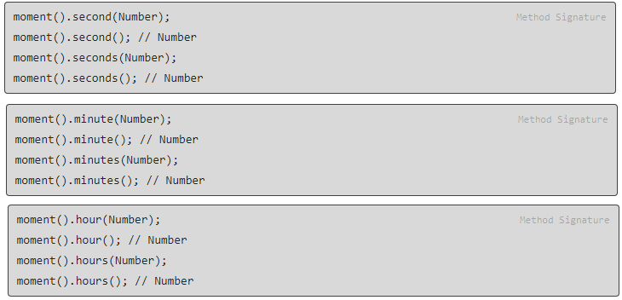
PARSE DATE / TIME

