Slide 1
OOP

Slide 2
BACKGROUND
Object oriented programming is a central part of backend software development especially within the DOT NET framework.

Slide 3
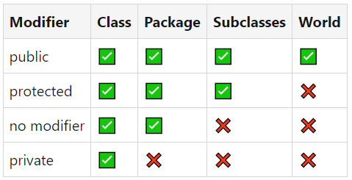
ACCESS MODIFIERS

Slide 4
STATIC
Static means a particular member belongs to a type itself, instead of an instance of that type.
A static member is shared among all instances of the class.

Slide 5
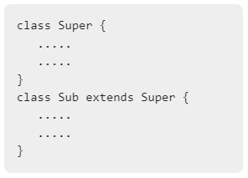
INHERITANCE
Inheritance is a way to pass the attributes of a parent class into a child class.
Many languages use the syntax extends to achieve this.
Using the implements syntax is also used for inheritance, but is mainly used to inherit interfaces.

Slide 6
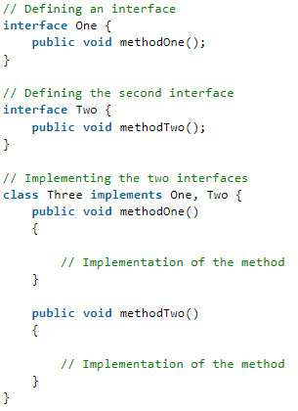
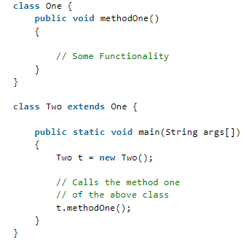
EXTENDS VS IMPLEMENTS

Slide 7
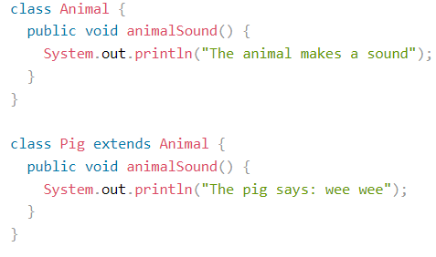
POLYMORPHISM
Polymorphism is a way to modify methods and properties of an inherited class.
Overriding is a good example of polymorphism.

Slide 8
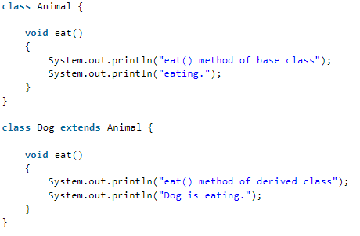
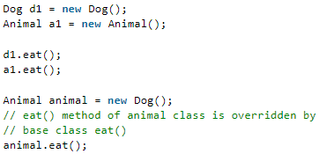
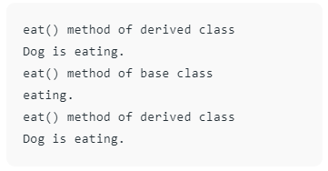
OVERRIDING
Overriding is when a child class has the same method name as a method in its parent class.
If the method is called on the parent, it will call the parent class. If the method is called on the child, it will call the child class.
It’s a type of polymorphism and allows consistency of method calling within an interface.

Slide 9
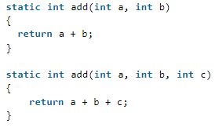
OVERLOADING
Overloading is when you have multiple methods of the same name with a different number of arguments.

Slide 10
SOLID PRINCIPLES
S-Single responsibility principle
a class should have one responsibility
O-Open closed principle
software entities should be open for extension but closed for modification
It means that it’s ok to modify instances but not templates
L-Liskov substitution principle
Use inheritance when you plan to use the methods of the super class as is, with minimal modifications.
I-Interface segregation principle
Use sub interfaces to accommodate more specialized groups of objects
D-Dependency inversion principle
Depend on high level abstractions instead of low level classes

