Slide 1
OPTIMIZATION

Slide 2

BACKGROUND
Software applications should be efficient, always.
There should never be longer than ½ sec of lag on any part of an app.
FAANG Companies have spent billions of dollars just to maintain lag-free performance.
In app development, common ways of improving performance is breaking, caching, lazy loading, paging, and selective searching.

Slide 3
BREAKING
In development, one of the most common reasons for lag is inefficient design of algorithms. They often loop on several layers and bloat space and time.
In most cases, these loops do not need to traverse through the entire structure to complete their purpose, this is why using breaks, as soon as a condition is met, is very important for improving performance.
A ‘break’ will exit out of a loop and no longer continue.

Slide 4
CACHING
While breaking improves speed, caching improves space.
In an application, there are many data structures that need to be loaded from the database to properly display on the page.
These structures can be overwhelming, especially when they are re-generated on every user event.
This is why it is important to cache, and store these structures once, so that any time they are called again, they can be fetched from the cache, instead of the database, and improve performance significantly.

Slide 5
LAZY LOADING
Lazy loading and virtualization often come hand and in hand, and refer to the idea of only loading what needs to be loaded in the provided display container.
For example, on large maps in video games, it is common to only load the map up to where the eye can see. Maps are rarely loaded all in one shot in video games because it would lag.
Lazy loading is often used on parent-child tree structures found often on graphic user interfaces.

Slide 6
PAGING
Paging is similar to lazy loading, but instead of dynamically updating elements in real-time through a scroll event for example, it is triggered through click events on buttons.
Common examples of these are done on large table sets, with ‘back’ and ‘next’ buttons.

Slide 7
SELECTIVE SEARCHING
On large data sets, it is very rare to download the entire structure and present it to the view. This could cause serious lag times and is highly discouraged.
It’s recommended to use selective searching instead, where results are presented based on a few keywords that are provided by the user.
This is commonly used on auto-complete dropdowns. Instead of fetching the entire list of items, the list is populated on a keyup event, to fetch all dropdown items that match the provided key presses.

Slide 8
LOCAL STORAGE
The localStorage read-only property of the window interface allows you to access a Storage object for the Document's origin; the stored data is saved across browser sessions.
localStorage is similar to sessionStorage, except that while localStorage data has no expiration time, sessionStorage data gets cleared when the page session ends — that is, when the page is closed. (localStorage data for a document loaded in a "private browsing" or "incognito" session is cleared when the last "private" tab is closed.)

Slide 9
SERVER-SIDE RENDERING
is the ability of an application to contribute by displaying the web-page on the server instead of rendering it in the browser.
Server-side sends a fully rendered page to the client; the client's JavaScript bundle takes over and allows the SPA framework to operate.
It enables pages to load faster which provides a better user experience.

Slide 10
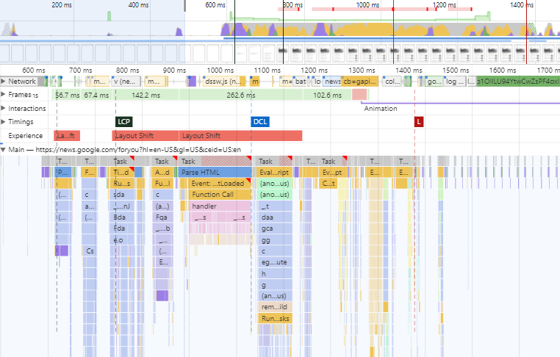
DEV TOOLS
To check performance of JavaScript, the performance.now() function can be used to display ultra-precise millisecond date stamps.
Another method is to use the performance tools on web browsers.

