Slide 1
POLITICS

Slide 2
BACKGROUND
Politics are unfortunately an important part of the job to understand in order to avoid a termination.
Software is very complicated, and when things are complicated, less people understand how they work, causing a lot of issues in the office such as unnecessary terminations.
Studies have shown that 1 in 3 software engineers get fired at least once in their lifetimes.
It’s important to understand why this happens to avoid these situations from happening.
Some of the most common reasons of terminations include bad bosses, unrealistic expectations, or lack of proper training.
Terminations can include firing and layoffs. Layoffs are more associated with financial restrictions and often include severance pay.

Slide 3
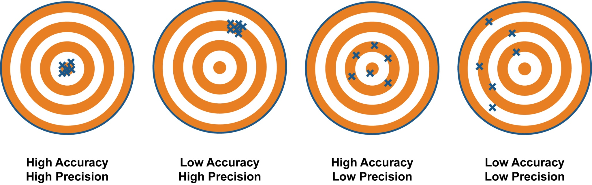
BAD BOSSES
It’s often very rare to find a talented manager who truly knows how to manage a complicated software system.
Many fail to see the difference between accuracy and precision. They might reinforce opinionated policies that they think are important in their minds, but not really to the success of the company. For instance, setting a policy to remove all ternaries from all the code bases.

Slide 4
UNREALISTIC EXPECTATIONS
Some bosses will often fail to understand the proper ramp up process of software development.
They will sometimes require a new dev to fix a complicated bug on day one and be surprised if they have not done it a day after.
They will fail to understand blockers, for instance you might not be able to install an app because of certificate issues that are outside your control. They will often blame you for issues you can’t control.

Slide 5
LACK OF PROPER TRAINING
A lot of companies are often lacking SME(Subject Matter Expertise) for newer or niche technologies that they are supporting.
For this reason, they often have to rely on new developers to figure out these techs through the school of hard knocks.
The problem is that many managers might not realize the time it takes to understand these new techs, and will often terminate developers within a 1-3 month period if they have not made enough progress.

Slide 6
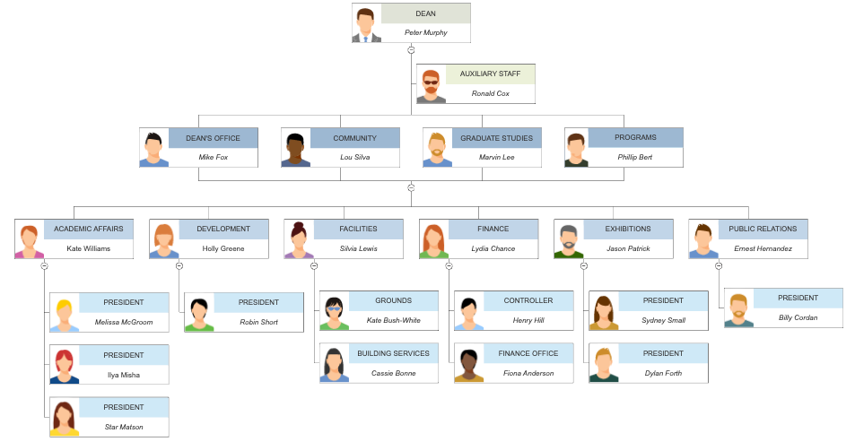
KNOWING WHEN TO ABORT MISSION
In an organization, your immediate boss often has tremendous influence on your termination.
The decision is often made by your boss, his/her boss, and another senior manager, but the associates besides your boss will often take the recommendation of your boss at face value without push-back on whether the decision was right or wrong.
When the decision is made to terminate, it’s too late to ask for departmental transfers and you may be black-listed from applying to the company in the future.
This is why as soon as you notice red flags in working for a bad boss, it’s important to ask his/her boss to be transferred to another department immediately, while you are still on good terms.

Slide 7
PERCEIVED VALUE VS ACTUAL VALUE
In business, perceived value often unfortunately has more value than actual value.
For instance, you will less likely be terminated if you please your boss even if your work is not benefiting the company, as opposed to truly adding value but not pleasing your boss.
For this reason, it’s common to hear middle managers mention textbook friendly material that doesn’t really add much actual value, but high perceived value to justify their position.
A valuable developer who often debates the questions of a manager will sometimes be terminated even though their work was essential to the success of the company.
Embracing debate is often a rarity in many sectors of the tech industry. Many managers often lack the strength and maturity to be questioned openly.

Slide 8


CASE STUDY – JOSHUA BELL
Joshua Bell is one of the world’s most famous violinists.
In 2007, he did an experiment by playing on the streets, and no one noticed, yet at his official concerts thousands will pay top dollar to attend.
Perceived value is different than actual value.

