Slide 1
PROCESSING

Slide 2


Slide 3
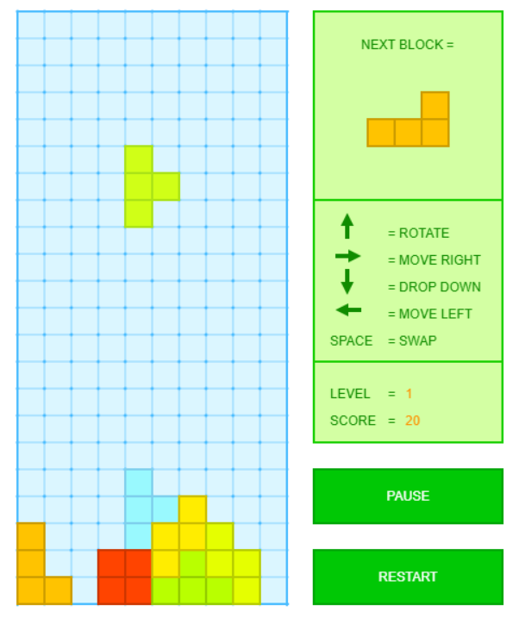
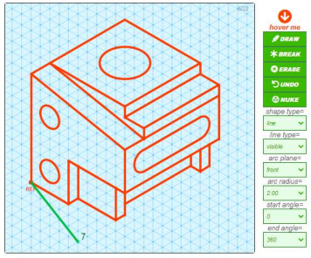

Slide 4
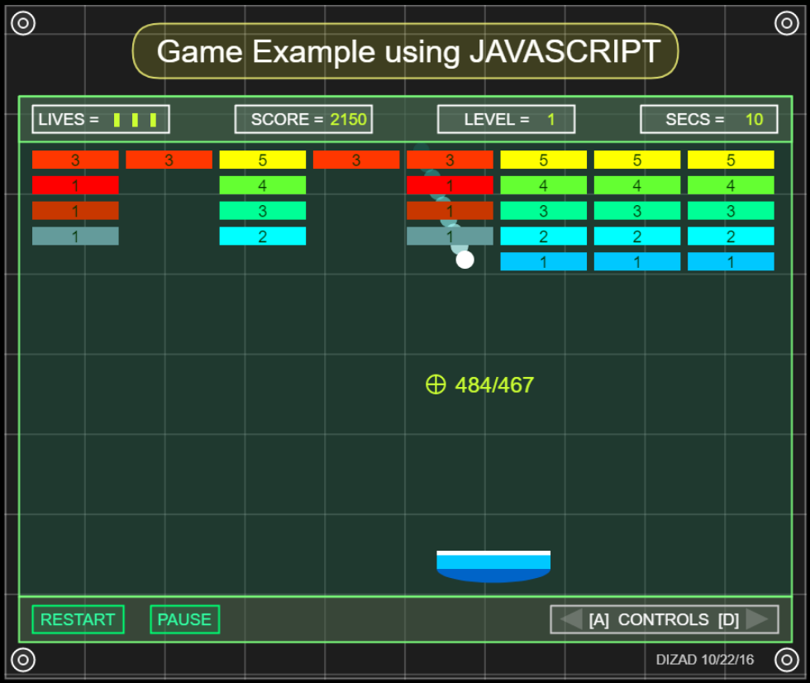

Slide 5

BACKGROUND
Processing is a JavaScript library used for generating vector graphics on a canvass. It’s similar to D3.js/Chart.js but processing is not designed to build charts, it is used to build shapes at the squares and circle level.
This library has been used extensively for people who are learning to code for the first time because it provides an easy visual representation of their code.
The documentation can be found here https://processing.org/.
The khan academy also provides a simplified version of this documentation https://www.khanacademy.org/computing/computer-programming/pjs-documentation.

Slide 6
IMPORTING
Processing is often installed by downloading the .js file from the documentation website and importing the script into the index HTML.

Slide 7
BIND CANVAS
The 1st step is to build the canvas on a canvas HTML element.
This is done with the syntax shown below.
The ctx variable is used as a master object that can be assigned shapes, styles, and sizes.

Slide 8
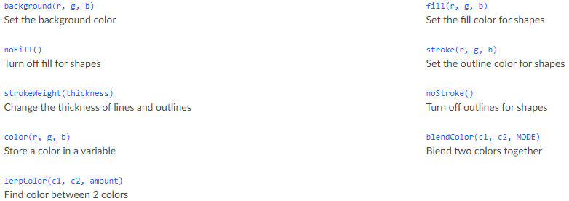
SET COLORS

Slide 9
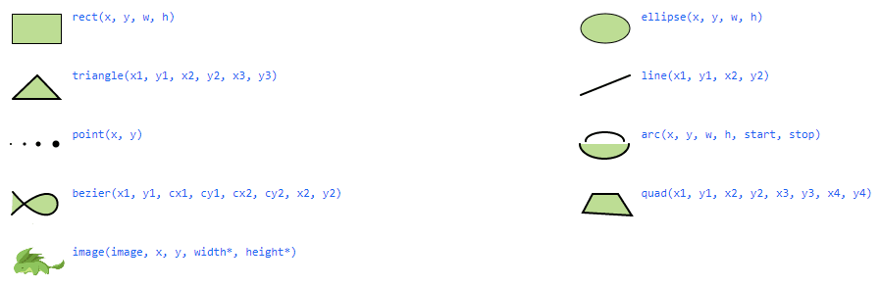
DRAW SHAPES

Slide 10
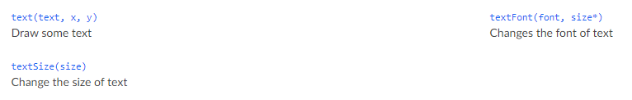
DRAW TEXT

Slide 11
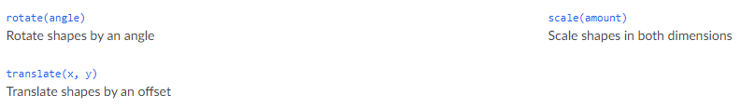
TRANSFORM

Slide 12
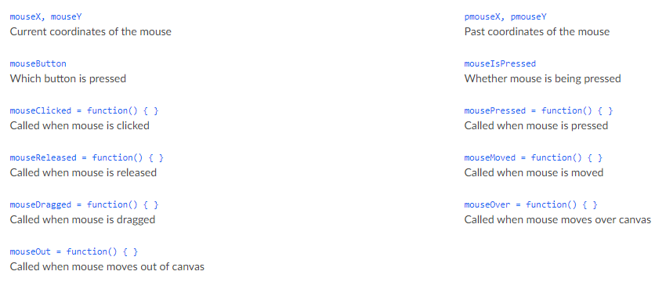
MOUSE EVENTS

Slide 13
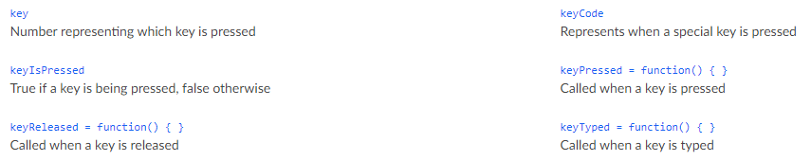
KEYBOARD EVENTS

Slide 14
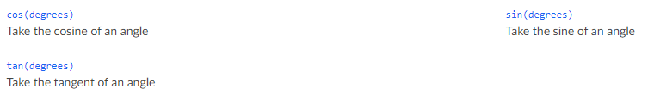
TRIGONOMETRY

Slide 15
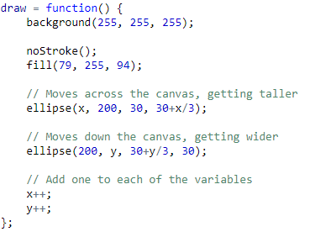
REAL-TIME DRAW
The draw function runs repeatedly 24times per second.
It’s used for real-time animation or motion.

