Slide 1
TESTING

Slide 2
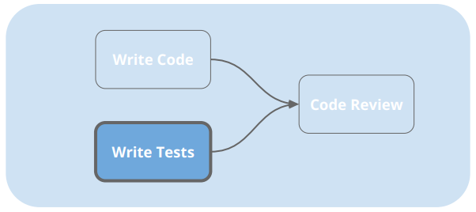
BACKGROUND
In a lot of companies, it’s very common to require test code for every functional code that you write. In angular components, these test are included in a .speck file that is included in the bundle of every component you create.
For instance, if you wrote a function that returns true or false based on an input, you would have to write a test that includes mock inputs and assure the right results are returned.

Slide 3
PROS
Reduces the time to complete the manual testing.
When devs leave company, the required tests are often forgotten.
Tests are often run before release to production to avoid having issues.

Slide 4
CONS
Adds more software development time.
Requirements change frequently and it is easy to forget to update the tests when making changes to the production code.
Does not always handle the more complicated tests that might be visual or dependent on many different scenarios.

Slide 5
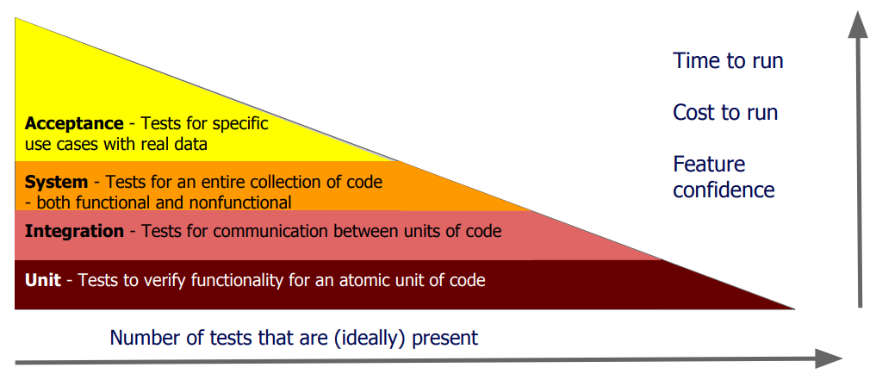
BALANCE

Slide 6

THE BENEFITS ARE OFTEN OPININATED
Automated tests are liked by some and disliked by others.
It’s important to be pragmatic and use your judgment on the best decision.
If the budget and deadline is tight, tests should not be written.

Slide 7
TYPES OF TESTS
Unit tests – test component in isolation, without external influences such as file systems, databases, and API endpoints. They are easy to write, very fast, but not much confidence on the reliability of the system.
Integration tests – tests both the component and template.
End to end tests – test the whole application as a whole. Provides the highest level of confidence on the reliability of the application but the tests are slow.

Slide 8
BEST PRACTICES
It’s important to exercise red-green-refractor - first test it so it fails, test it so it passes, and refractor the code so it’s clean.
Triple A: Arrange, Act, and Assert. Arrange initializes the component, the act calls a method, and the assert is to perform the check.
Test should have small functions (10 lines or less), have proper naming, and single responsibility.
Test cases should not be too specific because when changes are made, they may flag good code. For instance, if you are looking for a word in a sentence, don’t check for every word in the sentence, only check for the word that is designed to change.

Slide 9
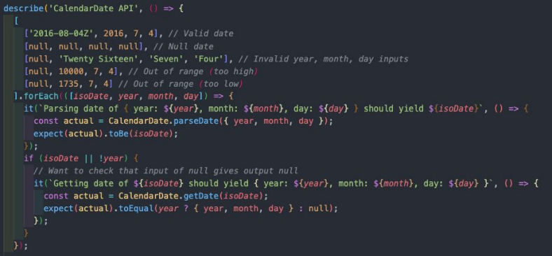
EXAMPLE TESTS
JEST is a famous framework for writing JavaScript tests.
It includes a describe clause that groups a series of it statements that test individual elements of a component.
A test can be forced by adding ‘f’ in front of the function, so that it will only run that test and not all the tests on the app.
You can run the tests by clicking a green play button at the banner bar of most IDEs or type ng test on the command line.

Slide 10
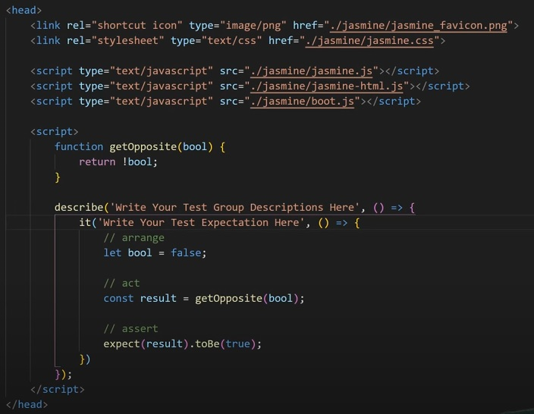
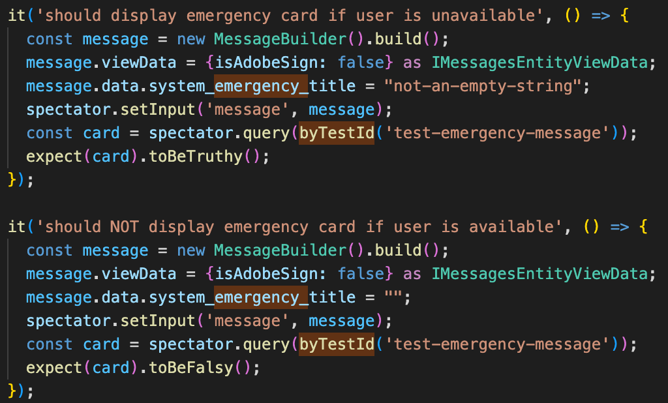
EXAMPLE TESTS

