Slide 1
TOASTR

Slide 2


Slide 3
BACKGROUND
Toastr is a JavaScript library used for alerts/toasters.
Alerts are often part of other mainstream libraries like Jquery UI or Vuetify but toastr alerts are very lite-weight and easy to use.
The documentation can be found here https://codeseven.github.io/toastr/demo.html.
The flagship syntax for toastr is the following single line:
toastr[type](‘message’, ‘alt’, {optionKey: optionValue, …})

Slide 4
IMPORTING
The preferred way to import is to use the npm install command.
Another way is to insert the CSS and JavaScript links(shown below) on the index.html file:
<link rel='stylesheet' href="https://cdnjs.cloudflare.com/ajax/libs/toastr.js/latest/toastr.css" />
<script type="text/javascript“ src="https://cdnjs.cloudflare.com/ajax/libs/toastr.js/latest/toastr.min.js"></script>

Slide 5
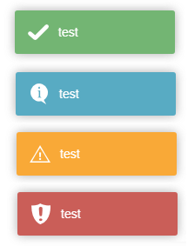
TYPES
There are 4 types available(success, info, warning, and error).
The type specifies the color of the alert and is used to indicate different scenarios.
The [‘success’] alert indicates a successful database change was made. An example could be ‘Successfully saved to database’.
The [‘info’] alert indicates a ‘good-to-know’ notification but usually does not entail a database change. An example could be ‘The drag and drop option is enabled on this page’.
The [‘warning’] alert indicates that the user provided information that is not desirable but will not cause a bug or error downstream. An example could be ‘Changes were not saved on the page’.
The [‘error’] alert indicates that the user provided information that can cause a bug downstream. An example could be ‘The age textbox does not contain a number’.

Slide 6
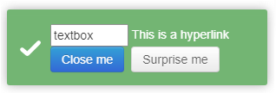

OPTIONS
Options are used to specify extra properties on these alerts.
This includes having a close button on the alert, extending the duration before the alert disappears, or placing the alert at a different location.
It is recommended to place alerts at the lower right of the page, because that location usually does not cover any panel/banner buttons.

Slide 7
EXAMPLES
toastr[“success"](“Saved successfully!“, “”, {closeButton: true});
toastr["warning"](“Label is mispelled!“, “”, {timeOut: 5000});
toastr[“error"](“Entry is not valid!“, “”, {
preventDuplicates: false,
showDuration: "300" ,
showEasing: "swing“,
positionClass: "toast-top-right“
});

