Slide 1
TYPESCRIPT

Slide 2


Slide 3
BACKGROUND
Microsoft developed TypeScript in 2012 to blend the flexibility of JavaScript with the added advantages of a stricter language.
Although JavaScript is good for small applications, TypeScript is good for large applications that have to deal with a lot of files.
When changes are made to large applications, JavaScript will not led the developer know that other parts of the app were broken when the changes were made, but stricter languages like TypeScript will do that.

Slide 4
BACKGROUND
TypeScript adds types to JavaScript, to spot potential bugs.
TypeScript maintains type consistency. For instance, if a series of values are coming in with different types, TypeScript can condition those values to only come in a certain type, and avoid downstream bugs.
TypeScript is used on many open-source projects such as Angular, Webpack, Amazon, Google, and CodeAcademy.
TypeScript transpiles into regular JavaScript on the browser using the tsc command. It is a superset of JavaScript, meaning it contains all the features of JavaScript plus added features. Much of TypeScript looks the same as JavaScript.
TypeScript files use the .ts extension.

Slide 5
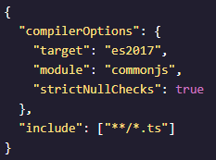
BACKGROUND
TypeScript provides a lot of useful intellisense that JavaScript might not provide. For instance, it provides tooltips on code to show if there might be an error. It also allows us to check for syntax errors before run times.
To turn and configure some of these features on and off, a tsconfig.json file can be used.

Slide 6
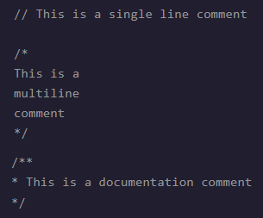
COMMENTING
TypeScript accepts regular JavaScript single line or multi-line comments.
It also accepts it’s own documentation comments which has the same function as multi-lines but are more commonly used to document functions such as params and return values.

Slide 7
TYPE INFERENCES
In TypeScript, if a value is initially assigned to a variable, that variable can not be assigned a value of another data type, otherwise an error will be thrown. For example, let order = ‘first’; order = 1; will throw an error.
If an actual initial value is unknown but the type is, the colon can be used to assign the type. For example, let order : string; order = ‘first’; will not throw an error.
However, if a value is not assigned when declaring a variable, that variable will automatically be assigned the type ‘any’, meaning that variable CAN be assigned any new value if needed, and an error will not be thrown. For example, let order; order = ‘first’; order = 1; will not throw an error.

Slide 8
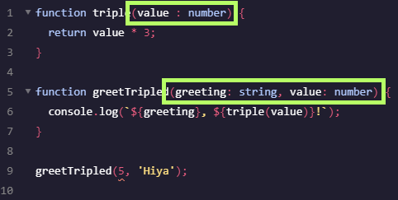
FUNCTION ARGUMENT TYPE INFERENCES
In TypeScript, it’s important to specify the variable type in the arguments of a function, as shown below.

Slide 9
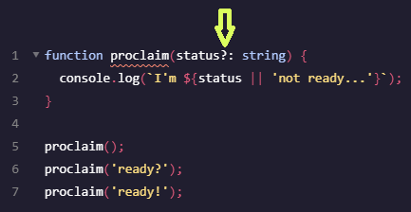
CONDITIONAL TRUTHY CHECKING
TypeScript is picky, if a value doesn’t exist, it wants to know it doesn’t exist otherwise it will through an error.
To address this issue on an argument, a question mark is added to the right of the variable name.
So in this case, if the variable exists, take it’s type, otherwise, default to string.

Slide 10
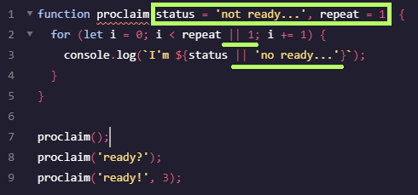
DEFAULT ARGUMENTS
Similar to JavaScript, if a value is not provided for an argument, it can be defaulted as shown below.
This removes the need to error check with conditional assignments as shown with the underlines below.

Slide 11
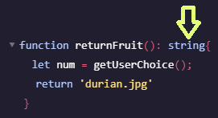
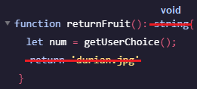
DEFINING RETURN TYPE
To return a specific type from a function, the type can be added right after the arguments as shown.
If a function does not return anything, it’s important to include void as the return type, and remove any line that returns a value as shown.

Slide 12

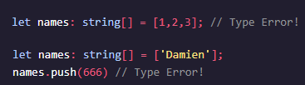
ARRAYS
Arrays in TypeScript can be defined in the 2 ways below and have only 1 data type throughout.
The main difference with JavaScript is that the data type is spelled out on the array callout.
If an incorrect file type is assigned, an error will display.

Slide 13
MULTI-DIMENSIONAL ARRAYS
Multi-dimensional arrays can be defined with multiple [][].

Slide 14
TUPLES
Tuples are similar to arrays but they are not expandable and can have multiple data types assigned.

