Slide 1
VUETIFY

Slide 2


Slide 3
BACKGROUND
Vuetify is a material design framework used for Vue.js.
Vue.js in itself is very lightweight and only contains the bare bone functionalities of a standard SPA framework.
Vuetify is similar to Boostrap, but includes much more modern UI components often seen in apps that came out after 2015.
For instance, before Vuetify, validators that were embedded directly on textboxes was a rarity. Validators were often coded as separate divs on many early frameworks.
This slide deck will cover the nomenclature for many UI components used in full-stack applications.

Slide 4
IMPORTING
Vuetify is a relatively large framework and may not work from a simple npm install command or link insertion.
It’s best to review the documentation to import Vuetify, it may require special injection syntax on the .app() function of the master vue.js callout.

Slide 5
SYNTAX
The syntax for vuetify can vary quite a bit but overall, it is very easy to implement.
It is best to review the samples, fiddles, and code pens provided from their documentation site https://vuetifyjs.com/en/.

Slide 6
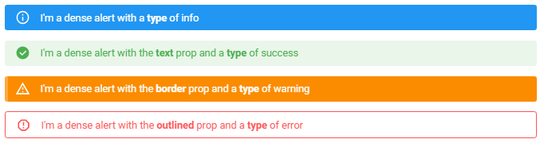
ALERTS

Slide 7

AVATARS

Slide 8

BADGES

Slide 9
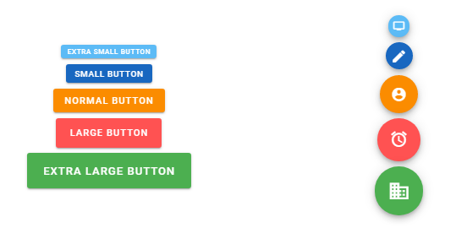
BUTTONS

Slide 10
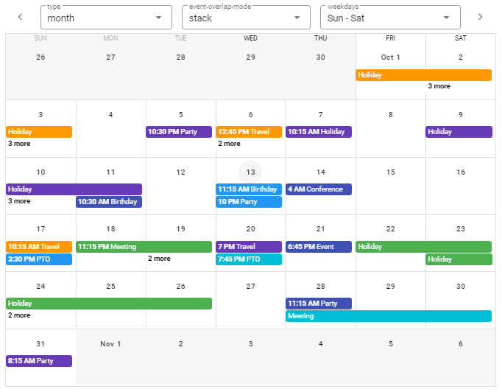
CALENDARS

Slide 11

CARDS

Slide 12

CHIPS

Slide 13
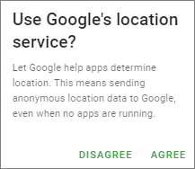
DIALOGS

Slide 14
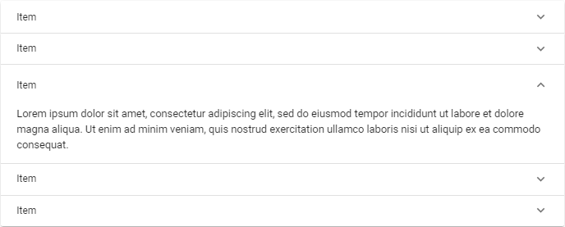
ACCORDIONS

Slide 15
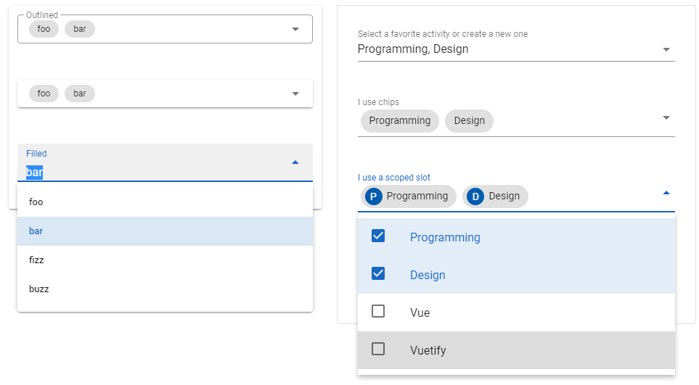
AUTO-COMPLETES / COMBO-BOXES

Slide 16
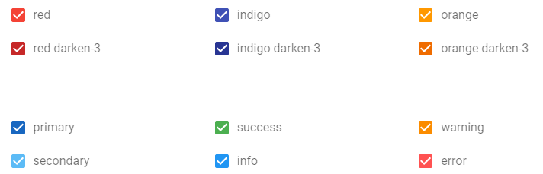
CHECKBOXES

Slide 17
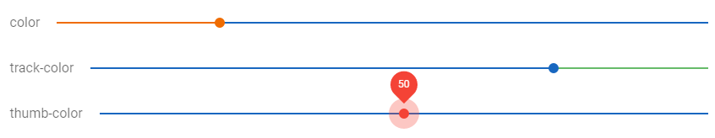
SLIDERS

Slide 18
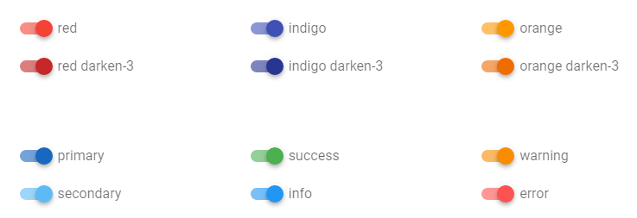
SWITCHES

Slide 19
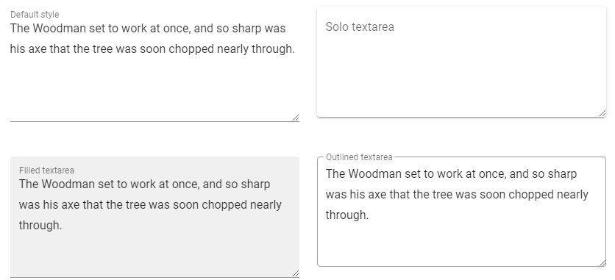
TEXTAREAS

Slide 20
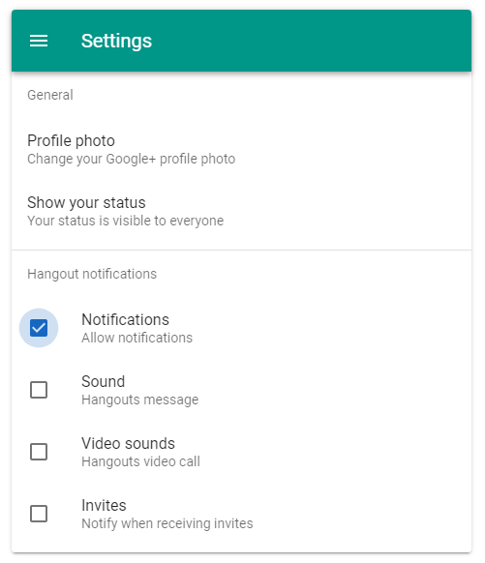
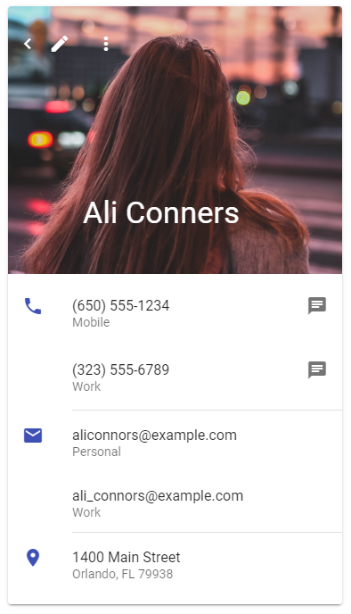
LISTS

Slide 21
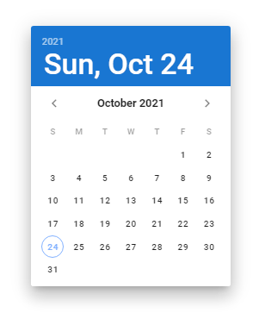
DATE PICKERS

Slide 22
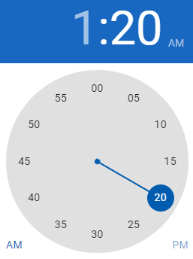
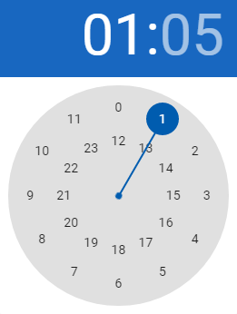
TIME PICKERS

Slide 23
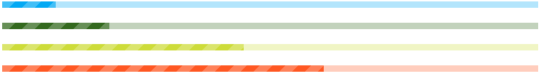
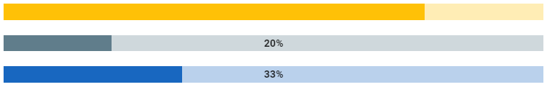
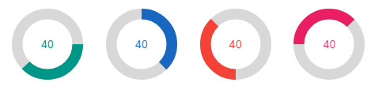
PROGRESS BARS

Slide 24
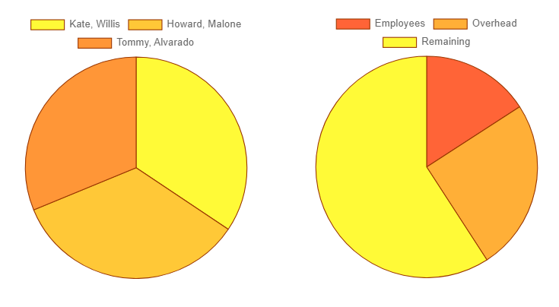
CHARTS

Slide 25
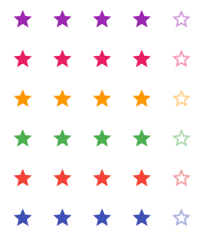
RATINGS

Slide 26
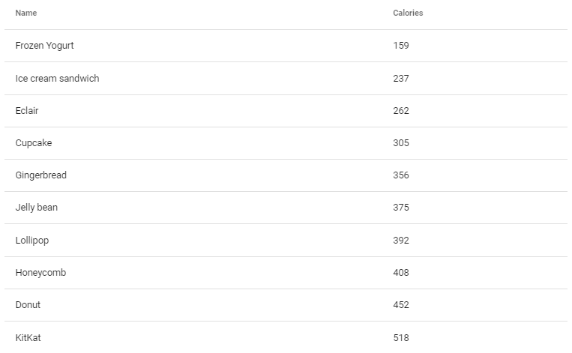
SIMPLE TABLES

Slide 27
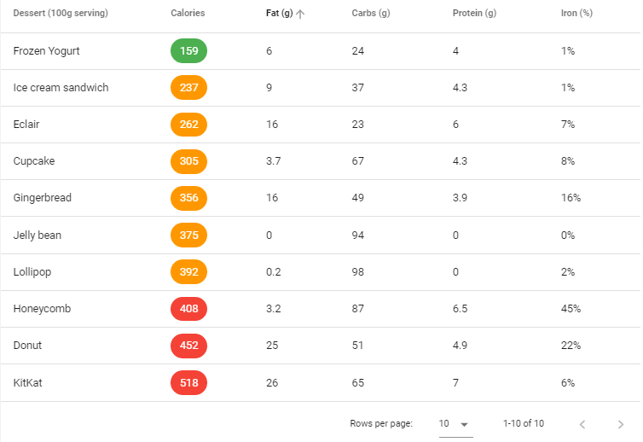
COMPLEX TABLES

Slide 28
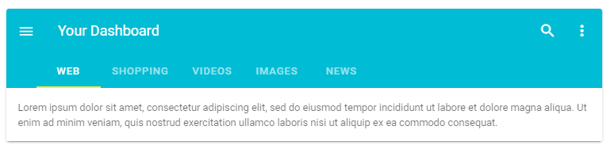
TABS

Slide 29
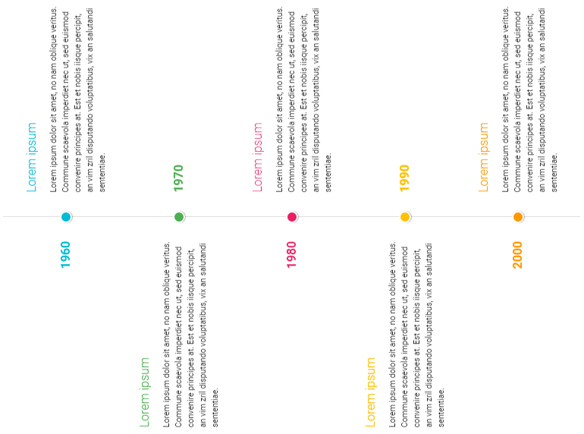
TIMELINES

Slide 30
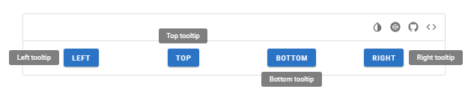
TOOLTIPS

Slide 31
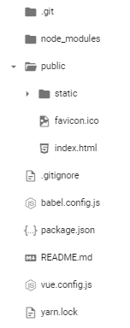
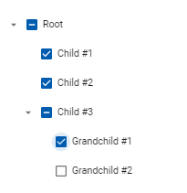
TREES

Slide 32
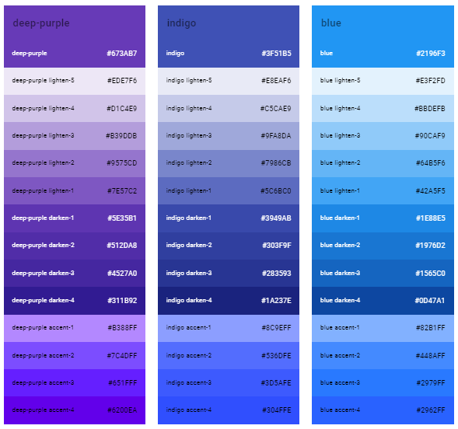
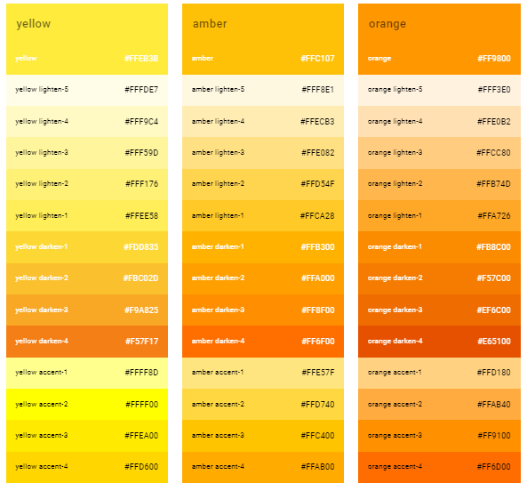
COLORS

