Slide 1

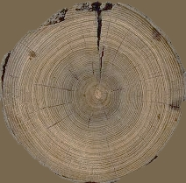

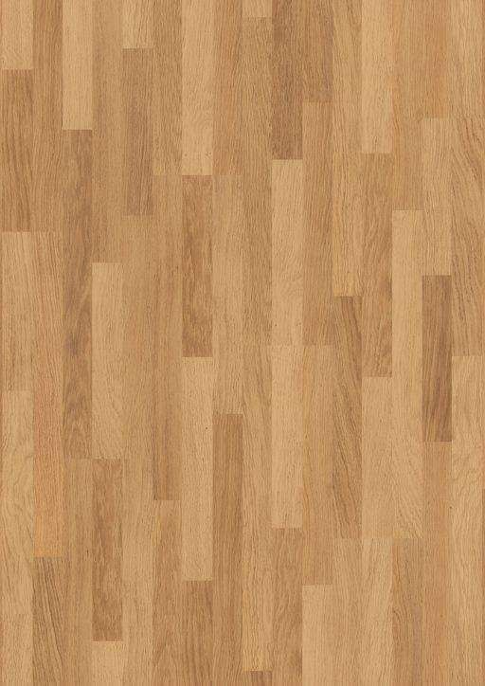
555 cm
395 cm
260 cm
BATHROOM
LVL 1

Slide 2

1615 cm
BATHROOM
LVL 2
395 cm
260 cm
BATHROOM
LVL 1

Slide 3
LAZARUS
ROOMS

Slide 4

555 cm
395 cm
260 cm
BATHROOM
LVL 1

Slide 5
780 cm
395 cm
295 cm
BATHROOM
LVL 1

Slide 6

780 cm
395 cm
260 cm
BATHROOM
LVL 1

