Slide 1
A Right and a Wrong Way to Lead a Testing Effort

Slide 3
Org Specific
Testing Specific

Slide 4
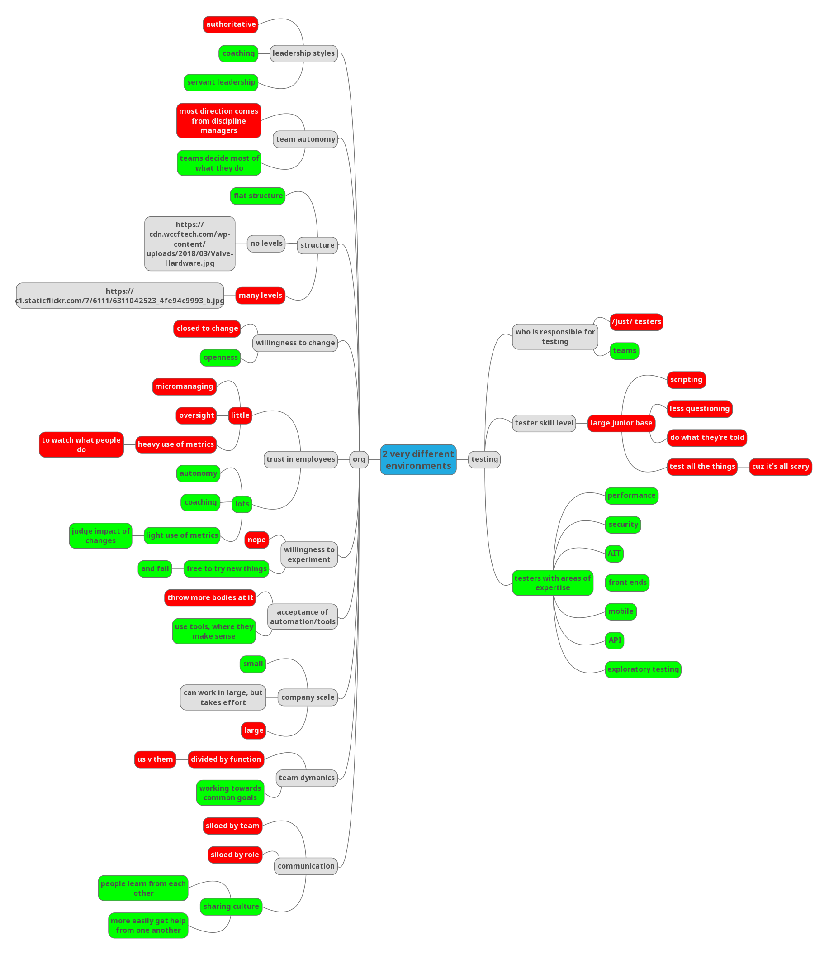

Slide 5
A Right and a Wrong Way to Lead a Testing Effort
Better
Worse

Slide 6
Org/Team Scale
Notes:
Large teams/orgs
Vs
Small nimble teams

Slide 7
Scale
Notes:
It can work in larges orgs

Slide 8
Scale
Notes:
It’s just more difficult

Slide 9
Structure

Slide 10
Leadership Styles
Notes:
Authoritative / command and control / 1 size fits all
Vs
Servant leadership / situational leadership

Slide 11
Team Direction

Slide 12
Trust in Employees
Notes:
Micromanagement / Directives
Vs
Coaching / self direction

Slide 13
Trust in Employees
Notes:
Decisions made by management
Vs
Decisions made by team/employees

Slide 14
Trust in Employees
Notes:
Metrics

Slide 15
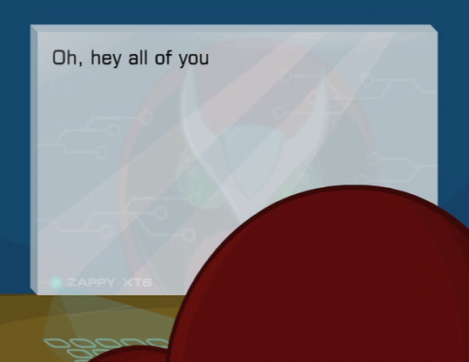

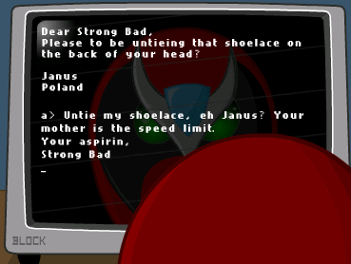



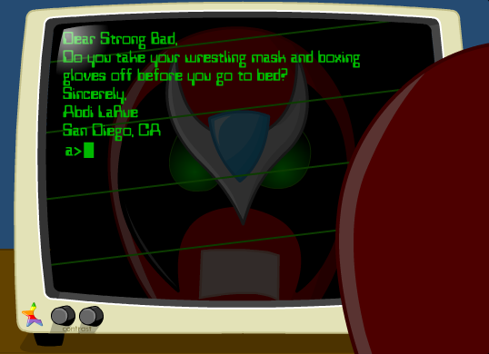
Willingness to Change
http://www.hrwiki.org/

Slide 16
Willingness to Change
Notes:
Nope
vs
Open to ideas/tools

Slide 17
Willingness to Change
Notes:
Words
AND
Actions

Slide 18
Communication
Dev
Ops
Test
Test
Dev
Ops
Dev
Notes:
Siloed by role
Vs
Cross team learning and collaboration

Slide 19
Communication
Test
Test
Test
Team A
Team B
Team C
Test
Notes:
Siloed by team
Vs
Sharing culture

Slide 20
Communication
Dev
Test
Test
Test
Team A
Team B
Team C
Test

Slide 21
Team Dynamics
Dev
Dev
Ops
Test
Test
Dev
Dev
Test
Notes:
Functions pitted against each other
Vs
Common goals and direction

Slide 22
Definition of Quality
Dev
Test
Ops
Test
Test
Test
Dev
Test
Notes:
A thing testers handle
Vs
Owned by the company

Slide 23
Who Tests
Dev
Test
Ops
Test
Test
Test
Test
Test

Slide 24
Who Devs
Dev
Dev
Ops
Dev
Test
Dev
Dev
Dev

Slide 25
Who Ops
Dev
Ops
Ops
Ops
Ops
Test
Ops
Ops

Slide 26
Problem Solving
Notes:
Throw more bodies at it
Vs
Use tools where they make sense

Slide 27
Test Team
ooh, look, the color changed…
I think we’re finally in the testing bucket
NOTICE
JUNIORS ONLY
Notes:
Mostly junior testers
Vs
mixed experiences

Slide 28
Test Team
Notes:
Scripted tested
Vs
Exploration and system knowledge

Slide 29
Test Team
?
?
?
?
?
?
?
?
?
?
?
?
?
?
?
?
?
?
?
?
?
?
?
?
?
?
?
?
?
?
Notes:
Little Questioning
Do what they’re told
Vs
All the questioning
XP to know where/how to test

Slide 30
Test Team
Notes:
Test all the things
Vs
Know risks / product

Slide 31

Tester Skill
Performance
Mobile
APIs
Security
Automation in Testing
REST end points
UI/UX
Exploratory Testing
http://pluspng.com/

Slide 32
In Summary
If your org or group is small or nimble enough, isn’t buried under structure, is led by servant leaders who adjust their leadership style to the individuals needs, has autonomy to make their own decisions (within reason), is trusted to do the right things, is surrounded by a willingness to accept change, communicates with others, across teams and disciplines, intelligently uses tools, is made up of individuals with mixed experience levels who are willing to question others about the system and can adjust their testing to fit the needs and risks of the current context, you’re leading your testing effort the right way.

Slide 33
In Summary
If your org or group is small or nimble enough, isn’t buried under structure, is led by servant leaders who adjust their leadership style to the individuals needs, has autonomy to make their own decisions (within reason), is trusted to do the right things, is surrounded by a willingness to accept change, communicates with others, across teams and disciplines, intelligently uses tools, is made up of individuals with mixed experience levels who are willing to question others about the system and can adjust their testing to fit the needs and risks of the current context, you’re leading your testing effort the right way.
better

Slide 34
Thanks!
Erik Davis
me@erikld.com
@erikld
This work is licensed under a Creative Commons Attribution-ShareAlike 4.0 International License.

