Slide 1
1
2
0
1
2
0
2
0
0
1
0
0
1
0
1
2

Slide 2
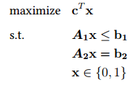
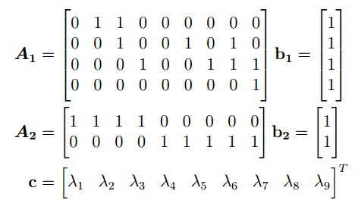
1
2
0
1
2
0
2
0
0
1
0
0
1
0
1
2
1
9

Slide 3
s
1
This formulation is not correct.
Target 1 can’t select 2->1, but target 2 can select 2->1.
Cost is also different for edges when using this formulation.
2
0
1
2
0
0
0
1
0
0
2
0
t

Slide 4
This will solve each tree locally,
but not the global forest.
Missing: mutual exultation
s
1/1
1/1
Demand = 2
1
2
Constrains:
Max flow = 1
Cost element in R
Only one target per measurement (node)
0
1
2
0
2
0
0
1
0
0
1
0
1
2
Demand = -2
t

