Slide 1
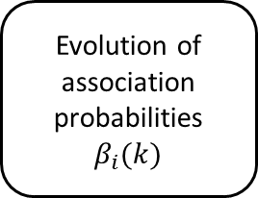

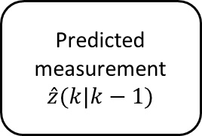
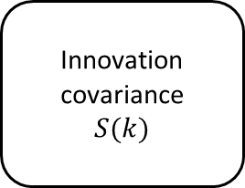
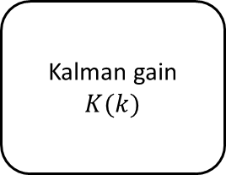
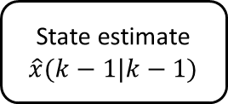
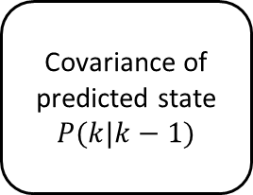
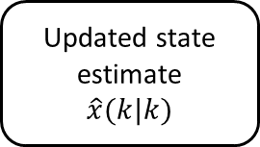
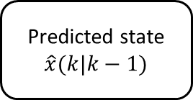
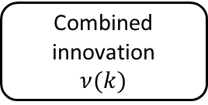
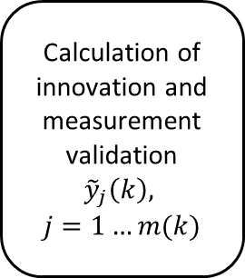
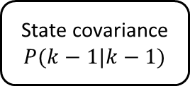
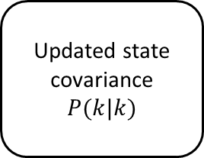
State estimate
$$\hat{x}(k−1|k−1)$$
State covariance
$$P(k−1|k−1)$$
Predicted state
$$\hat{x}(k|k−1)$$
Covariance of predicted state
$$P(k|k−1)$$
Predicted measurement
$$\hat{z}(k|k−1)$$
Innovation covariance
$$S(k)$$
Measurements
Calculation of innovation and measurement validation
$${\tilde{y}}_{j}\left(k\right),$$
$$j=1…m(k)$$
Kalman gain
$$K(k)$$
Effect of measurement uncertainty on state covariance
$$\tilde{P}(k)$$
Evolution of association probabilities
$$β_{i}(k)$$
Combined innovation
$$ν(k)$$
Updated state covariance
$$P(k|k)$$
Updated state estimate
$$\hat{x}(k|k)$$

