Slide 1
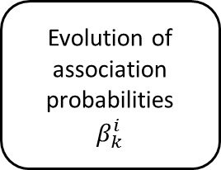

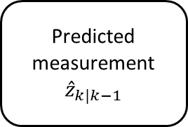
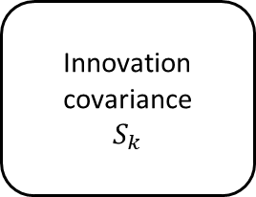
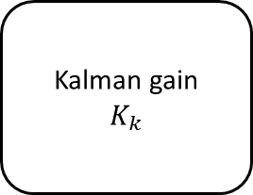
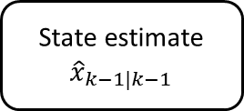
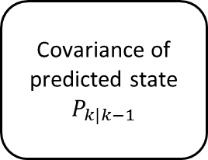
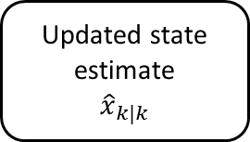
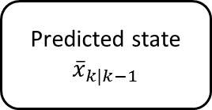
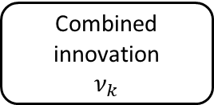
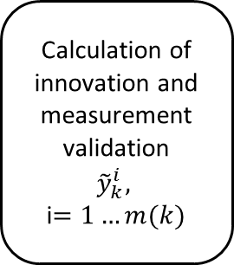
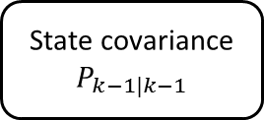
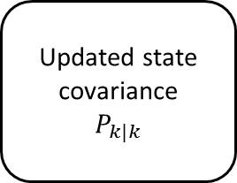
State estimate
$${\hat{x}}_{k−1|k−1}$$
State covariance
$$P_{k−1|k−1}$$
Predicted state
$${\overline{x}}_{k|k−1}$$
Covariance of predicted state
$$P_{k|k−1}$$
Predicted measurement
$${\hat{z}}_{k|k−1}$$
Innovation covariance
$$S_{k}$$
Measurements
Calculation of innovation and measurement validation
$${\tilde{y}}_{k}^{i},$$
i$=1…m(k)$
Kalman gain
$$K_{k}$$
Effect of measurement uncertainty on state covariance
$${\tilde{P}}_{k}$$
Evolution of association probabilities
$$β_{k}^{i}$$
Combined innovation
$$ν_{k}$$
Updated state covariance
$$P_{k|k}$$
Updated state estimate
$${\hat{x}}_{k|k}$$

