Slide 1
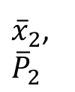
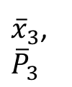

Current leaf node
A1-RAW
A1-FILTERED
X0, P0
A1,pred
${\overline{x}}_{2}$,
$${\overline{P}}_{2}$$
R1
${\overline{x}}_{3}$,
$${\overline{P}}_{3}$$
${\overline{x}}_{1}$,
$${\overline{P}}_{1}$$
R2

