Slide 1
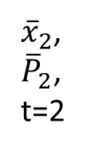
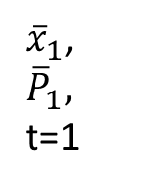
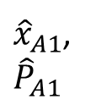
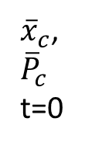
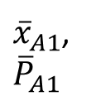
A2(t=2)
Current leaf node
A1 (t=1)
${\overline{x}}_{c}$,
$${\overline{P}}_{c}$$
t=0
${\hat{x}}_{A1}$,
$${\hat{P}}_{A1}$$
R3
${\overline{x}}_{1}$,
$${\overline{P}}_{1},$$
t=1
F1
R1
${\overline{x}}_{A1}$,
$${\overline{P}}_{A1}$$
${\overline{x}}_{2}$,
${\overline{P}}_{2}$,
t=2
Accuracy > 10m
Accuracy < 10m
R2

