Slide 1

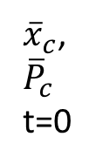

A2(t=2)
Current leaf node
A1 (t=1)
${\overline{x}}_{c}$,
$${\overline{P}}_{c}$$
t=0
R3
$$\overline{A1}$$
R1
$$\overline{A2}$$
R2

