Slide 1


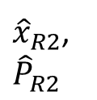
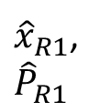
Current leaf node
$x_{c}$,
$$P_{c}$$
R3
R1
${\hat{x}}_{R1}$,
$${\hat{P}}_{R1}$$
${\overline{x}}_{1}$,
$${\overline{P}}_{1}$$
${\hat{x}}_{R2}$,
$${\hat{P}}_{R2}$$
R2

