Slide 1

BC-0504
Nature of Information
Days 2 and 3
Professor: Fancisco Javier Ropero Peláez
Santo André, September, 2017

Slide 2
Notes on the “essay assignement”
Printed essays must be handed at the end of the first test ( December, the 7th)
The essay consits in commenting one of the articles of PesquisABC using the knowledge of NI.
The evaluation of the essay could add two points to the final grade (either to the first or to the second chance test).
A few pages with good ideas is better than many pages with no real content.

Slide 3
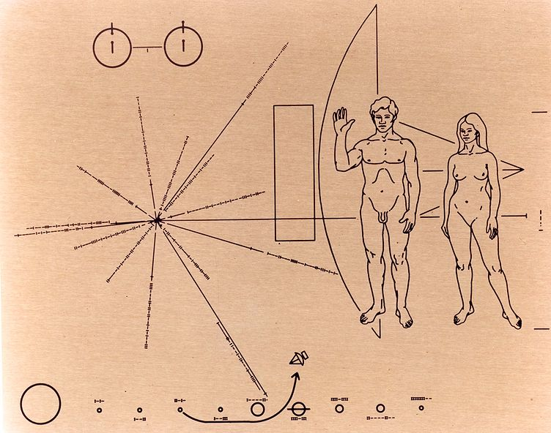
3
1
2
4
5

Slide 4
Tasks:
Discuss the potential for the Pioneer X plaque to convey information, in a manner similar to the discussion that was held regarding paintings of hands in the caves.
What are the three elements of semiotic triangle in this case?
The elements of the plaque would be icons, indices or symbols?
What type of sign would be the arrow that indicates the direction of the probe Pioneer X.
Do you think an intelligent being from another planet (in case it exists) could decode the plaque?

Slide 5
Elements of an information transmission system
Emitter
Receptor
Channel
Emitter
Repertoire
Receptor
Repertoire

Slide 6
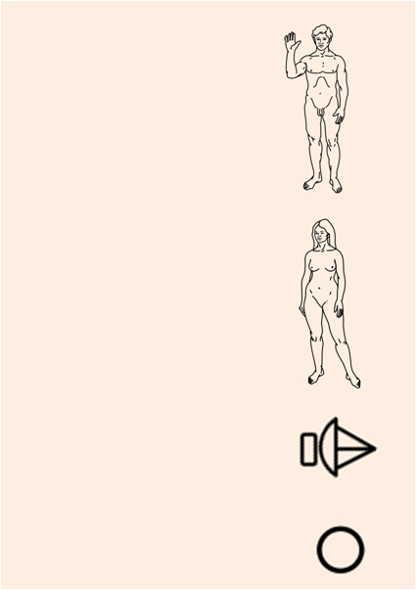


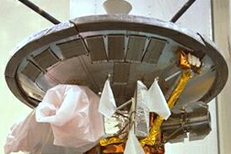
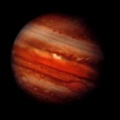
According to semiotics, a table listing the sign and the object is called the Repertoire, code table or, simply, code.
Let us remember that the process of converting an object into a sign is called encoding.

Slide 7
Some examples of repertoires, code tables or codes

Slide 8
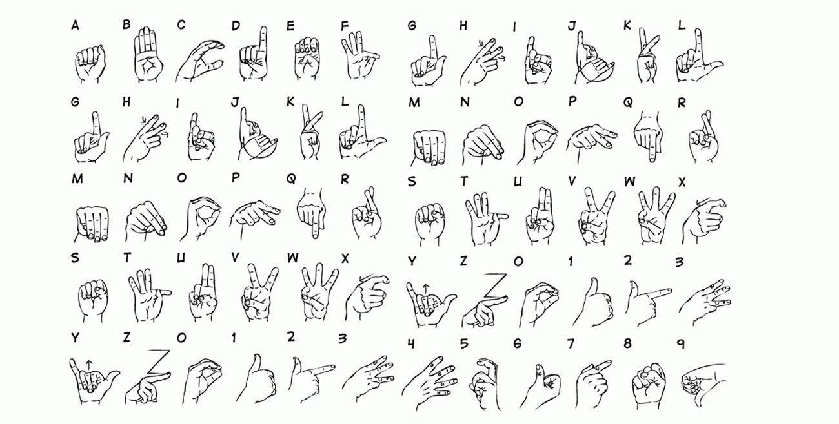
LIBRAS CODE

Slide 9
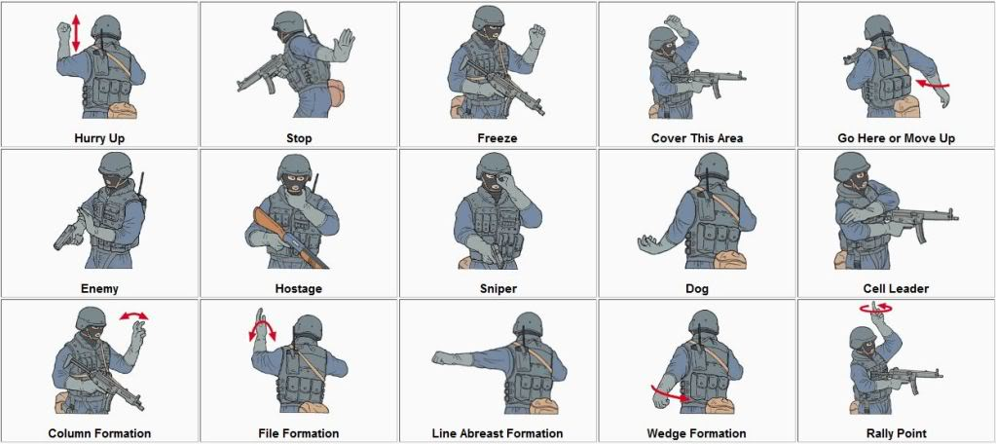
Special forces hand and arm code

Slide 10
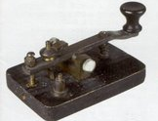
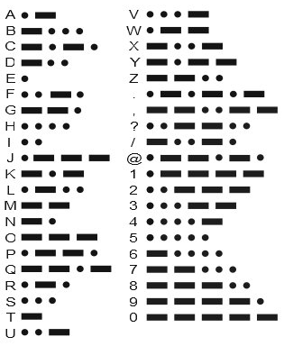
Telegraphy: Morse Code
Binary code created by Samuel F.B. Morse in 1837
The letters are represented by a sequence of points and lines.
Points and lines are high voltage levels,

Slide 11
The secret repertoires
(Cryptography in the Second World War)

Slide 12
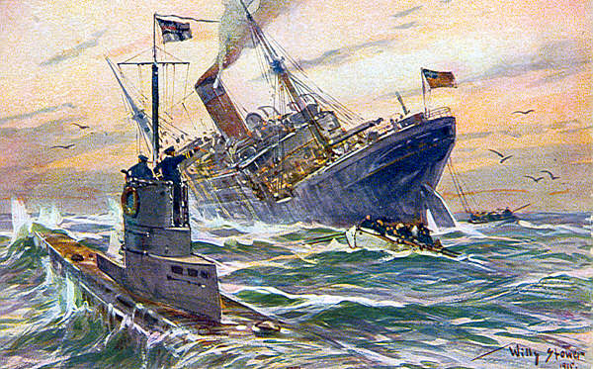
II World War “U-boats”

Slide 13
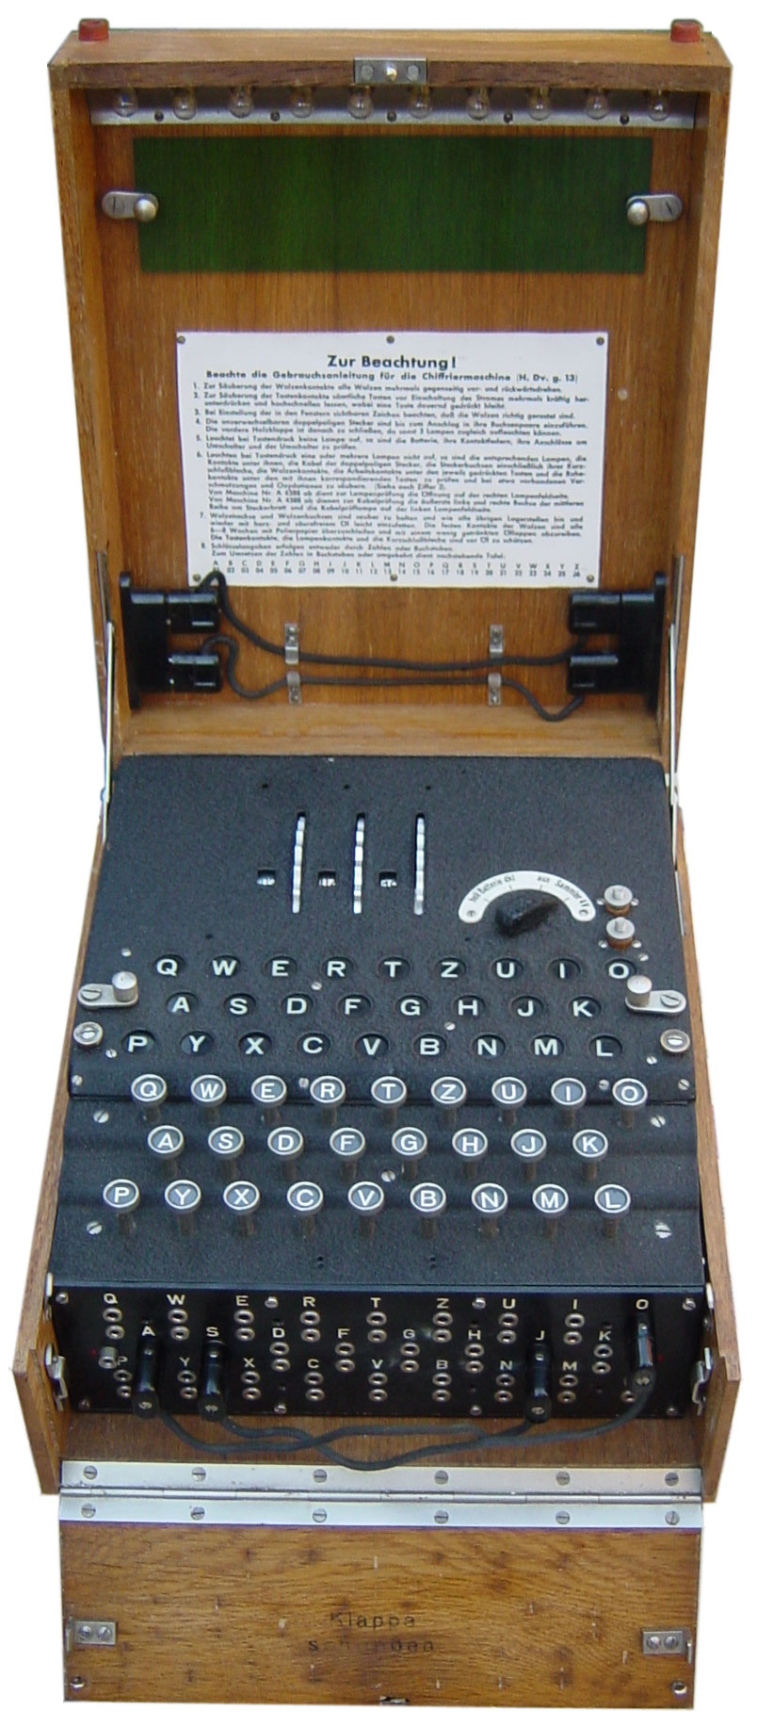
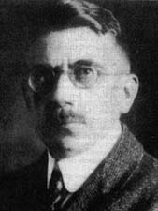
Enigma
The German Arthur Scherbius invented a machine for encrypting messages "Enigma“ with 3x10^114 different configurations
This amount is equivalent to every atom of the universe trying a trillion combinations per second since the beginning of the universe.

Slide 14
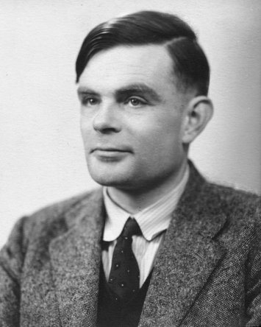
Turing and his colleagues of Blethley broke the Enigma code
Found that the Enigma machine never left any letter without change.
It was likely that frequently transmitted information had to do with climatology: "the weather is nice today“
One Enigma machine was found in a german submarine.
The Enigma code breaking allowed the destruction of the German submarines U-boats and the end of the war.

Slide 15
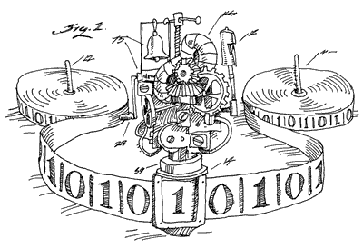
Turing also developed the first theoretical computer:
The Turing machine
Consisted of a machine that moved by an endless Ribbon.
It was the first computer that used a program.
The machine read, write, and erase symbols on tape.
The Turing machine had "universal computability“: it could simulate the logic of any computer algorithm.

Slide 16
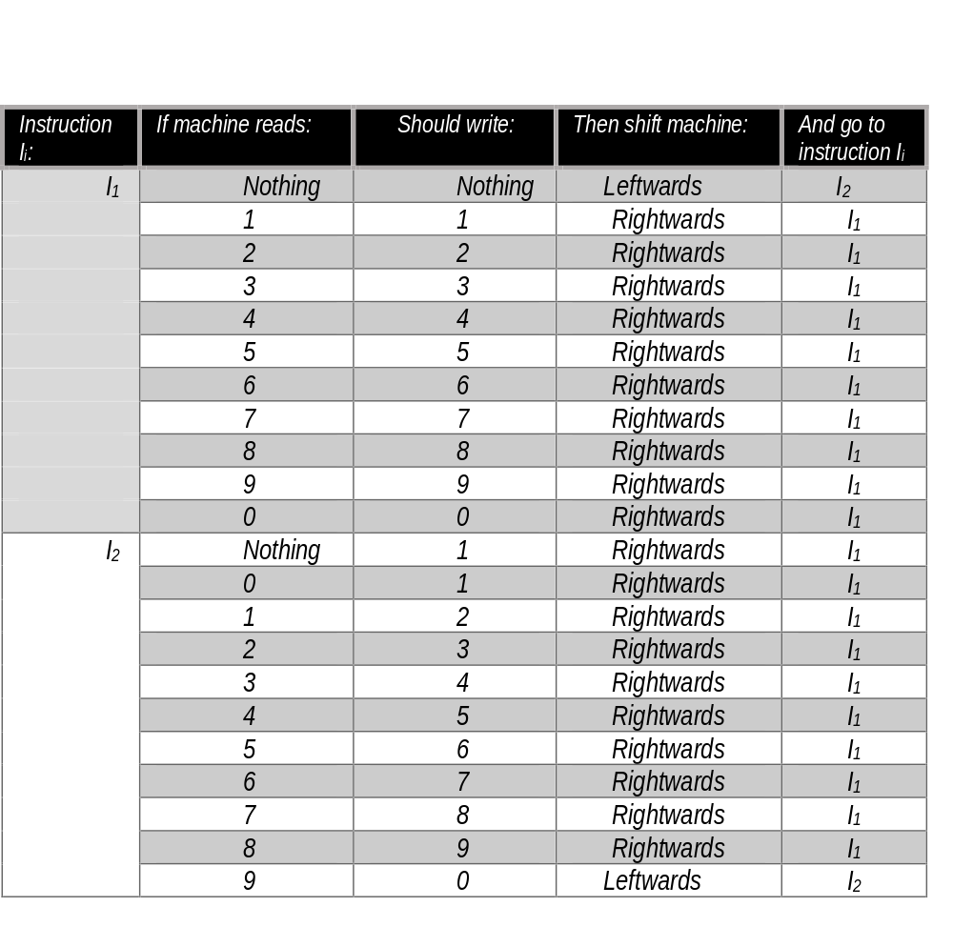
Program in Turing machine for allowing decimal counting

Slide 17
Turing also developed the first theoretical computer:
The Turing machine
Claude Shannon proposed in 1956 to use only binary symbols (digital codes).
This improvement didn’t alter Turing machine capabilities
From then, all Turing machines and computers utilize digital codes.

Slide 18
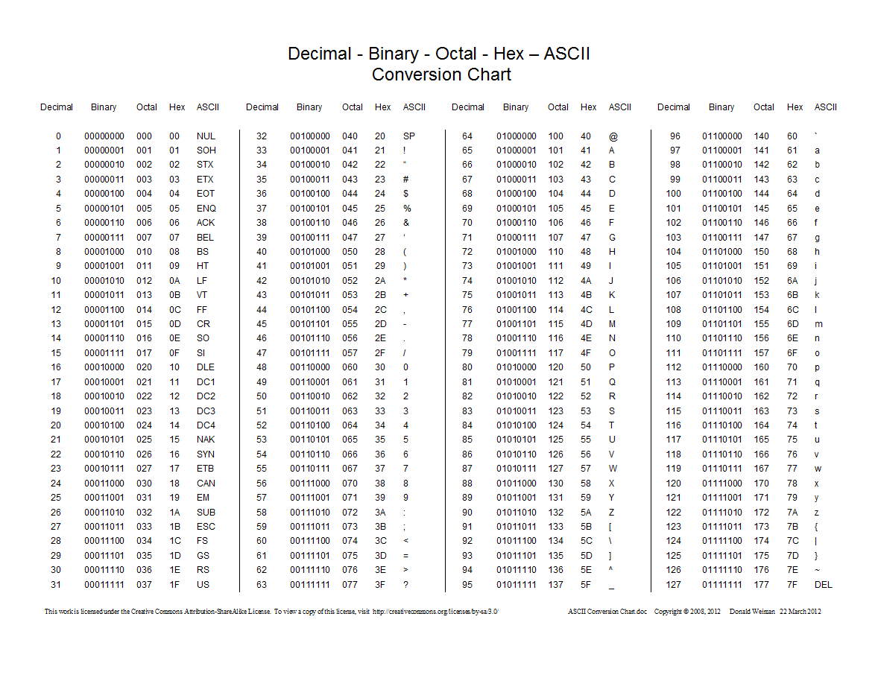

Código ASCII

Slide 19
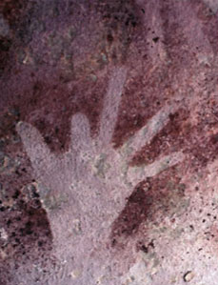
Exercise:
Is it possible that hand stencils found in Gargas and Cosquer caves are digital codes?
Or are they numeric codes like hand codes in LIBRAS?
http://www.kimberleyfoundation.org.au/irregular-infill-animal-period-ipad/

Slide 20
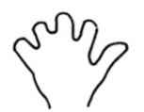














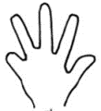
0 0 0 0
1 0 0 0
0 0 0 1
1 0 0 1
1 0 1 0
0 0 1 0
1 0 1 1
0 0 1 1
1 1 0 0
0 1 0 0
0 1 0 1
1 1 0 1
0 1 1 0
1 1 1 0
0 1 1 1
1 1 1 1

Slide 21
Gargas hand stencils
In the year 2014, there was an improvement in the interpretation of the meaning of the hands in Gargas and Cosquer caves.
Karenleigh A. Overmann of Oxford University suggested that the hands represent a primitive integer counting system.
Research has shown that there are five different positions of the fingers for the first five integers.

Slide 22
A
B
C
D
1
2
3
4
5
6
7
8
9
E
H
G
F

Slide 23
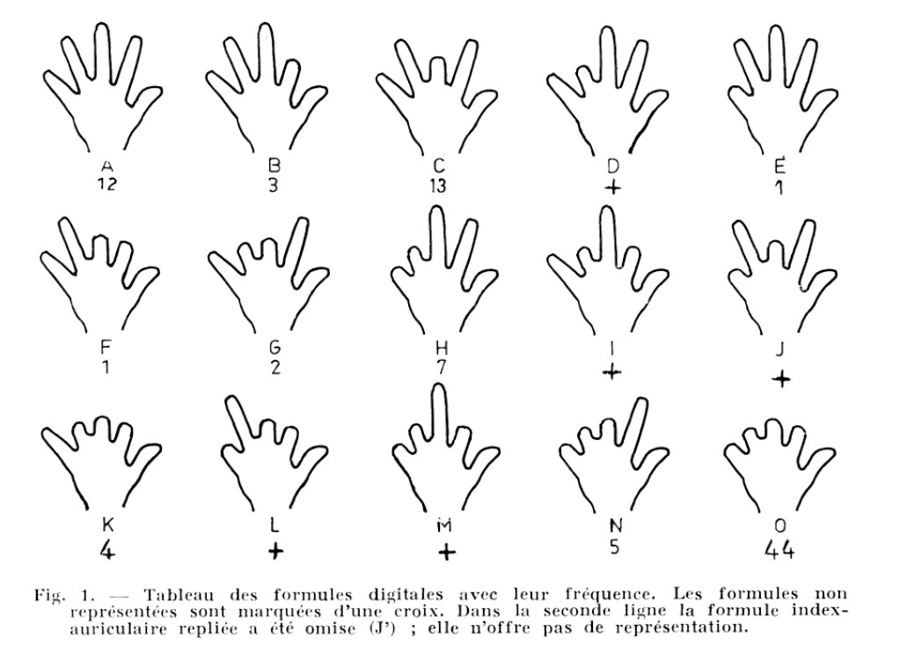

Slide 24
Classroom exercise:
How many codes we can produce with four fingers?
How many fingers are necessary for producing 32 codes.

Slide 25
Numeric codes:
Numeric codes are specific type of codes.
In which each symbol has a positional value besides its usual value.
In the numeric code “date” each element has a positional value: 03/10/2014
In the case of the numeral systems, the positional value is obtained by multiplying the symbol value by a power of the base, as follows:

Slide 26
Vp(S)=V(S)*B^{P(S)}
In a number, each symbol, S, has a:
Basic value, V(S)
and a positional value V_{p}(S).
Depending on the number base B
and on the symbol relative position, P(S), inside the numeric code.
P(S) is zero for the least significative symbol and is incremented in one unit for each following position.

Slide 27
For example, in the decimal number 649₁₀ number "6" has a positional value of 600 (six hundred), 4 has a positional value of 40 (4 dozen), and 9 have a positional value of 9 (9 units).
The value (in units) of the number is the sum of the positional values.
V (649₁₀) = V_{p} (6) +V_{p}(4) + V_{p}(9) =
=6*10² + 4*10¹ + 9 *10⁰= 600 + 40 + 9
In decimal numeral system the least significant digit is on the right and the most significant on the left.

Slide 28
Numeral systems (or systems of numeration)
Binary system (base 2)
Octal System(base 8)
Decimal system(base 10)
Dozenal system (base 12)
Hexadecimal system(base 16)
Vigesimal system (base 20)
Sexagesimal system (base 60)

Slide 29
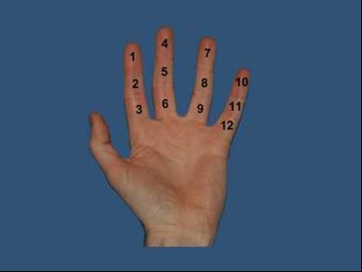
Finger counting (sumerian culture, 3000 bc)
Sumerians count to 12 units with the left hand by touching with the thumb the phalanges of the other fingers.

Slide 30
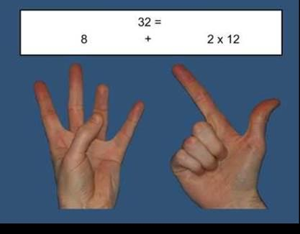

Finger counting (sumerian culture, 3000 bc)
Sumerian counting:
32₁₀=28₁₂
Units
Dozens

Slide 31
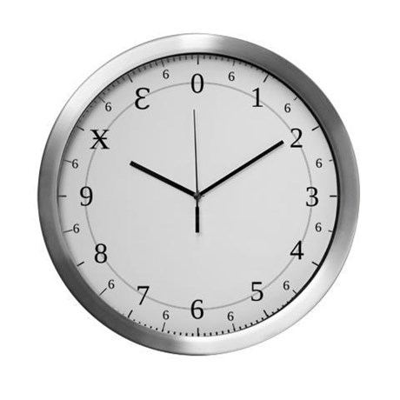
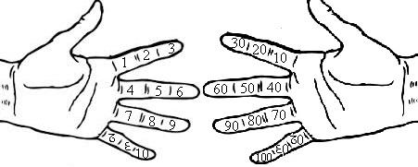
Dozenal Society proposal
Back to dozenal system
Where a foot was 12 inches.
Shilling was 12 pences.
British and irish became decimal a the “Decimal day” (February the 15th 1971)
Numbers:1,2,3,4,5,6,7,8,9,X,E,10...

Slide 32
Decimal value of a dozenal number
Let us remember that Vp(S)=V(S)*B^{P(S)}
Let us calculate V₁₀(E28₁₂)
Positional value of E: V_{p}( E)=V(E)*B^{P(E)}=11*12²=1584.
Positional value of 2: V_{p}( 2)=V(2)*B^{P(2)}=2*12¹=24
Positional value of 8: V_{p}( 8)=V(8)*B^{P(8)}=8*12⁰=8
V₁₀(E28)= V_{p}(E)+V_{p}(2)+V_{p}(8)= E*12²+2*12¹+8*12⁰=11*144+2*12+8=1616
In this case all operations are done in base 10.

Slide 33


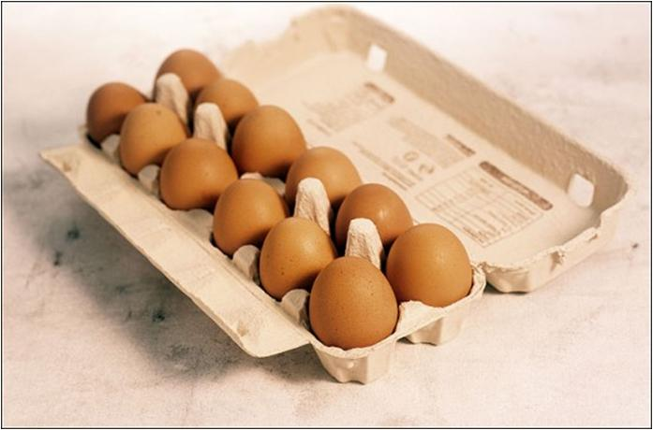
27 eggs. How many in dozenal? V₁₂(27₁₀) ?
From decimal to other base (12 in this example)

Slide 34
27 eggs. How many in dozenal? V₁₂(27₁₀) ?
From decimal to other base (12 in this example)

Slide 35
27 eggs. How many in dozenal? V₁₂(27₁₀) ?
From decimal to other base (12 in this example)
27 12
3 2
Dozens
Units

Slide 36
27 eggs. How many in dozenal? V₁₂(27₁₀) ?
From decimal to other base (12 in this example)
27 12
3 2
Dozens
Units
27₁₀= 23₁₂

Slide 37

196₁₀ eggs. How many in base 12?
196 12
4 16
Uniits
Dozens

Slide 38
196₁₀ eggs. How many in base 12?
Gross =12 dozens
196 12
4 16
Units
12
196₁₀=144₁₂
4
1
Gross
Dozens

Slide 39
The opposite: 144₁₂. How many in base 10?
Gross =12 dozens
144=1gross+4dozens+4units=
1x12dozens+4dozens+4units=
1x12x12eggs+4x12eggs+4eggs=
1x12^{^2}+4x12^{^1}+4x12^0=196eggs
Classroom Exercise: Repit calculus using positional equation.

Slide 40
Hexadecimal
Hexadecimal:1,2,3,4,5,6,7,8,9,A,B,C,D,E,F,10,11,12,13 14,15, 16, 17,18,19,1A , 1B, 1C, 1D, 1E, 1F, 20
3FA₁₆ = ?₁₀
  3FA₁₆= 3X16² +15x16¹ +10x16⁰ =3x256+15x16+10=
  =768+240+10=1018₁₀

Slide 41
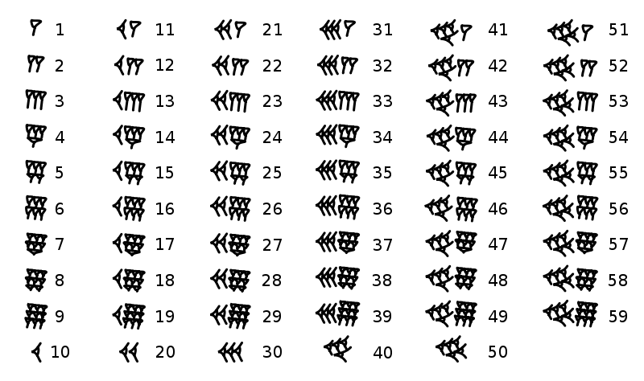
Sexagesimal system(sumerian)

Slide 42
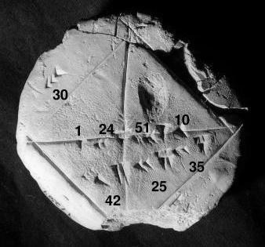
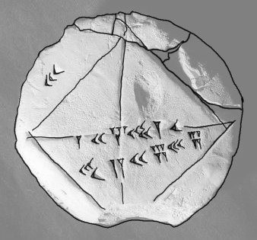
The marks around the center of the YBC 7289 plate (1600 BC) consists of 4 digits: |, < < || ||, < < < < < |, and <.. Representing the value of the diagonal triangle with catheti = 1 and whose Hypotenuse value is 1.414213
Positional values of symbols in negative positions
Sexagesimal.

Slide 43
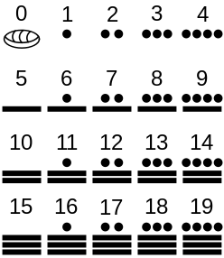
Maya numeral system (base 20):

Slide 44
Homework: Convert from decimal to hexadecimal any of the 14 binary codes representing pulsar frequency in Pioneer X plaque
Pulsar | Binario | Decimall, octal hexadecimal
1 | 1000110001111100100011011101010
2 | 10110010011000101011101101111
3 | 100000110110010110001001111000
4 | 111100011011011001010100111
5 | 10101011011001101100101000011
6 | 101100111011010101011110001011
7 | 10110011100000101010000010
8 | 100111101000110101000100111000100
9 | 111100011111100011111000010110
10 | 101101100101101001000010110001
11 | 101111001111001110011000001101
12 | 11110010111110001110100011110
13 | 10011001011010111010010111000
14 | 100000110100101010001110101100

Slide 45

Arithmetic Operations

Slide 46
Operations on binary system
Operations
  Addition
  Subtraction
  Multiplication
  Division

Slide 47
Operations on binary system
Addition operation
  0 + 0 = 0
  0 + 1 = 1
  1 + 0 = 1
  1 + 1 = 1 0
  With 1 transport to the position immediately following (left)
  1 + 1+1 = 1 1

Slide 48
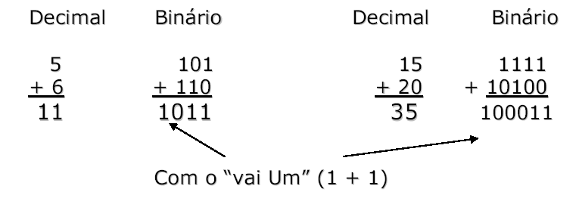
Operations on binary system
Addition operation
/

Slide 49
Operations on binary system
Subtraction operation
0 – 0 = 0
  0 – 1 = 1 1
    1 with 1 transport to the position immediately following (left)1 – 0 = 1
  1 – 1 = 0

Slide 50
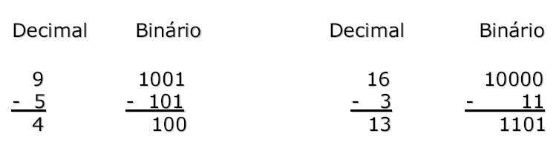
Operations on binary system
Subtraction operation

Slide 51
Operations on binary system
  An easier way to do subtraction of binary numbers is adding the 'COMPLEMENT of 2’ to the other
  For example, 11001001 is the complement of the 00110111 number. So, you have to:
  10010101 10010101
    - 00110111 + 11001001
    01011110 01011110
  How to obtain the complemente of 2 of a number?

Slide 52
Operations on binary system
Ex. 1101 – 1100 = 0001
  Keep the minuend ⇒ 1101
  Inverte o subtrahend (compl. 1) ⇒ 0011
  Sum 1 to subtrahend (compl. 2) ⇒ 0100
  Sum minuend to subtrahend ⇒ 10001
  Ignore the “carry" ⇒ 0001
    1101 1101
    + 0100 - 1100
    10001 0001

Slide 53
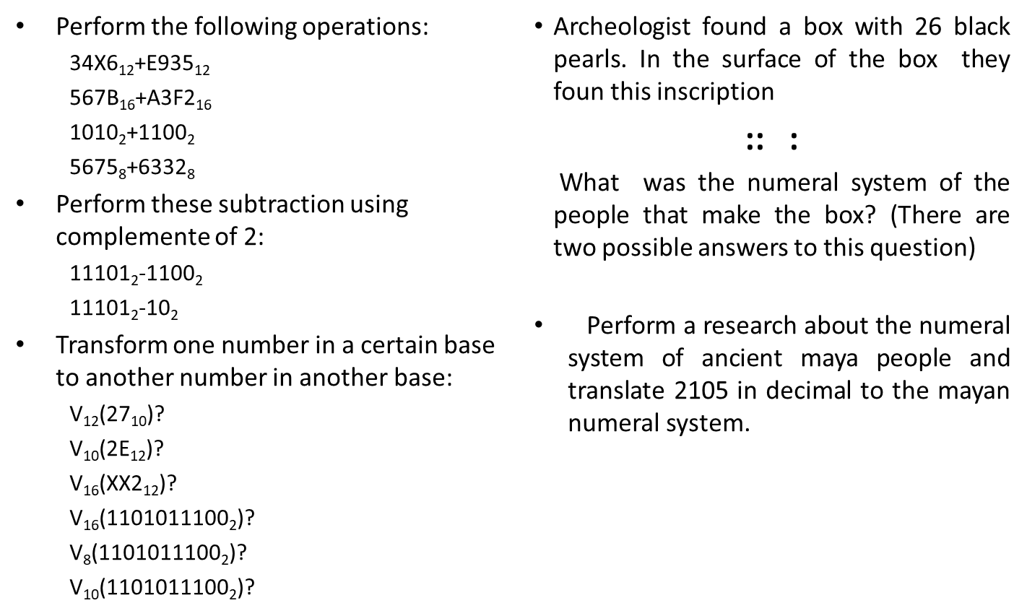
Homework

