Slide 1
Política Internacional dos EUA e da União Europeia Rumo à Pax Americana
TIDIA: PI_EUA_UE_2018.1
28 de fevereiro de 2018
Prof. Giorgio Romano

Slide 2
KEEP UP TO DATE ON WORLD AFFAIRS
54ª Conferência de Segurança de Munique (Munich Security Council) (16-18 de fevereiro)
The major global forum for the discussion of security policy. Each
February, it brings together more than 450 senior decision-makers
from around the world, including heads-of-state, ministers, leading personalities of international and non-governmental organizations, as well as high ranking representatives of industry, media, academia, and civil society, to engage in an intensive debate on current and future security challenges. ("transatlantic family meeting.“)
National Security Advisor H.R. McMaster: “evidence of Russian
interference in the U.S. presidential election was incontrovertible.”
Tweeter Trump: General McMaster forgot to say that the results
of the 2016 election were not impacted or changed by the Russians and that the only Collusion was between Russia and Crooked H, the DNC and the Dems. Remember the Dirty Dossier, Uranium, Speeches,Emails and the Podesta Company!”

Slide 3
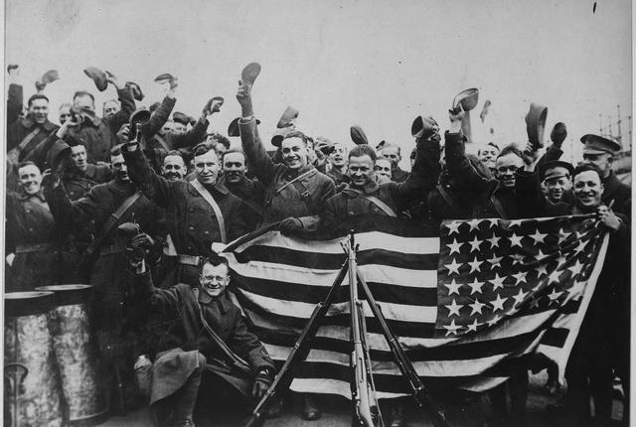
Primeira Guerra Mundial 1914-1918
Até abril 1917 política de não intervenção nas tradicionais disputas de poder na Europa.
Que mudou?
Risco de alteração de equilíbrio de poder desfavorável aos EUA (vitória alemã seria contrario aos interesses dos EUA) + Zimmermann note (México)
Narrativa (missão): entrada em favor das forças não-autoritários em favor
da democracia.

Slide 4
Justificativa declaração de guerra 2 de abril de 1917
A steadfast concert for peace can never be maintained
Except by a partnership of democratic nations. No autocratic
government could be trusted to keep faith within it or
observe its covenants... Only free peoples can hold their
purpose and their honour steady to a common end and
prefer the interests of mankind to any narrow interest of
their own.
Russia was known by those who knew it best to have been
always in fact democratic at heart...The autocracy that
crowned the summit of her political structure, long as it had
stood and terrible as was the reality of its power, was not in
fact Russian in origin, character, or purpose; and now it has been
shaken off and the great, generous Russian people have been
added...to the forces that are fighting for freedom in the world, for justice, and for peace. Here is a fit partner for a league of honour.

Slide 5
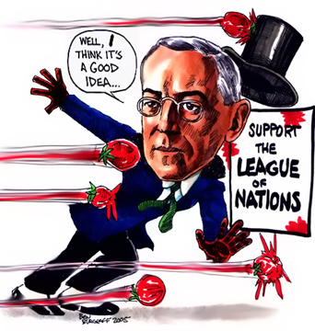
Internacionalismo contestado
Internacionalismo do
Presidente Wilson contrário
à opinião pública.
Eleições 1920 campanha candidato vencedor (Warren Harding):
“return to normalcy” + “America first”
https://www.youtube.com/watch?v=xaRYBPJmK88
Rejeição do ativismo do Theodore Roosevelt e do idealismo do Woodrow Wilson
“America´s present need is not heroics but healing; not nostrums but normalcy, not revolution, but restoration...not surgery, but serenity”.

Slide 6
Presidente Calvin Coolidge (1923-1929)
First Annual Message (12/1923)
Our foreign policy has always been guided by two
principles. The one is the avoidance of permanent
political alliances which would sacrifice our proper
independence. The other is the peaceful settlement
of controversies between nations…
It is 100 years since our country announced the Monroe doctrine. This principle has been ever since, and is now, one of the main foundations of our foreign relations. It must be maintained. But in maintaining it we must not be forgetful that a great change has taken place. We are no longer a weak Nation, thinking mainly of defense, dreading foreign imposition. We are great and powerful. New powers bring new responsibilities.

Slide 7
1920-1941
Em nível global: afastamento dos negócios mundiais.
Proposta do Wilson foi retomada durante e depois da II Guerra Mundial
Mas: no eixo hemisférico continuidade política do Corolário Roosevelt até 1932
FDR Good Neighbour Policy:
retirada das tropas;
fim política de intervenções (ex. nacionalização petróleo no México 1938);
processo de consulta e cooperação;
Mais geral: reconhecimento USSR

Slide 8
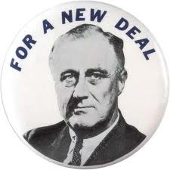
Crise 1929 e o New Deal
Estratégia do FDR: “appearing radical enough to enlist the forces of discontent”
“the forgotten man at the bottom of the economic pyramid”
“ For a more equitable opportunity to share in the distribution of national wealth. Thoso millions cann´t and shall not hope in vain. I pledge you, I pledge myself to a New Deal for the American people...This is more than a political campaign; it is a call to arms. Give my your help, not to win votes alone, but to win this crusade to restore America to its own people.
Democratic Convention, Chicago julho 1932
Democratic Convention, Chicago, julho 1932

Slide 9

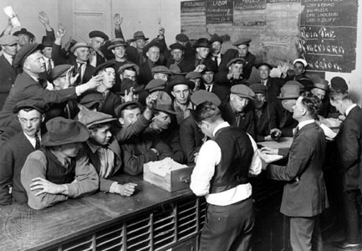
Crise 1929 e o New Deal
Relief, for the unemployed and poor;
Recovery of the economy to normal levels;
Reform of the financial system to prevent a repeat depression.
Employment Bureau in Los Angeles during
the Great Depression

Slide 10
New Deal - Políticas Sociais
Ortodoxia clássica era contra previdência social,
Porque implicaria em redistribuição.
FDR: redistribuição pode aumentar bem
-estar social
1935 Social Security Act (legislação federal)
Verbas federais para os Estados cuidarem de seus idosos e outros fins previdenciários;
sistema federal/ estadual de seguro-desemprego;
sistema nacional compulsório de aposentadoria.
=> tributação específica sobre folha de pagamento

