Slide 1
Introduction
To programming
Serhat Erdogan

Slide 2
Goals of this lesson
Getting to know the students and their background.
Student understand what a job as a developer entails and what job opportunities are possible after this course.
Student knows what an IDE is.
Student can open and use IDE.
Student understands how important it is to have backups. (google drive, cloud, …)
Student can use the online learning platform.
student understands how exam and assignments are organized.
Student know which sites to visit that can help them during this course.
Student can be critical when finding solutions online.
Student can make “Hello world” in Python.

Slide 3
Table of content
Introduction to the course
What is a developer & what job opportunities are there?
What is important as a developer?
What is programming language?
How many programming languages are there?
What is and IDE?
Which IDE’s are there?
Backups
Websites that can help!
Hello world application

Slide 4
Introduction course

Slide 5

Python 1
Class every Monday & Wednesday (6.45-10.15 PM)
Exams after every module
1ste semester: logica, basis programmeren en databases, groupswork
Examens date:
26 October basic programming
19 december databases

Slide 6
Developer & opportunities

Slide 7
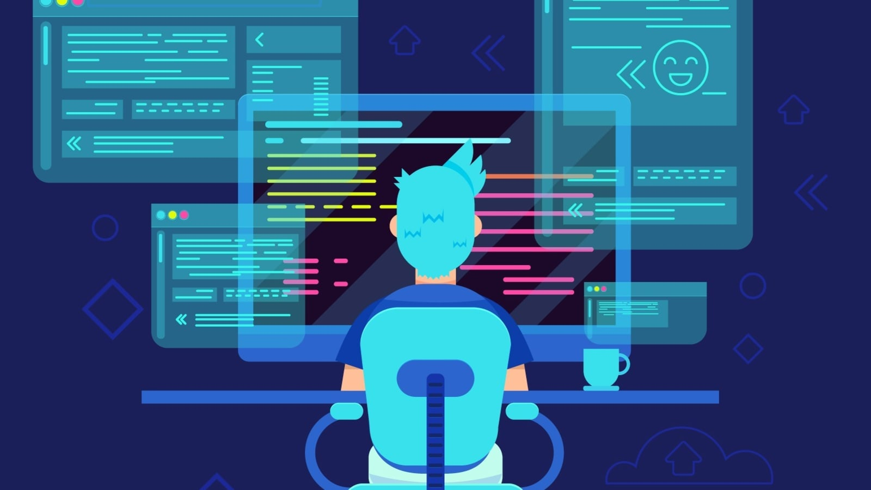
Developer
A developer, also known as a software developer or software coder, builds computer applications by writing, debugging, and executing the source of code in a computer application. Unlike programmers, developers are usually specialized in a specific set of programming languages.
Notes:
https://www.thinkful.com/blog/programmer-vs-developer/
https://www.vdab.be/beroep/263af849-d6f5-425b-9eb9-41aefc558f96/software-ontwikkelaar
What is a Programmer?
A programmer is a professional who writes or creates code for computer applications or software programs. Programmers provide specific instructions pertaining to programming. To be a programmer, you’ll have to actively think about solutions, sometimes abstract in nature, before beginning to code. Programmers have a strong background in coding and computing across several programming languages that often include Structured Query language (SQL), PHP, HTML, JAVA, Extensible Markup Language (XML), C, and C++.
A programmer may be an expert in multiple fields like databases, web development, security development, and more. Depending on their programming skill sets and areas of expertise, they may choose to specialize as application programmers, system programmers, AI and machine learning engineers, or game programmers.
Programmers are primarily responsible for writing code that gives life to computer applications and software programs. They deliberately use multiple programming languages to test out errors and make sure that the code is functional.
What Is A Developer?
A developer, also known as a software developer or software coder, builds computer applications by writing, debugging, and executing the source of code in a computer application. Unlike programmers, developers are usually specialized in a specific set of programming languages. They are also more involved with structuring and developing software core for building software programs. Depending on their specialization, they may be application developers, software developers, web developers, or mobile developers. Though the primary function of a developer is to write code, they may be involved with other tasks related to software documentation, design, software architecture, or the overall development of software.
However, there is some overlap between the functions or work processes of a software developer and those of a programmer. They both use specialized software to organize data. They also use software to look after the security and recovery of data. Additionally, a software developer has to check the compatibility of systems to make sure that the systems run smoothly for everyone involved.
How to Excel as a Programmer
Besides having a strong foundational knowledge in computer science, a programmer should know how to write clear, logical code. Additionally, to stand out as an efficient programmer, you must be able to read and edit other people’s code. Reviewing existing code gives you an opportunity to understand what works and what doesn’t: insight that’s valuable when you’re updating someone else’s application. Reading another programmer’s code could also encourage you to learn new languages, and see how multiple languages interact.
It is essential for a good programmer to have debugging skills. This becomes important if there’s dysfunctional software, in which case the programmer will need to trace back to the root of the problem. These skills can help a programmer build a flow document. Flow documents help programmers investigate the code and find the specific problem, instead of changing the code entirely.
Apart from the technical aspect, a programmer must be a strong team player. They should also remain optimistic when they’re met with failure, and love to research issues: great programmers are able to learn from their mistakes and constantly improve their craft.
How to Excel As A Developer
Every successful developer has to be a good programmer. If you want to be a developer, you must understand how to read and write code. Skillful programming is an art that is a prerequisite to becoming a developer. Even if a software developer has over ten years of experience, they must continue to practice coding to remain proficient.
If you’re interested in knowing which code languages every developer needs to know, we’ve got some recommendations. If you want to be a developer, you shouldn’t aim to find the exact or perfect solution; there is none. Instead, focus on getting as close to your desired goal as quickly as possible. If you practice your skills by taking on personal projects outside the workplace, you’ll become a faster, more efficient programmer. Lastly, despite the experience, an efficient developer should avoid using third-party libraries blindly without verifying the source code.
Other than coding skills, a developer must also be equipped with project management skills and soft skills.
Difference in Compensation
Even though most of the tasks of a programmer and a developer are closely related, their job profiles and career choices are different. The technical skills required for a programmer are coding languages suxh as SQL, JAVA, Microsoft C#, .Net Programming, and JavaScript. On the other hand, the technical skills required for a developer are typically JavaScript, jQuery, web application development, HTML5, and Hypertext Preprocessor. Despite a slight overlap of skills between the two, companies look for different skills during recruitment. Besides being technical, both of the jobs demand that the individuals possess interpersonal skills like communication and team collaboration.
Programmers may choose to become a programming analyst, SAS programmer, systems programmer, mainframe developer, or .Net programmer. Developers, on the other hand, can work as a PHP developer, web application designer, front end developer, user interface developer, and user experience designer. Both of the professions pay well in today’s rapidly evolving IT market. According to a 2018 report, the average annual salary for computer programmers in the U.S. grew to $84,280, while the annual median salary of developers was $103,620.
The difference in the salaries of these two career paths fluctuates. This difference exists because the work of a programmer is more specialized, while developers require a broader range of skills. However, despite the difference in salaries, both are excellent career choices if you’re passionate about coding and crafting user-friendly applications.
How to Begin
If you want to become a programmer, some companies may only require a certificate course in programming or an Associate’s degree. It’s always advisable to enroll yourself in a software engineering course that includes system design and development, programming logic, database management, SQL, and programming languages. Programmers must continue to write and learn different codes as the field is rapidly advancing. With experience, a programmer gradually grows to become a supervisor, lead programmer, or analyst.
On the other hand, a developer must be educated in either computer science or software engineering. You may encounter math requirements like calculus, linear algebra, and differential equations. Software engineering also offers specialized programs in computer programming, networking, and operating systems.
Software developers work in two major areas—system software and application software, both of which require efficient knowledge base in Java, C, and C++. Patience is one of the key soft skills that software developers and coders need besides specialization in various languages and programs.
Deciding Whether to Be A Programmer or A Developer
To review, it’s the scope of work that differentiates these two professions. While programmers are involved with more in-depth work and require more technical specialization than developers, developers need to handle a broader range of work that includes overseeing the whole project, or even managing a team of developers.
All in all, choosing a career as a programmer or a developer is entirely up to your preference. Both are challenging careers that are in high demand. Both provide very comfortable salaries and lead to a wide array of enviable benefits, like work-from-home opportunities and generous paid vacation time.
Browse our tips for becoming a software engineer to learn more about careers in the tech world, and how to turn your coding skills into a full-time profession.

Slide 8
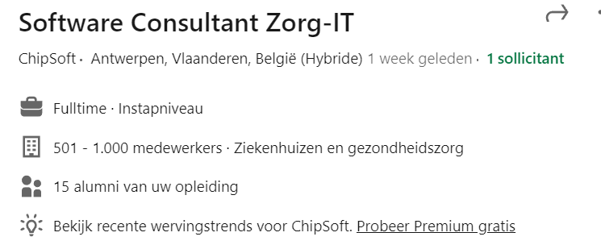

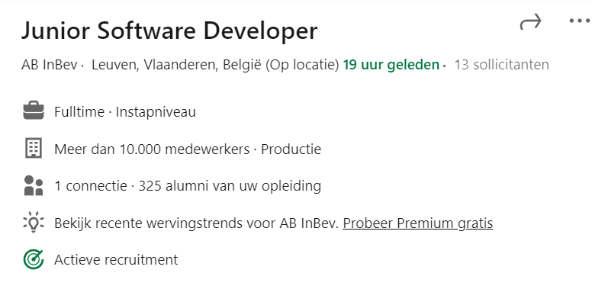
Job opportunities
At the entry level, there are certainly many options.
What is also possible is to incorporate your knowledge into the job that has already been practiced.
Adding Python, sql, logic,.. In your portfolio can offer more possibilities.

Slide 9
Important as a developer

Slide 10
Job opportunities
Problem solver!!
Making things automatic, helping with decision making through data visualization, Creating more effciënt working space,…
Your tools to solve problems are the programming languages you mastered.
Independent learning!
In my opinion the most important one!
Having an eye on structure
When developing code you want your code to be easily readable for your fellow programmer.
Team player
You will almost always program together in team!
Critical about the efficiency of you code
Its important that when you write code that that code is written as short and efficient as possible.

Slide 11
What is a programming lang?

Slide 12
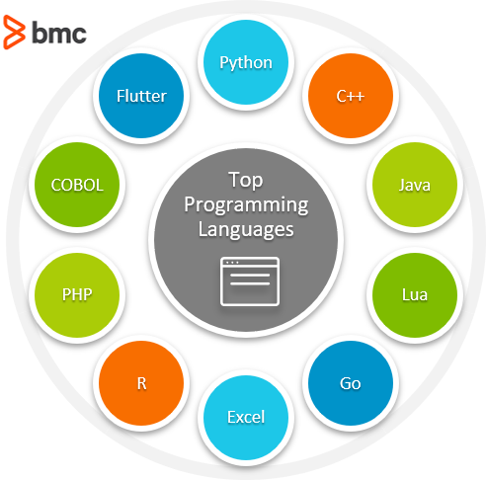
Programming language
A programming language is a vocabulary and set of grammatical rules for instructing a computer or computing device to perform specific tasks.

Slide 13
Types of Programming
Object-oriented programming
Java, C++, C#, Python,..
Object-oriented programming (OOP) is a style of programming characterized by the identification of classes of objects closely linked with the methods (functions) with which they are associated.
Functional programming
Python is not a strictly functional programming language. But it is trivial to write Python in a functional style.
Simply, functions are a set of instructions grouped to achieve a specific outcome. Here, pure functions are given more importance as pure functions are not allowed to interact with outside elements and they always return the same output, given the same input.
Pure functions are not allowed to change their state which is exactly opposite to the OOP where any method can mutate the state of the objects. Pure functions are also proven best for concurrency as there is no shared state between functions.
Notes:
https://www.spec-india.com/blog/functional-programming-languages

Slide 14

How many programming languages?
Notes:
The Short Answer. There are about 700 programming languages, including esoteric coding languages. Some sources that only list notable languages still count up to an impressive 245 languages.

Slide 15
IDE

Slide 16
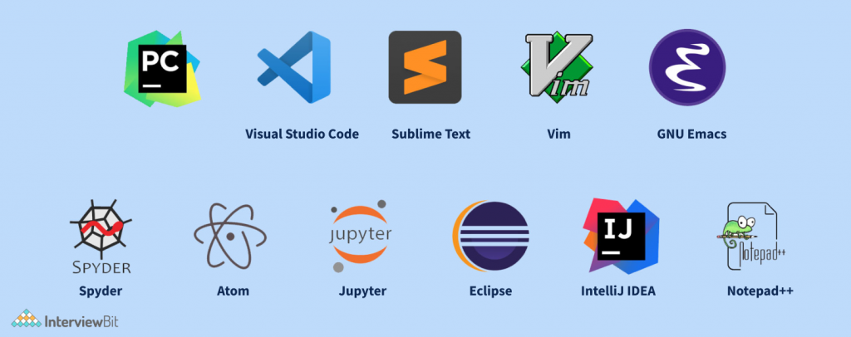
IDE
An integrated development environment (IDE) is a software application (environment) that helps programmers develop software code efficiently.
Notes:
https://www.spec-india.com/blog/functional-programming-languages

Slide 17
Backups of code

Slide 18

Backups
It is important to keep backups for those times when something unforeseen happens. You might drop and break your computer, a hard drive might fail, a hack may destroy your files, or some other detrimental event can happen, leaving you with an immediate and dire need for those backups
Notes:
https://www.spec-india.com/blog/functional-programming-languages

Slide 19
Websites

Slide 20
Usefull website
https://www.w3schools.com/python/
https://www.python.org/
https://www.programiz.com/python-programming
https://www.sololearn.com/learning/1073
https://stackoverflow.com/
…
Notes:
https://www.spec-india.com/blog/functional-programming-languages

Slide 21
Our first program!!

