Slide 1
Cross-site scripting (xSS)
Erik Prananta
C00209974

Slide 2
Executive summary

Slide 3
Internet security state is never static
Swift responses by developer, network operator and service provider reduce number of vulnerable server
Majority of attack are simple, but some show influence of intelligence

Slide 4
Top 5 Exploit
XSS
SQL injection
Path traversal
Local file inclusion
Distributed denial of service (DDos)

Slide 5
Big Number

Slide 7
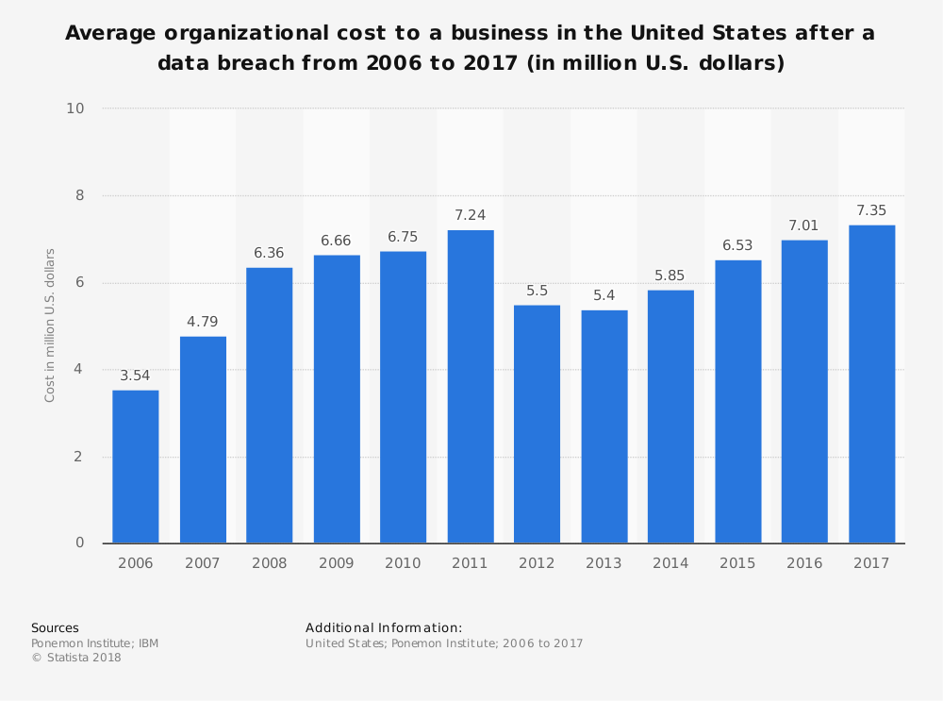

Slide 8
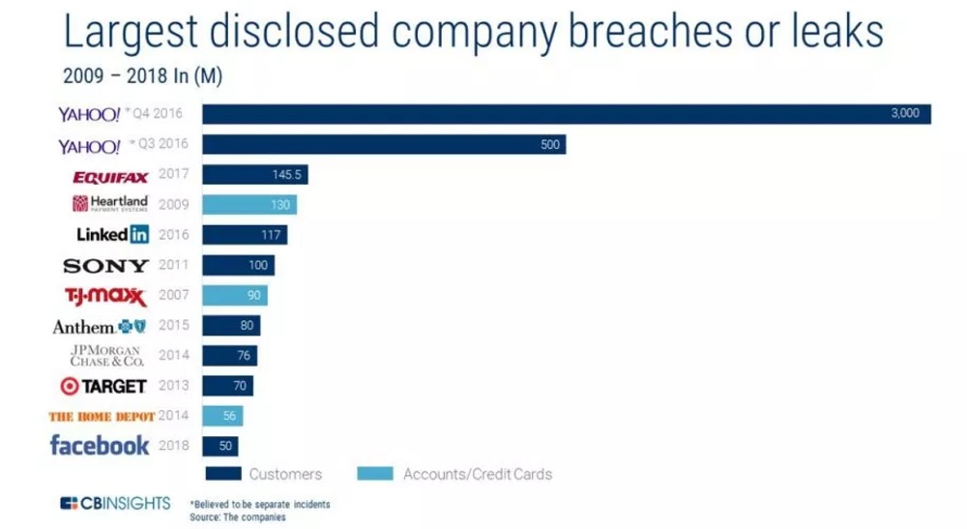

Slide 9
Deep dive to Cross-site scripting (XSS)

Slide 10
What is Xss?
INJECTING MALICIOUS SCRIPT INTO A TRUSTED WEBSITE
CAN OCCUR WHEN THE WEBSITE USE USER INPUT
NO WAY FOR BROWSER TO KNOW THAT THE SCRIPT IS MALICIOUS AND SHOULD NOT BE TRUSTED
COOKIES, SESSION TOKENS AND SENSITIVE INFORMATION USED AND KEPT BY THE BROWSER AND WEBSITE CAN BE ACCESSED
CAN REWRITE CONTENT OF HTML PAGE

Slide 11
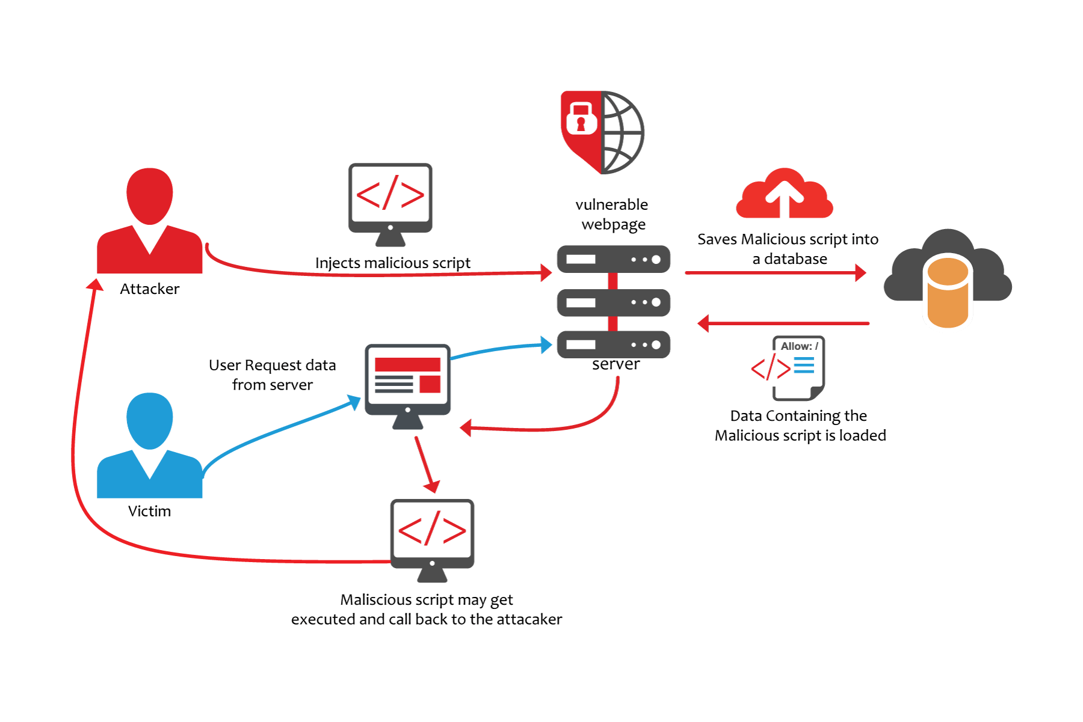
How does xss work?

Slide 12
Type of xxs
Reflected xss
Stored xss
Persistent xss
XSS based on document object model(dom)

Slide 13
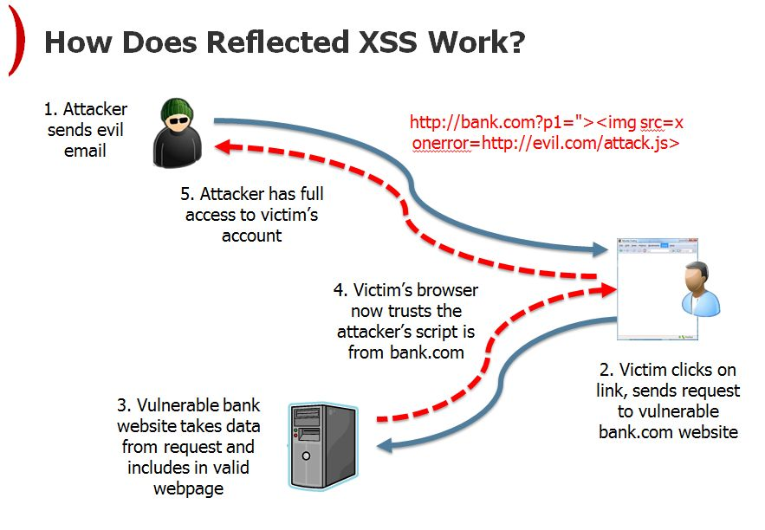
Reflected xss
Allow attacker to steal sensitive information
Need social engineering to send malicious code

Slide 14
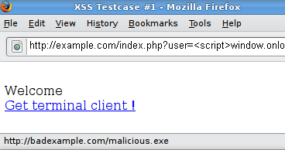
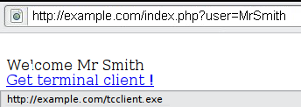
Example reflected xss

Slide 15
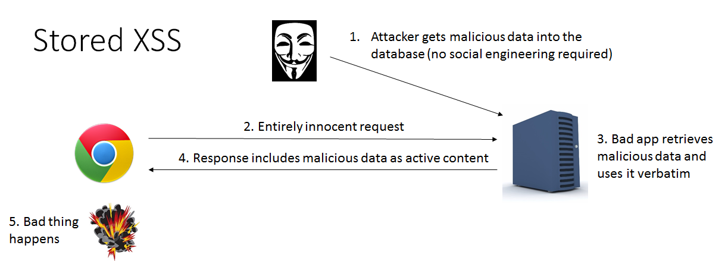
Stored XSS
Malicious code is permanenly stored in DB
Comment field, visitor log, forum

Slide 16
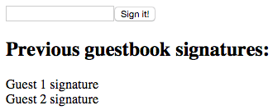
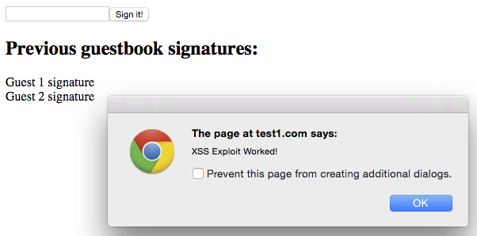
Example stored xss

Slide 17
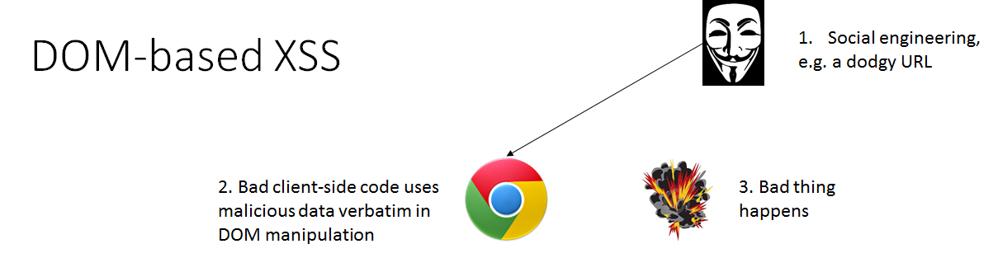
Xss based on dom
Happen in client side
Server side filter doesn’t matter

Slide 18
Server XSS
Occur when untrusted user supplied data is included in html
Source could be from request or stored location
Vulnerability is in server side
Reflected xss and stored xss

Slide 19
Client XSS
Untrusted user supplied data used to update Dom with unsafe JS call
Vulnerability in client side
Dom based xss

Slide 20
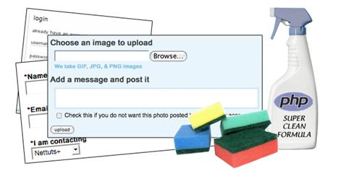
Prevent xss
Escaping
Validation
Blacklisting
Whitelisting
Sanitizing
Html
Attribute
Javascript
Css
url

Slide 21

Question?

Slide 22
References
https://lockmedown.com/3-powerful-rules-identify-untrusted-data/
https://www.checkmarx.com/2017/10/09/3-ways-prevent-xss/
https://github.com/OWASP/CheatSheetSeries/blob/master/cheatsheets/Cross_Site_Scripting_Prevention_Cheat_Sheet.md
https://secure.wphackedhelp.com/blog/wordpress-xss-attack/
https://www.owasp.org/index.php/Cross-site_Scripting_(XSS)
https://www.cvedetails.com/vulnerabilities-by-types.php

Slide 23
https://teamtreehouse.com/library/escape-sequence
https://www.statista.com/statistics/273575/average-organizational-cost-incurred-by-a-data-breach/
https://www.noffcu.org/home/resourcecenter/security_center?sosnoteid=2384
https://www.owasp.org/index.php/Testing_for_Reflected_Cross_site_scripting_(OTG-INPVAL-001)
https://www.wordfence.com/learn/how-to-prevent-cross-site-scripting-attacks/
https://www.owasp.org/index.php/Types_of_Cross-Site_Scripting

