Slide 1
Austin–San Marcos
Housing Affordability
A data-driven look at pricing pressure, spatial inequality, and the legacy of zoning.
Erik Olvera • CS 4379G • Dr. Aniruddha Bora
Final Presentation — May 2026

Slide 2
01 — MOTIVATION
Why this matters
• Austin's population grew ~30% in the 2010s — driven by a tech-sector boom.
• Median home prices and required incomes have decoupled from local wages.
• Spillover demand pressures San Marcos and the I-35 corridor.
• Question: how severe is the affordability gap, and where is it concentrated?

Slide 3
02 — DATA & METHODOLOGY
Four datasets used
DATASETS
• Zillow ZHVI — typical home values, Austin & San Marcos
• Zillow Income-Needed — required income for median home
• Redfin Data Center — weekly inventory & median sale price
• City of Austin Open Data — affordable housing locations

Slide 4
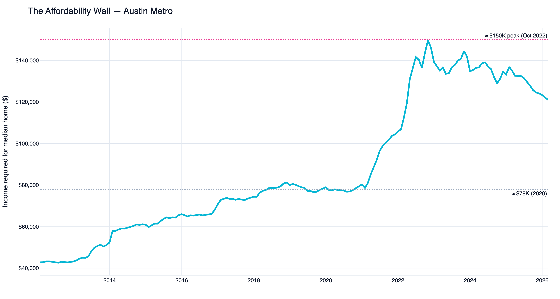
The Affordability Wall
FINDING 01
Takeaway: Required income to afford a median home nearly doubled — from ~$78K (2020) to a ~$150K peak (Oct 2022) — pricing out median earners.

Slide 5
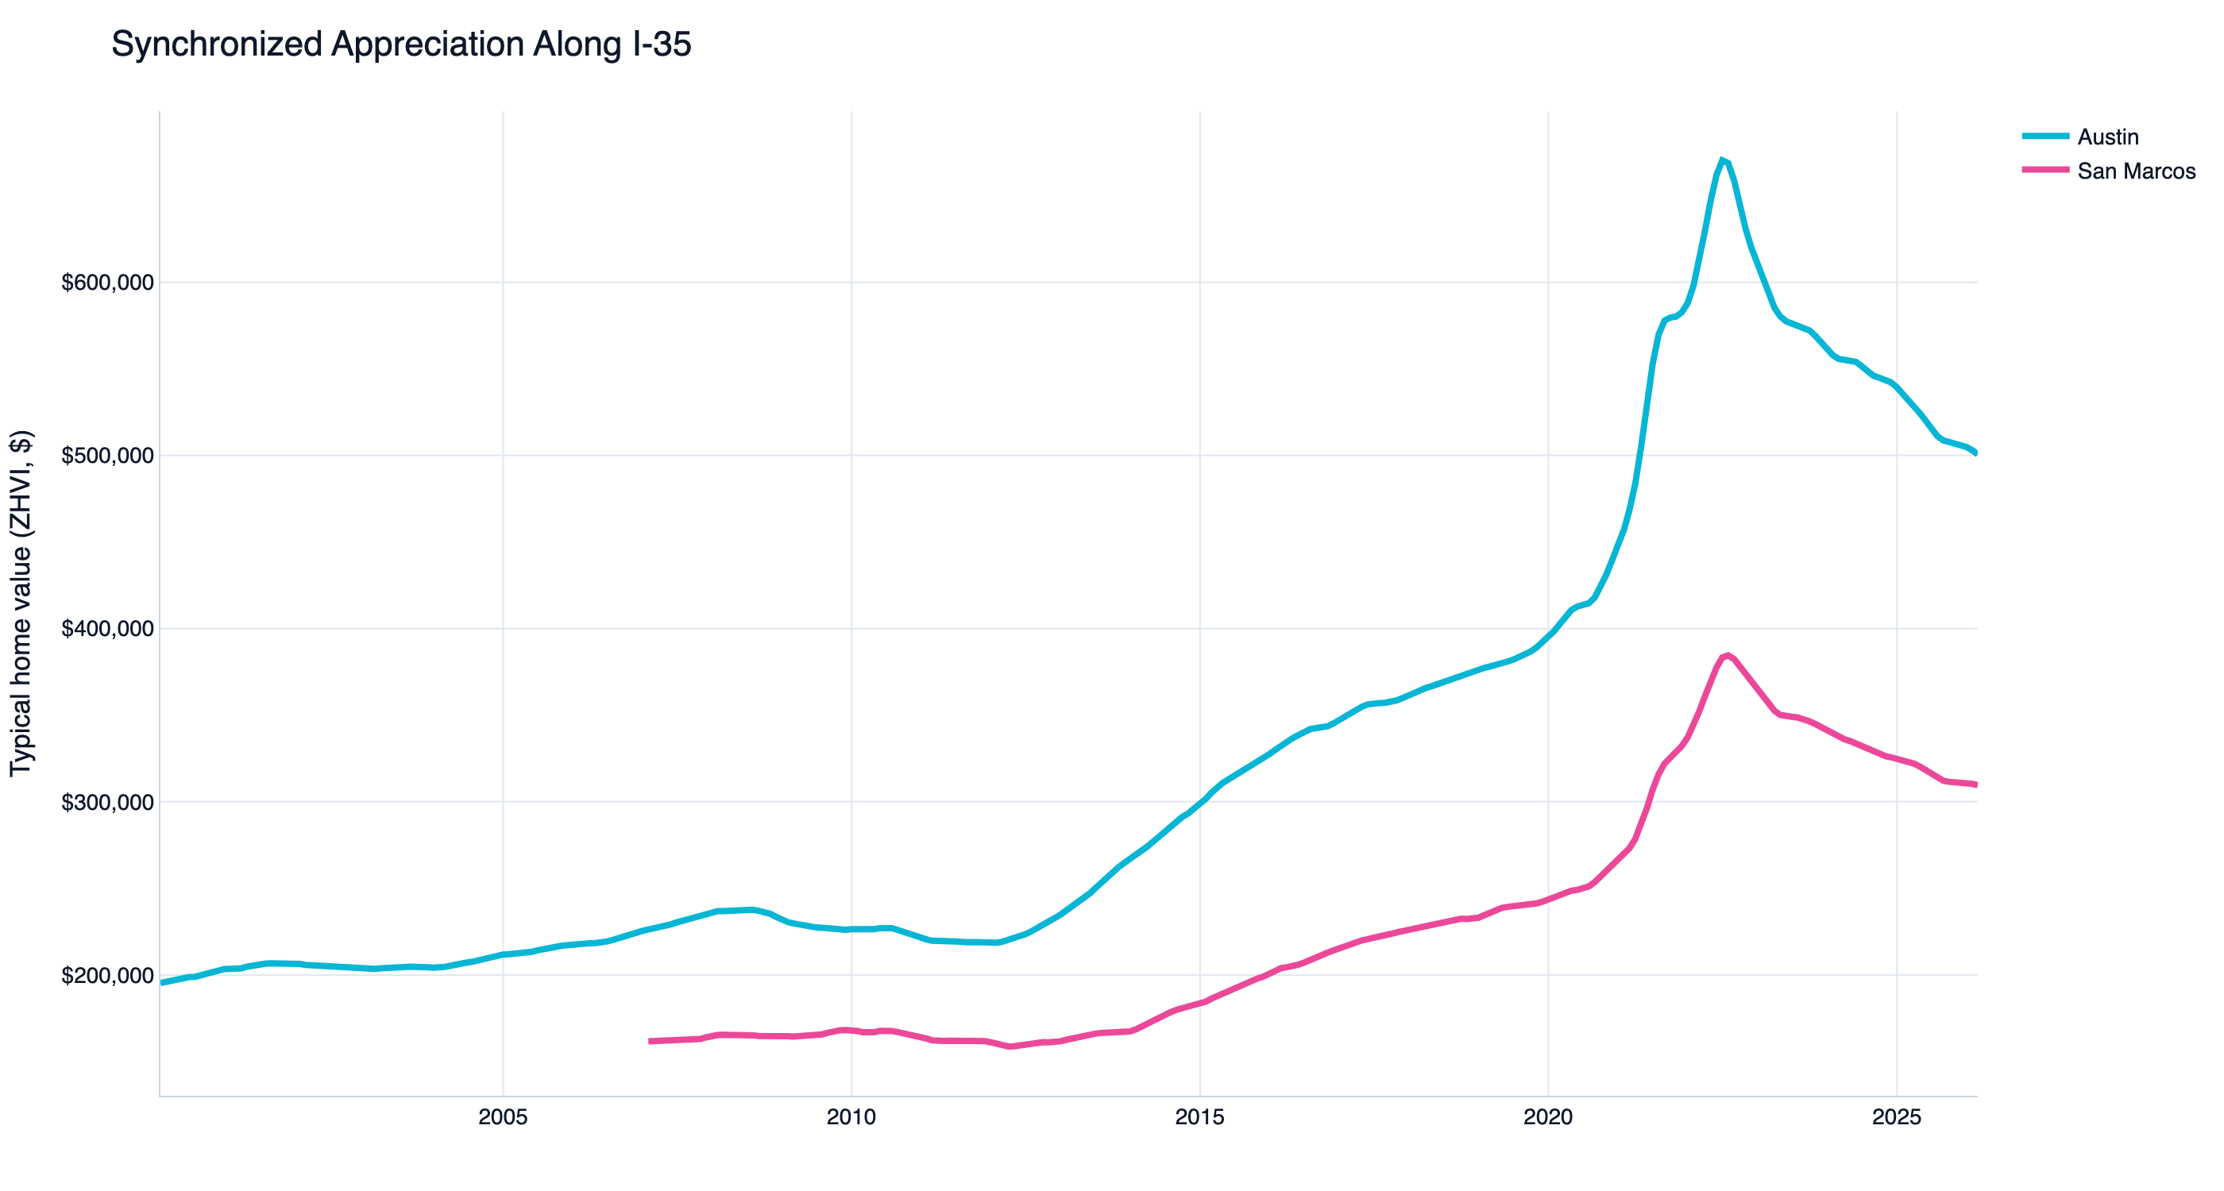
Synchronized I-35 Appreciation
FINDING 02
Takeaway: Austin and San Marcos move in lockstep — spillover demand inflates both markets proportionally.

Slide 6
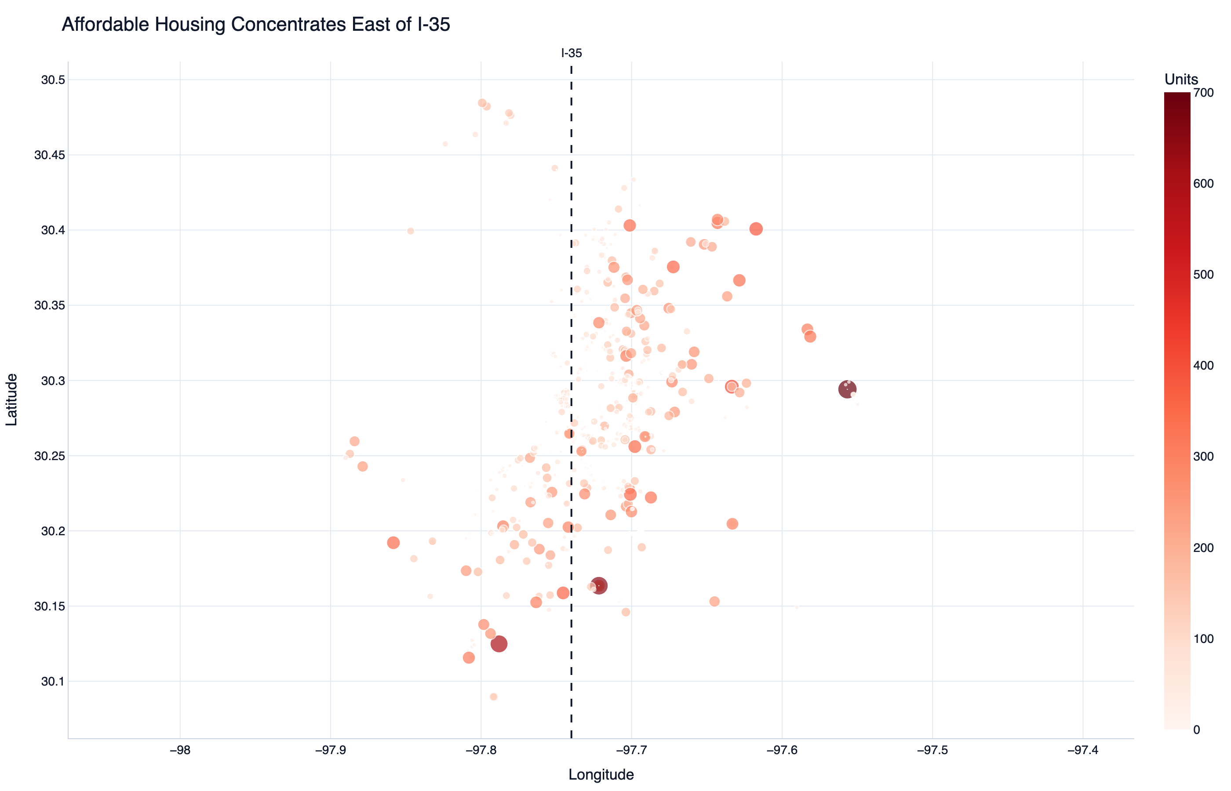
Spatial Inequality of Affordable Housing
FINDING 03
Takeaway: Affordable housing clusters east of I-35; West and Central Austin are housing deserts.

Slide 7
HISTORICAL CONTEXT
The 1928 Austin City Plan
• 1928 plan used redlining and exclusionary zoning to relegate minority and low-income communities east of I-35.
• Decades of underinvestment made East Austin the default site for city-sponsored affordable housing.
• Today's bubble map is the visible footprint of that policy
• Compounding crisis: as East Austin gentrifies, the populations dependent on this concentrated infrastructure are being displaced.

Slide 8
LIVE DEMO
Streamlit Dashboard

Slide 9
04 — LIMITATIONS & FUTURE WORK
What this analysis can't tell us
LIMITATIONS
FUTURE WORK
• Federal interest-rate effects not modeled
• Inventory data is metro-aggregated, not by ZIP
• Naturally Occurring Affordable Housing (NOAH) is excluded from the city dataset
• Add NOAH inventory via parcel-level data scraping

Slide 10
Thank you.
Erik Olvera • CS 4379G • Spring 2026

