Slide 1

Exploratory Data Analysis
G2M insight for Cab Investment firm
Name: Erik Perez
Location: Peru
Team: Data Science
Date: 15/3/2021

Slide 2
Background
XYZ is a private firm in the US that is planning to invest in a Cab company due to the fast and remarkable growth of the Cab Industry in the last several years. Two companies (Pink Cab Company and Yellow Cab Company) will be analyzed in terms of profit and number of clients.
Objective: Perform an exploratory data analysis and a forecast prediction for both companies and provide insights to the XYZ firm to make the right decision about which company to invest in.
Structure of the analysis:
Concatenation of files
Forecasting of profit and number of transactions
Find the best positioned company
Investment recommendation

Slide 3
Data Exploration
26 Features (including 12 derived features)
Timeframe of data: 01-01-2016 to 30-12-2018
Total data points: 359392
Cab_Data.csv
Customer_ID.csv
Transaction_ID.csv
City.csv
USholiday.csv
Final cab data

Slide 4
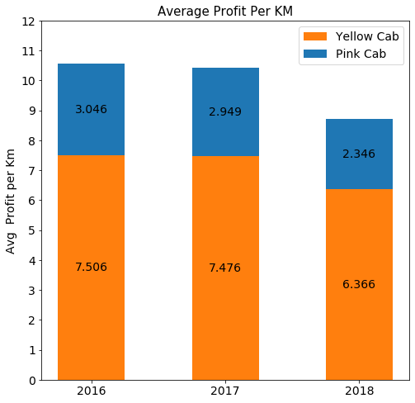
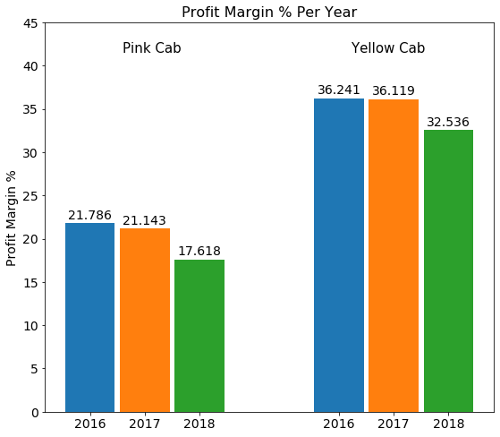
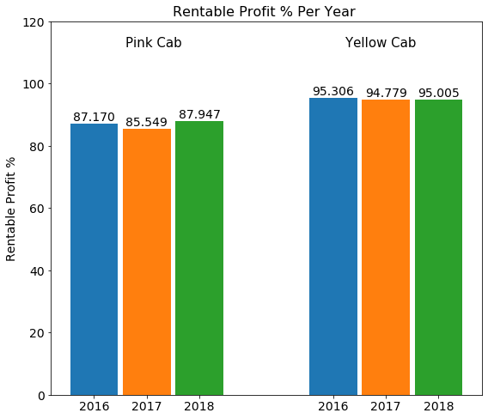
Profit Analysis
Company | Profit | Total Rides | Profit Per Ride
Pink Cab | 5,307,328 | 84,711 | 62.6522
Yellow Cab | 44,020,373 | 274,681 | 160.2600

Slide 5
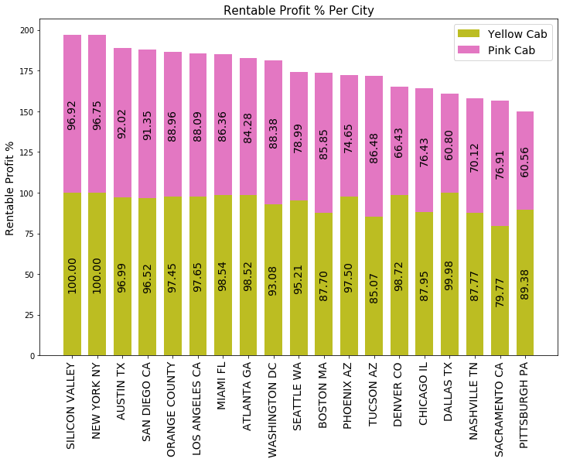
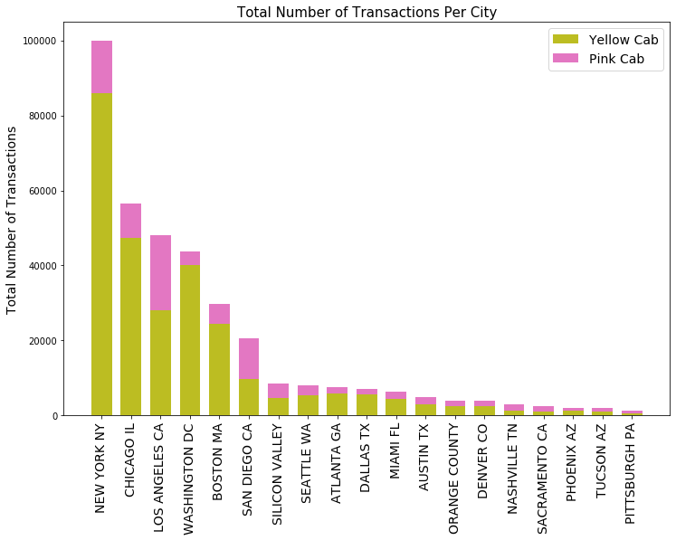
Profit and Transactions Per City Analysis

Slide 6
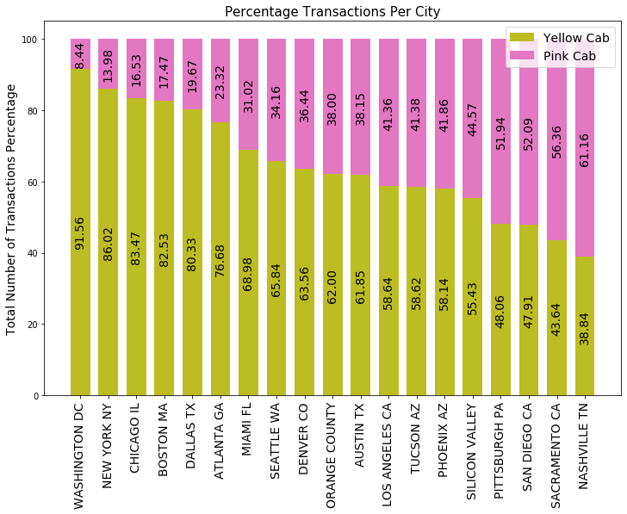
Profit and Transactions Per City Analysis
In each city the Yellow Cab company has a greater percentage of rentable rides than the pink company, i.e., rides with profit > 0.
The city with more Yellow cab transactions is New York and the city with more Pink Cab transactions in Los Angeles CA.
In the cities of Pittsburg, San Diego, Sacramento and Nashville, the Pink Cab company has more percentage of transactions compared to the Yellow Cab company. In the rest of the cities the Yellow Cab company has the dominance percentage of transactions.

Slide 7
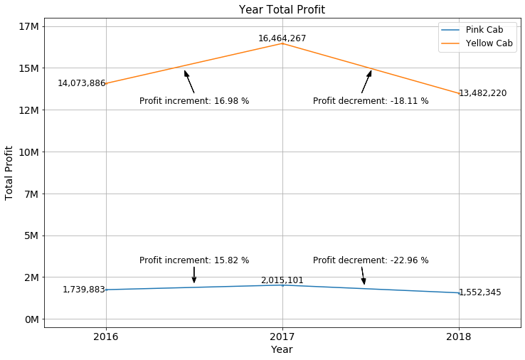
Yearly Profit Analysis

Slide 8
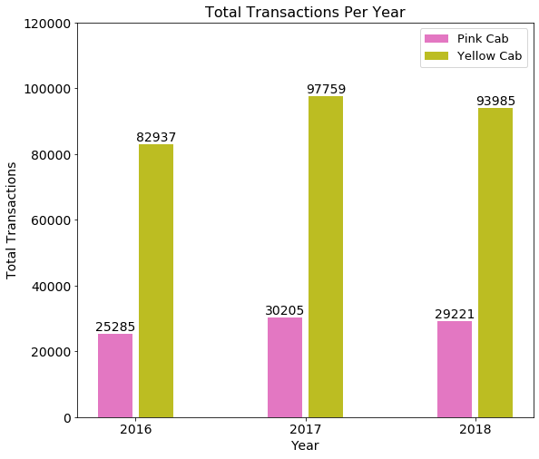
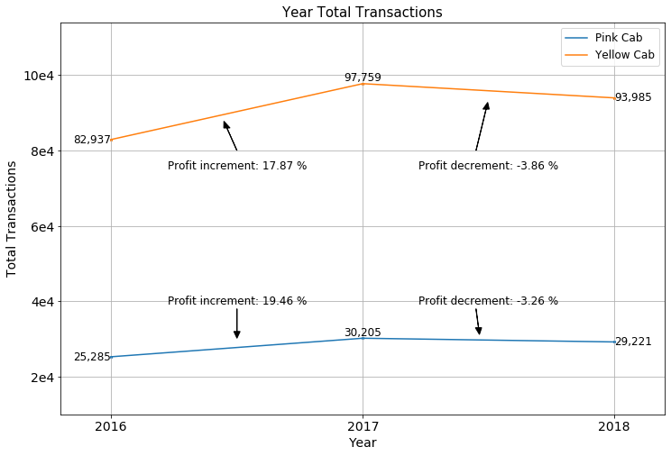
Yearly Transactions Analysis

Slide 9
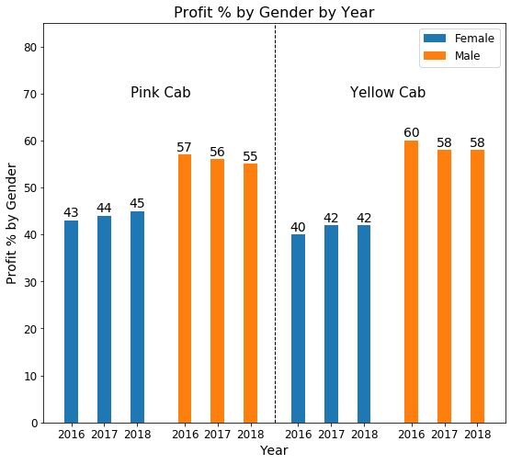
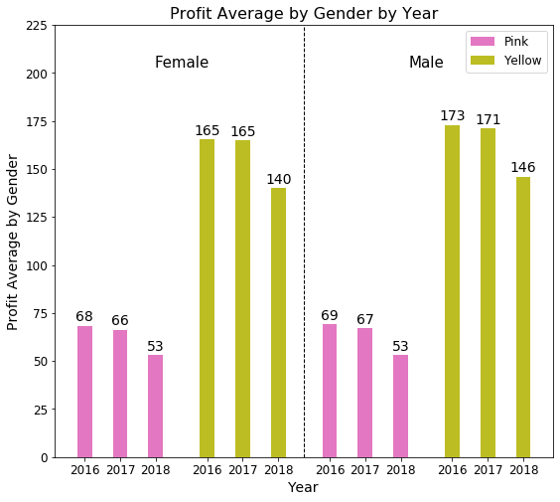
Profit and customer base Analysis Gender wise

Slide 10
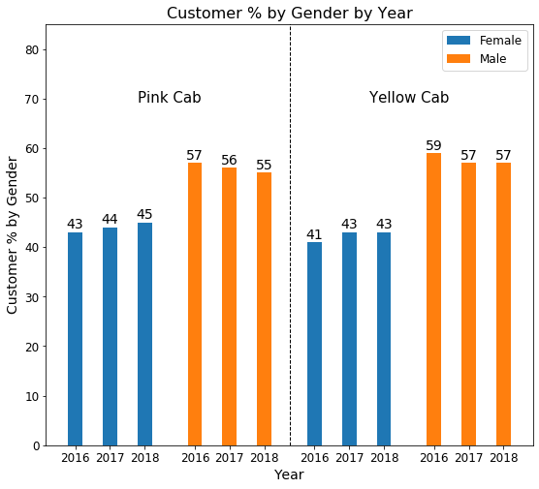
Profit and customer base Analysis Gender wise
For each company per year the profit contributed is greater in male customers than in female customers in both companies.
In both genders the contributions by year is always greater in the Yellow Cab company.
For each company per year the number of male customers is greater for both companies.

Slide 11
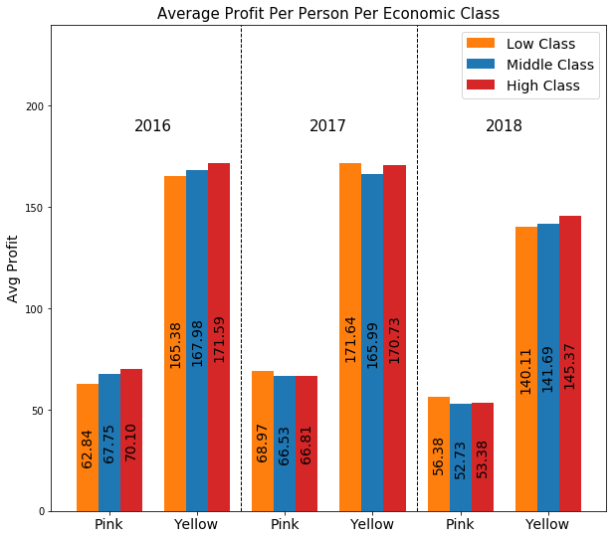
Income Class Profit Analysis
Income USD/Month
Low Class | < 2,500
Middle Class | 2,500 – 15,000
High Class | > 15,000
In 2016 the High Class contributed more profit per person in both companies
In 2017 the Low Class contributed more profit per person in both companies.
In 2018 the Low Class contributed more profit for the Pink Cab company per person and the High Class contributed more profit for the Yellow Cab company.
In all three years the Yellow Cab company has more profit by the three economic classes.

Slide 12
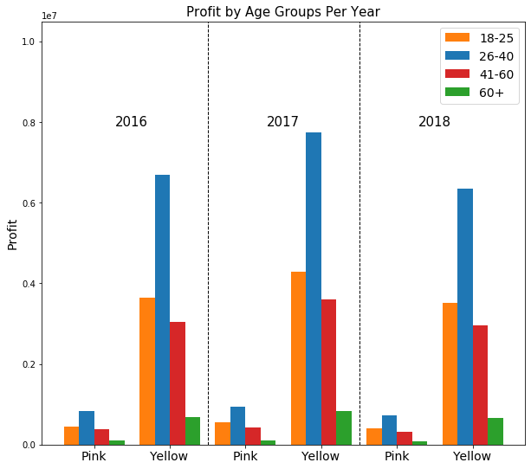
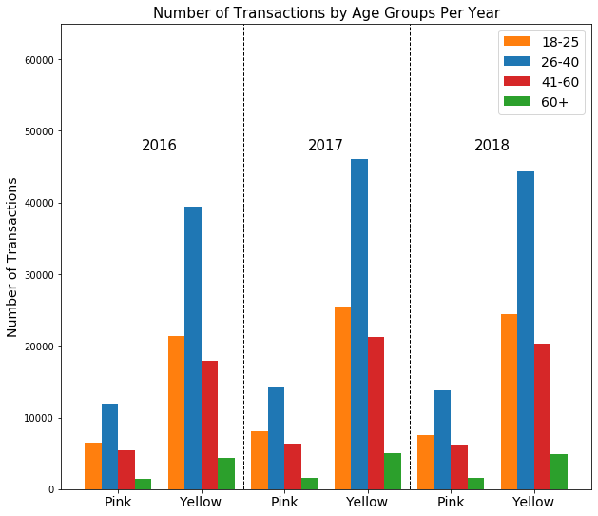
Age Group Profit and Transactions Analysis

Slide 13
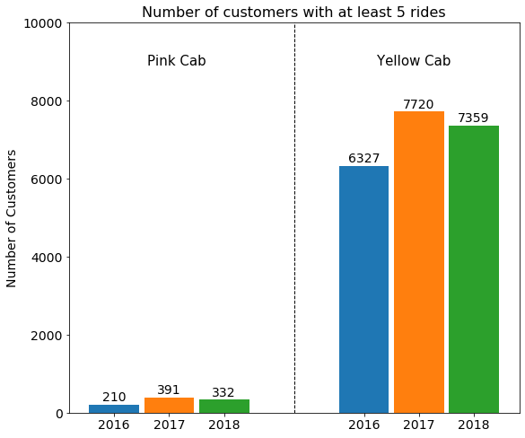
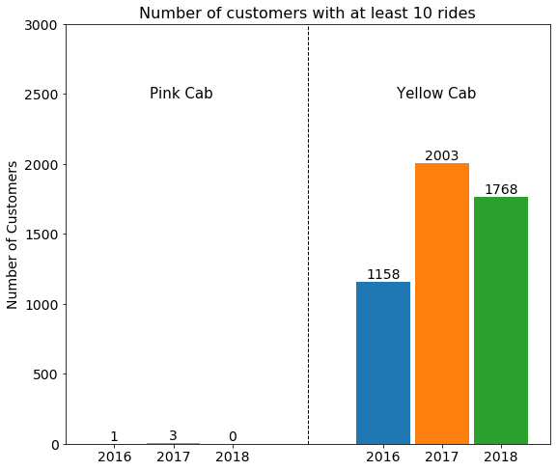
Customer Retention
For the case of customers with more than 5 rides the Pink has a very low number of customers while the Yellow Cab has very high number of customers.
In the case of more than 10 rides the Yellow Cab company dominates.

Slide 14
Customer Retention

Slide 15
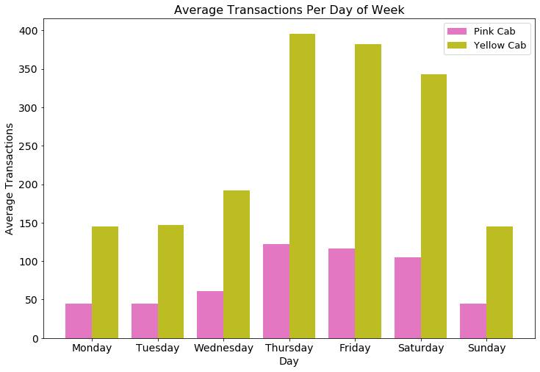
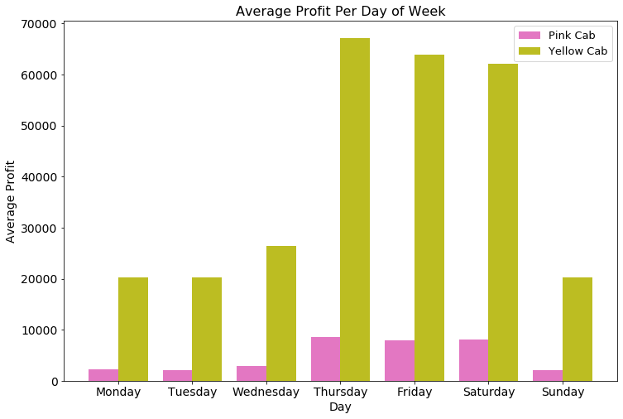
Profit and Transactions Per Weekday Analysis

Slide 16
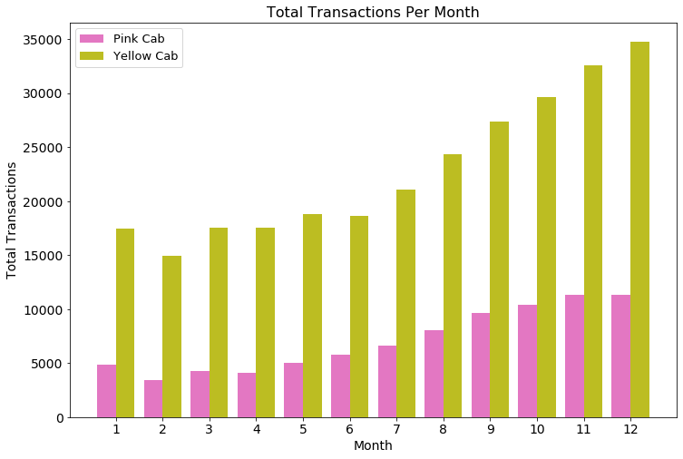
Profit and Transactions Per Month Analysis
Thursday is the day with more number of transactions, hence, profit for both companies.
Yellow and Pink companies' weekday distributions are similar, only that the Yellow Cab company has a larger amount of customers.
As months increase the total number of transactions increase for both companies except for February. December is the month with more transactions for both companies.

Slide 17
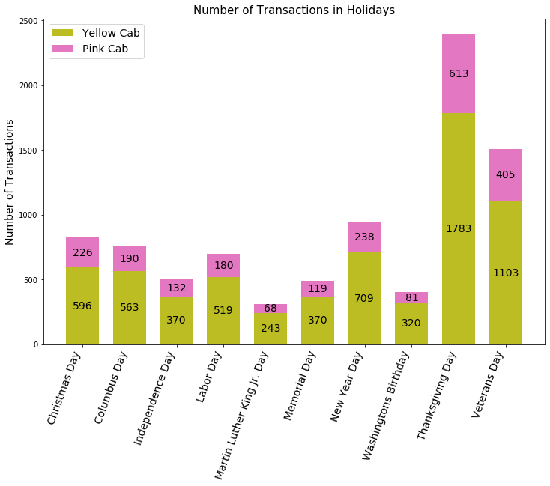
Holiday Analysis
Yellow Cab company performs better than Pink Cab company in every holiday.
Thanksgiving Day has the more transactions than other holidays.

Slide 18
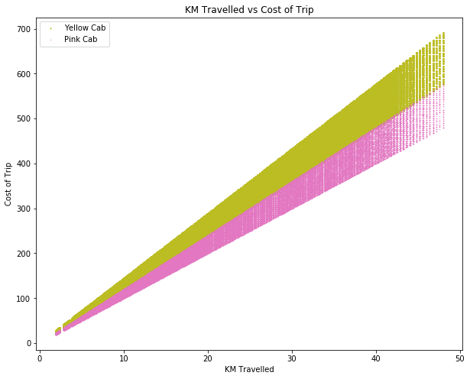
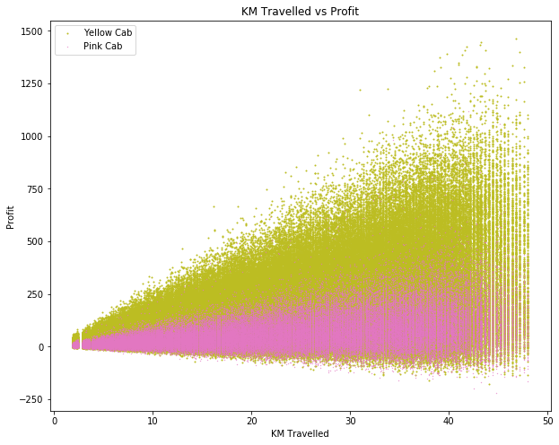
Correlation Analysis

Slide 19
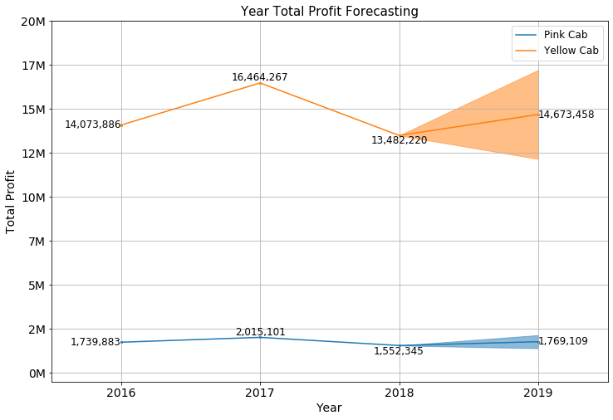
Profit Forecasting

Slide 20
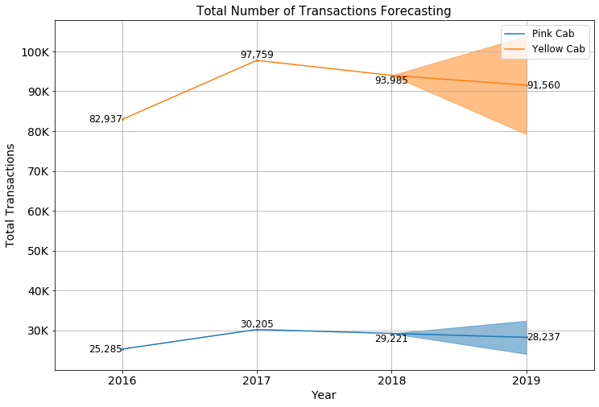
Transactions Forecasting

Slide 21
Recommendations
Customer Reach : Yellow cab has higher customer reach in 25 cities while Pink cab has higher customer reach in 4 cities.
Customer Retention: Yellow Cab company has greater customer retention for customers with 5 or more transactions and 10 or more transactions while Pink company has nearly 0 customers with 10 or more transactions.
Age Group Reach: The group of ages between 26 and 40 has a greater number of profit contribution and transactions number for both companies. Nevertheless, the Yellow Cab company has more clients in all age groups.
Gender Group Analysis: In both genders the contributions by year is always greater in the Yellow Cab company.
Average Profit per KM: Yellow cab’s average profit per KM is almost three times the average profit per KM of the Pink cab.
Total Profit per Year: Yellow Cab’s company has greater income per year than the Pink Cab’s company, nearly as 7-8 times more income.
Total Transactions per Year: Yellow Cab has a greater number of transactions per year, but Pink company is growing faster.
On the analysis performed we recommend to invest in the Yellow Cab company.

Slide 22

Thank You

