Slide 1


Insight to Innovation:
Doctors Should be Designing Healthcare, Not Just Delivering It
Angela Fusaro, MD

Slide 2
Goals
What is Healthcare Innovation?
Why is it important that MDs participate?
Why do Emergency Medicine MDs excel as innovators?
What barriers exist?
How do we to get involved?
Notes:
Good morning, excited about the day, learn a tremendous amount from the subject matter experts from the Coulter Foundation, but we wanted to nstart with a brief overview of what healthcare innovation is and isnt and discuss your role as a clinical inventor in this process.
Healthcare innovation is too Vast a concept, and Today is full of valuable information, and obviously we hope that you retain all of it, but perhaps the most important goal is to instill passion
Recognize the importance and have confidence that you have the ability to do this
When I started in that role, my intentions were to teach advanced science concepts.
I was teaching in a very underserved area and it took very little time to realize that my students, who couldn’t even add and subtract fractions, did not have the capacity to understand advanced science concepts. And that within the confines of that opportunity, it was more important for me to instill in them a passion for learning science, so that perhaps when they were in a future scenario they would elect to invest in learning more.
to and we are having this conversation in a controlled environment that does not have to deal with the practicalities of every day life, like protected time and hospital admin.

Slide 3
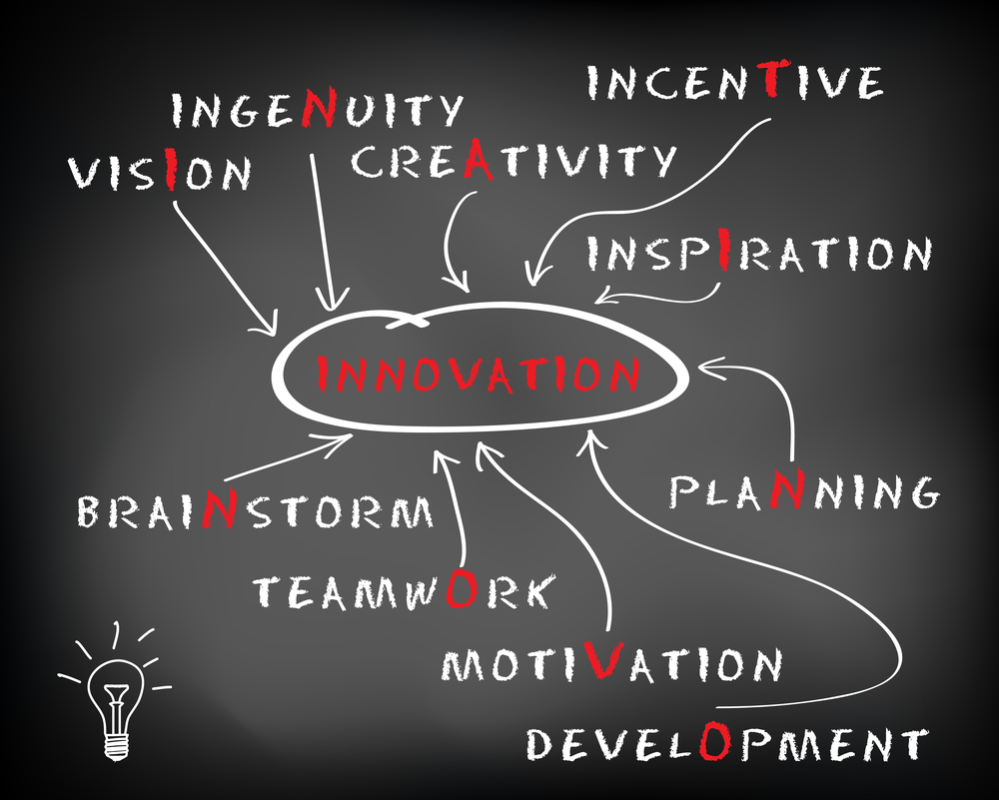
What is innovation?

Slide 4
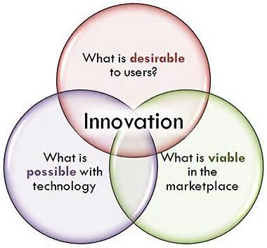
Healthcare Innovation
New match between a solution and a need
Notes:
What is innovation, process, product, cultural revolution
However, one of the cornerstones to this process, is what not how principle. Which essentially says, you should discover a solution while answering an open-ended what question. As opposed to back fitting the already pre-conceived solution to a problem. There are several examples of failed technologies, where companies have anchored on building a product that either had little real world applicability, or was not the best value solution to the need they were trying to address
Example- Segway, from the outset, introduced a particular solution. Segway invented a dynamic stabilization technology required mutiple motors, multiple sets of drve electronics and position sensors and a high level of fault tolerance. And their driving quesiton was probably something like ‘how do we employ 2 wheel stabilization technology?” The truth is what Segeway should have been asking “what would provide efficient personal transport?” because there are very few instances when a dynamically stabilizaed scooter beats a simple one with one motor and simple throttle.
But Successful innovation adds value, and here value means the user will pay more for the solution than the cost to deliver it. Meeting a need is a necessary condition for value creation, but not a sufficient one. The other condition required is that the solution be cost effeciicnt.

Slide 5
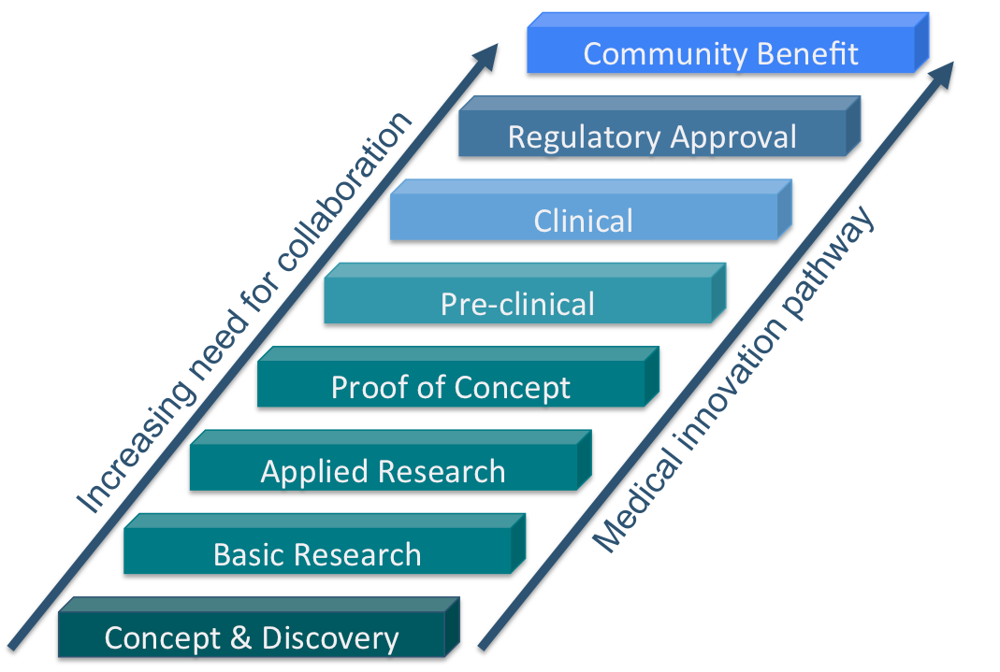
A clear, deep and unbiased
understanding of the healthcare need is the critical starting point.
Notes:
For every successful new medical
device, insights from many areas of science, engineering,
medicine, business and law are needed.
No single individual or discipline alone has the ability
to successfully create, develop, and implement an
effective solution.
However, this entire complex process is build on a clear, deep and unbiased
understanding of the healthcare need for which a
solution is to be developed
That is the critical starting point.
Because of your position within the healthcare system, because of your passive observation of the human condition and challenges that patients and providers, physicians have insight and deep understanding of what these healthcare needs are and we should be using it do design healthcare solutions
http://www.nfmri.org.au/research-and-innovation/

Slide 6
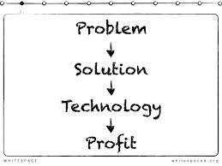
The technology needs to follow
the problem, not the other way around.
Notes:
most exciting, groundbreaking technology is pointless if it is unable to
address an urgent and relevant need.
As scientists, our impact is measured
by generating new knowledge and advancing
our understanding of how the world works.
The challenge of the entrepreneur is different:
absorb that information, process it and
synthesize something new that serves relevant
human needs
As such, a bioentrepreneur’s influence on society
is governed not only by technical knowledge
alone but also by understanding human
needs.
In particular, one must have the insight
of when, where and how a particular technology
can make a difference. In other words, not all
problems are worth solving, and your job as a
bioentrepreneur is to figure out which ones are most relevent.
Again, given your unique insight, there is no more qualified stakeholder to serve as a bioentrepeneur

Slide 7
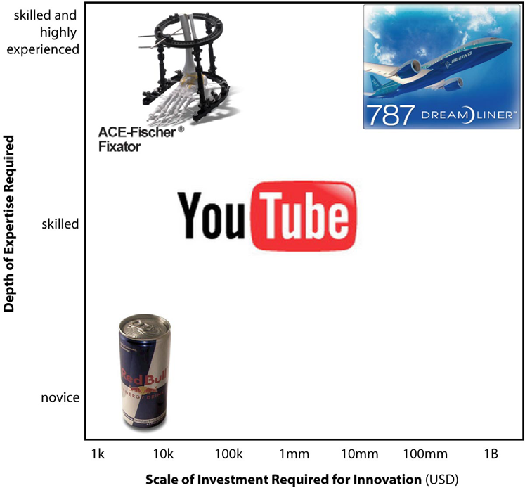
Notes:
minimum required scale for innovation is the resource level and expertise level necessary to design and develop a new solution or product.
helps to determine whether innovation should be done internally or, at least partly, externally.
For examaple, A team of thousands of people at Boeing, for example, developed the 787 Dreamliner commercial airframe at a cost of billions of dollars. 2 Boeing can be confident that a couple of latter-day Wright brothers won’t cobble together a competing plane in their garage. The soft drink industry, in contrast, enjoys no such comfort. Competitors like Red Bull can pop up anywhere, because innovation in that arena requires little more than a home kitchen.
In some fields, innovation requires deep expertise but only modest amounts of money. And although it is hard to put the words healthcare, and modest amounts of money in the same sentence, our inducstry is one of them. Individual surgeons, for example, have created many orthopedic devices, including the Ace- Fischer Fixator. Recognition of the need required expertise, but creation of a solution called for only a modest investment in basic mechanical design and fabrication.
In the left upper corner, New opportunities are most likely to come from highly skilled professionals, many time workin in a lab or university.
Ideal for skilled professionals, already obtained high level of expertise

Slide 8

Emergency Medicine Physicians are Perfect in this Role
Process favors imperfect information over extensive data collection
Balance between efficiency and accuracy
Observational studies
Low resource environment
Notes:
All clinicians, in varying capacity, should be translating their clinical insight into tangible focused healthcare needs and challenges, which engineers, business professionals can focus on solving. However, there are several reasons, and obviously I am biased, why EM physicians are particulary great at this:
There are A LOT of healthcare needs. And not all of them can be addressed simultaneously. So, all of these opportunities to be screened, and that process needs to it must be efficient. Its like a triage, where decision-making with imperfect information is going to occur over lengthy discussion and extensive data collection.
2. It must be accurate despite the uncertainty that still clouds the prospects for a particular opportunity; you obviously do not want to overlook an opportunity that has the potential to be really successful.
These two requirements, efficiency and accuracy, are in tension with each other. And I could not think of a better way to summarize our clinical environment, So even if you are not actucely aware of it, you have built a cognitive skill set that allows you to excel at triaging different innovation opportunities.
There is no better field of medicine for performing observational studies, which provide a deeper understanding of the true ‘customer’ needs. This form of data collection provides more insight than one could obtain through a survey or other more formalized modality.
This concept has many different titles, user anthropology, ethymography, but despite what you call it, its what we do every day when we observe the real intricacies of the human condition.
Why we are perfect for this- ethnography pg 85 identify latent attribute that lead to opportunity

Slide 9
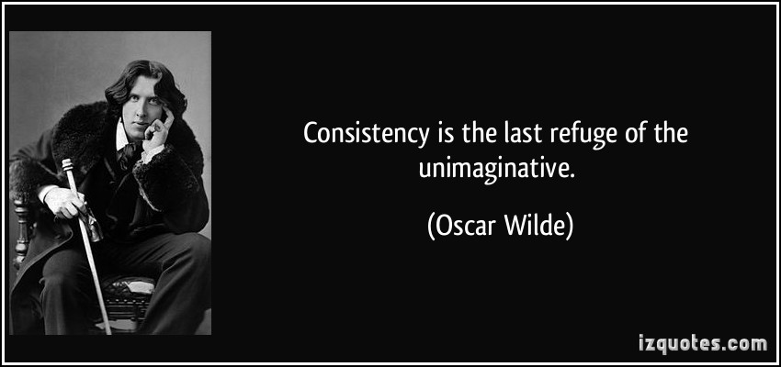
Healthcare professionals have been trained to try to eliminate variability in processes
Notes:
Why has that not been the case?
Part of the challenge is that Creativity, variablity. Are not valued in traditional medical educaiton… correct answers are valued. Rote, explicit knowledge and the ability to regurgiate it has traditionally been rewarded and values.
Drive towards highly consistent, repeatable ouputs and outcomes. This is the logic embodied in modern quality improvement, including concepts like Six Sigma, and even evidence based medicine or safe harbors (practice a certain way for legal protection). For the sake of being more efficient. Obviously there is a role for that, but this also happens to be exactly the wrong logic for creating opportunities for innvoation.
And there are several reasons to embrace variability for the sake of innovation. First, the entire culture of healthcare is changing. Patients, and doctors, alike, now have tools like the internet. And we no longer need to be a repository of explicit knowledge because 1. its impossible, that quanity of knowledge is too vast to kept anywhere but the internet and 2. patients can access that information themselves.
So if we are no longer playing the role of information gate keeper. If that is no longer our world class skill, it is time to adjust our role within the healthcare system
We want to feel that physicians bringing to the table that is irreplaceable? instead of being the person who delivers care,
we need to start playing more of a role in designing it.
There is a role for ‘right answers’ and we need to wrap our minds around seeing value in ‘wrong answers as a function of finding an exceptional answer”
If you managed a hot dog stand, you would want to produce 1000 tasty hotd gos each day, with little variation in quality. That consistency and to some degreee familiarity is what makes for happy customers. But if you are trying to make the best hot dog ever eaten by man, woman or child, then you would rather produce 999 terrible hotdogs and 1 truly exceptional hot dog, than 1000 good hot dogs.

Slide 10
Some Universities Exploit Their Intellectual Property More Than Others
Geography
Industry-funded research
Policies with greater incentives
Notes:
In addition to changing the general healthcare culture, academia has its own barriers to innovation, some universities are more welcoming to innovation and entrepeaurship.
Stanford University, with sponsored research
expenditures of US$ 391 million generated 25
TLO start-ups in 1997; whereas Duke University, with
sponsored research expenditures of US$ 361 million,
generated none.
Rates of start-up activity are not
a simple function of the magnitude of sponsored research
funding or the quantity of inventions created.
For example,
To date we have no systematic explanation
for why some universities generate more new
companies to exploit their intellectual property than
do others.
First, universities located in geographic
areas rich in venture capital could be more likely
generate TLO start-ups because the abundance of
venture capital makes resource acquisition easier
for entrepreneurs. Several reasons why investors want to invest lcoally, beyond our scope
Second, universities that conduct
industry-funded research tend to make commercially-oriented
discoveries. Universities differ on the degree to which their researchers focus on industrial
problems. Some focus their
research more closely on the needs of industry than do
other universities.

Slide 11



Traditional academic culture, centered on publications and recognition from peers, has not changed.
Notes:
Although universities are being asked to play a central role in innovation by the technology transfer of their discoveries. The innovation culture at and around universities is slow to change.
So the reward systems for faculty members are not aligned with institutional aspirations toward technology transfer (25). In many places there is a lack of change in incentives for the central stakeholder, the faculty member.
along with publishing, teaching, and service, we need to Expand their criteria to treat patents, licensing, and commercialization activity by faculty as an important consideration for merit, tenure, and career advancement,
and until patents and spin-off companies are recognized as evidence of scholarly
contributions, the willingness of the faculty to spend their time on such activities will be considerably reduced”
(24).

Slide 12
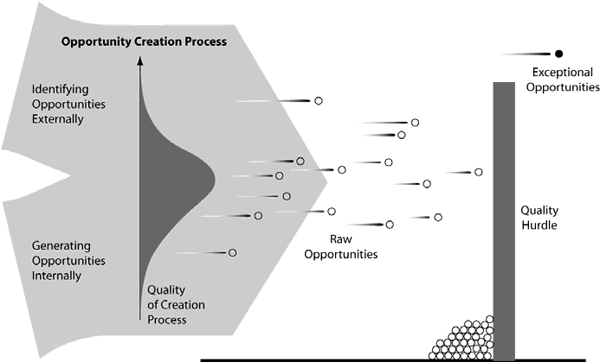
Exceptional Ideas Are Rare
Increase:
Quality, Variability or Quantity
Notes:
In innvation only a few truly exceptional opportunities created. Your value as an innovator is eliminating the average opportunitie and developing the exceptional.
Increase quality, quantity or variance
-Obviously increasing the quality of each individual idea or opportunities will increases the overall quality of opportunities considered. This is the hardest variable to change- because to some degree everyone has varying intrinsic aptitude Promote those creative mind sees these opportunities transparently
-maintain average quality, increase quantity
-if all other statistics are held constant, (average quality and number of opportunities), you will generate more exceptional ones if your process exhibits greater variability, the less consistent the quality of ouptut.

Slide 13

Protect
Time To
Brainstorm
Explore
Ideas In
Groups
Reward
Smart
Failure
Notes:
Although we are primed to have these inventive insights, we need to appropriately protect time to brainstorm, to allow these insights to mature. There are several studies that have shown that people working independently will outperform those same people working together on the order of 3-7 more productive in generating ideas, partially because consecutive meeting speak becomes a bottleneck and there are group dynamics where others feel intimidated. But while the quantity is higher, but the variance is lower, so tends to work best if you initially have some time to research on your own and then some time of online tool or in-person workshop
11. Create “mastermind” brainstorming teams that meet regularly to brainstorm key issues and opportunities.
As some organizations do, give employees 10 – 20% of their work time to work on their own pet projects and initiatives.
Since there is no concrete formula for innovation success
20. Reward smart failure. If you’re truly valuing creative ideas, then people need to be given room to make smart mistakes without fear. Creating a reward program that actually recognizes people’s blunders in the face of trying something new sends a powerful message.
(J Goldenberg and D. Mazursky, Creativity in Product Innovation, Cambridge, UK Cambridge University Press 2002),

Slide 14

Generating Innovation
Alternative approaches to existing solutions
Follow a passion
Annoyance-driven innovation
De-commoditize a commodity
Trend-driven innovation
Notes:
Successful innovators are chronically disapppointed with the world around them. They see every problem is an opportunity.
This is why we are good: we complain a lot, my scrubs don’t fit right, my feet hurt, the lab always loses my samples, the patients allergies are appropriately documented in the chart, a service dog licked me in the mouth….but also any annoyance that gives birth to an opportunity does not have to yours alone, it can be based on customer complaints, market research and in our case, the incidental contact and exposure we have to the human condition every moment that we are working.

Slide 15
Solutions
Idea Challenge of the Month
Hack-a-thon
Partner with a BME program
Fellowship and Certification Programs
Medical School Electives
Notes:
What tangible steps can you employ now:
Have an “Idea Challenge of the Month” that encourages employees and customers to generate ideas on a specific problem or in a specific area.
Ask for ideas. Make sure everyone on your team knows that, yes, they ARE paid to think!
Coursera
Hack a thon - A hackathon (also known as a hack day, hackfest or codefest) is an event in which computer programmers and others involved in software development, including graphic designers, interface designers and project managers, collaborate intensively on software projects.^{[1]} Occasionally, there is a hardware component as well. Hackathons typically last between a day and a week. Some hackathons are intended simply for educational or social purposes, although in many cases the goal is to create usable software. Hackathons tend to have a specific focus, which can include the programming language used, the operating system, an application, an API, or the subject and the demographic group of the programmers. In other cases, there is no restriction on the type of software being created. ACEP, boston, san fran
Partneship w BME (technical school)- The Department of Biomedical Engineering at Cornell University is building research and educational programs around a vision that a quantitative understanding of the human body can be used as a foundation for the rational design of therapies, molecules, devices, and diagnostic procedures to improve human health. Clinical advisor for Capstone ,
Fellowship and certification programs:
fellowship and degree programs- Biodesign fellowships, UPENN, masters, create one within EM
Personal opinion is that resdients need to be more focused on explaining the already existing science. faculty should be facilitating innovation. Like a journal club
http://www.wsj.com/news/articles/SB118841662730312486?mod=WSJ_mgmt_promo_left&mg=reno64-wsj&url=http%3A%2F%2Fonline.wsj.com%2Farticle%2FSB118841662730312486.html%3Fmod%3DWSJ_mgmt_promo_left
Given these facts, is there a role for academia in
medical technology innovation? Historically, academic
engineering has contributed in two vital areas. The first
is the advancement of science and the development of
fundamentally new technologies that combined form
the bedrock of advances in medical devices. The second
is the education and development of talented
engineers with deep skills in specific areas of science
and technology.
Address correspondence to Youseph Yazdi, Department of
Biomedical Engineering, Johns Hopkins University, Baltimore, MD,
USA. Electronic mail: yyazdi@jhu.edu
Annals of Biomedical Engineering, Vol. 41, No. 9, September 2013 ( 2013) pp. 1822–1833
DOI: 10.1007/s10439-013-0869-4
0090-6964/13/0900-1822/0 2013 Biomedical Engineering Society
1822
While most traditional academic engineering programs
today are focused mainly on advancing the frontiers
of science and technology, they have not played a
major role in the task of understanding market needs and
creating solutions amenable to commercial development.
There is,
however, a clear lack of emphasis in graduate programs
on the skills, tools, and partnerships needed to
create and develop an effective and commercially viable
solution to a specific healthcare challenge.
We describe a new model of graduate education in
bioengineering innovation and design- a year long Master’s
degree program that educates engineers in the process of
healthcare technology innovation for both advanced and
low-resource global markets. Students are trained in an
iterative ‘‘Spiral Innovation’’ approach that ensures early,
staged, and repeated examination of all key elements of a
successful medical device. This includes clinical immersion
based problem identification and assessment (at Johns
Hopkins Medicine and abroad), team based concept and
business model development, and project planning based on
iterative technical and business plan de-risking. The experiential,
project based learning process is closely supported by
several core courses in business, design, and engineering.
Students in the program work on two team based projects,
one focused on addressing healthcare needs in advanced
markets and a second focused on low-resource settings. The
program recently completed its fourth year of existence, and
has graduated 61 students, who have continued on to
industry or startups (one half), additional graduate education,
or medical school (one third), or our own Global Health
Innovation Fellowships. Over the 4 years, the program has
sponsored 10 global health teams and 14 domestic/advanced
market medtech teams, and launched 5 startups, of which 4
are still active. Projects have attracted over US$2.5M in
follow-on awards and grants, that are supporting the
continued development of over a dozen projects.
Keywords—Graduate education, Biomedical engineer
A New Model for Graduate Education and Innovation in Medical
Technology
YOUSEPH YAZDI and SOUMYADIPTA ACHARYA
Department of Biomedical Engineering, Johns Hopkins University, Baltimore, MD, USA
(Received 11 February 2013; accepted 15 July 2013; published online 14 August 2013)
Associate Editor Andrew DiMeo oversaw the review of this article.
Healthcare INnovation group
Academic projects
Work with industary

Slide 16
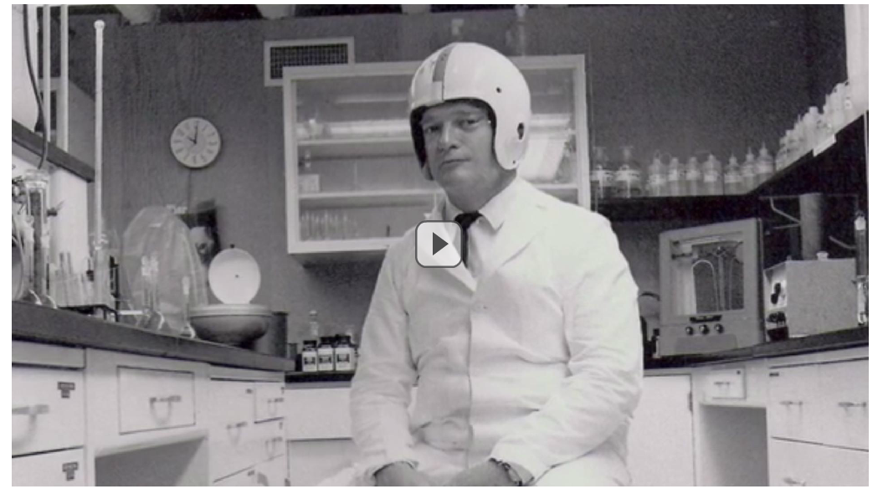
“You never know when that small idea is going to take wings and literally change the course of history.”
Notes:
feeling overwhelmed and despondent at the end, because the message is the system is so flawed, how could one individual ever make a significant contribution to fixing it.
Innovation is is the roadmap for empowering physicians to design of healthcare system you can be proud of. To preventing those feelings of marginizaltion. So we can use that skillset we have trained our whole lives to obtain. To engage in the process of improving healthcare
“You never know when that small idea is going to take wings and literally change the course of history”
Dr. Cade, nephrologist, at the U of Florida. Innovator of Gatorade after observing
The signifocant volume and eletrolyte depleted a football player experiences on a hot after

Slide 17
References
Gerngross, Tillman. It’s the Problem, Stupid! Building Business. Nature Biotechnology. Advanced Online Publication. 2013
John Dodge, “Will Boering’s 787 Dreamline Improve the Flying Experience?” Design News Vol 62 Issue 8 June 4, 2007, 11
Terwiesch, C., Ulrich, K., Innovation Tournaments: Creating, Selecting and Developing Exceptional Opportunities. 2008
Gregorio, D.; Shane, S.; Smith, R. Why do some universities generate more start-ups than others? Research Policy 32 (2003) 209–227
EdwardsM., Murray, F., Yu, R., Gold in the ivory tower: equity rewards of outlicensing. Nature Biotechnology. Volume 24 No 5 May 2006
Jason N. Itri,J., Ballard, D., Kantartzis, S., Sullivan, J., Weisman, J., Durand, D., Ali, S., Kansagra, A., Entrepreneurship in the Academic Radiology Environment. Academic Radiology, Vol 22. No 1. Jan 2015
Langar, R., A Personal Account of Translating Discoveries in an Academic Lab. Nature Biotechnology, Vol 31 No 6 June 2013
Sanberga, P, Gharibc, M, Harkerd, P, Kalere,E, Marchasef, R, Sandsg, T, Arshadih, N, Sarkara, S. Changing the Academic Culture: Valuing Patents and Commercialization Toward Tenure and Career Advancement. www.pnas.org/cgi/doi/10.1073/pnas.1404094111 Edited by David A. Weitz, Harvard University, Cambridge, MA, and approved March 27, 2014 (received for review March 3, 2014)
Yazdi, Y, Acharya, S. A New Model for Graduate Education and Innovation in Medical Technology. Annals of Biomedical Engineering, Vol. 41, No. 9, September 2013 ( 2013) pp. 1822–1833
http://www.nfmri.org.au/research-and-innovation/

