Slide 1

webtechnologie 1
4. Flask en Jinja

Slide 2
1. positie van Flask

Slide 3

client
server
server process
scripts
database

Slide 4
client
server
server process
routeerder
scripts
database
In principe in dezelfde sandbox

Slide 5
Intermezzo: vorm van een http request
pad van het bestand (PATH)
HTTP method (verb)
protocol-versie
GET /nld HTTP/1.1
Host: www.hanze.nl
Accept-Language: nl
//data
Er zijn acht methods (beschreven in RFC2616)
headers
Browsers kunnen zonder meer alleen GET en POST gebruiken.
https://developer.mozilla.org/en-US/docs/Web/HTTP/Overview

Slide 6
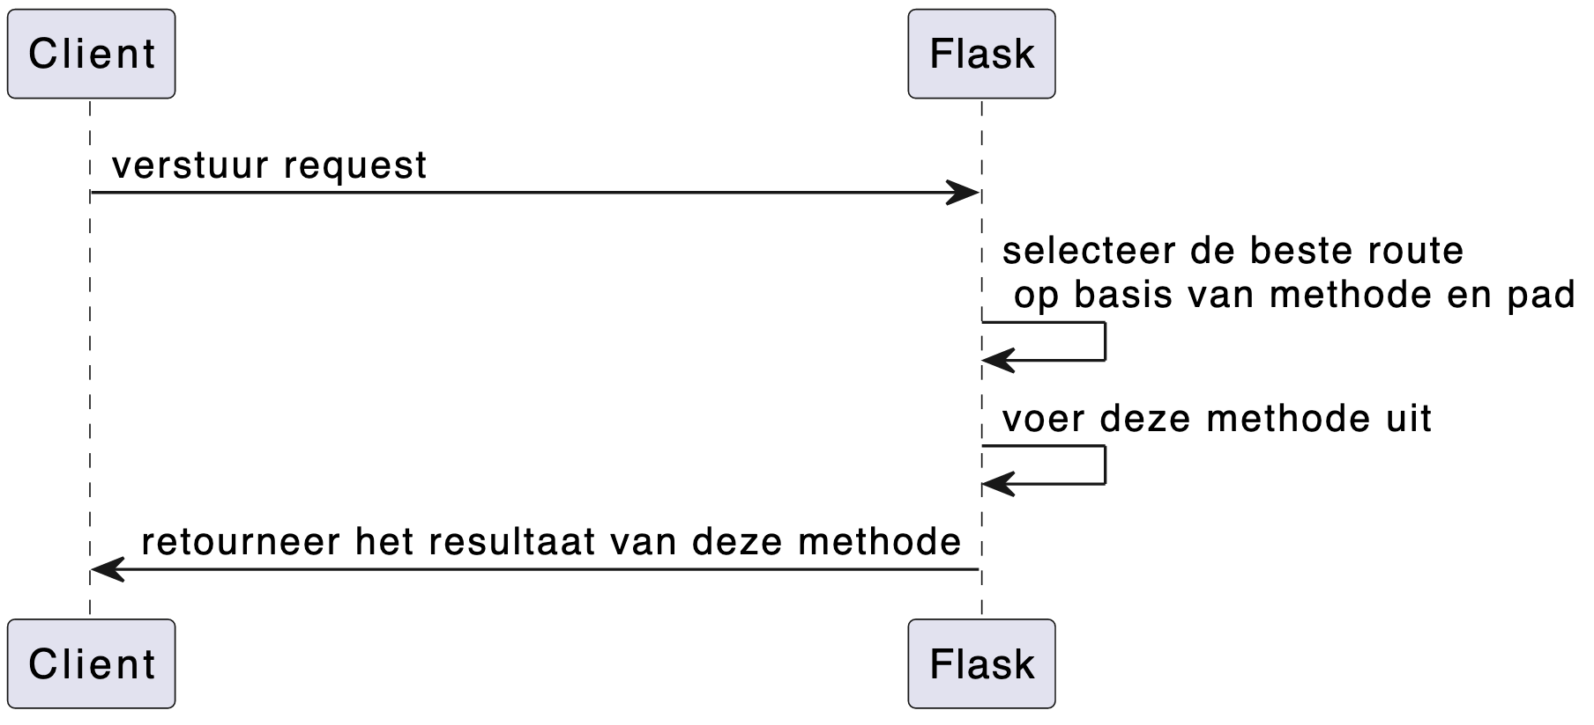

Slide 7
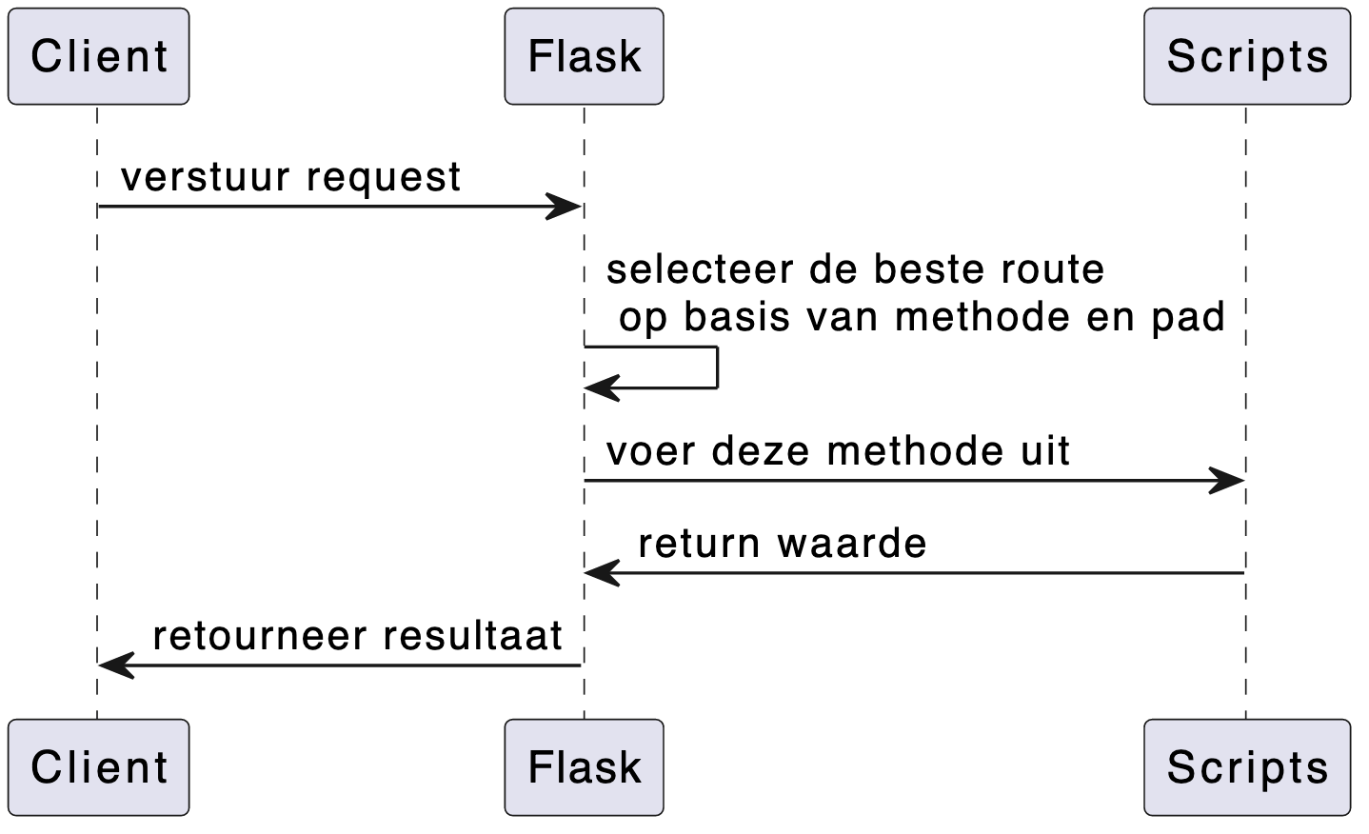

Slide 8
Intermezzo: functie-decoraties in Python
def hello_str():
return 'hallo allemaal!'
print (hello_str())
>> hallo allemaal!
def splitter(f):
def wrapper():
res = f()
f_res = res.split()
return f_res
return wrapper
@splitter
def hello_str():
return 'hallo allemaal!'
print (hello_str())
>> ['hallo', 'allemaal']
functie 'splitter' krijgt een functie als parameter mee.

Slide 9
client
router
GET / HTTP/1.1
@app.route('/')
GET /demo HTTP/1.1
@app.route('/demo')
GET /api/v1/demo HTTP/1.1
@app.route('/api/v1/demo')
GET /demo/1 HTTP/1.1
@app.route('/demo/1')
GET /demo/1 HTTP/1.1
@app.route('/demo/<id>')
POST /demo HTTP/1.1
@app.route('/demo', methods=['post'])
POST /demo/1 HTTP/1.1
@app.route('/demo/<id>', methods=['post'])

Slide 10
client
server
GET /demo
server process
@app.route('/demo')
def demo():
return 'Hallo'
Hallo

Slide 11
2. positie van Jinja

Slide 12
client
server
server process
router
scripts
database

Slide 13
@app.route('/minerals', methods=['get'])
def get_minerals():
return """
<!DOCTYPE html>
<html>
<head>
<meta charset="utf-8">
<title>Alle mineralen</title>
<link rel="stylesheet" href="css/bootstrap.min.css" >
</head>
<body>
<table>
<tr>
<th>Naam</th>
<th>Mollmassa</th>
<th>Formule</th>
</tr>
<tr><td>diopside</td><td>216.55</td><td>MgCaSi_2O_6</td></tr>
<tr><td>feldspar</td><td>818.76</td><td>KAlSi_3O_8 – NaAlSi_3O_8 – CaAl_2Si_2O_8</td></tr>
<tr><td>ilmenite</td><td>151.71</td><td>FeTiO_3</td></tr>
<tr><td>olvine</td><td>203.77</td><td>(Mg,Fe)2SiO4</td></tr>
</table></body></html>
"""

Slide 14
client
server
server process
router
scripts
templates
database

Slide 15
@app.route('/minerals', methods=['get'])
def get_minerals():
return render_template('minerals.html')
directory 'templates'
minerals.html
<!DOCTYPE html>
<html>
<head>
<meta charset="utf-8">
<title>Alle mineralen</title>
<link rel="stylesheet" href="css/bootstrap.min.css" >
</head>
<body>
<table>
<tr>
<th>Naam</th>
<th>Mollmassa</th>
<th>Formule</th>
</tr>
<tr><td>diopside</td><td>216.55</td><td>MgCaSi_2O_6</td></tr>
<tr><td>feldspar</td><td>818.76</td><td>KAlSi_3O_8 – NaAlSi_3O_8 – CaAl_2Si_2O_8</td></tr>
<tr><td>ilmenite</td><td>151.71</td><td>FeTiO_3</td></tr>
<tr><td>olvine</td><td>203.77</td><td>(Mg,Fe)2SiO4</td></tr>
</table></body></html>
minerals.html
<!DOCTYPE html>
<html>
<head>
<meta charset="utf-8">
<title>Alle mineralen</title>
<link rel="stylesheet" href="css/bootstrap.min.css" >
</head>
<body>
<table>
<tr>
<th>Naam</th>
<th>Mollmassa</th>
<th>Formule</th>
</tr>
<tr><td>diopside</td><td>216.55</td><td>MgCaSi_2O_6</td></tr>
<tr><td>feldspar</td><td>818.76</td><td>KAlSi_3O_8 – NaAlSi_3O_8 – CaAl_2Si_2O_8</td></tr>
<tr><td>ilmenite</td><td>151.71</td><td>FeTiO_3</td></tr>
<tr><td>olvine</td><td>203.77</td><td>(Mg,Fe)2SiO4</td></tr>
</table></body></html>
minerals.html
<!DOCTYPE html>
<html>
<head>
<meta charset="utf-8">
<title>Alle mineralen</title>
<link rel="stylesheet" href="css/bootstrap.min.css" >
</head>
<body>
<table>
<tr>
<th>Naam</th>
<th>Mollmassa</th>
<th>Formule</th>
</tr>
<tr><td>diopside</td><td>216.55</td><td>MgCaSi_2O_6</td></tr>
<tr><td>feldspar</td><td>818.76</td><td>KAlSi_3O_8 – NaAlSi_3O_8 – CaAl_2Si_2O_8</td></tr>
<tr><td>ilmenite</td><td>151.71</td><td>FeTiO_3</td></tr>
<tr><td>olvine</td><td>203.77</td><td>(Mg,Fe)2SiO4</td></tr>
</table></body></html>
minerals.html
<!DOCTYPE html>
<html>
<head>
<meta charset="utf-8">
<title>Alle mineralen</title>
<link rel="stylesheet" href="css/bootstrap.min.css" >
</head>
<body>
<table>
<tr>
<th>Naam</th>
<th>Mollmassa</th>
<th>Formule</th>
</tr>
<tr><td>diopside</td><td>216.55</td><td>MgCaSi_2O_6</td></tr>
<tr><td>feldspar</td><td>818.76</td><td>KAlSi_3O_8 – NaAlSi_3O_8 – CaAl_2Si_2O_8</td></tr>
<tr><td>ilmenite</td><td>151.71</td><td>FeTiO_3</td></tr>
<tr><td>olvine</td><td>203.77</td><td>(Mg,Fe)2SiO4</td></tr>
</table></body></html>

Slide 16
/application
router.py
scripts.py
...
/templates
minerals.html
orders.html
/static
styles.css
awesome.js
/imgs/
logo.png
lopside.png
dancing_banana.gif

Slide 17

DEMO
https://github.com/hanze-hbo-ict/MoonPie

