Slide 1
SportsInfoAPI
By Erik Swanson 4/21/2024

Slide 2
Introduction
The objective of this initiative is to create a streamlined method for retrieving detailed information about sports clubs or players, particularly in Major League Baseball (MLB) and the National Basketball Association (NBA). When users input a specific name or identifier, the system will furnish a plethora of information, including the latest statistics, recent achievements, status, and historical records. This solution aims to be versatile, employing APIs, web scraping, and other suitable data collection methods to ensure comprehensive coverage. This also means that the API can expand upon as new data sources become available

Slide 3
Part 1: Problem and Plan

Slide 4
Problem Statement
The problem for sports fans is that much of the data that is out there about sports is scattered through the internet. Websites like baseball reference have a lot of info but it takes time to search through all the tables and find the information that you are looking for. While ESPN is a popular sports platform, it often lacks certain information, leading users to seek additional sources

Slide 5
Solution Overview
Our solution is designed to be a comprehensive and versatile tool for sports data retrieval. It leverages powerful APIs such as pybaseball for MLB data and nba_api for NBA statistics, providing users with a wealth of information at their fingertips. Recognizing the dynamic nature of sports data, our system also employs web scraping techniques to gather additional data and expand the scope of the API. This ensures that our system remains up-to-date and can seamlessly integrate new data sources as they become available.

Slide 6
Applications
One of the most exciting applications is in the realm of Fantasy Sports. Users can leverage the data provided by your API to make informed decisions about player selection and team management. It can also be used to develop Sports Analytics Platforms, providing insights into player performance, team dynamics, and game outcomes, which can be invaluable to coaches, players, and sports enthusiasts. can power Sports Betting Applications, providing the necessary data for users to make educated bets.

Slide 7

The State of the Art
The closest thing to my solution is a web site called StatMuse
StatMuse is a creative technology startup that focuses on conversational AI for sports. Their primary product is an eponymous website that offers rapid answers to sports-related inquiries, mostly in the NBA, NFL, NHL, MLB, Premier League, and PGA.
You ask it text-based sports queries and get back your answer with a little image of something related to your query usually an athlete

Slide 8
Tasks
Task 1: Deciding the data for queries.
Task 2: Method of data collection.
Task 3: Data retrieval system.
Task 4: Developing the UI.
Task 5: Creating the query functions.
Task 6: Testing and speed optimization.
Task 7: Documentation of the project.

Slide 9
Task 1: Deciding The data
Our first task is to decide the data that will be used to create these queries. The project will focus on MLB and NBA stats. This decision is crucial as it sets the foundation for the type of information our system will provide.
Do we used historical data
What types of stats are we looking
Are we going to do individual players/teams
Advanced metrics?

Slide 10
Task 2 - Method of Data Collection
The second task involves deciding the method of data collection. For MLB data, we can use APIs like pybaseball or data files from Retrosheet.org. For the NBA, we can use the nba_api to get statistics. We also consider using data scrapers to get more data or expand the scope of these APIs. Deciding how we are going to collect the data will decide on what queries we can do and techniques we will need to use

Slide 11
Task 3 - Data Retrieval System
The third task is to develop the data retrieval system. We need to figure out what format the data will be collected in. The system will also need to ensure that when new data sources become available, they can be integrated. This ensures our system remains versatile and up-to-date. Each method of data collection from the previous task has different ways of passing data and we need to decide what format we are going to accept them in or modify the collected data to become

Slide 12
Task 4 - Developing the UI
The fourth task is to develop the user interface. We aim to create a user-friendly interface that works efficiently with queries for better stats lookups. Looking at how sites like Baseball Reference or ESPN are designed would allow for ideas on what to do. Statmuse’s UI is cool because they will display images of players that are related to the query that they received. Our UI needs to be simple and easy for all users to understand

Slide 13
Task 5: Creating the query functions
The functions will need to designed differently depending on you need to process information. For just getting a single piece of data from a table, it would be better to use something like a pandas dataframe to allow the system to selected the required statistics. If you are using a bunch of data and will be parsing it, you are going to need to use a logic language such as Clingo

Slide 14
Task 6: Testing and speed optimization.
This task involves using test cases and running a series of test to determine how you can improve performance, format outputs and make it better for users. Test cases are a great way to run a bunch of test to make sure that everything is running well.

Slide 15
Task 7: Documentation of the project.
The documentation of the project is final task that needs to be done. You need to document everything that will happen while working on your project.

Slide 16
Part 2: Design

Slide 17
API Functions
The API is structured around several key functions that retrieve specific types of data. These functions are the backbone of our API, each designed to perform a specific task and retrieve a specific type of data. Functions like get_player_game_logs, get_team_roster, get_team_schedule, get_league_standings, get_player_shot_chart, and get_team_stats are designed to fetch data related to player game logs, team rosters, team schedules, league standings, player shot charts, and team statistics respectively. Each function interacts with the NBA API, pybaseball, or Retrosheet database, parses the returned data, and formats it into a user-friendly dictionary. This ensures that our users can easily understand and use the data provided by our API. All of the function that worked on parsing through large amount of information was done using Clingo

Slide 18
List of Function (NBA)
AllTimeLeaders()
get_NBA_team_details
get_NBA_team_roster
get_career_averages
get_league_standings
get_mvp
get_nba_career_stats
get_nba_championship_winner
get_player_ID_NBA
get_player_award
get_player_game_logs
get_player_shot_chart
And more

Slide 19
List of Function (MLB)
all_time_leaders
get_average_game_length()
get_best_record
get_career_averages
get_day_night_wins()
get_extra_inning_walkoffs
get_games_with_many_pitchers
get_high_scoring_games
And More

Slide 20
Data Sources
Our API relies on multiple data sources to provide comprehensive and up-to-date data. Retrosheet, a non-profit organization, provides comprehensive play-by-play accounts of every major league baseball game. This historical data forms a significant part of our data sources. For current games and analytics, we use the pybaseball API. For NBA statistics, we use the nba_api, a python library that allows users to get statistics from the NBA.com API. These sources ensure our API provides comprehensive and up-to-date data, making it a reliable tool for sports enthusiasts, analysts, and fantasy sports players. We also used web scraping to get any information that was be unable to be received through the other options.

Slide 21
Part 3: Implemation

Slide 22
API Design and Algorithms
Our API is designed with a three-pronged approach to data retrieval. In the NBA section of the API, we use the basic nba_api which sends back a dataframe of the collected data. The second approach involves using web scrapers to gather tables from websites such as baseball-reference and basketball-reference. The data from these tables is parsed and the requested information is collected. The third approach uses clingo to parse the data that is in an excel file containing the game logs of the 2014-2023 MLB Season. This multi-faceted approach ensures comprehensive data retrieval.

Slide 23
System Implementation
The implementation of the system is divided into two parts. The first part is a driver program called 'driver' that has a basic UI. This UI provides a simple interface for users to interact with the application. The second part of the implementation involves two different query analyzers - NBA_Query and MLB_Query. These analyzers use the tokens,NER and bigrams to take a string-based query and use an algorithm to figure out context clues to use the correct function.

Slide 24
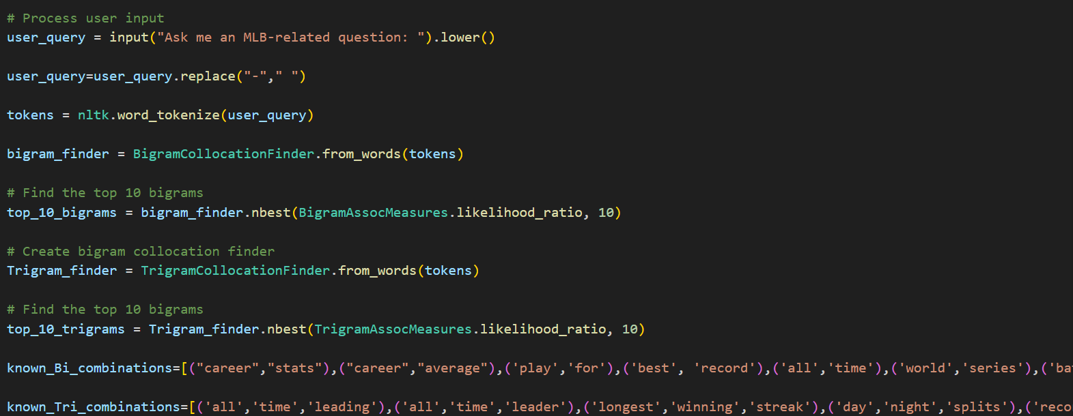

Slide 25
Tokeneization
Tokenization involves breaking down a piece of text (such as a sentence or paragraph) into smaller units called tokens
Tokens can be words, characters, subwords , phrases and punctation marks
These tokens are then used in many applications such as text representation, information retrevial, text summation and much more
The tokens within the systems serve two different uses: creating bigrams/trigrams and matching specific words in lists so that the system knows what are the words.

Slide 26
Bigrams and Trigrams
Bigrams are two words that are in a sequential order to make a phrase such as “Love You”
Trigrams are the same thing as bigrams but with three words instead of two
Bigrams and trigrams are used to find combination of words that make sense to be together in a specific order
By using a specific function in the NTLK library we can make a list of the ten most popular combination of words using the tokens that are in the query
We can use those common combination and a list of known bigrams to figure the context of the query being asked

Slide 27
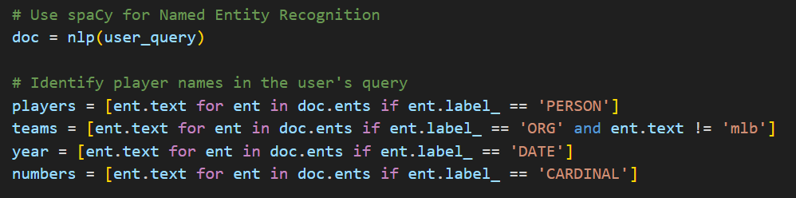

Slide 28

NER or Named Entity Recognition
Its goal is to locate and classify named entities mentioned in unstructured text into predefined categories.
Named entities refer to specific objects or concepts, such as:
Person names: Individuals’ names (e.g., “John Smith”).
Organizations: Company names, institutions, or groups (e.g., “Microsoft”).
Locations: Place names (e.g., “New York City”)
The technique we are using is called Rule-based which Create grammar rules to identify entities based on structural and grammatical features.

Slide 29
Tools and Libraries
The entire system was created using Python as the primary language. We used the NLTK library for tokenization of the queries and the spacy library for Named Entity Recognition or NER, which is used to identify proper nouns present inside the query. For logic queries, we used the clingo python interface, which allowed us to parse through thousands of rows of data to answer questions that the user has about sports. It used the Pandas library to allow for dataframes which help with data manipulation. The data was given using the NBA_api , retrosheet data sheets and pybaseball library. There was also the beautifulsoup library which was used to scrap from websites.

Slide 30
Part 4: Testing/Evaluation

Slide 31
Testing and Evaulation
For testing and evaluation, two different files were created that have a sample version of every single function that was created for the application. Each of these files contains samples of the queries that can be run by the individual on both the NBA and MLB. To facilitate easy testing, users can simply run the files MLBTestcases and NBAtestcases. These files are set up to not only execute the functions but also to measure and display the time it takes for a function to run, providing valuable performance metrics.

Slide 32
Test Results
The results of the tests were positive, with everything running as expected. While the output of these functions could be further refined for better user experience, the functions did return the expected values. Interestingly, the overall outcome of the test cases showed that the information being sent to the user was delivered faster than the state of the art that was mentioned in Part 1. In fact, some of the answers were delivered faster than Google and were unable to be found anywhere else, demonstrating the unique value proposition of our application.

Slide 33
Part 5: References

Slide 34
References
Data Sources and Libraries:
NBA API. (n.d.). Retrieved May 6, 2024: https://github.com/swar/nba_api/tree/master
Used in the NBA Class
Retrosheet. (n.d.). Retrieved May 6, 2024: https://www.retrosheet.org/
Used in the MLB Class
pybaseball: Retrieved May 6, 2024: https://github.com/jldbc/pybaseball
Used in the MLB Class
Baseball Reference. (n.d.). Retrieved May 6, 2024 : https://www.baseball-reference.com/
Used in the MLB Class
Basketball Reference. (n.d.). Retrieved May 6, 2024 : https://www.basketball-reference.com/
Used in the NBA Class
Articles I have read for help:
Gebser, Martin; Kaminski, Roland; Kaufmann, Benjamin; Ostrowski, Max; Schaub, Torsten; Thiele, Sven. (2015). Clingo Guide. Retrieved May 6, 2024, from https://wp.doc.ic.ac.uk/arusso/wp-content/uploads/sites/47/2015/01/clingo_guide.pdf

Slide 35
Any Questions?

