Slide 1


Screenshots
These have been taken from the terminal to help illustrate Bloomberg functionalities
The pen icon shows you where to input something (e.g. in a box or using a tab)
The eye icon draws your attention to a relevant item
Use these shots as an aid, but please do try and access the functions for yourself !
Note you will usually see different data as prices will have moved since these were taken
1.
2.
ABC
123

Slide 2
Session 1

Slide 3
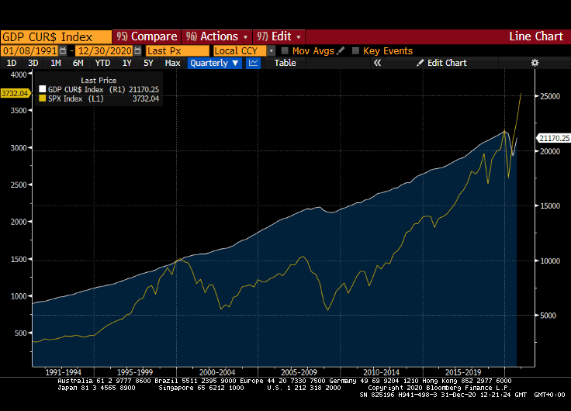
GDP CUR$ <index> GP Q
Compared with SPX (the US stock market S&P500 index)
Some correlation but the SPX tends to overshoot or be more volatile
GDP drop for 2020 is likely to be worse than 2008 yet the SPX has not only recovered but hit a record

Slide 4
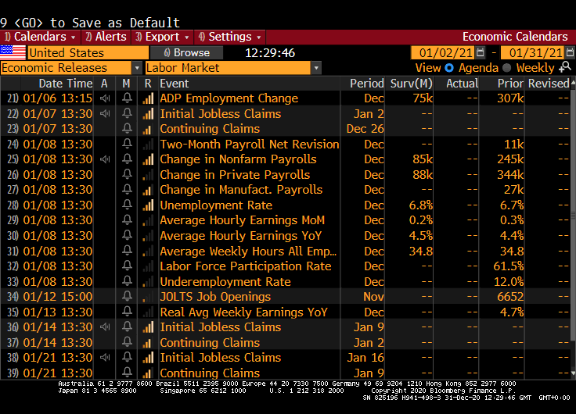

ECO
From landing page, selecting Labor Market releases for Jan 2021
Note the “wifi” symbol next to releases. When the number comes (Actual) it may move lead to a short term move in markets if it is much different from the estimate (Surv)

Slide 5
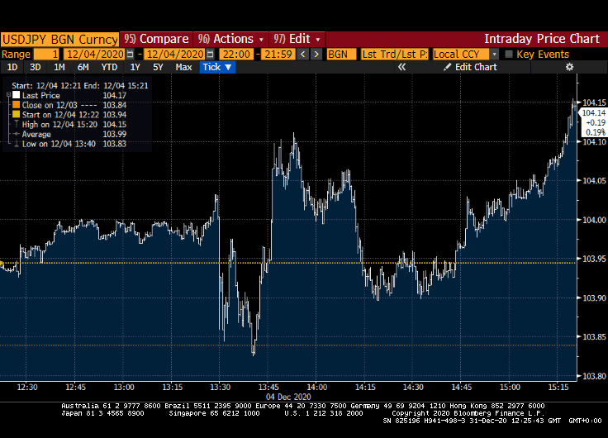
USDJPY <> GIP
On the 4th Dec 2020 at 13:30 (UK time) the US non-farm payrolls report was released.
It was weaker than expected (see Actual v Surv on ECO) and the USD dipped for a couple of minutes though it then bounced back soon afterwards

Slide 6
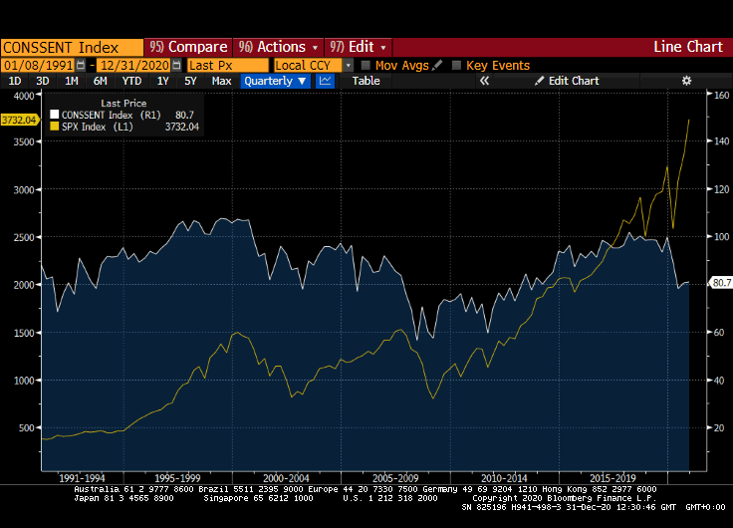
CONSSENT <index> GP Q
Compared with SPX (the US stock market S&P500 index)
Close correlation 1990-2020 but note how the sentiment index moved first in 2007/08! (use the track tool on the terminal)
The recent stock market rally is either unrealistic or pre-empting a recovery in confidence ?!

Slide 7
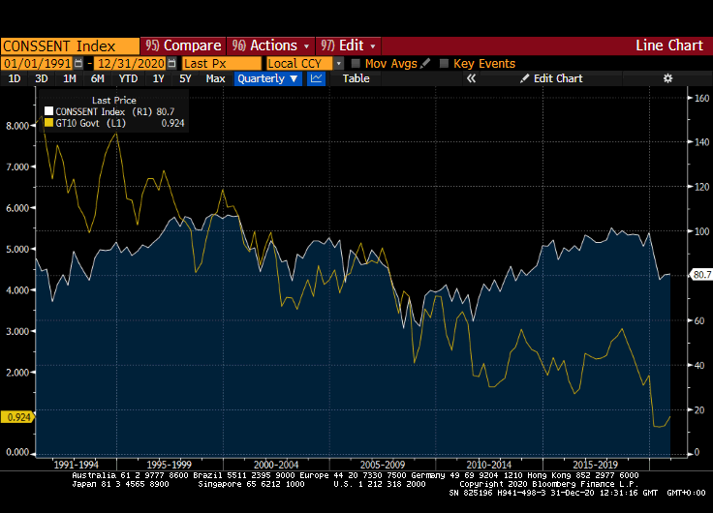
CONSSENT <index> GP Q
Compared with GT10 (the yield on prevailing 10-yr Treasury bonds)
Very close correlation from 1995-2010 before breaking down since then
The drop in both since COVID appeared is what we would typically expect (unlike stocks)

Slide 8
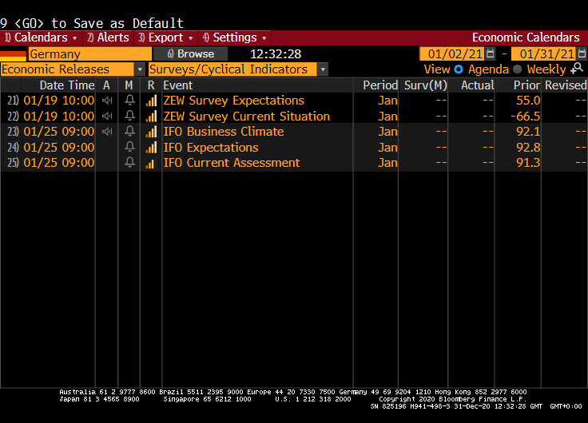
ECO
From landing page, selecting Germany and Survey/Cyc… released in Jan 2021
Click the bell symbol to set yourself an alert for the IFO release coming out on 25 Jan. Will it move markets? Which prices might respond?

Slide 9
Session 2

Slide 10
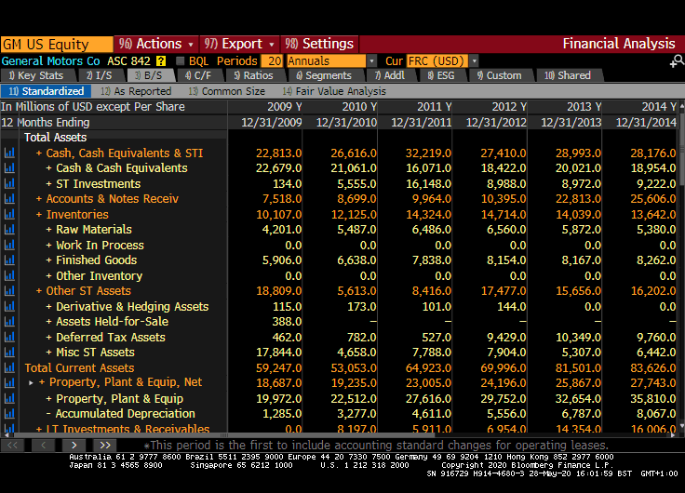
GM US <Eqty> FA BS
Change to 20 periods (it won’t go earlier than 2009)
Find “Total Assets” for 2009 by scrolling down. Continue down to find “Pension Liabilities”
Repeat for 2019

Slide 11
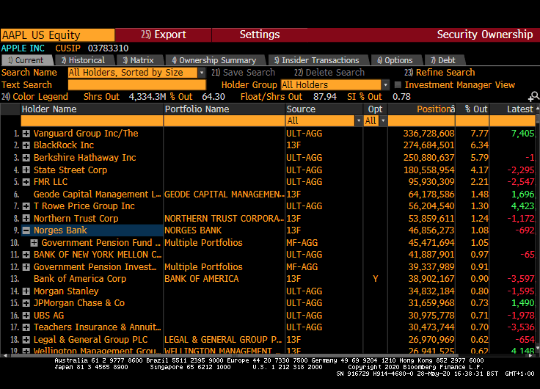
AAPL US <Eqty> HDS
Norway’s government holds about 1% of Apple
Can you see any other sovereign holders of Apple shares?
You can also access this information via DES on page 2

Slide 12
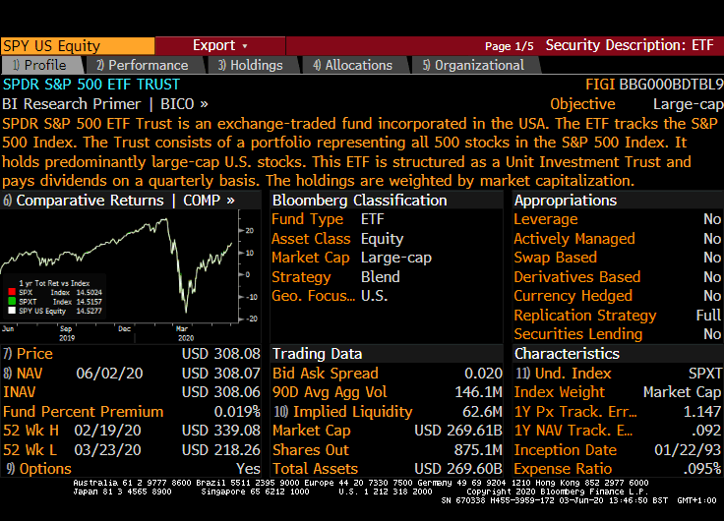
SPY US <Eqty> DES
The “Spider” ETF. Probably world’s largest fund
Low fee, passive management, tracks index very closely (can also be seen with statistics such as beta on the ”performance” tab)

Slide 13
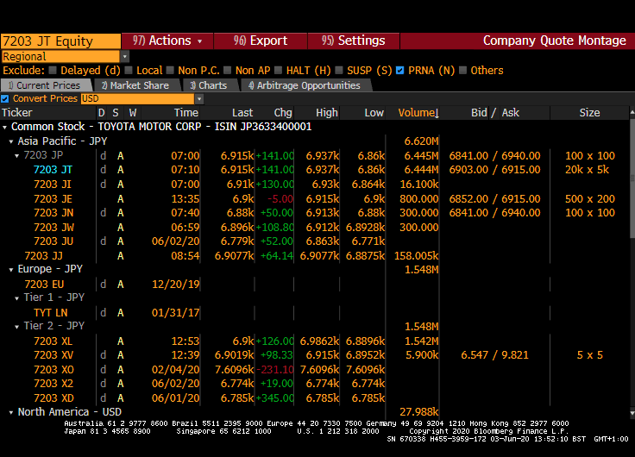
7203 JP <Eqty> ALLQ
Different venues for trading Toyota shares. Tier 2 refers to OTC venues (off exchange or “dark pools”)
Click on market share tab. Toyota volume is still dominated by the Tokyo exchange (note that some companies are listed in more than one country)

Slide 14
Session 3

Slide 15
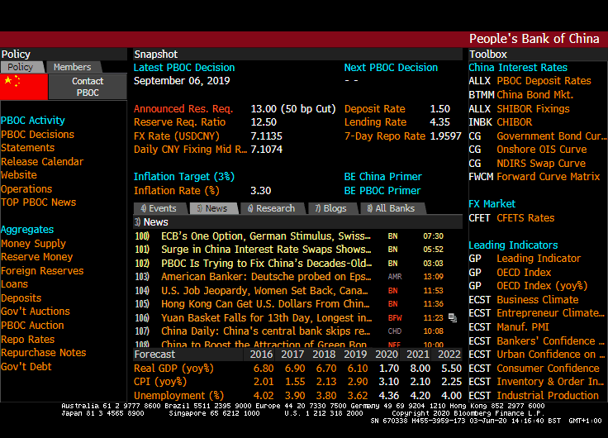
PBOC
Landing page for PBOC. Note the inflation target, and policy rate information
But there are some differences with the US FED and other central banks (The CNY fixing reflects currency management. The reserve ratio is used as a policy tool more often compared with other central banks who typically use Basel III guidelines in this respect)

Slide 16
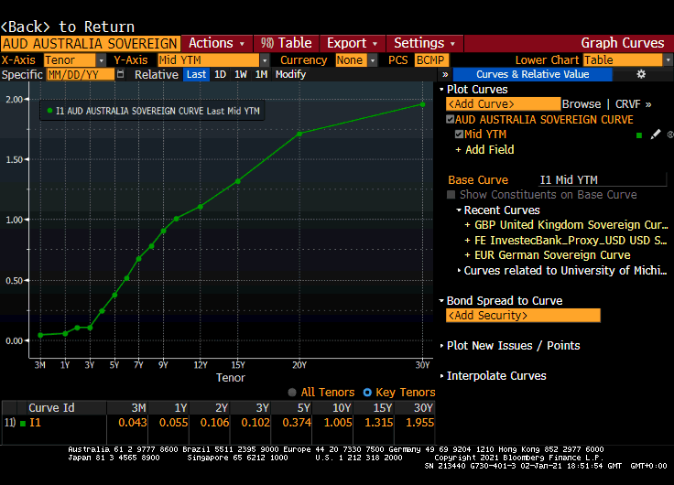
CRVF
Using Australia sovereign here. Note long-term rates are higher than short-term (the yield curve is positive)
Change the date to early 2020 to compare to yields pre-COVID
How could the central bank lower longer- term rates if it wished to?

Slide 17
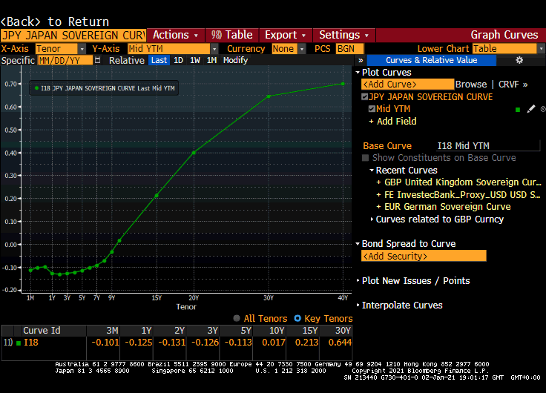
CRVF
The Japanese Government yield curve
The shape looks a little misleading. Yields are very flat and close to zero for 0-10 years
Japan explicitly targets 0% for its 10-year yield

Slide 18
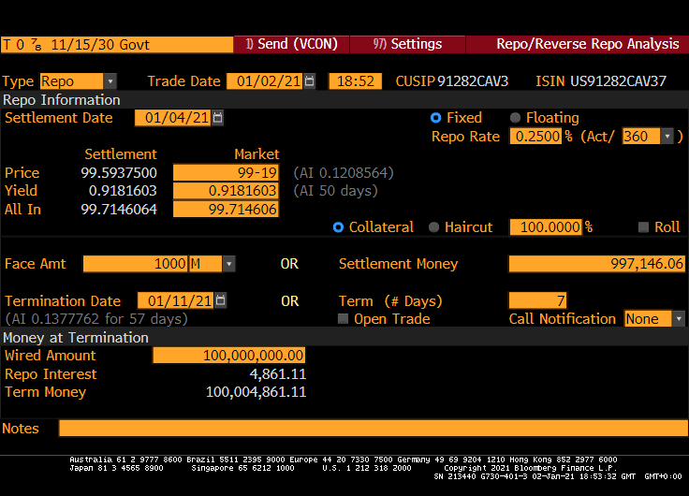
CT10 <govt> RRRA
Repo/Reverse Repo (borrower is repo, lender is reverse repo)
Here we changed the rate to 0.25% (from market) as well as borrowing $100 million for 7 days

Slide 19
Session 4

Slide 20
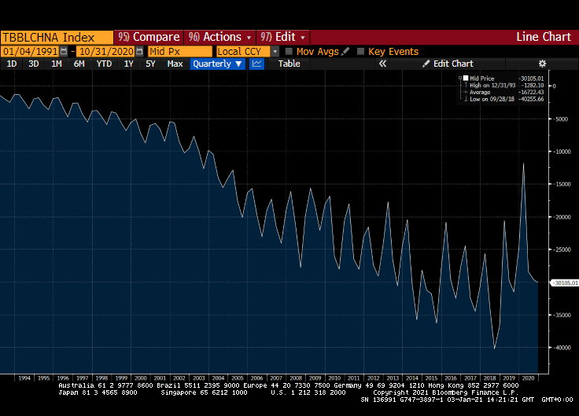
TBBLCHNA <index> GP Q
China was admitted to WTO in 1990 and trade has grown since. Some seasonality in evidence in this chart (possibly agricultural products and/or Christmas trade)
Largely ignored by markets until 2016

Slide 21
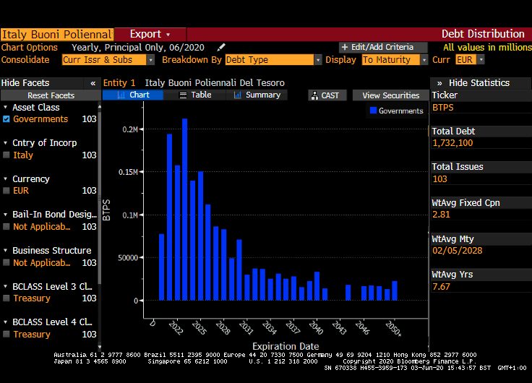
DDIS
You need to select an Italian bond. Easiest way to do this via is WB page and click on any Italy bond issue. Then type DDIS.
Italy has a lot of maturities in the next few years

Slide 22
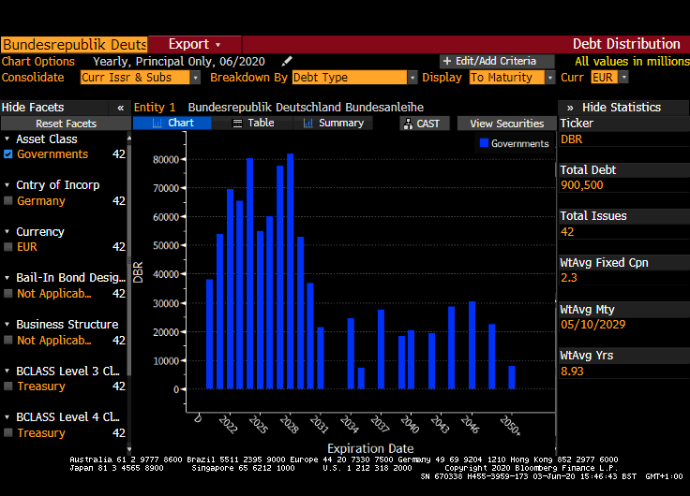
DDIS
Change to Germany using ticker DBR or via WB screen.
A longer maturity profile than Italy as well as lower debt
This DDIS function also works for corporates

Slide 23
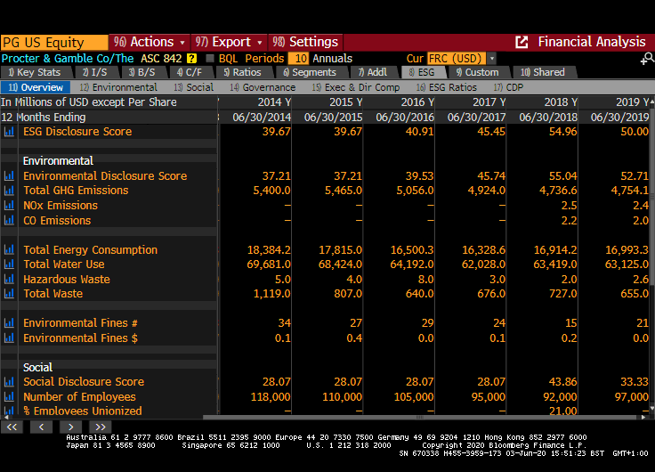
FA ESG
This is for Procter & Gamble. Note the page scrolls down further
Improvement in scores between 2014 and 2018 but perhaps stopped in 2019?
How does Unilever (ULVR LN) compare?

Slide 24
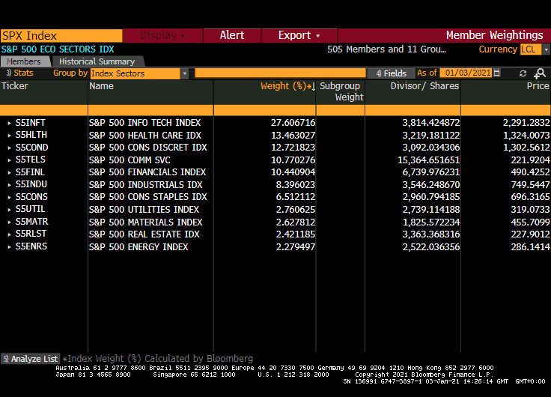
SPX <index> GWGT
You can also access this via the DES page
We want 11 top level sectors rather than all the Index Sub-Industries so change the yellow drop-down box as indicated
Note the high INFO TECH weighting

Slide 25
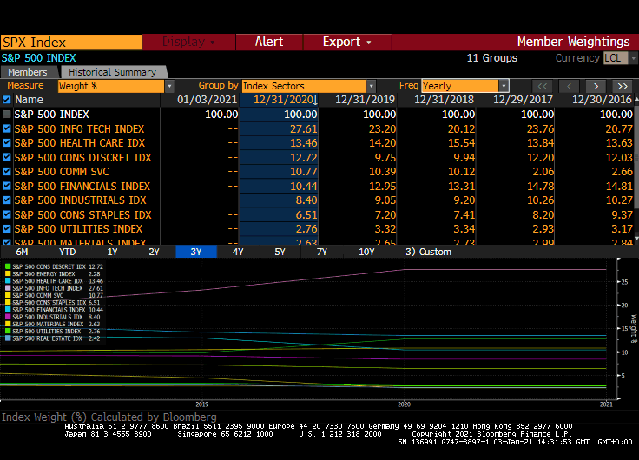
SPX <index> GWGT
Historical Summary tab and change the frequency to Yearly
Which sectors have increased in value (weight up) relative to others (weight down) over time
Which of these trends have accelerated as a result of COVID? Are any of these results a surprise?

Slide 26
Session 5

Slide 27
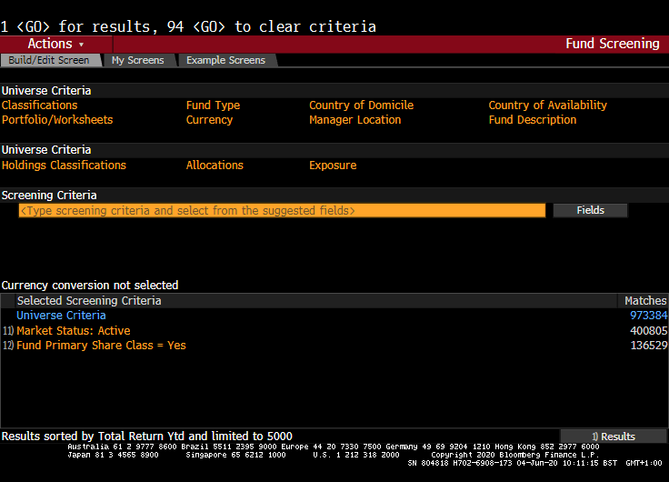
FSRC landing page
Nearly 1 million funds (although many of them may be dormant or closed)
The “Screening Criteria” box is quite intuitive, though be careful specifying your exact criteria (e.g. USD not USd)

Slide 28
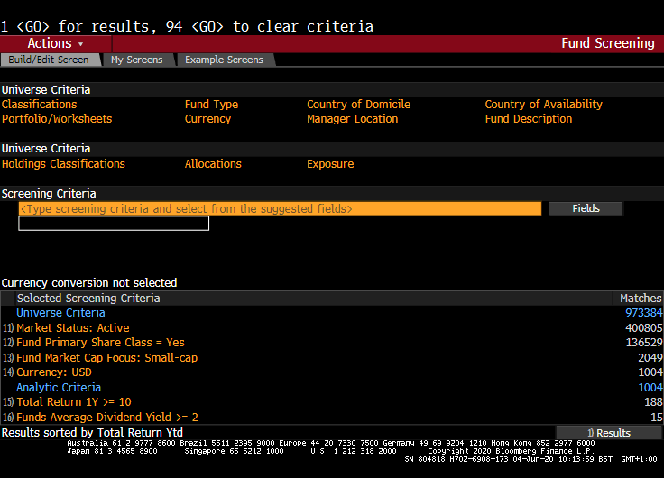
FSRC
Filtered as shown down the bottom to give us 15 funds meeting the criteria
This is known as “screening” and you can save your own screens, or use Bloomberg examples, as shown with the tabs at the top

Slide 29
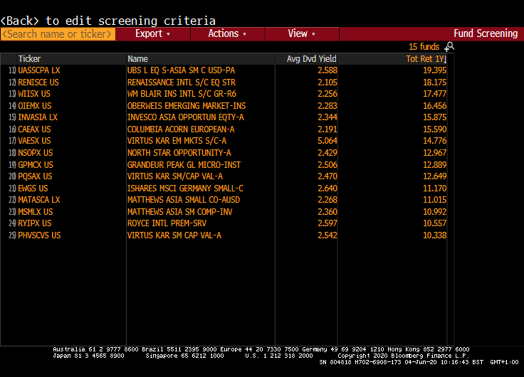
FSRC
Results from our earlier screen. Click on the Tot Ret 1Y field to sort them based on their recent 12-month performance

Slide 30
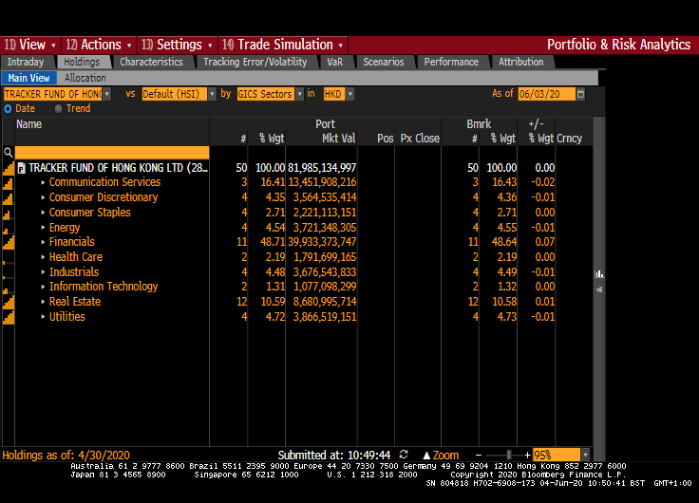
PORT
This is for a Hong-Kong tracker fund (2800 HK) using “Holdings” and “Main View” tabs
Note the fund holdings are almost exactly in line with the Hang Seng Index (shown as Bmrk)

Slide 31
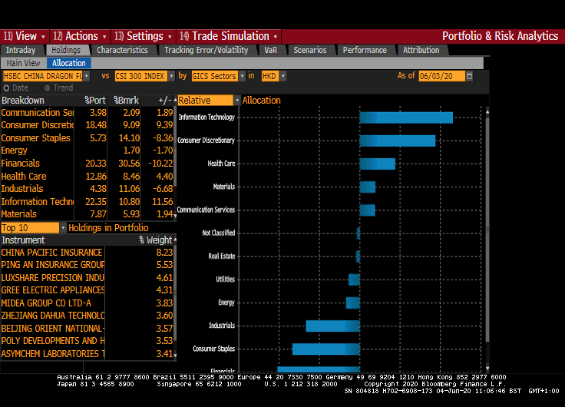
PORT
This time for the actively managed HSBC China Dragon Fund (820 HK)
You need to make sure the fund benchmark is the CSI 300 index
Where has this fund moved away from its benchmark?

Slide 32
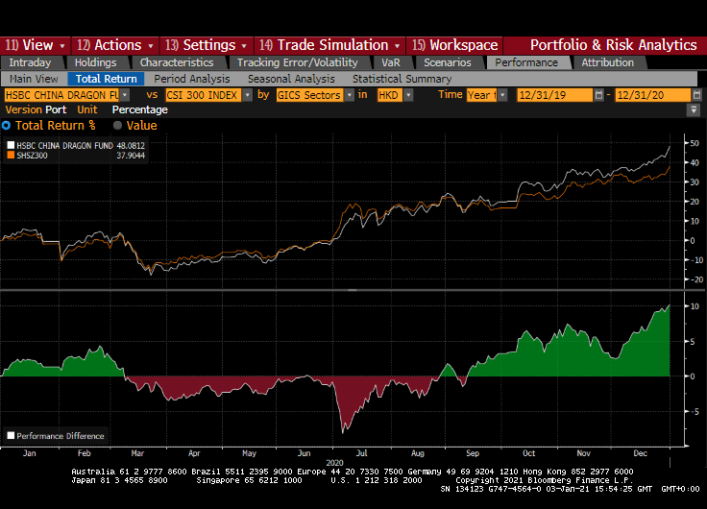
PORT
Relevant tabs highlighted for comparing the performance of the actively managed Dragon fund with the CSI300 index
Why do you think the fund has recovered and outperformed its benchmark lately?

Slide 33

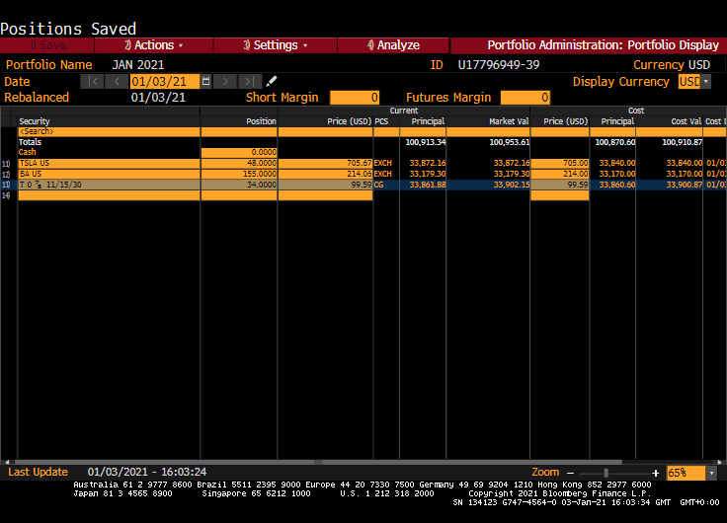
PRTU
Setting up your own portfolio
Here we have $100,000 split approx. 1/3 each into Boeing, Tesla and the 10-yr US Treasury (I weighted them by editing the Position column with round numbers and inputting COST prices close to market. Note the first “Price” column on left refers to the current market price and you should leave this alone provided the price source (PCS) is reliable
Remember to save!

Slide 34
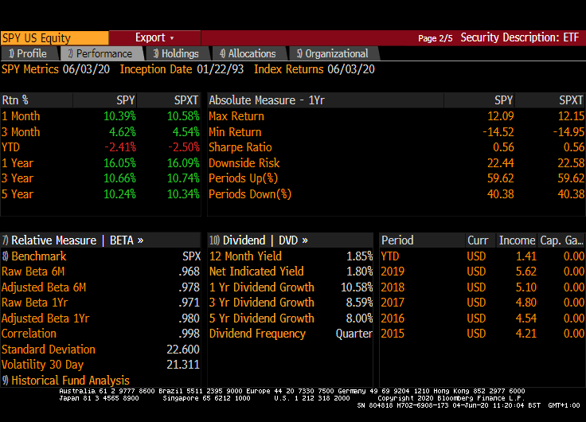
SPY US <eqty> DES
This is on the Performance tab or page 2 of DES
Sharpe ratio is (Return – RFR)/σ
Using approx. figures on this screen and a 2% risk free rate in US gives us:
(16-2) / 23 = 0.61

Slide 35
Session 6

Slide 36
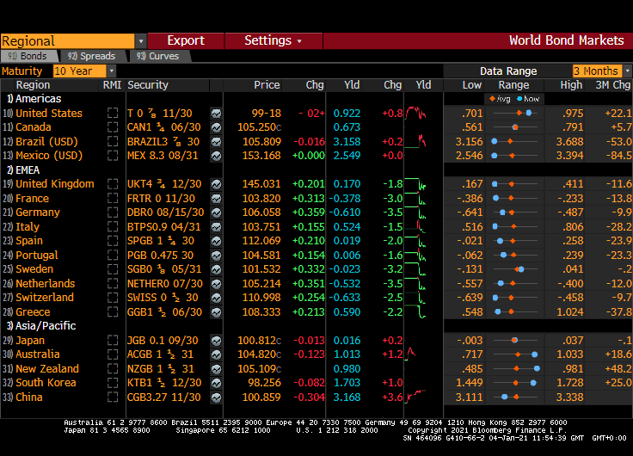
WB
World Bonds landing page. You can change the 10 Year maturity in the yellow box
Note the number of negative yields even at this maturity!
This is also a useful page for accessing benchmark bonds. For example, clicking the top row will access benchmark 10-yr US Treasury

Slide 37
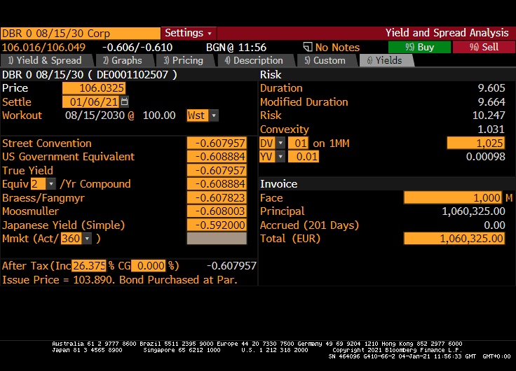
DBR 0 30 <Govt> YA
You can also access this 10-year Germany bond through WB
The zero refers to the coupon! At a price above 106, you pay €1,060,325 now to get back just €1,000,000 in ten years time
A loss of about 6% or 0.60% per annum
🙁

Slide 38
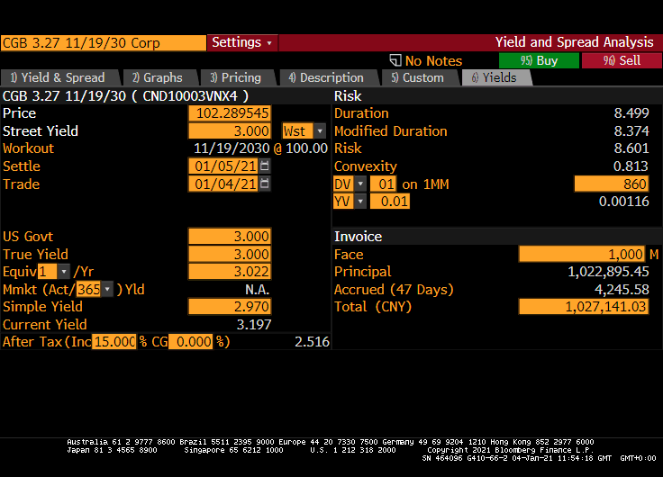
CGB 3.27 30 <Govt> YA
Again, you can find this bond on WB
China bonds pay semi-annually so a s/a yield of 3% is 3.0225% on annual equivalent basis ((1.015)² -1)
If the yield was 10% the a.e.y. moves to?

Slide 39
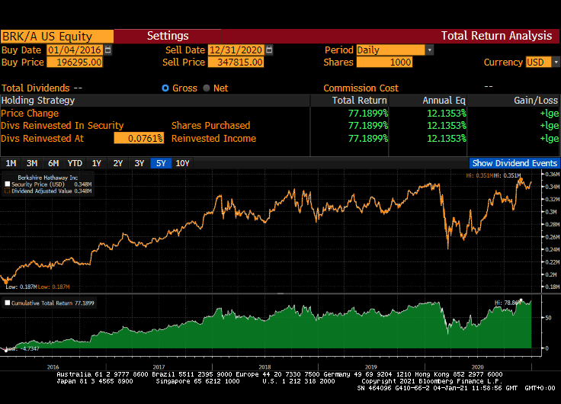
BRK/A <> TRA
Total Return Analysis
77.19% over a 5-year period
A per annum return of 12.13% which is NOT 77.19 divided by 5!
As there are no dividends, the analysis is neat and (1.1213)⁵ gives us the value of an initial $1 investment made 5 years ago

Slide 40
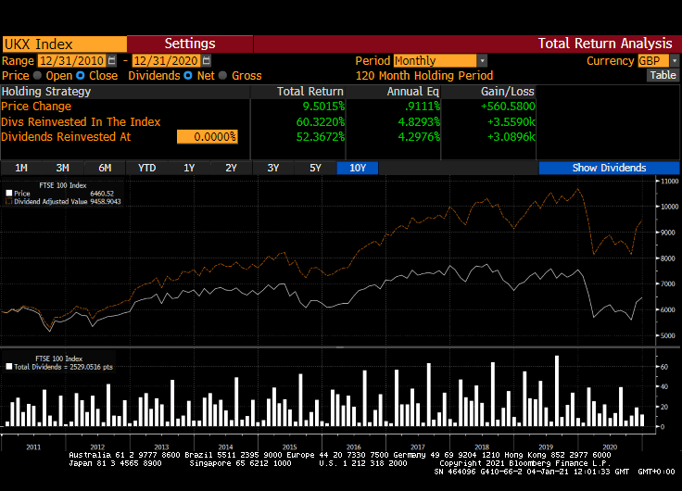
UKX <> TRA
For the UK FTSE100 index this time
9.5% capital price change over 10 years, but with dividends we are looking at over 50%!
Analysis is harder with dividends. They do change, and do we reinvest them in more stocks or cash?

Slide 41
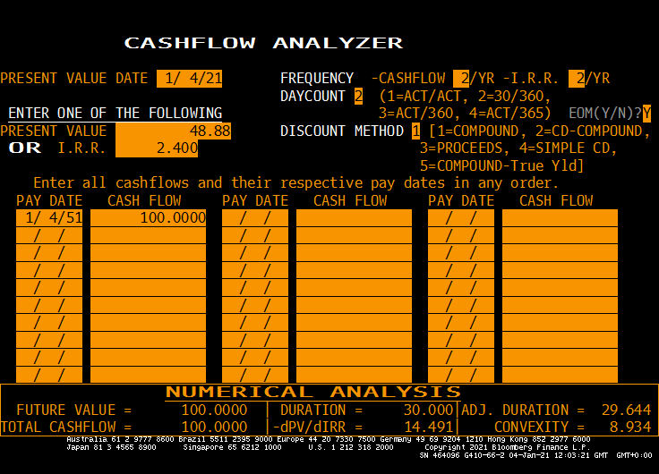
PF
An old looking GUI on the terminal!
More useful for analysis of long-term projects with irregular cashflows than bonds or loans. IRR (internal rate of return) is a project finance term. Here we input 2.40% and Bloomberg solved for Present Value
This is essentially a 30-year zero coupon bond priced at a yield of 2.40% nominal (s/a)

Slide 42
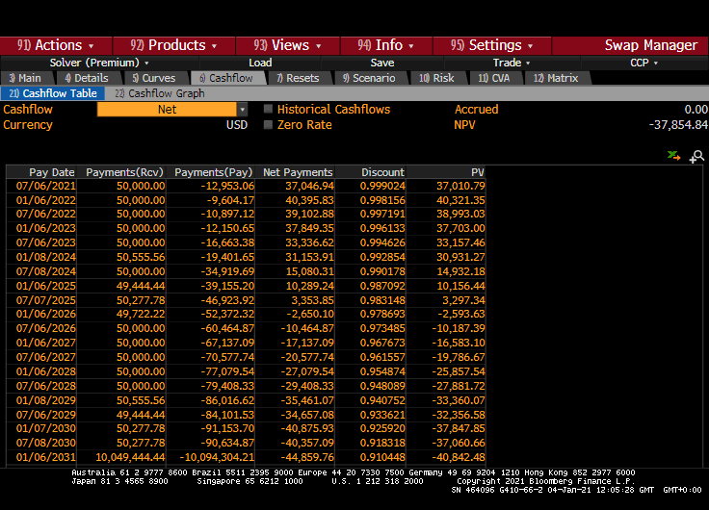
SWPM
This is a semi-annual USD interest rate swap. The product is covered in other courses and beyond scope here, but note the column of discount factors
If the present value of $1 received on 6th January 2031 is 0.910448, we can easily calculate the PV of -44,859.76 (or any number!) on that date

Slide 43
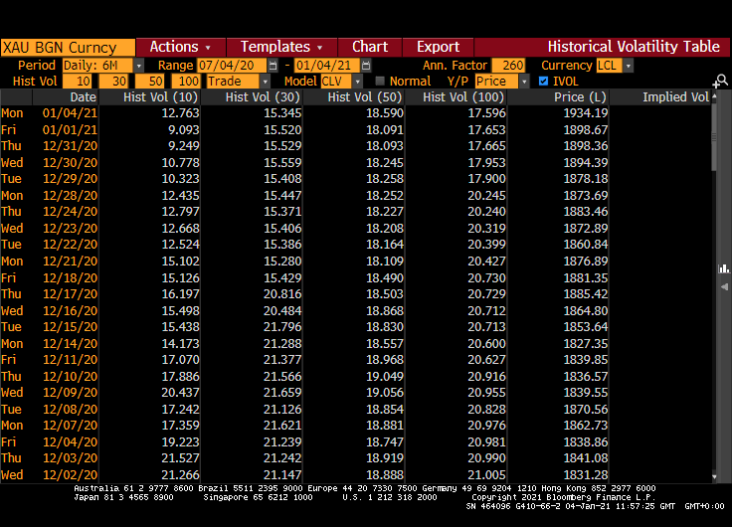
XAU <> HVT
Latest value of 15.345 using 30-day horizon (you will see something different as markets will have moved since this screenshot)
Dropping compared with a few weeks ago
What about other assets?

Slide 44
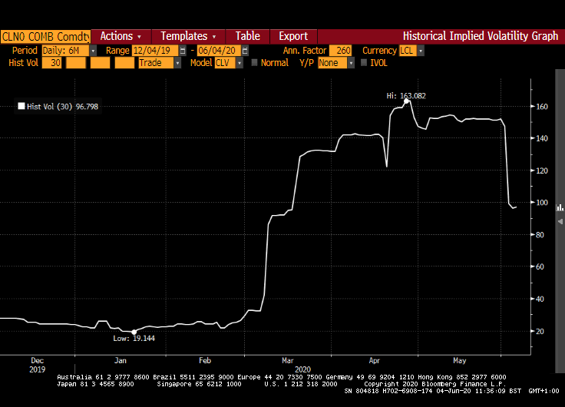

CLA <Cmdty> HVG
HVG is a visual view of HVT. Here we picked a 6-month period either side of the COVID outbreak for crude oil futures
In this case using data based on a rolling 30-day window
We can see the massive increase as a result of COVID. Vols climbed above 100% !

