Slide 1
getfame -n names -s series -e expression
getfame Json api 2024 / 2025
Erik.Soberg@ssb.no
2025 Supports series w identical series names in different FAME databases, formulas can aggregate from several open databases

Slide 2
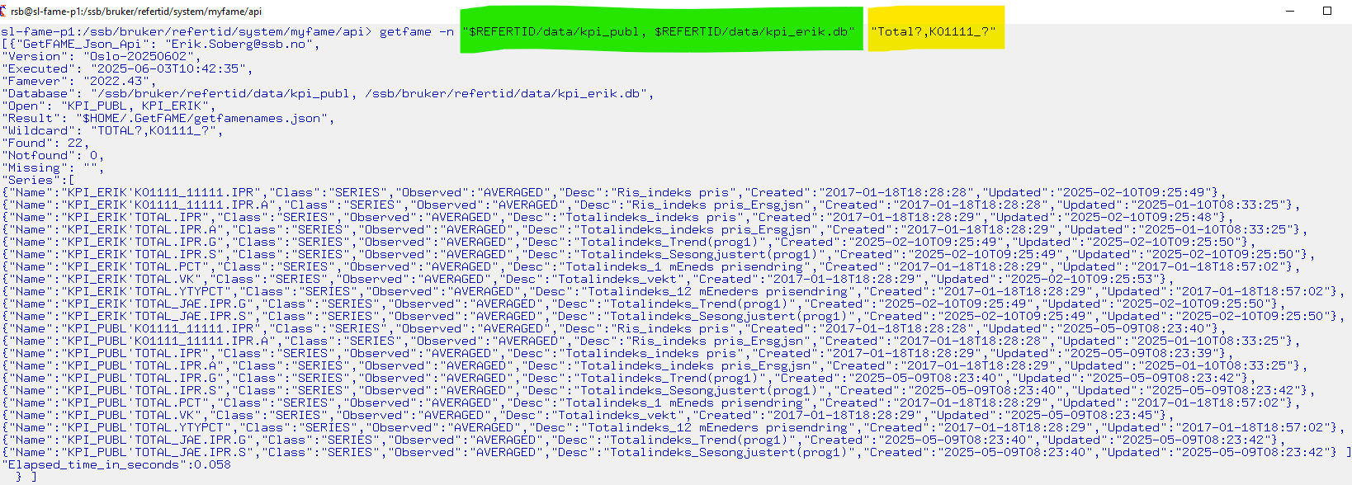
1. getfame -n = getfamenames gets FAME metadata

Slide 3
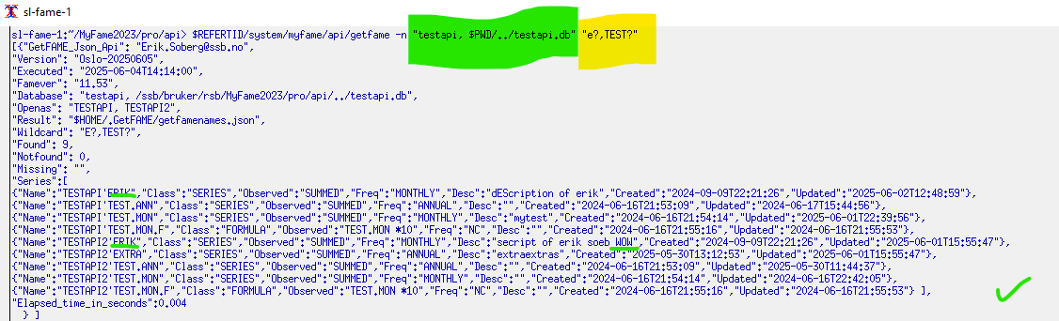
getfame –n with identical databases identical seriesnames different places)

Slide 4
getfame -n $REFERTID/system/myfame/api/getfamenames Combine with linux commands to find descriptions, or series with incorrect definitions The command below lists all series in the database but only show the one with the text «SUMM»

Slide 5
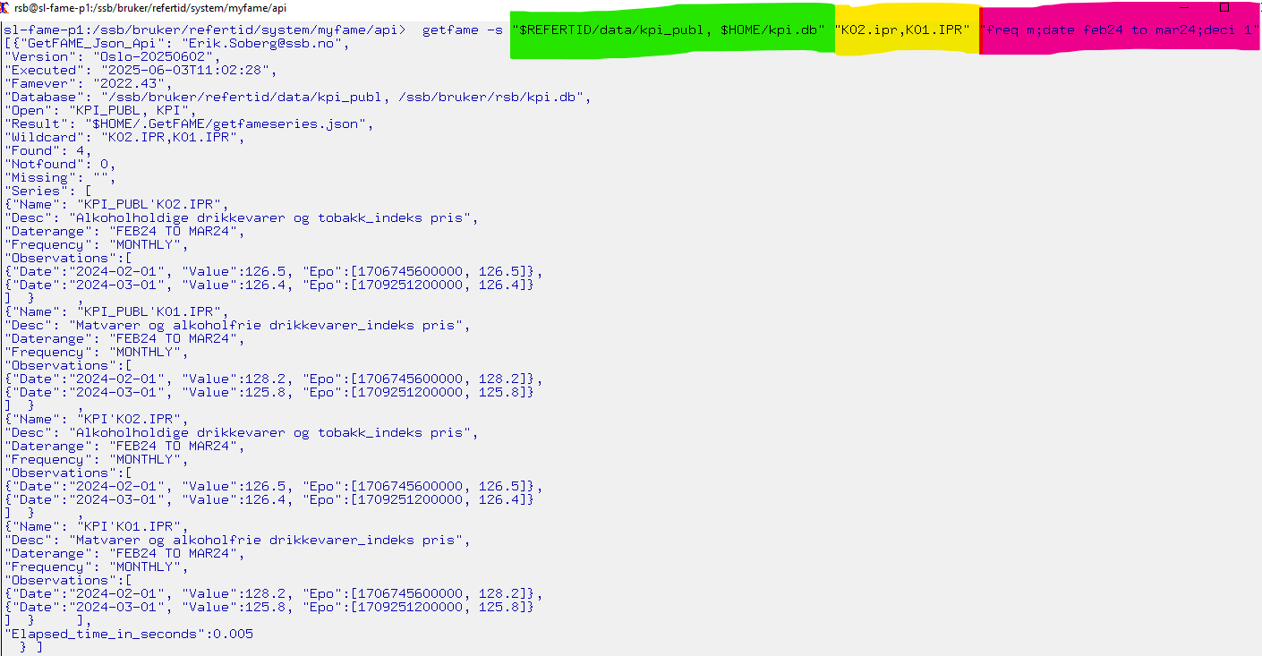
2. getfame -s $REFERTID/system/myfame/api/getfameseries

Slide 6
getfame -s getfameseries samples
$REFERTID/system/myfame/api/getfameseries /ssb/bruker/refertid/data/kpi_publ.db "total.ipr"
getfameseries /ssb/bruker/refertid/data/kpi_publ.db "total.ipr, K0?IPR " "date 2024 "
getfameseries /ssb/bruker/refertid/data/kpi_publ.db "total.ipr" "freq m; date thisday(m)-5 to *"
getfameseries $REFERTID/data/fornavn.db "?ERIK,KRISTIN,JIM?" "date 2010 to 2012 "
getfameseries " /ssb/bruker/refertid/data/fornavn.db" "?JAN?" "date 2000 to 2005 "
getfameseries " /ssb/bruker/refertid/data/fornavn.db" "JI? " "date 2000 to *; deci 1 "
getfameseries "fornavn.db, name.db" "JI? ,MATT?" "date 2000 to * ; deci 2 "
getfameseries "pi1.db, cpi2.db,cpi_form.db" "Total.ipr" "date 2025 ; deci 2"

Slide 7
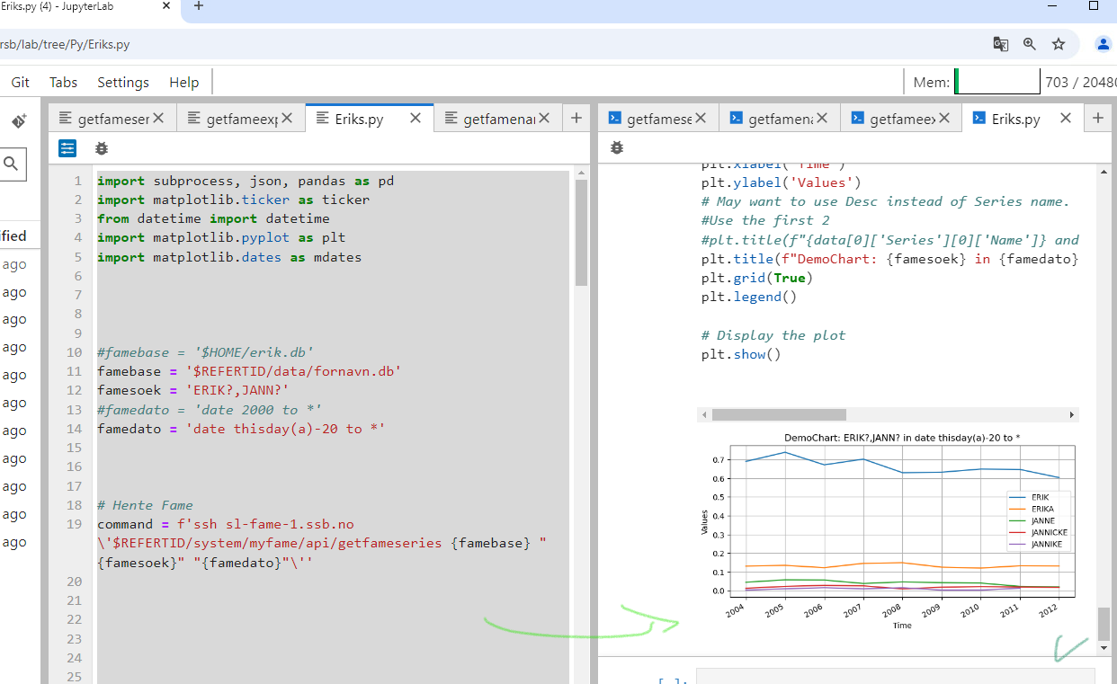
getfame -s From jupyter with py:

Slide 8
3. getfame -e $REFERTID/system/myfame/api/getfameexpr advanced mode
Data-observations, from FAME database(s) given a fame-expression:
getfame -e "$REFERTID/data/fornavn.db " "mave(ERIK,2)" "date 2000 to 2010"
getfame -e "$REFERTID/data/fornavn.db " "Lsum(ERIK,EIRIK)" "date 2000 to *"
getfame -e "$REFERTID/data/fornavn.db " "ERIK+EIRIK" "date 2000 to *"
getfame –e "$REFERTID/data/kpi_publ.db, mycpi.db " "convert(total.ipr,annual,constant) " "date *; deci 1 "
getfame -e "$REFERTID/data/kpi_publ.db, mycpi.db " "PCT(mycpi’K09.IPR)" "date 2025; deci 1 "
getfame -e "cpi1.db,cpi2.db,cpi_form.db" "cpi1’Total.ipr" "date 2025 ; deci 2"
Be aware to double quote arguments when they contain special char like : , ( ‘ ;

Slide 9
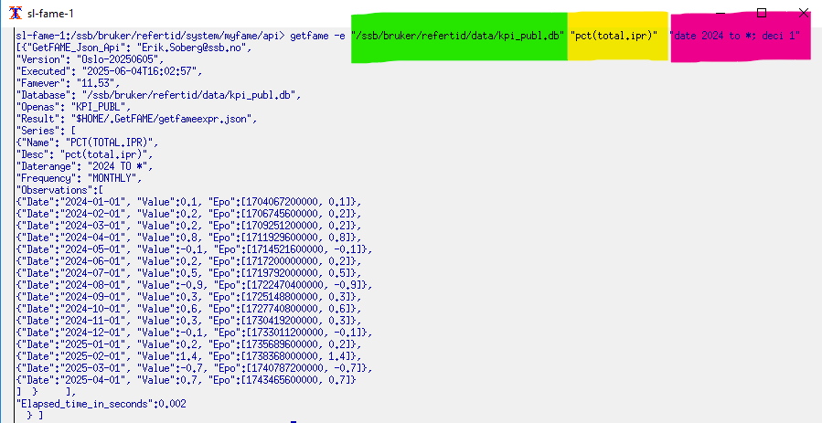
getfame –e gets a fame-expression

Slide 10
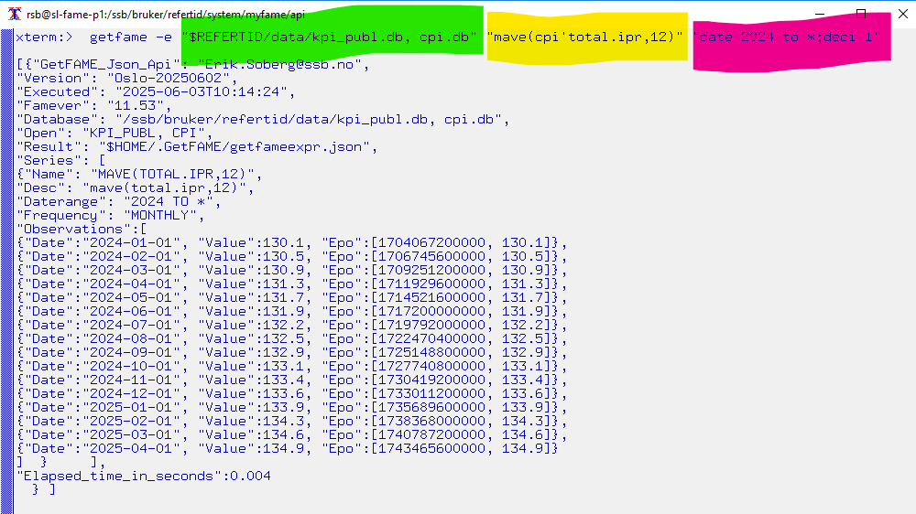
getfame –e with several databases in case u have formulas elsewhere

Slide 11
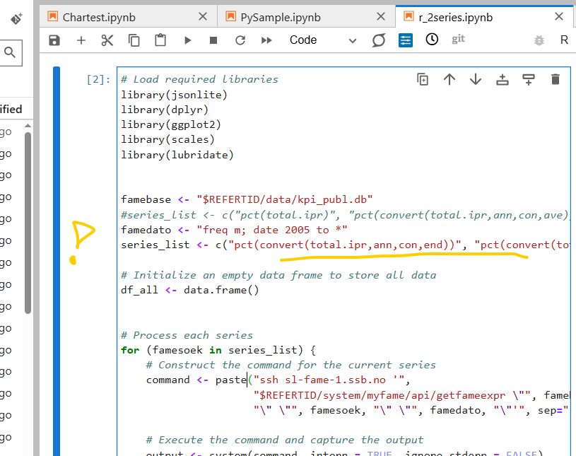
Using the power of FAME by getfame –e with R from Jupiterlab

Slide 12
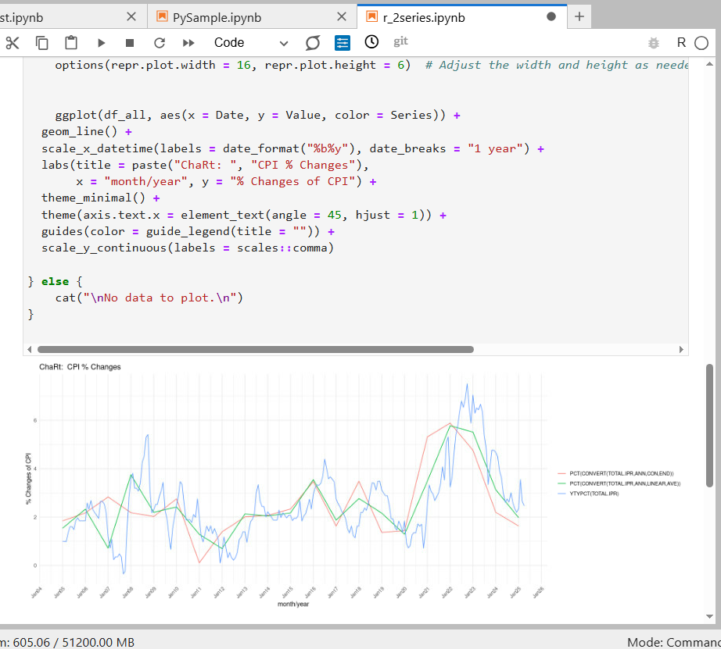
getfame -e with R from Jupiterlab

Slide 13
Samples ( shows help info, when no arguments passed)
getfamenames (gets series names & metadata from databases with a list of wildcards
getfame –n
getfameseries (gets observations from >= 1 series in database(s) given a list of wildcards)
getfame –s
getfameexpr (gets observations given 1 FAME expression)
getfame -e
For complete jupyterlab samples, see Github

Slide 14
Summary
The getfame –e option use the full power of FAME and can evaluate formulas, functions, conversions among various series, formulas,frequiencies and databases
To get more series with getfame –e simply loop by expression and add to same charts or dataset.
getfame –n is powerful when combining grep | more |head to search for series/formulas names or metadata

